Slide 1
A growing demand for small area statistics.
How to make demand and supply meet?
Asta Manninen, Pilar Martin-Guzmán and Derek Bond
CESS Budapest, 20 – 21 October 2016

Slide 2
A growing demand for small area statistics.
How to make demand and supply meet?
From the users´point ov view
DEMAND
VALUE ADDED
EXAMPLES and CASE STUDIES
CHALLENGES and OPPORTUNITIES
CONCLUSIONS
THEY WAY FORWARD

Slide 3
A growing demand for small area statistics from all sectors
GOVERNMENT
COMMERCIAL AND BUSINESS
RESEARCH
MEDIA
NON-PROFIT AND VOLUNTARY ORGANISATIONS
LOCAL COMMUNITIES
GENERAL PUBLIC and CITIZENS

Slide 4
Value added.
Small area statistics support and facilitate
better informed decisions
evidence based policies
citizens´ engagement and empowerment; democracy
better quality of life
better allocation and use of resources
better performance of the city and region
improved businesses
monitoring and measuring impact of territorial and place-based policies and programmes

Slide 5
Small area statistics – examples and case studies
GEOGRAPHY at the heart of small area statistics
SPATIAL DATA INFRASTRUCTURE
GEOSPATIALLY ENABLED STATISTICS
INTEROPERABLE MULTISOURCE DATA;
INTEGRATION OF STATISTICAL AND GEOGRAPHIC DATA
INTERFACE SERVICES TO THE USERS
MEETING NEW NEEDS BY MAKING USE OF NEW DATA SOURCES and BETTER USE OF ALREADY EXISTING DATA

Slide 6
Small area statistics – examples and case studies.
Spain
Padrón Continuo – The Population Register:
rich municipality level statistics and
for big cities also sub-city level statistics
Labour market statistics: requests for higher granularity, and
promising development projects
The Central Directory of Enterprises: municipality level statistics
Producers: INE and its Regional Statistical Offices, municipalities

Slide 7
Small area statistics – examples and case studies.
UK, Nothern Ireland
NESS, Neighbourhood statistics Service, ONS
NINIS, Nothern Ireland Neighbourhood Information System, NISRA
Challenges: availability of sub-regional data limited (censuses and surveys)
Opportunities: the Government is requesting the availability of high quality spatially disaggregated economic and social indicators

Slide 8
Small area statistics – examples and case studies
Finland, Case Helsinki
Producers: City of Helsinki Urban Facts,
Statistics Finland, and
also other producers, e.g. The Finnish Environment Centre
Approach: integrated multisource geospatially enabled statistics;
three examples next

Slide 9

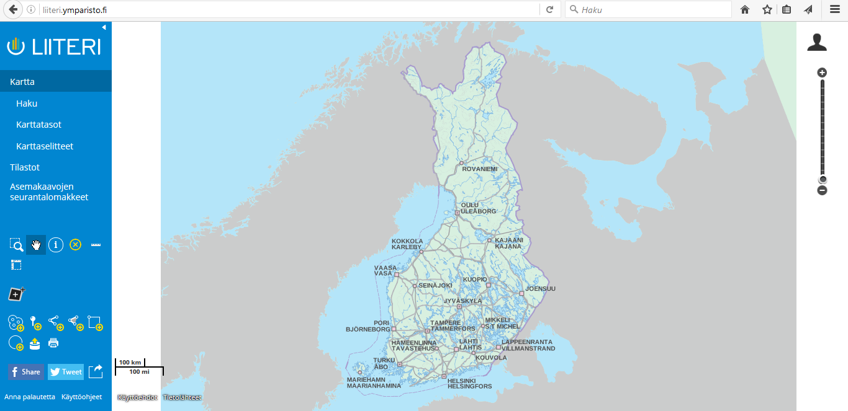
Liiteri information service
Ari Jaakola, City of Helsinki Urban Facts, 25 September 2016 www.ymparisto.fi
More than 1000 different statistics
Several hundreds of map layers
Possibility to create thematic maps
Possibility to combine statistics, maps and own data
Possibility to download statistics and maps
Maintained by the Finnish Environment Institute
The data is derived from different sources and maintained by many public authorities: Statistics Finland, Finnish Environment Institute, Population Register Centre, National Land Survey of Finland, Finnish Transport Agency, National Board of Antiquities, Centre for Economic Development, Transport and the Environment, cities and municipalities, Ministry of the Environment, The Housing Finance and Development Centre of Finland and Geological Survey of Finland.

Slide 10
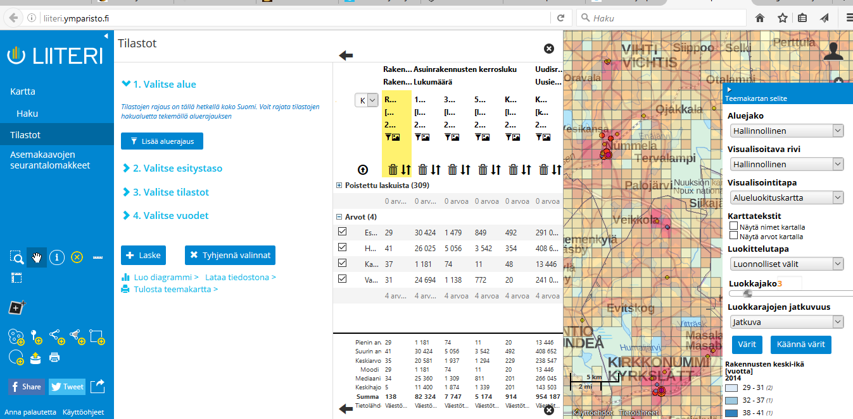
Liiteri information service
Ari Jaakola, City of Helsinki Urban Facts, 25 September 2016 www.ymparisto.fi
1. Select statistics

Slide 11
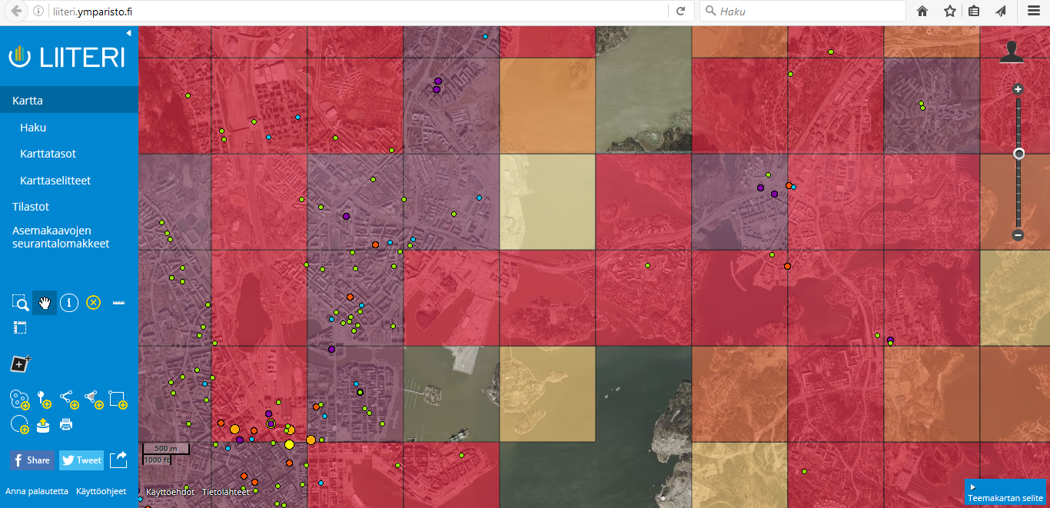
Liiteri information service
Ari Jaakola, City of Helsinki Urban Facts, 25 September 2016 www.ymparisto.fi
1. Select statistics
2. Show it on the map, e.g. Population density in 1km x 1km grid cells and
grocery stores in Helsinki in 2016
Sources: Statistics Finland, National Land Survey of Finland

Slide 12
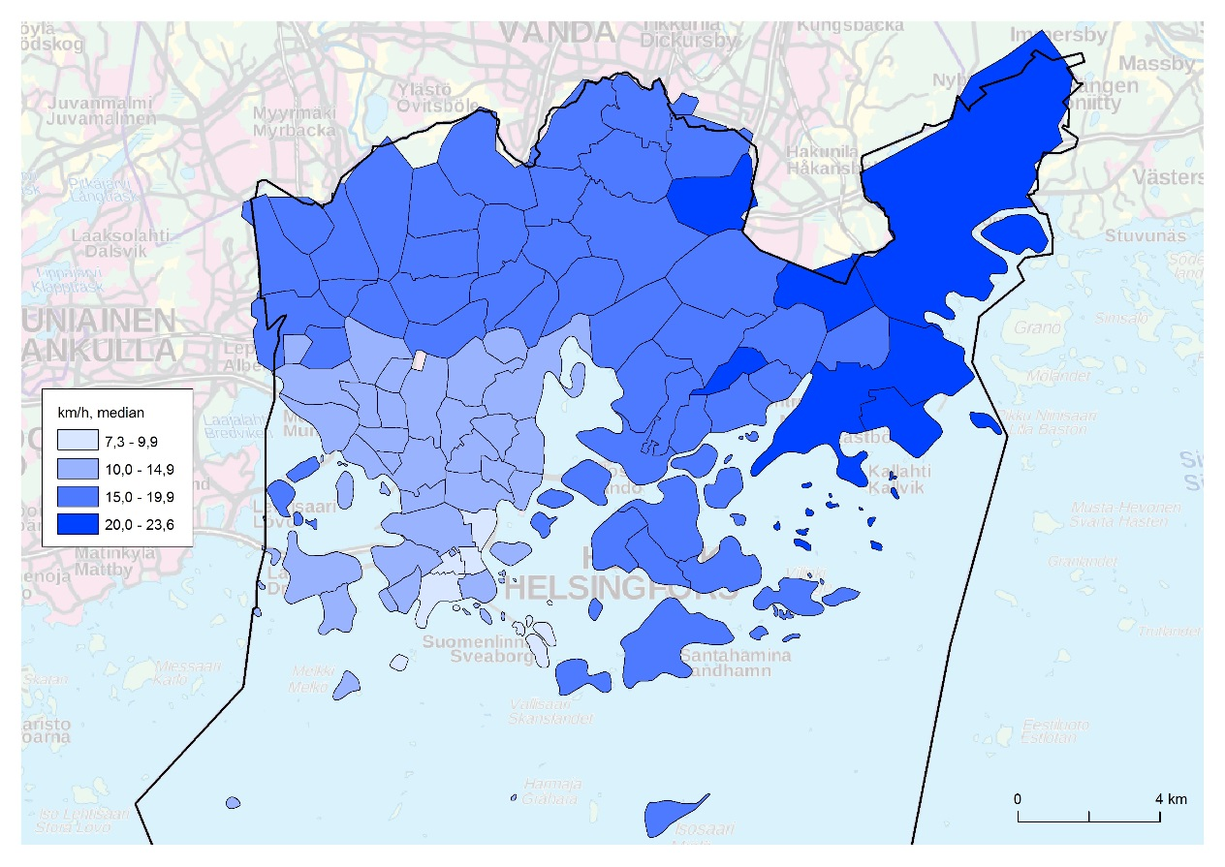
Median commuting speeds (km/h by public transportation) by post code area in Helsinki (city of residence). Aura Pasila, Statistics Finland, 2016.

Slide 13
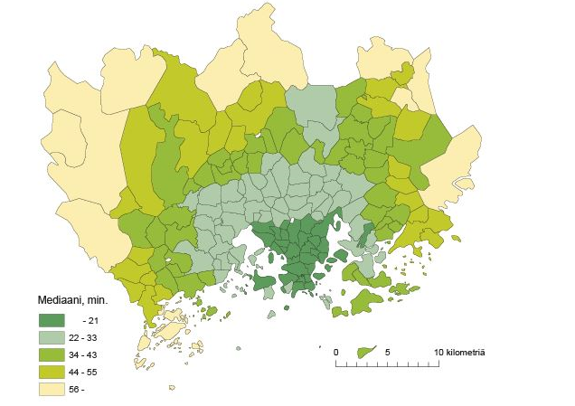
Median commuting time by post code area in the Helsinki Region
(minutes by bike) . Pasi Piela, Statistics Finland, 2015.

Slide 14
Small area statistics – conclusions and recommendations
CO-OPERATION
COMMON FRAMEWORKS, RULES AND STANDARDS
PROVIDE GEO-REFERENCED DATA SETS, PREFERABLY AS OPEN DATA
DEVELOP INTERFACE SERVICES
USE NEW OPPORTUNITIES FOR SMALL AREA ESTIMATION
BE STRICT ON INTEGRITY AND CONFIDENTIALITY ISSUES
ADDRESS ISSUES OF DATA OWNERSHIP, ACCESS AND LIABILITY
LISTEN TO THE USERS

