Slide 1

KOMUSO - ESSnet on quality of multisource statistics
Ildikó Szűcs
Hungarian Central Statistical Office
Methodology Department
Ildiko.Szucs@ksh.hu

Slide 2
Topics
1. ESS.VIP Admin Project
✓
2. ESSnet on Quality of multisource statistics
3. Conclusions

Slide 3
ESS.VIP ADMIN
Main objectives
  To improve the use of administrative data sources
  To support the quality assurance of the output produced using administrative sources
Timing
  2015-2019

Slide 4
Key fields of work
Access to administrative data
Quality measurement
Methodology for multiple data sources
Frames for social statistics
Eurostat as (in) direct user of administrative data

Slide 5
Work packages and their implementation in the ESS.VIP ADMIN
1. Access to and development of administrative data sources
Contracts + Workshop + ESTAT internal + TF + Contracts
2. Statistical methods
Contracts + ESSnet on statistical methods for administrative data
3. Quality measures for statistics using administrative data
ESSnet on Quality of Multisource Statistic
4. Eurostat as an (in)direct user of administrative data sources held or designed by the Commission
ESTAT Internal + TF + contracts + grants
5. Frames for social statistics
ESTAT internal + TF + Contracts + ESSnet on Quality of Multisource Statistics
6. Pilot studies and applications
Grants + contracts
7. Methodological support to Member States
Centre of excellence on administrative data

Slide 6
Topics
1. ESS.VIP Admin Project
✓
2. ESSnet on Quality of multisource statistics
✓
3. Conclusions

Slide 7
ESSnet on quality of multisource statistics - KOMUSO
3. Quality measures for statistics using administrative data
3.1 Checklists for evaluating the quality of input data
3.2 Framework for the quality evaluation of statistical output based on multiple sources
3.3 Dissemination and implementation
5. Frames for social statistics
5.2 Methodology for the assessment of the quality of frames for social statistics

Slide 8
ESSnet on quality of multisource statistics - KOMUSO
Objectives
To provide quality measures in the scope of using administrative sources in the production of official statistics
Timing
SGA1: January 2016 - April 2017
Consortium
Denmark, Norway, Netherlands, Austria, Hungary, Lithuania, Italy, Ireland
To promote the results of the ESSnet
ESSnet KOMUSO: 2015-2019

Slide 9
SGA1 of the ESSnet KOMUSO
Evaluating the quality of input data (WP1)
Methodology for the assessment of the quality of frames for social statistics (WP2)
Framework for the quality evaluation of statistical output based on multiple sources (WP3)
Communication (Wp4)
Project management (WP5)

Slide 10
WP1: Evaluating the quality of input data
Objective:
Create checklists for evaluating the quality of input data
Subtasks:
Critical review and testing of existing methodology
Commented repository
Consolidated version of checklist
Identification of possible gaps

Slide 11
Creation of the checklist
A gross list was created with more than 500 indicators
Participants of WP1 selected indicators for testing
Six dimensions are used (similarly to the ESSnet Admin project)
16 quantitative indicators
Tests were carried out by 3 countries
Report of WP1 was prepared and it is under approval

Slide 12
WP2: Methodology for the assessment of the quality of frames for social statistics
Subtasks:
Literature review
Comparative analysis
Gap analysis
Proposal of quality measures
Development and test
Objective:
Produce guidelines for assessing frame quality for social statistics

Slide 13
Types of frame errors
Coverage error
Alignment error
Domain classification error
Unit error
Contact information error

Slide 14
WP3: Framework for the quality evaluation of statistical output based on multiple sources
Subtasks:
Critical review
Suitability tests
Action plan
Objective:
Produce relevant measures for the quality of the output

Slide 15
Basic configurations
Configuration 1: multiple cross-sectional data that together provide complete dataset with full coverage of target population

Slide 16
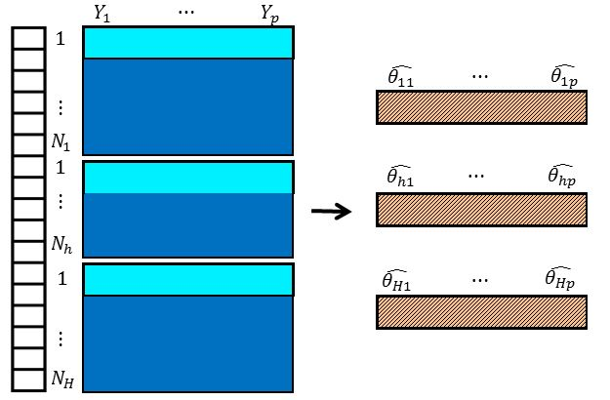
Basic data configuration 1

Slide 17
Basic configurations
Configuration 1: multiple cross-sectional data that together provide complete dataset with full coverage of target population
Configuration 2: same as Configuration 1, but with overlap between different data sources

Slide 18
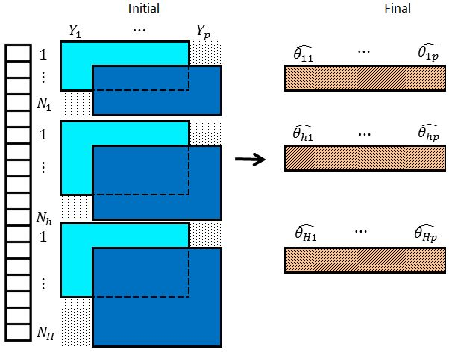
Basic data configuration 2

Slide 19
Basic configurations
Configuration 1: multiple cross-sectional data that together provide complete dataset with full coverage of target population
Configuration 2: same as Configuration 1, but with overlap between different data sources
Configuration 2S: Special case of Configuration 2: one of the data sources consists of sample data

Slide 20
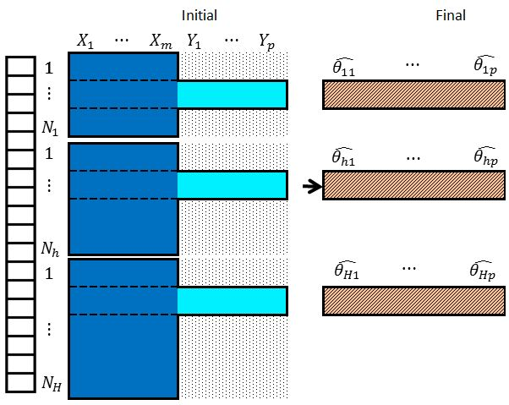
Basic data configuration 2S

Slide 21
Basic configurations
Configuration 1: multiple cross-sectional data that together provide complete dataset with full coverage of target population
Configuration 2: same as Configuration 1, but with overlap between different data sources
Configuration 2S: Special case of Configuration 2: one of the data sources consists of sample data
Configuration 3: extension of Configuration 2: we now also have under-coverage of the target population

Slide 22
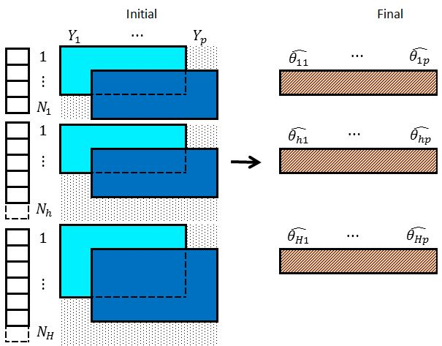
Basic data configuration 3

Slide 23
Basic configurations
Configuration 1: multiple cross-sectional data that together provide complete dataset with full coverage of target population
Configuration 2: same as Configuration 1, but with overlap between different data sources
Configuration 2S: Special case of Configuration 2: one of the data sources consists of sample data
Configuration 3: extension of Configuration 2: we now also have under-coverage of the target population
Configuration 4: aggregated data are available besides micro data

Slide 24
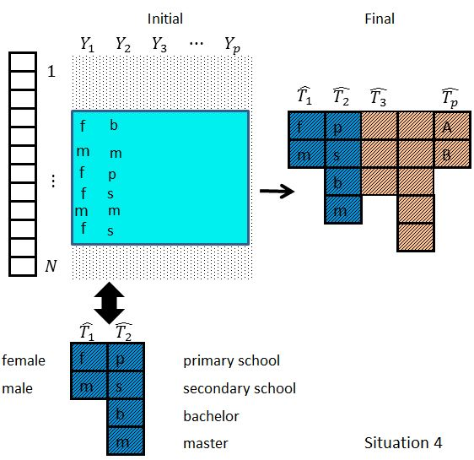
Basic data configuration 4

Slide 25
Basic configurations
Configuration 1: multiple cross-sectional data that together provide complete dataset with full coverage of target population
Configuration 2: same as Configuration 1, but with overlap between different data sources
Configuration 2S: Special case of Configuration 2: one of the data sources consists of sample data
Configuration 3: extension of Configuration 2: we now also have under-coverage of the target population
Configuration 4: aggregated data are available besides micro data
Configuration 5: only aggregated data overlap with each other and need to be reconciled (complete macro-data counterpart of Configuration 2)

Slide 26
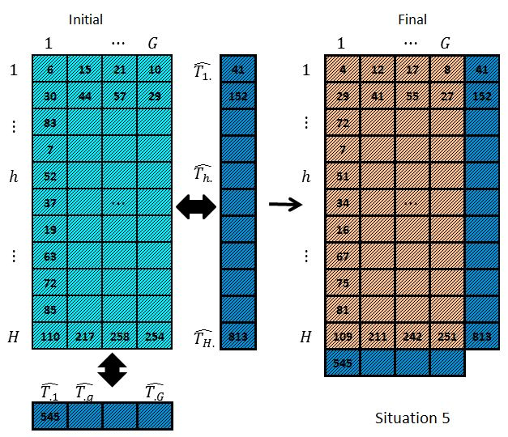
Basic data configuration 5

Slide 27
Basic configurations
Configuration 1: multiple cross-sectional data that together provide complete dataset with full coverage of target population
Configuration 2: same as Configuration 1, but with overlap between different data sources
Configuration 2S: Special case of Configuration 2: one of the data sources consists of sample data
Configuration 3: extension of Configuration 2: we now also have under-coverage of the target population
Configuration 4: aggregated data are available besides micro data
Configuration 5: only aggregated data overlap with each other and need to be reconciled (complete macro-data counterpart of Configuration 2)
Configuration 6: longitudinal data are considered

Slide 28
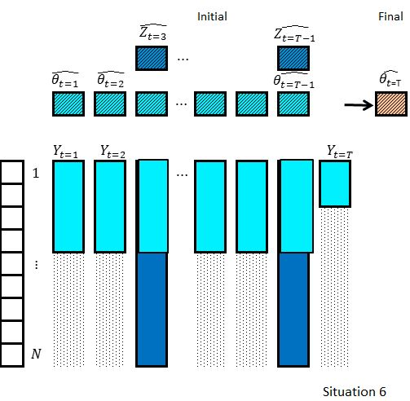
Basic data configuration 6

Slide 29
Topics
1. ESS.VIP Admin Project
✓
2. ESSnet on Quality of multisource statistics
✓
3. Conclusions
✓

Slide 30



ESSnet KOMUSO – Conclusions
Background
Part of the ESS.VIP ADMIN
Consortium of 8 Member States
Scope
Quality of input data
Quality of frames
Quality of output
Forthcoming work
Finalise the work
Prepare guidelines

Slide 31
Further information
https://ec.europa.eu/eurostat/cros/content/essnet-quality-multisource-statistics_en
https://ec.europa.eu/eurostat/cros/content/essvip-admin-administrative-data-sources_en

Slide 32
Thank you for your attention!
Ildikó Szűcs
Hungarian Central Statistical Office
Methodology Department
Ildiko.Szucs@ksh.hu

