Slide 1


Integrating multiple data sources: working together to modernise official statistics
Conference of European Statistics Stakeholders
Budapest, 20th-21st October 2016
UNECE Data Integration Project
Jenine Borowik (United Nations Economic Commission for Europe)
Presenter: Zoltán Vereczkei
Deputy Director of Methodology
Hungarian Central Statistical Office
Methodology Department
zoltan.vereczkei@ksh.hu

Slide 2
High Level Group for the Modernisation of Official Statistics
Created by the Conference of European Statisticians (CES) in 2010
Promotes standards-based modernisation of official statistics
Oversees the development of frameworks, tools and methods, to support modernisation in statistical organizations
Aims to improve efficiency of statistical production, and to produce outputs to better meet user needs.
Each year 2-3 projects are supported.
2016 projects are Data Integration and Implementing Modernstats Standards
Notes:
The UNECE High-Level Group for the Modernisation of Official Statistics (HLG-MOS) was set up by the Conference of European Statisticians (CES) in 2010 to oversee and coordinate international work relating to statistical modernisation.It promotes standards-based modernisation of official statistics. It reports to the CES and received its mandate from this body.
The mission of the HLG-MOS is to oversee the development of frameworks, tools and methods, to support modernisation in statistical organizations. The aim is to improve the efficiency of statistical production, and the ability to produce outputs that better meet user needs.

Slide 3
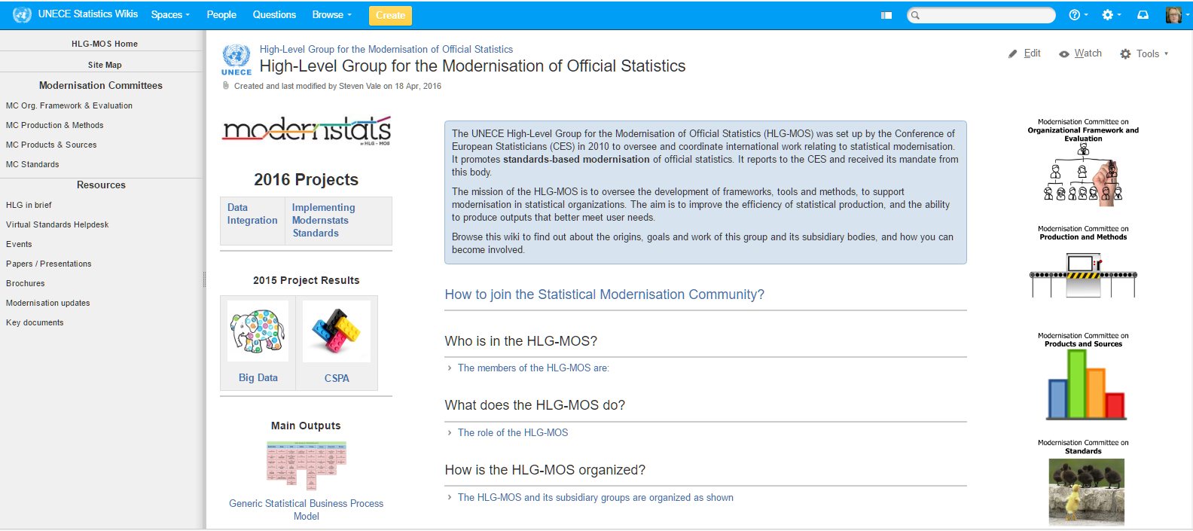
High Level Group for the Modernisation of Official Statistics
http://www1.unece.org/stat/platform/display/hlgbas/High-Level+Group+for+the+Modernisation+of+Official+Statistics
Notes:
Further information about the High Level Group can be found on the United Nations Economic Commission for Europe (UNECE) Wikis at http://www1.unece.org/stat/platform/display/hlgbas/High-Level+Group+for+the+Modernisation+of+Official+Statistics

Slide 4
The Data Integration Project – Motivation
“We must move from a paradigm of producing the best estimates possible from a survey to that of producing the best possible estimates to meet user needs from multiple data sources” (Conny Citro)
Produce stable output with unstable ever changing inputs
Opportunities
Big data and administrative data
New technologies
Challenges
Increasing needs: timeliness, frequency and disaggregation
Less budget, lower response burden
Other statistics producers
It’s Time to Collaborate!

Slide 5

The Data Integration Project
Main objectives:
gain experience by collaborating on joint practical activities (experiments)
translate experience into general recommendations
provide initial guidance for a quality framework
Project structure – 7 Work Packages:
  WP0: Data sets for common approaches
  WP1: Integrating survey and administrative sources
  WP2: New data sources (such as Big data) and traditional sources
  WP3: Integrating geospatial and statistical information
  WP4: Micro-macro integration (inactive in 2016)
  WP5: Validating official statistics
  WPA: Synthesize lessons learned from new working methods
10 countries involved: Australia, Brazil, Canada, Colombia, Hungary, Italy, Mexico, New Zealand, the Netherlands, Poland, Serbia, Slovenia (and growing….)
Supported by United Nations Economic Commission for Europe (UNECE)

Slide 6
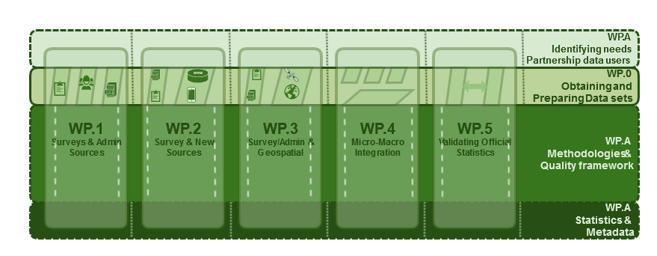
Work Packages – Structure

Slide 7
Work Packages – Ongoing work
Experiments & objectives
Work Package A: Synthesize lessons learned from new working methods
Synthesis in a clear and standard structure (guideline)
Seek input from other countries with experience
Work Package 0: Data sets for common approaches
Identify and obtain data sets that can be used for testing in a collaborative environment
Prepare and make data sets available, in the Sandbox environment, if possible
Online and scanner data for integrated price measurement
Work Package 1: Integrating survey and administrative sources
Integrating potential information sources for the statistical data production on job vacancies
Linking the Statistical Register of Employment and the Labour Force Survey
A System of Consultation and Geographic Location of Schools

Slide 8
Work Packages – Ongoing work
Experiments & objectives
Work Package 2: New data sources (such as Big data) and traditional sources
Web-scraping strategy case studies
Integrated Big data price measurement: Estimation and comparison of price indexes from different Big data sources across countries
Integrating web scraped data for the compilation of price statistics
Integrating potential information sources for the statistical data production on job vacancies
Work Package 3: Integrating geospatial and statistical information
Conduct work in purpose to inventory the level of integration spatial objects used in statistics and geodesy - The 10 Level Model for harmonization of statistical and geodesy reference framework
Analysis over a scheme of integration of geospatial and statistical information
Work Package 5: Validating official statistics
Identify issues related to systematically using data from other sources in the validation of official statistics
Recommend potential approaches and modelling techniques
A comparative analysis of income data from New Zealand Income Survey with administrative data
Linking the Statistical Register of Employment and the Labour Force Survey

Slide 9
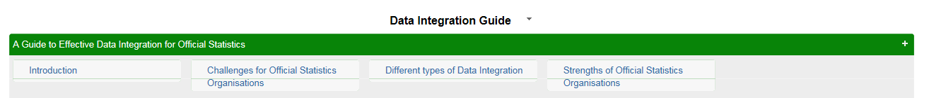
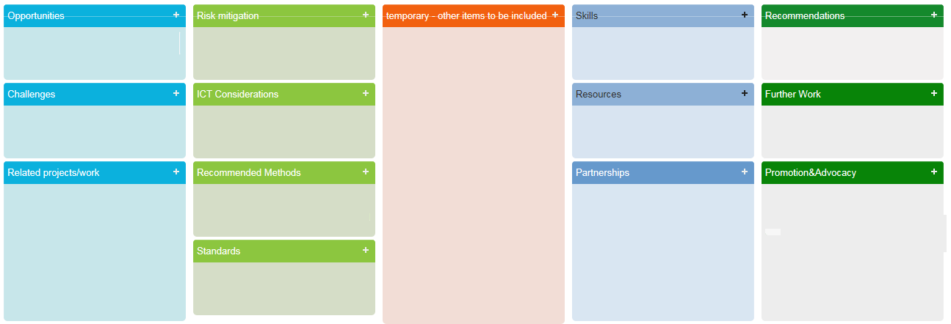

Guideline
(current structure – subject to change)

Slide 10
Messages
Do you face similar issues? Work on similar experiments?
  Please provide input for the guideline!
Do you have an opinion on the Work Packages or individual experiments?
  Let us know!
Are you interested in our overall work and/or individual experiments?
  Check the UNECE DIP team website regularly for updates on current work
Presentation at the Workshop on the Modernisation of Official Statistics: Geneva, 22-23 November 2016

Slide 11
on behalf of the UNECE DIP team
Thank you for your attention!
UNECE Data Integration Project
For more information/questions, please check our UNECE wiki site @ http://www1.unece.org/stat/platform/pages/viewpage.action?pageId=120129595

