Slide 1
Using Administrative Data to Understand Civil Society Organisations in Scotland
Dr Alasdair Rutherford &
Dr Orian Brook
University of Stirling
October 2016

Slide 2
Data on Civil Society Organisations
What does the distribution of Civil Society Organisations look like in Scotland?
How does the distribution, type and activity of organisations vary across space, rurality and deprivation?
How can we use new sources to improve the data we have?

Slide 3
Measuring Civil Society Organisations
Charity registers commonly used
  Office of the Scottish Charity Regulator (OSCR) hold records on all registered Scottish charities (no income threshold)
  c24,000 records, high quality and complete data (relatively)
  But suffers Head Office bias:
    legal address not operational address
    Only one location per charity, no matter how many they have
MILO Database
  Managed by Scottish Council for Voluntary Organisations, used by Third Sector Interfaces/Volunteer Centres across Scotland
  Supporting CSOs in legal formation, training, advising trustees etc
  Key activity: matching volunteers and volunteering opportunities

Slide 4
Milo Data
Details of 35,000 voluntary orgs/38,000 orgs (plus volunteers, opportunities but not used for this project)
Pros (compared to OSCR)
Records working sites not legally registered addresses
Records multiple sites (eg charity shops)
Records vol orgs which aren’t registered charities
Cons (compared to OSCR)
Recorded for working not research – messy, inconsistent
Incomplete – orgs not recorded if not interacting with TSIs/VCs

Slide 5
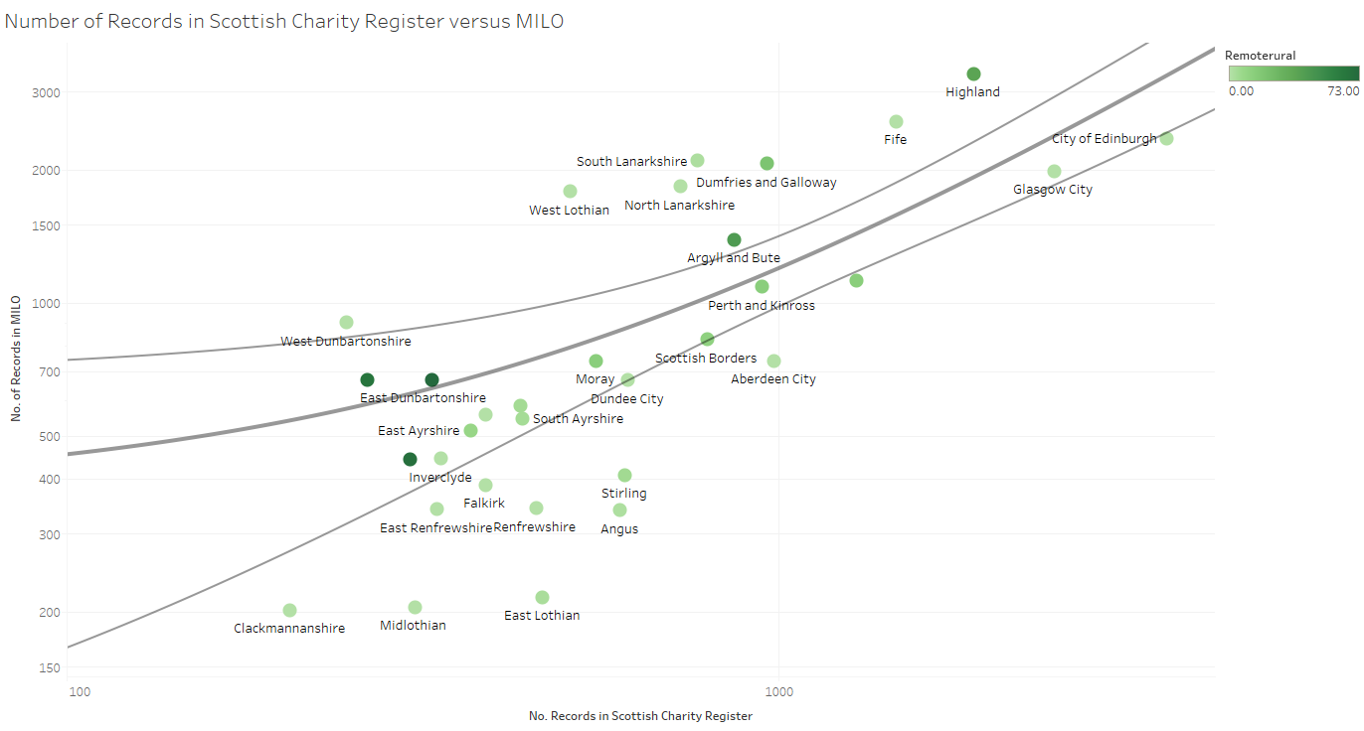
Total Number of CSOs in the Two Databases

Slide 6
Urban-Rural Classification
Standardised by population shows greater impact of how Milo represents CSOs outside large cities

Slide 7
Indices of Multiple Deprivation
Analysis by population shows much more important presence of CSOs in deprived areas.
Address of CSO not = area of operation, but more likely on Milo, and unlikely to be based in a deprived area but not working in one

Slide 8
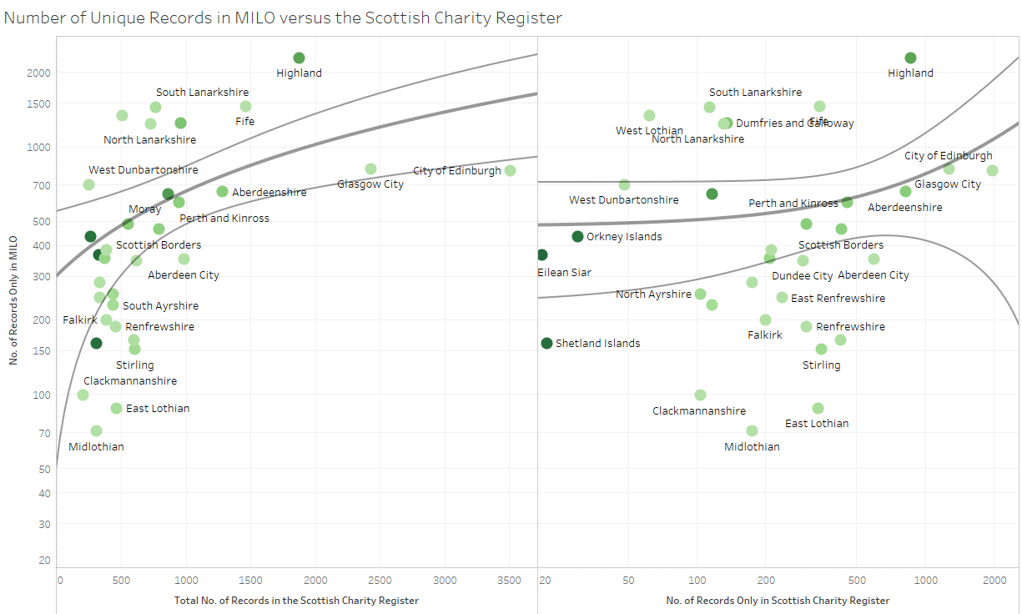
Comparing Records in the Two Databases

Slide 9
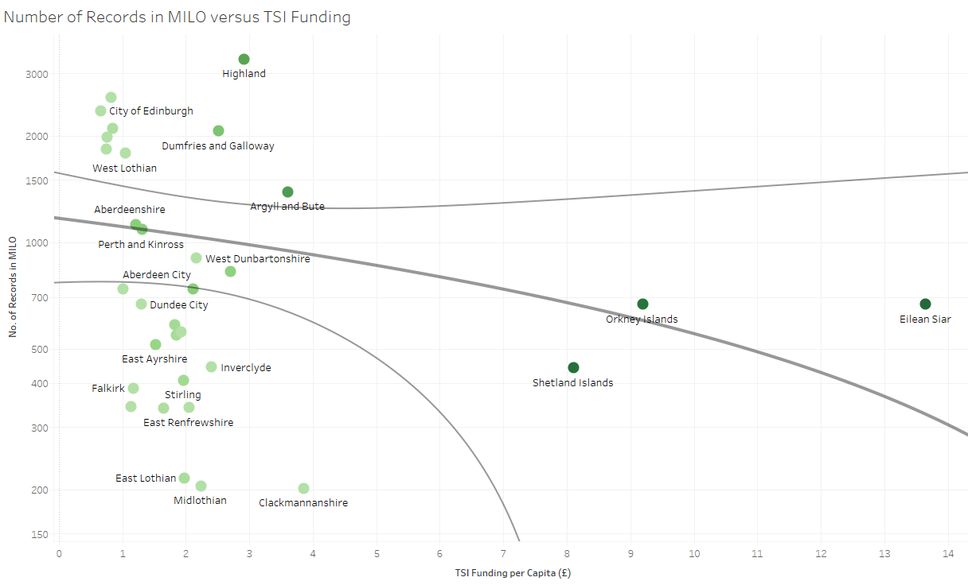
Government Funding and No. of Records

Slide 10
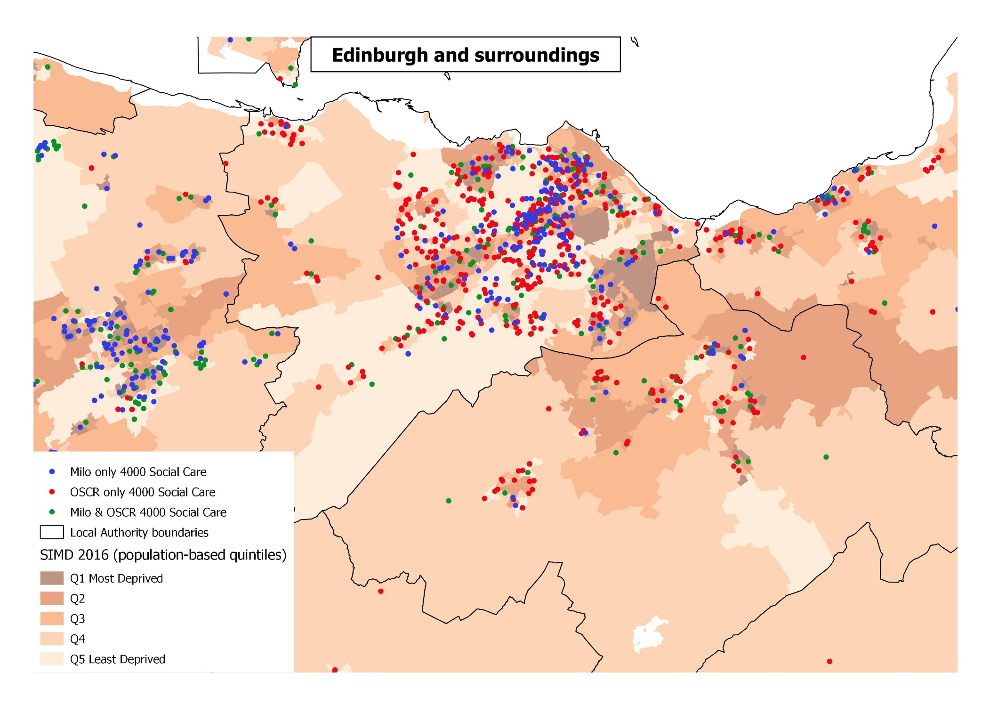
Social Care Organisation Numbers

Slide 11
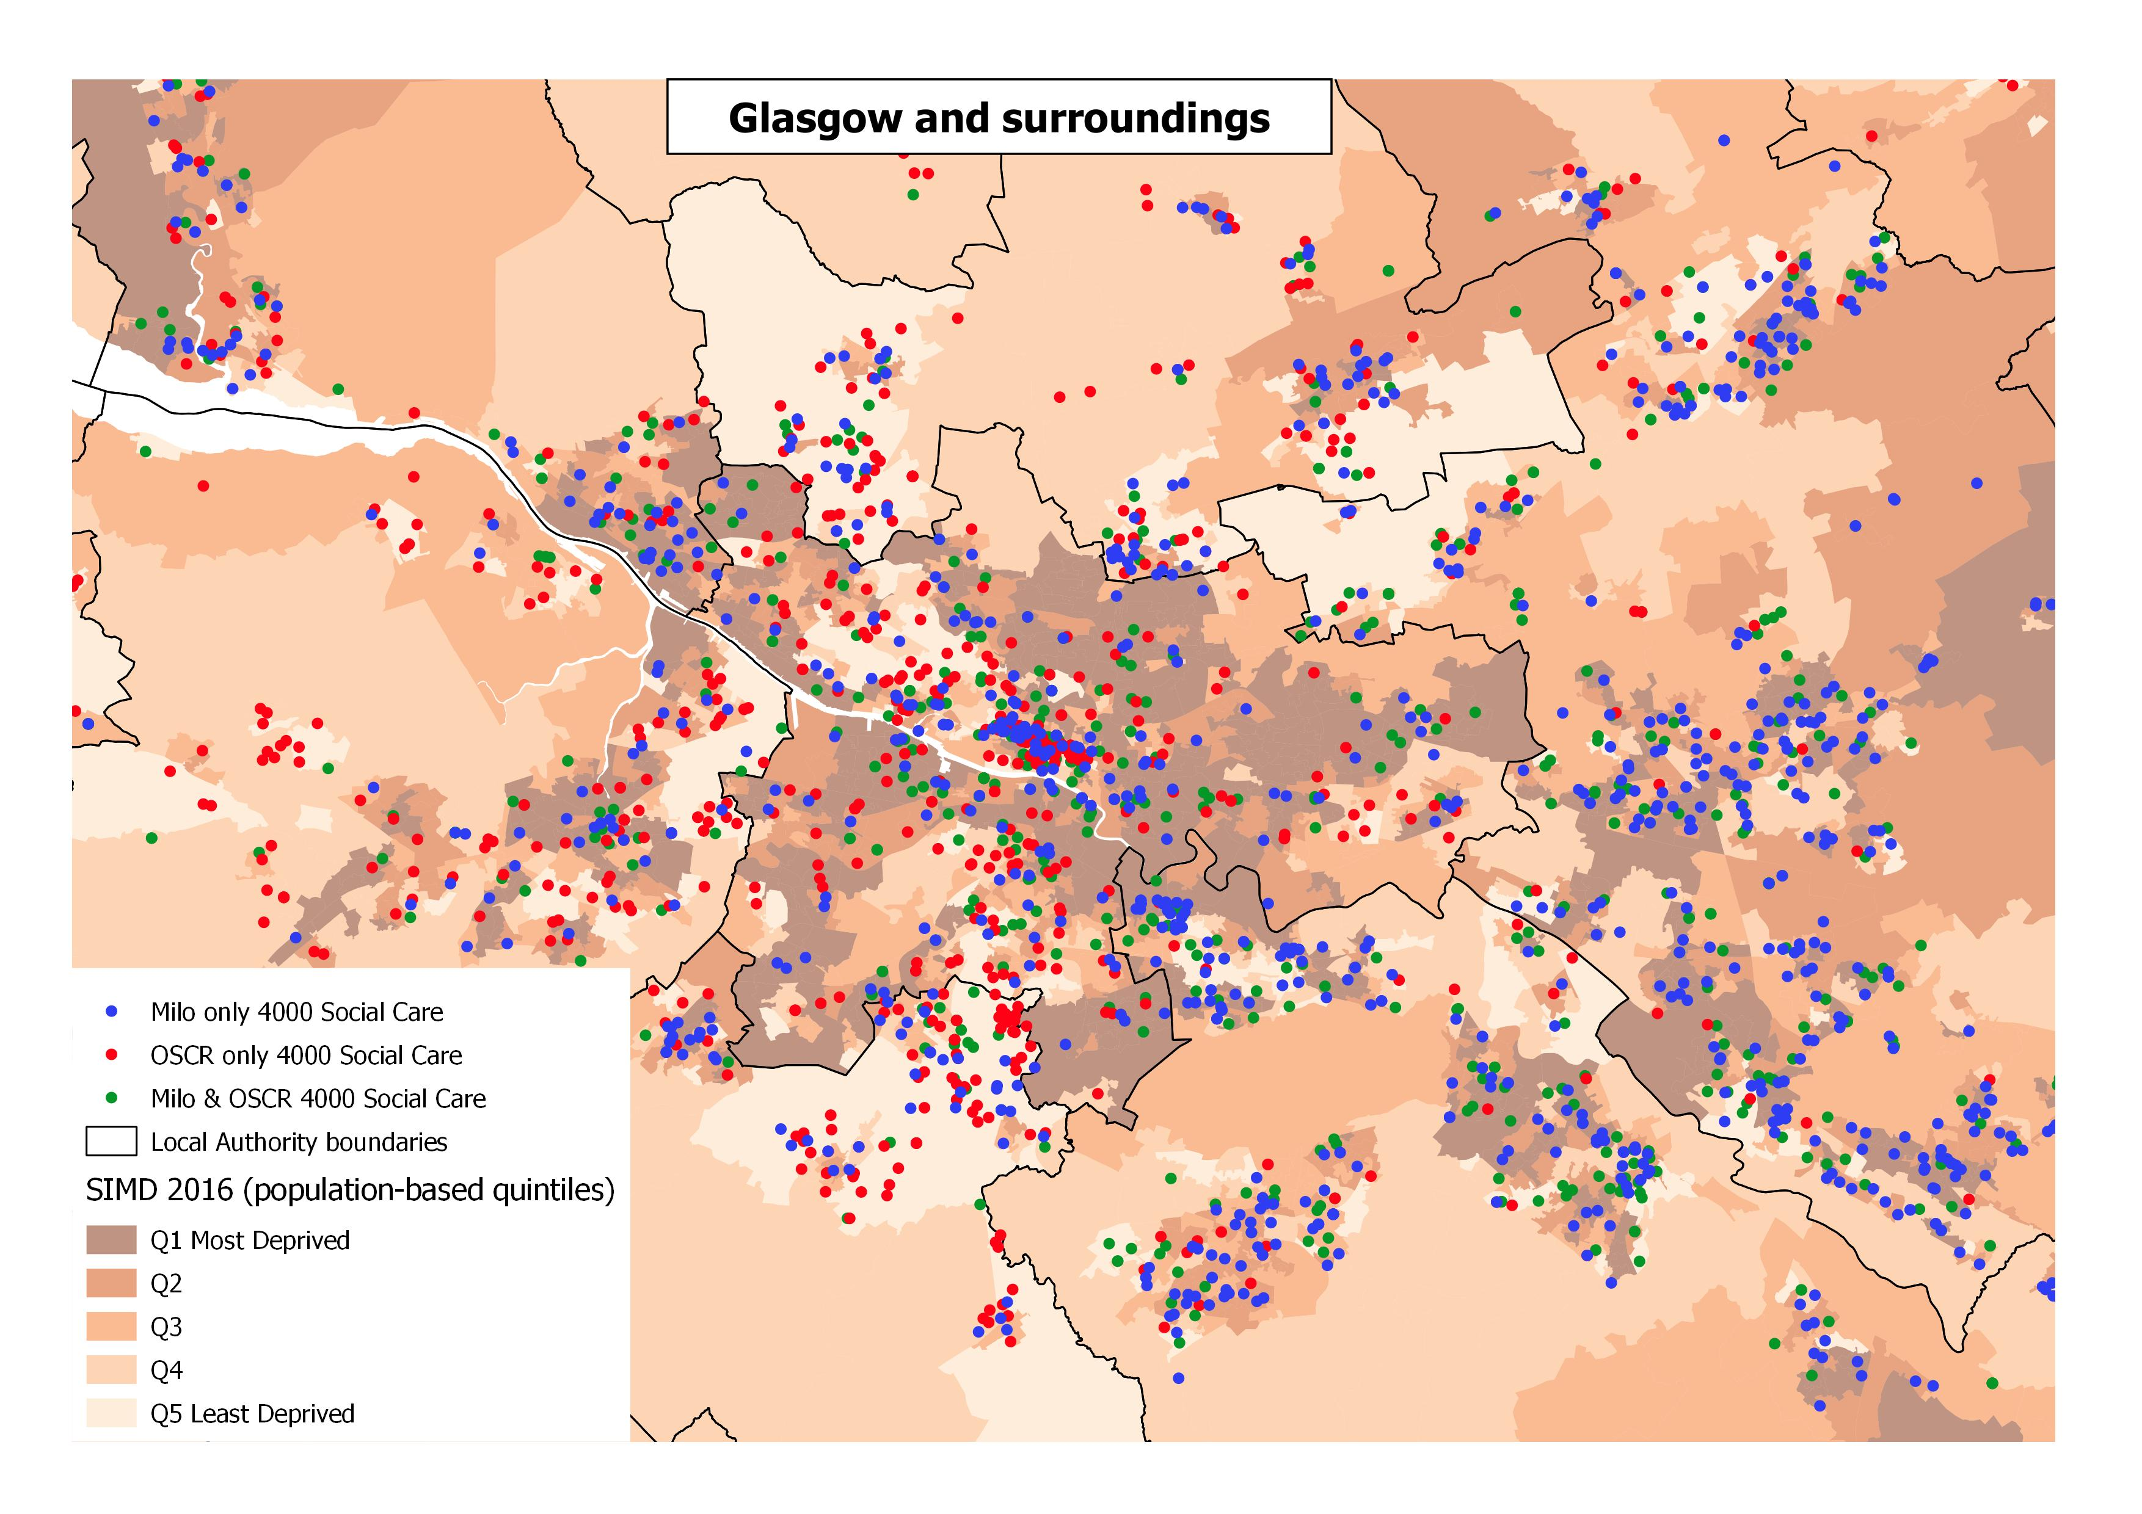
Social Care Organisation Numbers

Slide 12
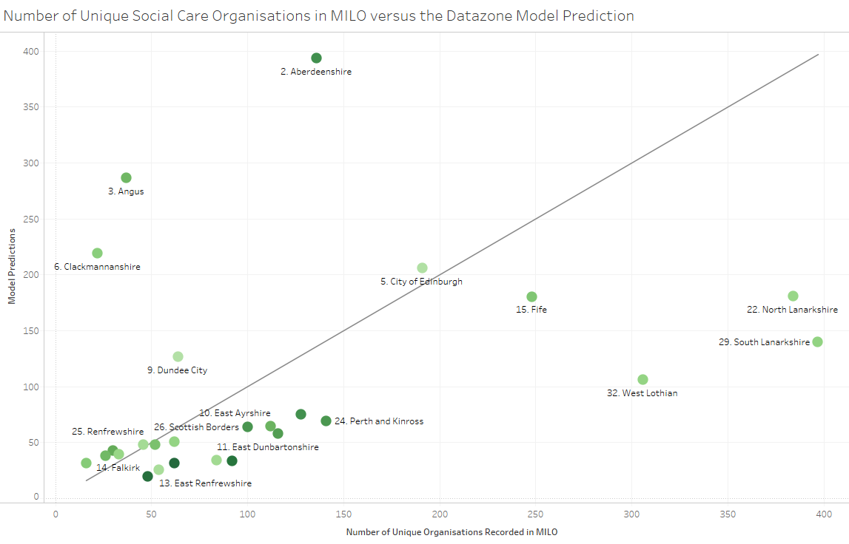
Modelling Social Care Organisation Numbers
Model: Negative Binomial at Datazone level, controlling for rurality; deprivation; population numbers; total recorded organisations (all types) in both databases

Slide 13
Using Administrative Data to Understand Civil Society Organisations in Scotland
Significant numbers of organisations are recorded locally that do not feature in the Charity Register Data
Using local data highlights patterns in the distribution of organisations concealed by “head office bias”
There are data quality issues that need to be addressed in using data from local databases

