Slide 1



Davide Castellani (Henley Business School, University of Reading)
Andreas Koch (Institute for Applied Economic Research)
Comparable Indicators of
Competitiveness across Europe
State of the Art and Challenges
Conference of European Statistics Stakeholders
Budapest, October 20/21, 2016

Slide 2
Motivation
Competitiveness is a key objective of national and European economic policies
Large number of competitiveness reports with many different concepts and indicators
  But no general consensus about how to measure competitiveness
Economic literature emphasizes that aggregate competitiveness may be the result of a few very competitive firms
  Heterogeneity of firms vs. average/representative firm
No global or even European harmonized data for an assessment of different aspects of competitiveness
  Particularly for micro-data
Researchers and policy makers need a ‘handbook’ on what to look for and where to find the appropriate data
  MAPCOMPETE project

Slide 3
Aims of the MAPCOMPETE project
MAPCOMPETE develops and compiles a comprehensive inventory of…
  concepts and indicators of competitiveness
  data availability on different levels of aggregation in the EU28
  potentials, barriers and perspectives of data matching within and across countries
MAPCOMPETE compiles and develops propositions for an efficient use of existing data as well as for an improvement of the framework conditions for data availability and accessibility, particularly with regard to micro-level data
MAPCOMPETE suggests adjusted and new concepts and indicators of competitiveness in a European comparative perspective

Slide 4
Example: Labour productivity
Computabilty | Austria | Belgium | Bulgaria | Croatia | Czech Rep. | Denmark | Estonia | Finland | France | Germany | Hungary | Ireland | Italy | Latvia | Lithuania | Malta | Netherlands | Poland | Portugal | Romania | Slovakia | Slovenia | Spain | Sweden | UK
Labour productivity (average, median, other moments) - all firms | 1 | 2 | 2 | 0 | 1 | 2 | 2 | 2 | 2 | 1 | 2 | 2 | 1 | 1 | 2 | 1 | 2 | 2 | 1 | 1 | 2 | 2 | 2 | 2 | 2
TFP (average, median, other moments) - all firms | 1 | 2 | 2 | 0 | 1 | 2 | 2 | 2 | 2 | 1 | 2 | 1 | 1 | 1 | 1 | 0 | 2 | 2 | 1 | 1 | 2 | 2 | 2 | 2 | 2
Labour productivity (average, median, other moments) - exporters | 1 | 2 | 1 | 0 | 1 | 2 | 1 | 2 | 2 | 1 | 2 | 2 | 1 | 1 | 1 | 1 |  | 2 | 1 | 1 | 2 | 2 | 2 | 2 | 2
Labour productivity (average, median, other moments) – foreign-owned firms |  | 2 | 1 | 0 | 1 | 0 | 1 | 2 | 1 | 0 | 0 | 2 | 1 | 0 | 1 | 1 |  | 0 | 0 | 1 | 1 | 1 | 2 | 2 | 2
Accessibility | Austria | Belgium | Bulgaria | Croatia | Czech Rep. | Denmark | Estonia | Finland | France | Germany | Hungary | Ireland | Italy | Latvia | Lithuania | Malta | Netherlands | Poland | Portugal | Romania | Slovakia | Slovenia | Spain | Sweden | UK
Labour productivity (average, median, other moments) - all firms | 0 | 2 | 1 | 9 | 1 | 1 | 1 | 1 | 1 | 1 | 1 | 1 | 1 | 1 | 0 | 1 | 1 | 1 | 1 | 0 | 0 | 1 | 0 | 1 | 1
TFP (average, median, other moments) - all firms | 0 | 2 | 1 | 9 | 1 | 1 | 1 | 1 | 1 | 1 | 1 | 1 | 1 | 1 | 0 | 9 | 1 | 1 | 1 | 0 | 0 | 1 | 0 | 1 | 1
Labour productivity (average, median, other moments) - exporters | 0 | 0 | 1 | 9 | 1 | 1 | 1 | 1 | 1 | 1 | 1 | 1 | 1 | 1 | 0 | 1 | 9 | 1 | 1 | 0 | 0 | 1 | 0 | 1 | 1
Labour productivity (average, median, other moments) – foreign-owned firms | 9 | 0 | 1 | 9 | 1 | 9 | 1 | 1 | 1 | 9 | 9 | 1 | 0 | 9 | 0 | 0 | 9 | 9 | 9 | 0 | 0 | 1 | 0 | 1 | 1

Slide 5
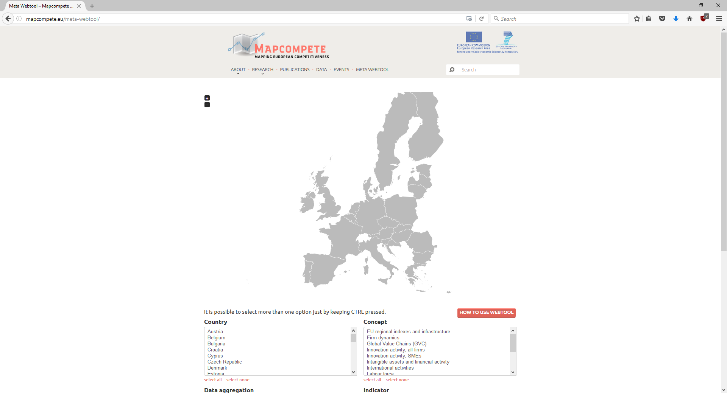
http://mapcompete.eu/meta-webtool/

Slide 6
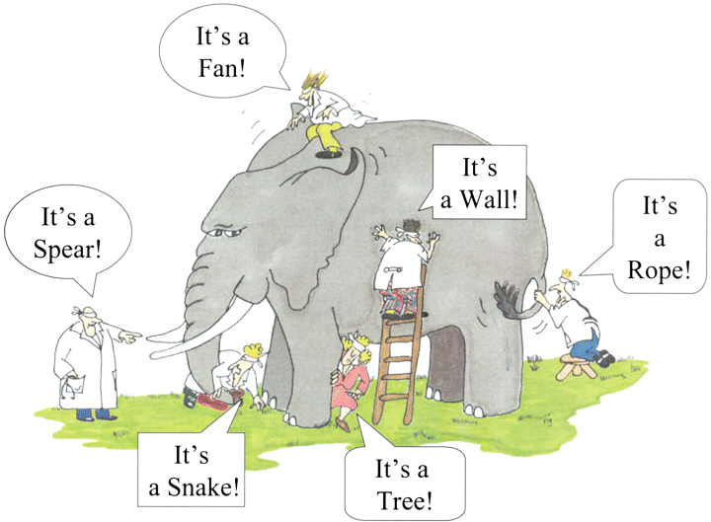
Data matching is increasingly popular…
© G. Renee Guzlas

Slide 7
… but barriers remain
Factual Restrictions, e.g.
    Different units of observation (e.g. firms vs. establishments)
    Divergent time periods
    No data available
Technical Restrictions, e.g.
    No common identifiers in the data
    Lack of computing capacities (hardware or software)
    Lack of knowledge with regard to potentials and benefits of matching
Legal Restrictions, e.g.
    Accessibility of (parts of) underlying data is restricted
    Matching of data is not allowed due to privacy protection

Slide 8
Typology of matched data across countries
Type 1: Multi-country harmo-nized micro-data collections
Integration of routinely collected microdata (Amadeus, LIS, EGR etc.)
Micro-aggregated statistics available to researchers
Distributed microdata approach
Type 3: Specific projects
Unique, specific projects dedicated to matching micro-level data
Type 4: Meta-projects
Matching pursues specific topical aim
Enhance researchers’ access to official micro data
Cross-country surveys (EFIGE, CIS, ISS etc.)
CompNet, MicroDyn, MultiProd, ESSLait etc.
e.g. INNODRIVE, KombiFiD
ESSnet and ESS.VIP, Data without Boundaries (DwB)
Projects that support matching
Improve metadata and data-management
Type 2: Micro-aggregated statistics

Slide 9
Summary of findings
  Availability of micro-level data is rather good in many countries, substantially improving recently. It is possible in principle to compute several indicators within countries
  Accessibility of the data is quite heterogeneous between countries ranging between full accessibility, clear but restrictive rules, unclear rules and total denial of access. This substantially limits cross-country comparative studies
  Conditions and frameworks for data matching within countries are also improving, but still quite heterogeneous between European countries
  Divergent pathways are used regarding data matching across countries:
    “Genuine” cross-country micro-level data is dominated by Eurostat, whereas accessibility of this data is rather restricted
    DMD approaches are a common way to generate knowledge in cross-country studies, but these data are somewhat limited
  Many potentials arising from matching data and from using matched data are currently unused due to factual, technical and legal restrictions

Slide 10
Pathways to Improve Comparable Micro-Level Cross-Country Data on Competitiveness
First-best solution: Changing the national and EU-level rules of data contents, data availability, data matching and data access. Some actions are taken (and successful), but much time is still needed
Workaround #1: Dealing with current restrictions using improved methods, e.g. by matching after separate processing (e.g. DMD) or by imputation techniques
Workaround #2: Improving architectures of matching data (e.g. by involving „matching institutions“) and data access for researchers (e.g. by improving techniques of data anonymisation)
Workaround #3: Supporting and coordinating multiscope cross-country firm-level surveys – and linking them to further data
Workaround #4: Alternative Data, e.g. Big Data

Slide 11


Thank you for your attention!
Dr. Andreas Koch
Institute for Applied Economic Research
Ob dem Himmelreich 1
D-72074 Tübingen
Telefon: 07071 – 9896-12
E-Mail: andreas.koch@iaw.edu
www.iaw.edu

