Slide 1
A comparative analysis between industrial gross value added and production in the euro area
– Session D12 Multisource statistics
ECB-UNRESTRICTED
FINAL
Gabe de Bondt
European Central Bank
DG-Economics
Stanimira Kosekova
European Central Bank
DG-Statistics
Conference of European Statistics Stakeholders, 2016
Budapest, 20-21 October 2016

Slide 2
Agenda
ECB-UNRESTRICTED
1
Motivation
2
Euro area developments in value added and industrial production
3
Country results
4
Conceptual and statistical differences
5
Conclusion

Slide 3
Industrial production quarterly growth not 1-to-1 translated into industrial value added growth
Motivation
ECB-UNRESTRICTED
FINAL
Industrial production widely used for conjunctural analysis
Monthly available and comparatively short reporting lag
Industrial production excluding construction (IP) might provide misleading signals for value added (VA)
2016Q2: IP -0.4% (12 August) vs. VA +0.5% (6 September)
Warrants a closer look at the differences between IP and VA

Slide 4
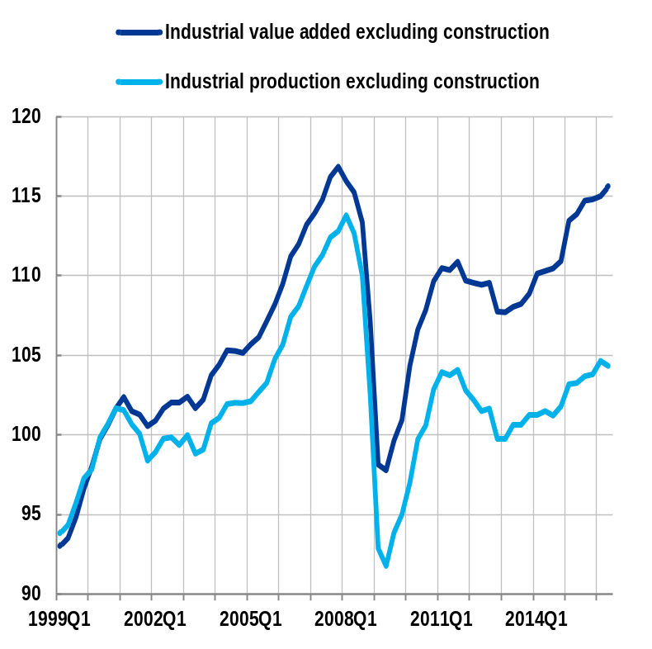
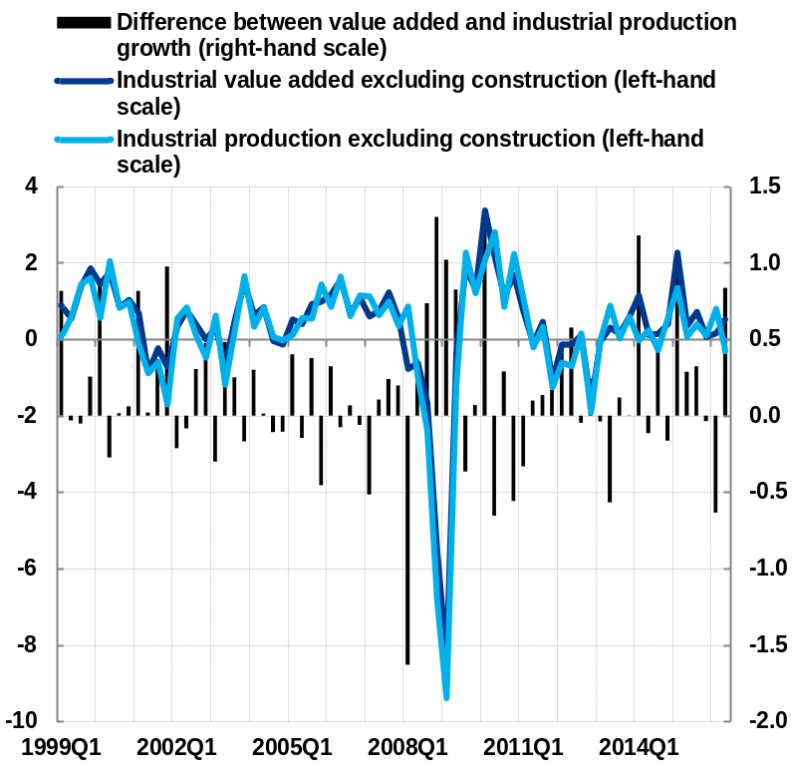
Euro area industry excluding construction
Euro area developments in value added and industrial production
ECB-UNRESTRICTED
Level Quarter-on-quarter growth
(2000=100) (%; percentage points)
Note: gross value added: calendar and seasonally adjusted chain-linked volumes; industrial production index: quarterly average of working day and seasonally adjusted monthly data
Comparative analysis between industrial value added and production

Slide 5
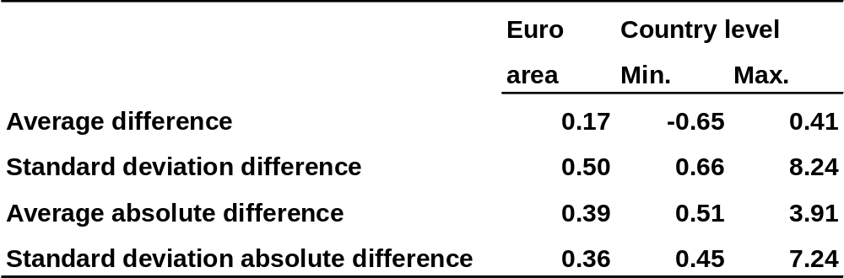
Overview growth rate difference
Country results
ECB-UNRESTRICTED
(1999Q1 to 2016Q2)
Comparative analysis between industrial value added and production

Slide 6
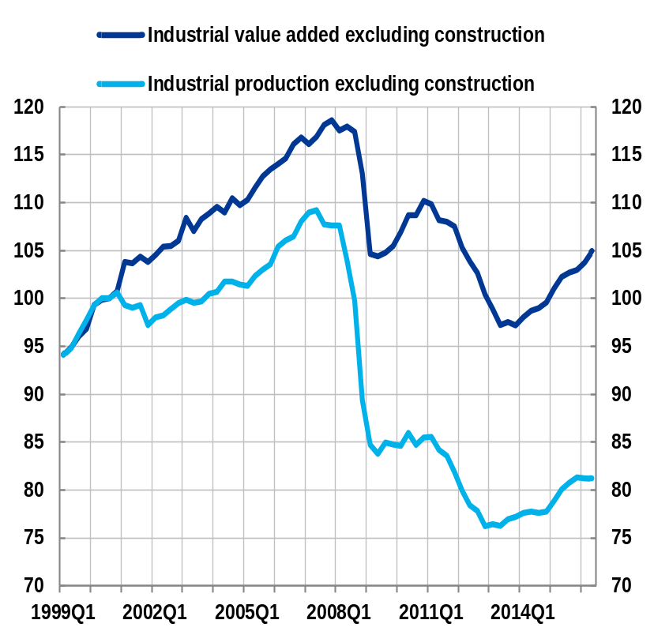
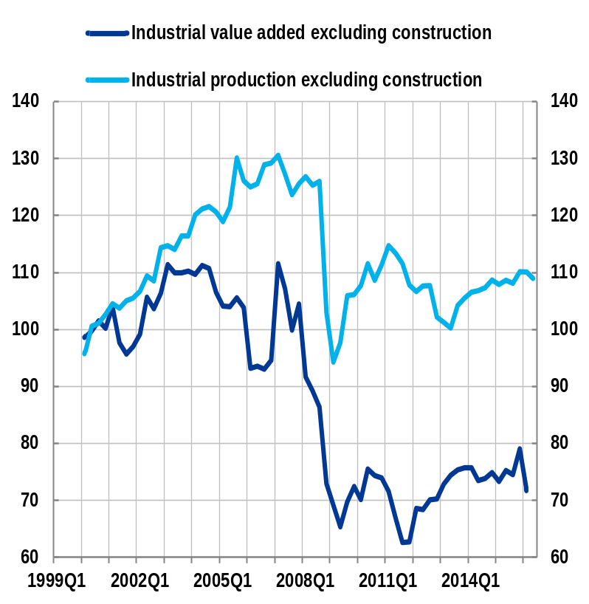
Level
Country results
ECB-UNRESTRICTED
(2000=100)
Spain Luxembourg
Note: gross value added: calendar and seasonally adjusted chain linked volumes; industrial production index: quarterly averages of monthly working and seasonal adjusted data
Comparative analysis between industrial value added and production

Slide 7
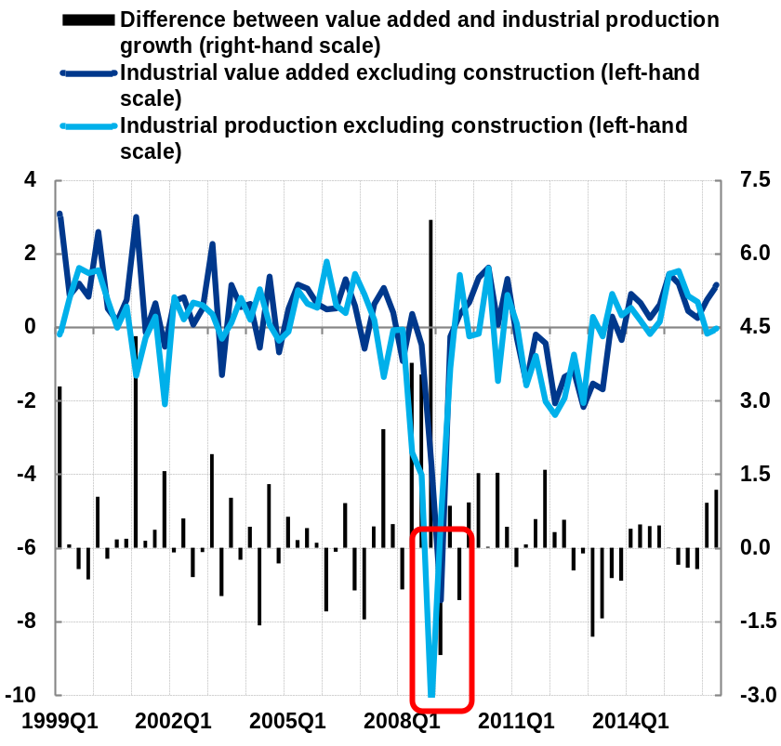
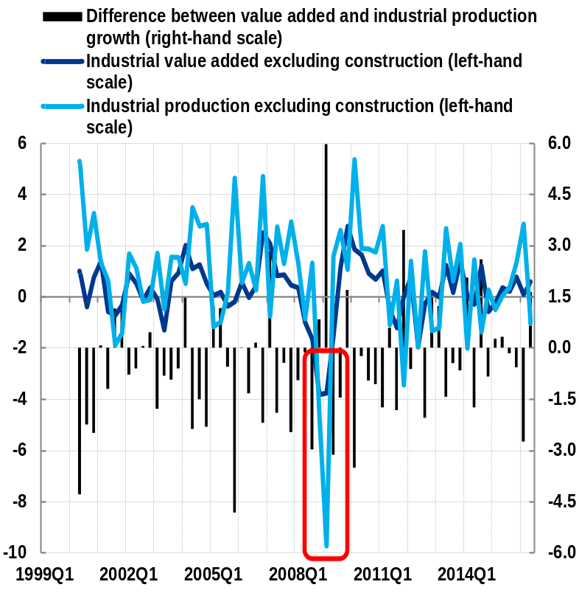
Quarter-on-quarter growth
Country results
ECB-UNRESTRICTED
(%; percentage points)
Spain Belgium
Note: gross value added: calendar and seasonally adjusted chain linked volumes; industrial production index: quarterly averages of monthly working and seasonal adjusted data
Comparative analysis between industrial value added and production

Slide 8
Concepts
Conceptual and statistical differences
ECB-UNRESTRICTED
Value added (volume)
Basic prices
Double deflation approach (deflated output less deflated intermediate consumption)
Chain-linking approaches
Seasonally adjusted at quarterly frequency; direct vs. indirect adjustment
Euro area excludes Malta
NACE Rev 2: B to E
Aiming at exhaustive coverage (other sources may be used)
Industrial production(volume)
Factor costs
Combination of source data is used; output index using value added as weights
Chain-linking & fixed base approaches
Seasonally adjusted at monthly frequency; direct vs. indirect adjustment
Euro area based on 19 countries
NACE Rev 2: B to D
Covers firms above a threshold (turnover or # of employees)
Comparative analysis between industrial value added and production

Slide 9
Statistical differences
Conceptual and statistical differences
ECB-UNRESTRICTED
Impact of seasonal adjustment on
euro area industrial production
(%; percentage points)
Industrial production seasonally adjusted at quarterly frequency
Defining seasonal adjustment parameters matters
Does not diminish the impact of other factors
Comparative analysis between industrial value added and production

Slide 10
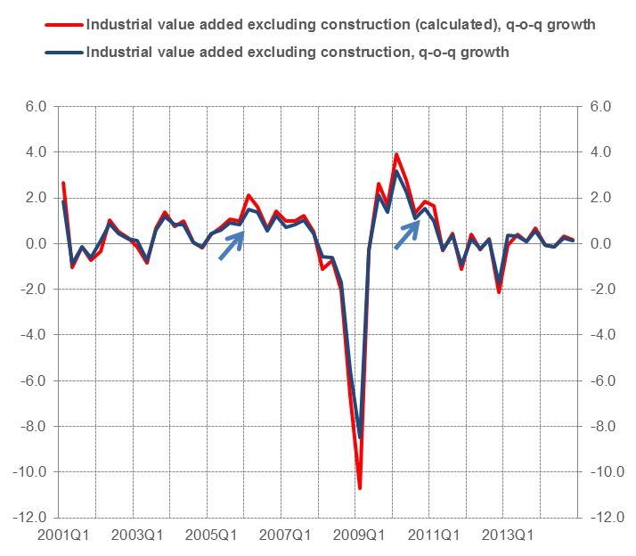
Statistical differences
Conceptual and statistical differences
ECB-UNRESTRICTED
Impact of coverage of Sector E
(%; percentage points)
(%)
Comparative analysis between industrial value added and production

Slide 11
Conclusion
ECB-UNRESTRICTED
Close link between value added and industrial production…
but differences exist due to various factors…
which relative importance is difficult to assess
In order to enhance the information content of IP for VA further harmonisation is needed between
  National accounts and short-term statistics, i.e. the same activity coverage in NACE available at monthly and quarterly frequency
  National practices for seasonal adjustment
  Approaches to volume data, i.e. common application of chain-linking
  Metadata at euro area and country level
Comparative analysis between industrial value added and production

