Slide 1

Session D12: Multisource statistics
New sources: new modelling approaches
Author:
Gras Fabrice,
Eurostat, unit B1, Methodology and corporate architecture
Conference of European Statistics Stakeholders
Budapest, 20–21 October 2016

Slide 2
Outline:
New sources: multiple usages with a tendency towards more and more multi-sources statistics.
Integration of new sources in the "official statistics" universe: increasing use of various modelling techniques in addition of surveys.
Quality assessment of multi-sources statistics?
Measuring uncertainty of multi-sources statistics
Eurostat activities

Slide 3
Possible usages of new sources
Usages
Direct
1. Direct Tabulation
2. Substitution and supplementation
Indirect
1. Creation and update of registers
3. Estimation
4. Data validation/
confrontation
2. Editing and imputation

Slide 4
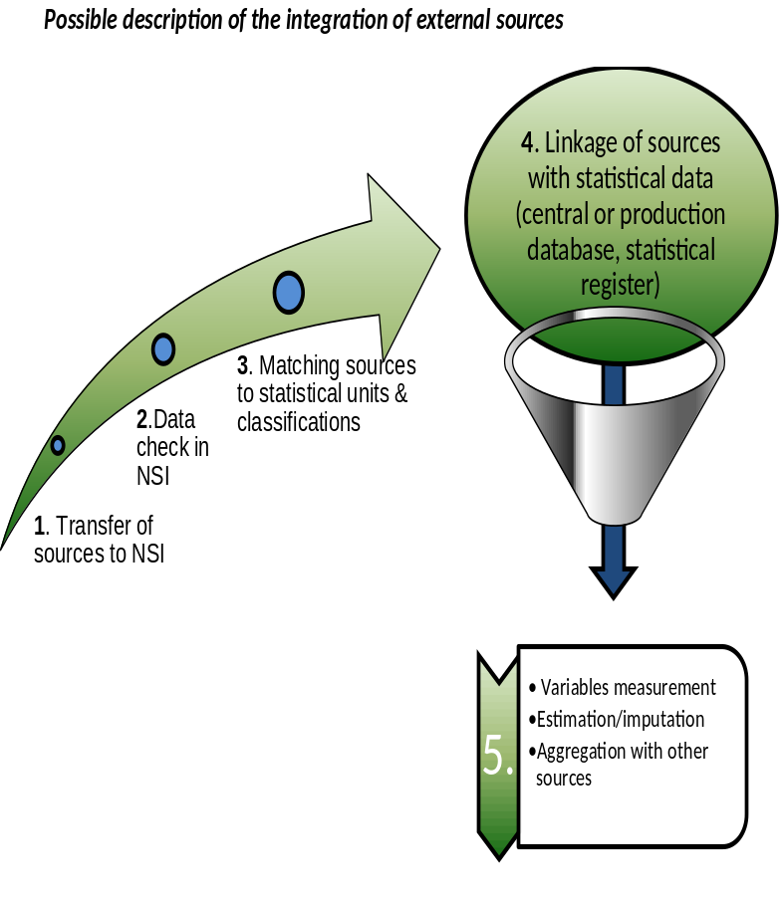
Integration of new sources
Statistical toolbox:
Editing techniques and outliers detection.
Data linkage/matching methods: probabilistic or not.
Modelling: calibration, state-space models, temporal disaggregation, small area models, stone model, regression techniques, etc …

Slide 5
Quality assessment of new sources:
Input quality: Eurostat quality dimensions applicable (timeliness, relevancy, accuracy, comparability, consistency, clarity, sustainability)
Process quality: total quality management
Output quality: Eurostat quality dimensions
Main issue accuracy measurement (bias +measurement error)
Notes:
Bias = comparability

Slide 6
Sources of uncertainty
Input Sources n:
Bias + Measurement error = B + ε _{In}
Data linkage/matching for source n:
false positive/true positive (p_{1n}, p_{2n})
Estimation/imputation:
Y = f(X) + η (normally should remove the bias)
Main issue: estimation of the parameters above

Slide 7
Measurement of uncertainty:
Survey for estimating parameters of underlying distributions.
Model outputs
Qualitative assessment of parameters.
Bias: need of several sources, availability of auxiliary variable, qualitative assesment

Slide 8
Output accuracy
Aggregation of the different sources of errors for the different used sources at the different steps of the statistical process:
  Existence of an analytical expression.
  Simulation.
Main issues:
  Computational cost.
  Model specification errors not taken into account.
  Cost and update of the estimated parameters.

Slide 9
Example:
Input measurement error transmission during the linkage/matching process:
  Xi N (m, σ²), i = 1 … N
  X= Σ Xi
  E(X) = N (1- p1n+ p2n) m
  Var (X) = Var (N (1- p_{1n}+ p_{2n}) σ²)
= N² (1- p_{1n}+ p_{2n})² σ²
To be inserted during the estimation/imputation phase:
  Y = f(., X) + η

Slide 10
Eurostat activities:
ESS VIP.ADMIN:
  Working package 2: Estimation methods
    Review of relevant estimations methods and provision of guidelines (2016-2018)
  Working package 3: Quality measures for statistics using administrative data
    Consortium of NSIs led by Denmark dealing with input, process and output quality (2015-2019).
BIG-DATA:
  Assessment of the quality of Big-Data sources (including big-data selectivity).
  Big-data econometrics

Slide 11
Conclusion:
Multi-sources statistics:
Increasing use of estimation methods
Input of uncertainty other than sampling error at different steps of the statistical production process.
Parameters necessary to the estimation of the uncertainty could be obtained through surveys or qualitative assessment.
Output accuracy: aggregation of the uncertainty coming fron various sources along the production process.
Use of simulation methods.

Slide 12
Thank you for your attention
Questions welcome
References:
Zhang, L-C. (2012). Topics of statistical theory for register-based statistics and data integration. Statistica Neerlandica, vol. 66, pp. 41-63.
ESS.VIP.ADMIN
http://ec.europa.eu/eurostat/cros/content/essvip-admin-administrative-data-sources_en
BIG-DATA
http://ec.europa.eu/eurostat/cros/content/big-data_en

