Slide 1
BETTER DATA FOR BETTER ANALYSIS FOR BETTER POLICIES
Econometrics and Applied Statistics
Competence Centre on Microeconomic Evaluation (CC-ME)
CESS, Budapest, 19 October 2016

Slide 2
JRC Competence Centre on Microeconomic Evaluation (CC-ME) mission:
1. Where are we coming from?
To provide evidence on the impact of EU policies, in order to improve effectiveness of public financing
To contribute to developing a ‘causal evidence culture’
To facilitate the contact between EU policy makers and the scientific community
To support the European Member States
Notes:
Message: push the agenda on administrative data for better policies. How do we press for data availability?

Slide 3
2. Why do we want data to be available?
Public data is a public good – statistical authorities are only data keepers or data providers
Access to public data is a key element for democracy
We need to know how public money is spent
And whether it is well spent...
Public knowledge also helps confronting spending; also helps the call for adequate studies

Slide 4
However... there are justifiable confidentiality concerns
It’s our duty to protect people
keep data secure
help establishing security standards
and to explain to people...
data linkage can preserve confidential data
there are safe protocols and algorithms
But, after all, we need data to help knowing reality and to help improving public policies

Slide 5
3. How can we evaluate policy?
(Play video)
The main challenge for impact evaluation methods is answering the following question:
        What would have happened to the beneficiaries of a programme (individuals, families, firms, etc) had the programme not existed?
We need good data in order to identify the comparison group (the so called counterfactual) and quantify the impact of the programme.
Notes:
EH: scholarship treshold
Comment: Randomised control trials are not feasible. That is why scientists need to manipulate the data and create quasi-experments to answer some research questions. Think about the following example. We would like to know whether receiving a scholarship helps reduce time to graduation and improve students’ outcomes. Scholarships are often assigned based on the GPA and Sat score. Fixing a threshold, is like doing an experiment: we can compare the outcomes of students whose SAT score/GPA is just above the threshold with those that lie just below the threshold. This is called a regression discontinuity design and is often used when we use thresholds, sharp laws to estimate the impact of an intervention.

Slide 6
Randomized control trials are not always feasible (ethical issues, external validity, costs...)
But... we can rely on other research designs (quasi-experiments) if we have good microdata
The scientific instruments exist
    Regression discontinuity
      compare units just below and just above the threshold
    Propensity score matching
      matching units in with units out for exogenous reasons
    Differences in differences
      measuring the evolution of different groups
    Instrumental Variables...
    But for this we need microdata, and a special type of data...
Notes:
EH: example with longitudinal data
Administrative data have a longitudinal structure (by construction), allowing to calculate the impact of a policy change or a specific intervention, simply comparing the outcomes of individuals, firms, etc before and after the intervention.
One example is participation into a training programme/counselling programme to help unemployed find a job. From administrative data (unemployment lists usually), you can observe the employment outcomes of individuals who participated in the training and those who didn’t.
By computing this double difference one can calculate the impact of the intervention comparing the labour market outcomes of the treated and control group before and after the programme.
The same method can be used to estimate the impact of an intervention targeted to firms (a tax credit), by comparing the profits of firms before and after.

Slide 7
4. We need administrative data
Administrative data have enormous advantages over survey data (and other microdata):
        already collected – collection not intrusive
        large samples (high representativeness)
        recorded regularly
        longitudinal structure - units can be followed over time
        less affected by some statistical problems (attrition, non-responses...)
        already subject to accuracy tests
        have good unit identifiers that allow for linkage

Slide 8
Summing up:
We can save public money
    Are we doing what we can to better the impact of public policies?
Research can help in evaluating, reassessing, and designing public policies
Scientific methods exist and resources exist
Data are there and can be protected and safely used
    Linkage is possible, confidentiality can be protected
We need administrative data access
    We should plan its availability from the beginning start
    Conceive both institutional research access and public access
    Impact assessment should be planned from the start of funding

Slide 9
Some past and ongoing activities...

Slide 10

COMPIE Conferences
COMPIE 2016:
October 20-21
Milan
Focus on employment, social inclusion and education policies
173 delegates from 33 countries
11 % from the European Commission
33 % from Universities
56 % from Governmental Institutions
61 scientific papers, mostly on labour market and social inclusion programmes
Notes:
Call for papers still open until the end of May

Slide 11
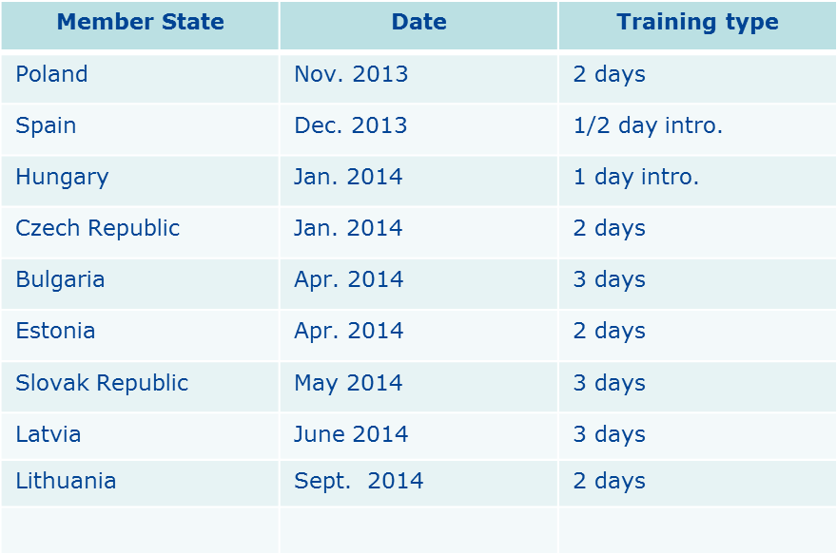
Training courses on counterfactual impact evaluation
Notes:
We organised many training courses in different member states.

Slide 12

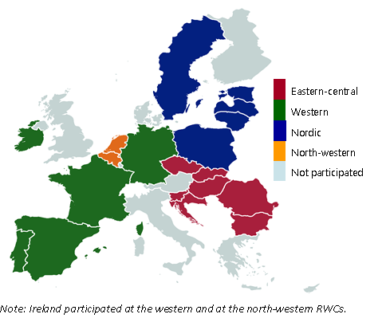
Regional Workshops 2015
Notes:
We organised 4 regional workshop on counterfactual impact evaluation between April – November 2015

Slide 13

Knowledge gaps in evaluating labour market and social inclusion policies
Policy reports:
Review the existing evidence on the effect of labour market policies, and signal the areas where knowledge is scarce
2. Define possible areas of priority for evaluations of ESF-type interventions in the 2014-2020 programming period.

Slide 14
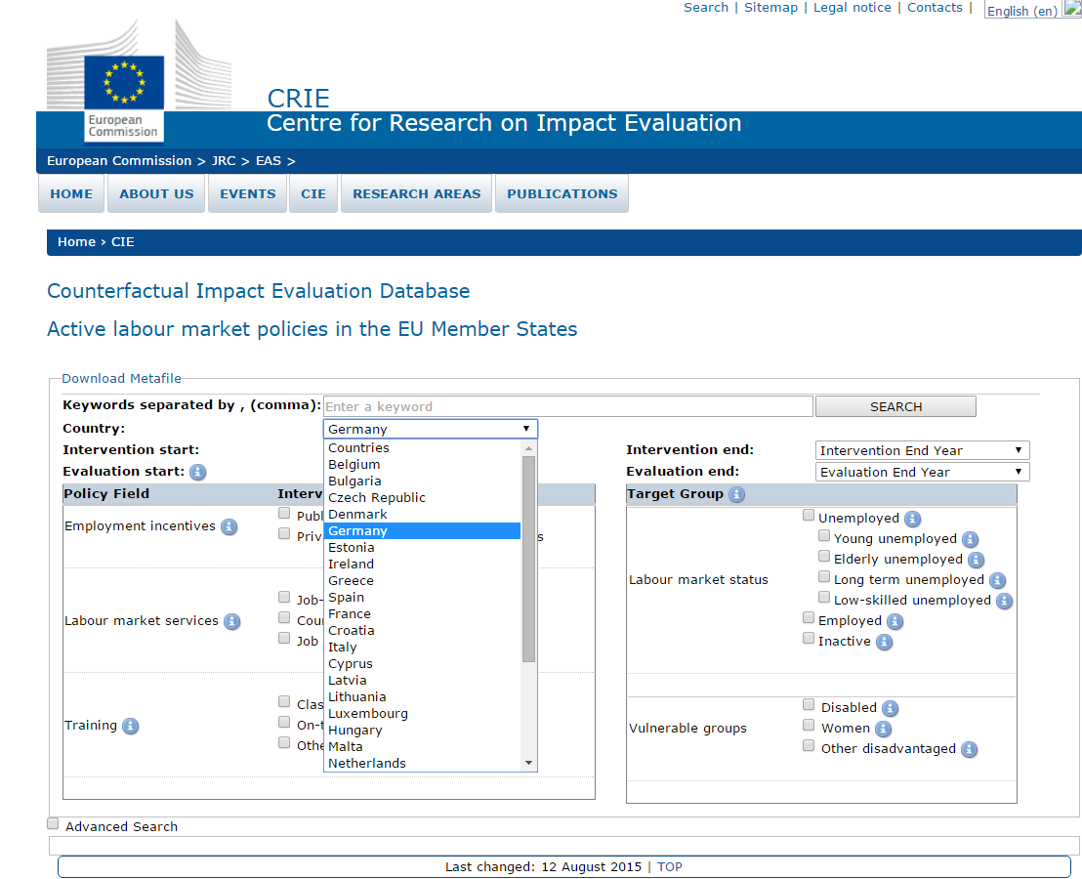
Counterfactual Impact Evaluation Archive

Slide 15
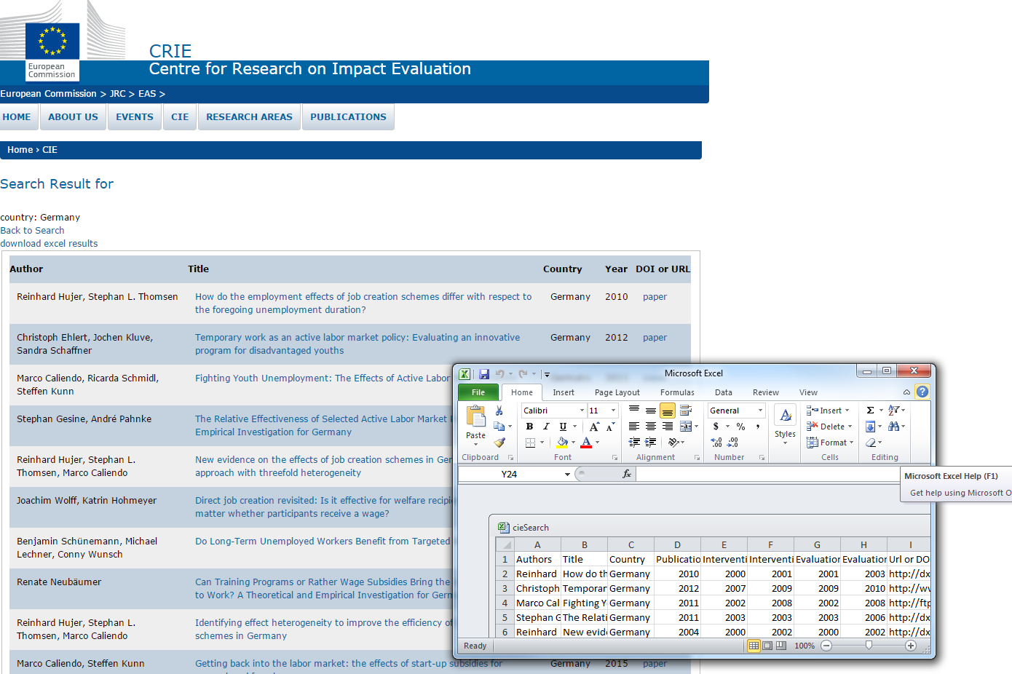
Notes:
We can download publication metadata

Slide 16
Supervision of pilot projects
Eight pilot projects were awarded a grant: Italy (2), Spain, Estonia, Lithuania, Portugal (2), Slovakia.
Main challenge encountered:
availability and access to a suitable data set on the control group.
Merging of administrative data, often held by different agencies, was subject to countries' and regions' data protection laws.
Better data would have increased the quality of evaluation, allowing the implementation of several and more refined methods (rather than only Propensity Score Matching)

Slide 17

Data fitness initative
Call closed in April: JRC will perform the studies proposed by the best projects:
detailed information on the intervention
clear definition of a control group
better data
Notes:
EH: Add one example
This project is targeted to interventions financed under the European Social Fund.
What we expect from participants in the call is a clear description of the intervention and the data.
The focus is mainly on active labour market policies (training to the unemployed, job search counselling) and social inclusion (programmes targeted to minority groups).

Slide 18
... let’s get back to the main message
We need better data
for better evidence
for better policies…
How can we push at the macro level?
How can we work on the micro level?
Notes:
Message: push the agenda on administrative data for better policies. How do we press for data availability?

Slide 19



Stay in touch!
CC-ME website: https://ec.europa.eu/jrc/en/microeconomic-evaluation
email: me@jrc.ec.europa.eu

