Slide 1

Open Science=Open Methodology
Oshrat Hochman & Christof Wolf

Slide 2

Open Science
“All European researchers will be able to deposit, access and analyze European scientific data through a European Open Science Cloud.”
European Commission

Slide 3
Open Science
Access to publications,
Access to data,
Access to source code,

Slide 4
Open Science
Access to publications,
Access to data,
Access to source code

Slide 5
Scientific use files of EU official statistics
Reduced problem of item non-response
Representativeness
Comparability across countries
Comparability across time

Slide 7
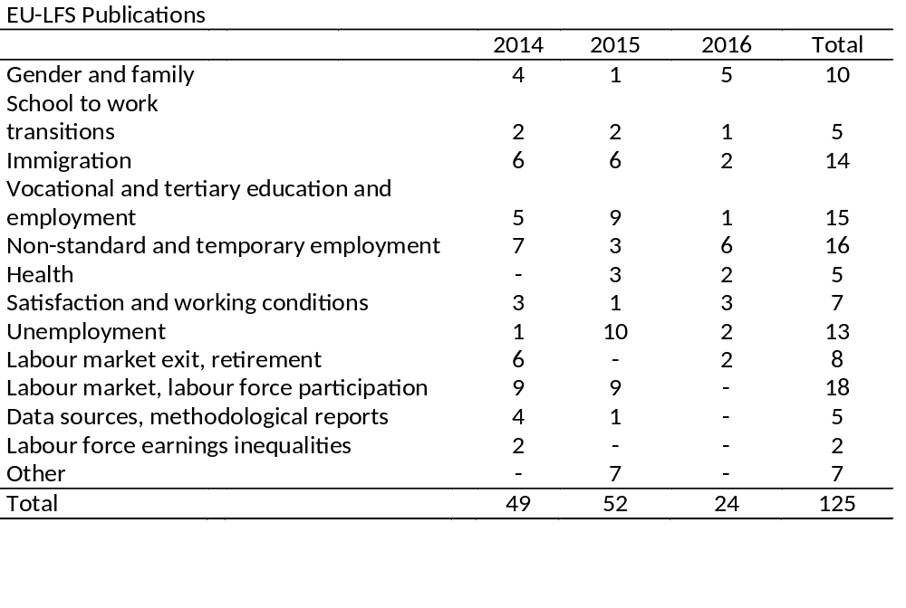
But: The data is not collected primarily for scientific purposes.

Slide 8
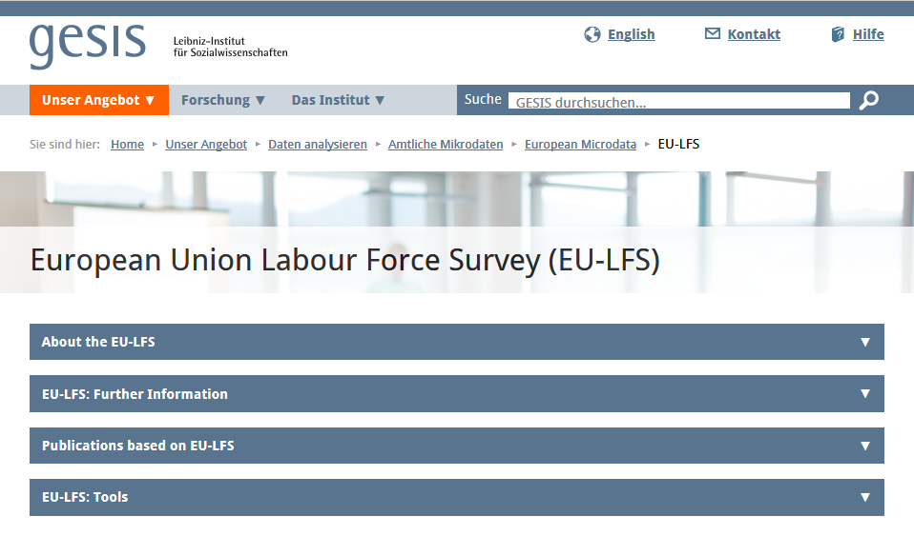
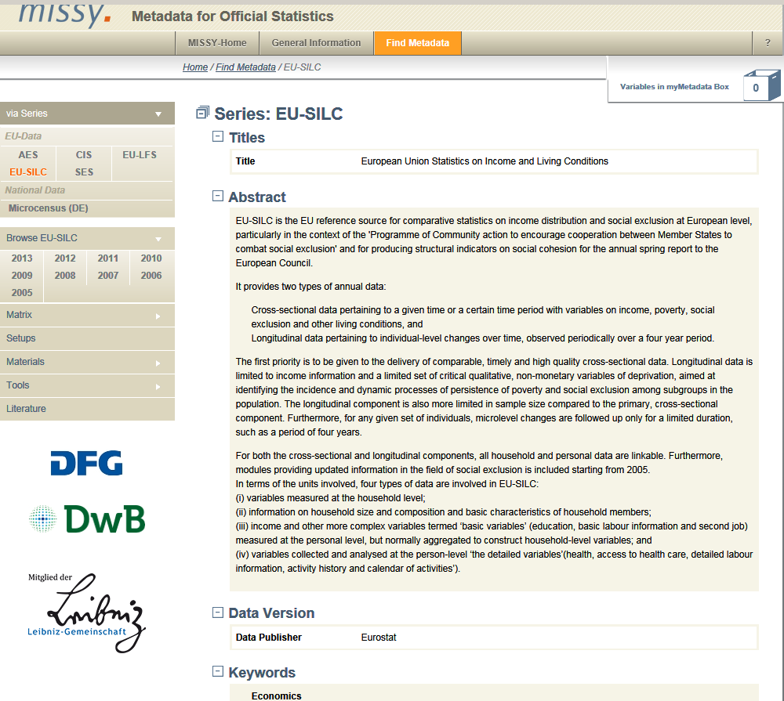
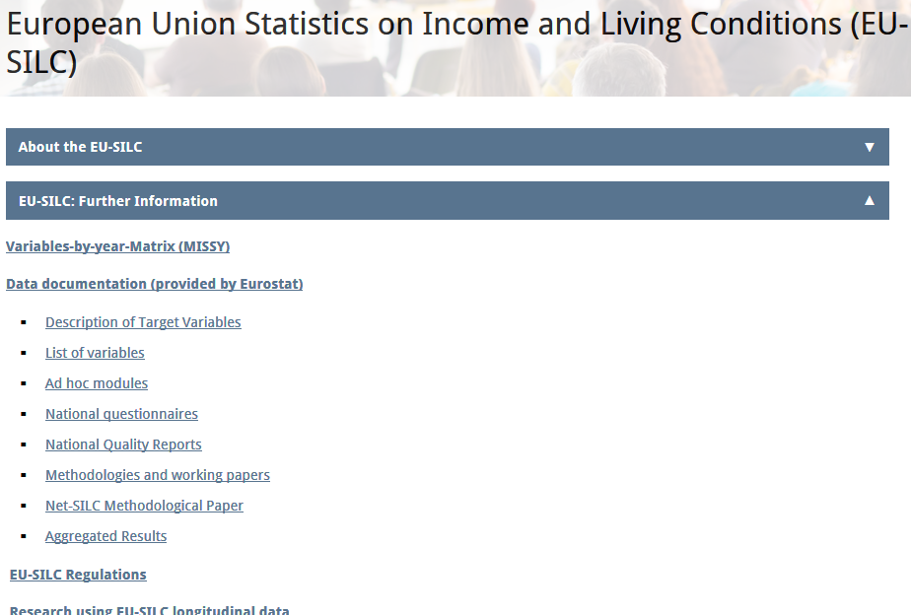
The Metadata in GESIS GML

Slide 9
The Metadata system in GML
All the available metadata about the different datasets in one place

Slide 13

The next step…
“Non-reproducible single occurrences are of
No significance to science”
(Popper)

Slide 14
Open Science
Access to publications,
Access to data,
Access to source code,
Access to Methodology

Slide 15
Challenges: Comparability
Data collection mode: register, interview, proxy
  Formulation of question, timing, subjectivity
Operationalization: ex-post harmonization of indicators
  Formulation, categorization into the ex post harmonized variables
→ Information on deviations from the guidelines is reported in the Eurostat and national quality reports.

Slide 16
Addressing the challenges
Flag variable: Survey, Proxy or register?
English translations of all country questionnaires
Country specific description of the operationalization of the variables to be harmonized: how was the original classification applied in the harmonized variables?
→ First step: for key harmonized (target or generated) variables like income, socioeconomic status, education, etc.

Slide 17
Thank you for your attention
http://www.gesis.org/en/missy
http://www.gesis.org/en/institute/competence-centers/rdc-german-microdata-lab/

Slide 18
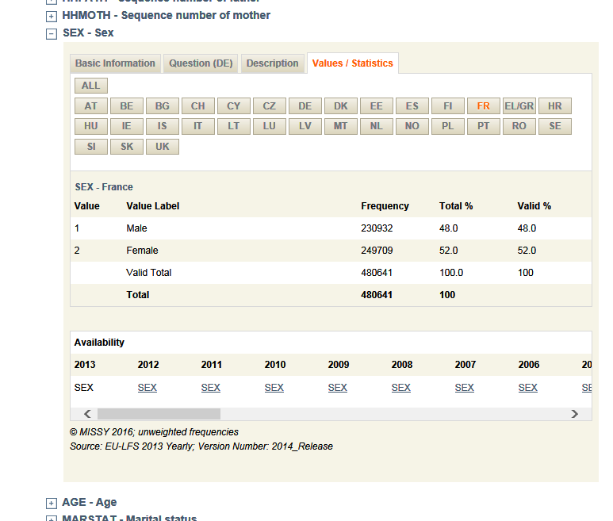
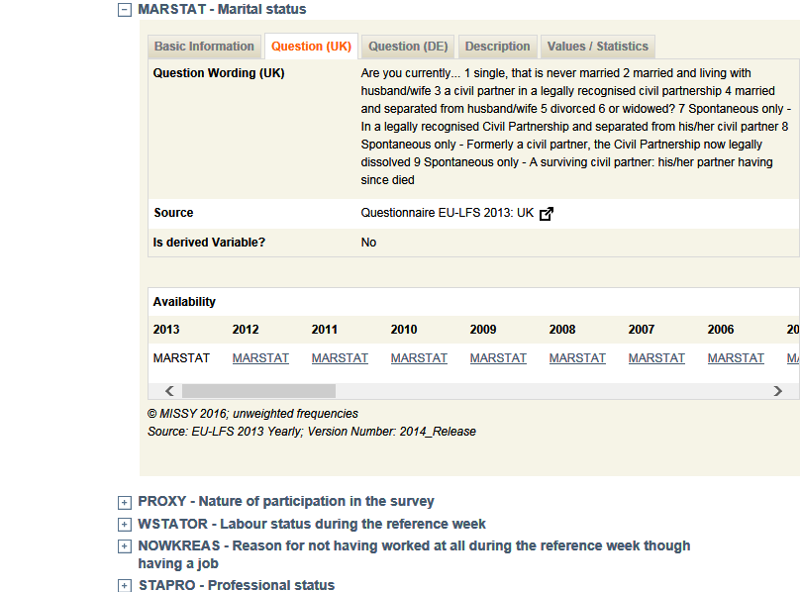
Variable level Information

Slide 19
Additional Collection mode and operationalization examples
Variations in order of questions

Slide 20
Data collection mode
Register data is likely to be less up to date than survey data.
It may also be operationalized differentially than the survey items.
Register data is objective while survey items are subjective.

Slide 21
Operationalization
Wirth 2016 (EU SILC):
Childcare in the household should according to EU SILC guidelines be measured with the following categories:
Preschool or equivalent; Primary school; Extracurricular childcare; Kindergartens or similar; Unstructured childcare;
Childcare through grandparents or other relatives.

Slide 22
In some countries, childcare also includes additional categories like parental child care (DE), or is differentiated by whether childcare is salaried or not (AT).
Parental childcare, appears then under the SILC category “other”, yet this category implies additional childcare solutions in other countries.
We do not know how the paid/unpaid childcare categories are entered into the SILC official categories.

Slide 23
Similar problems also exist in EU LFS
Items for employment – e.g. hours worked
Items for marital status – e.g. cohabitation
Items for drop-outs from school or vocational training programs

