Slide 1



Data at the Core: Archives of Data Science, Series B: (CESS 2016)
Organizing a Journal Around Data Sets Andreas Geyer-Schulz | 17. Oktober 2016
INFORMATION SERVICE AND ELECTRONIC MARKETS andreas.geyer-schulz@kit.edu
KIT – Universität des Landes Baden-Württemberg und nationales Forschungszentrum in der Helmholtz-Gemeinschaft
www.kit.edu

Slide 2
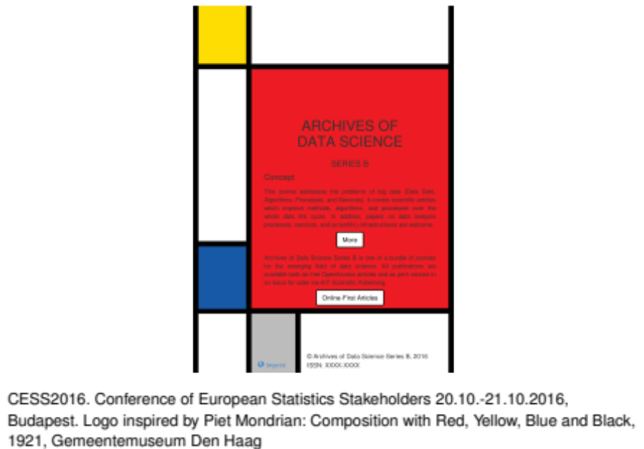
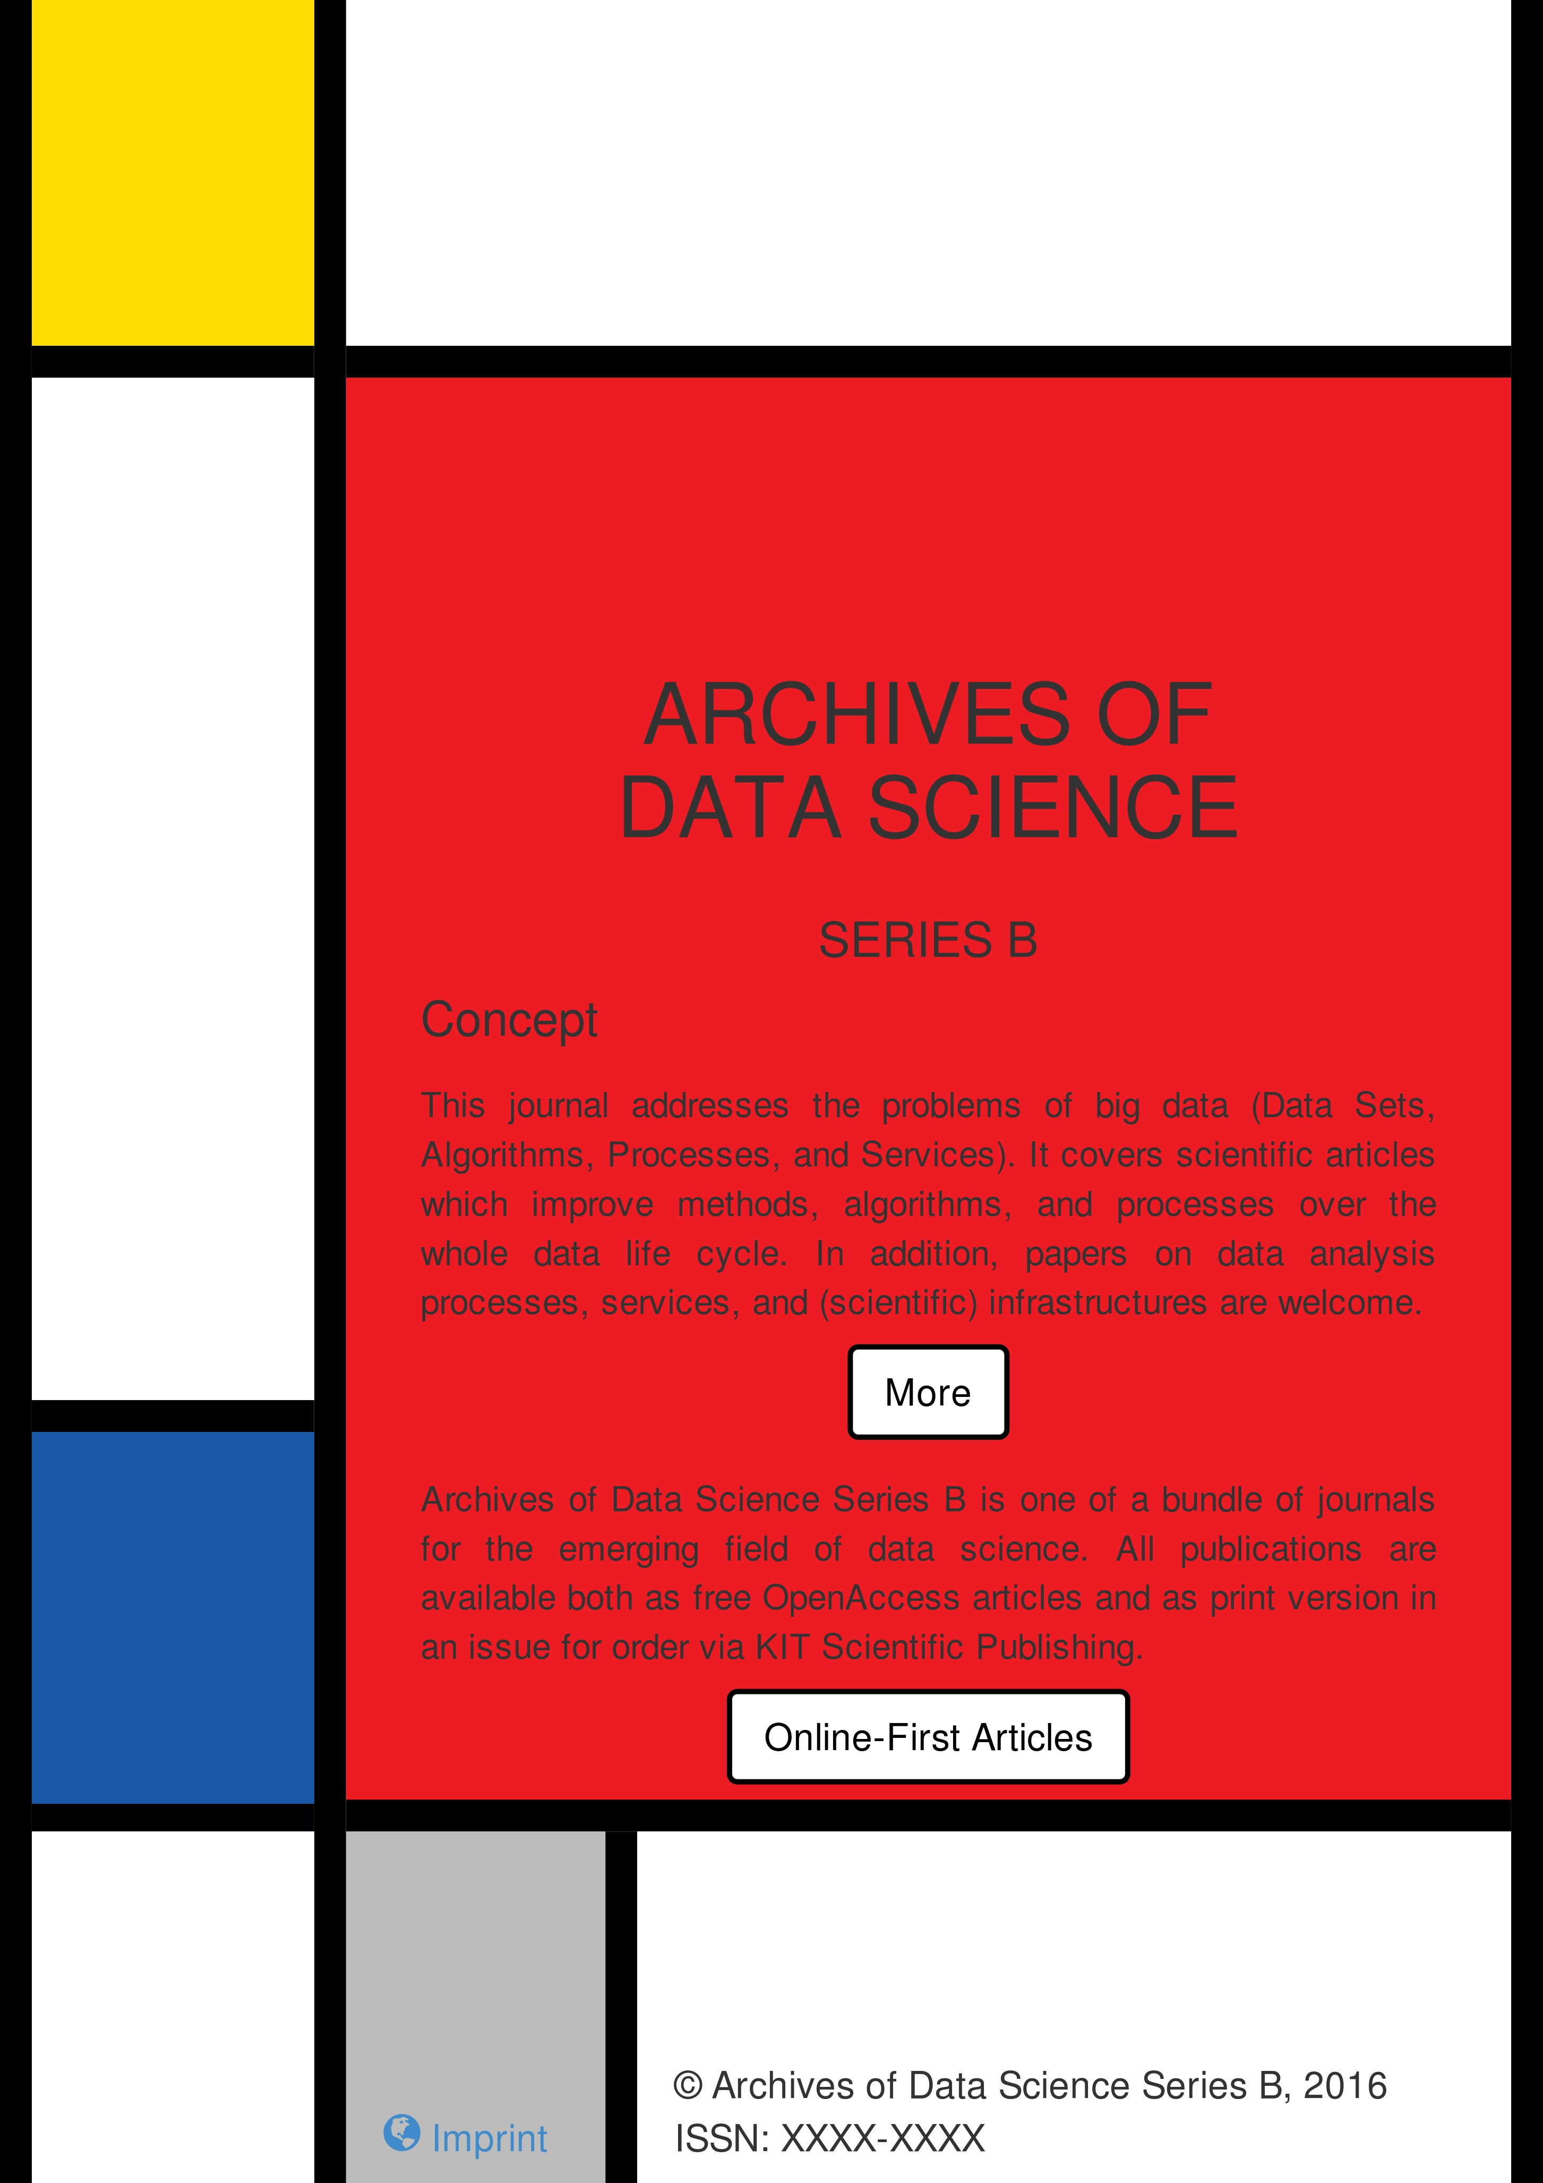
CESS2016. Conference of European Statistics Stakeholders 20.10.-21.10.2016, Budapest. Logo inspired by Piet Mondrian: Composition with Red, Yellow, Blue and Black, 1921, Gemeentemuseum Den Haag

Slide 3
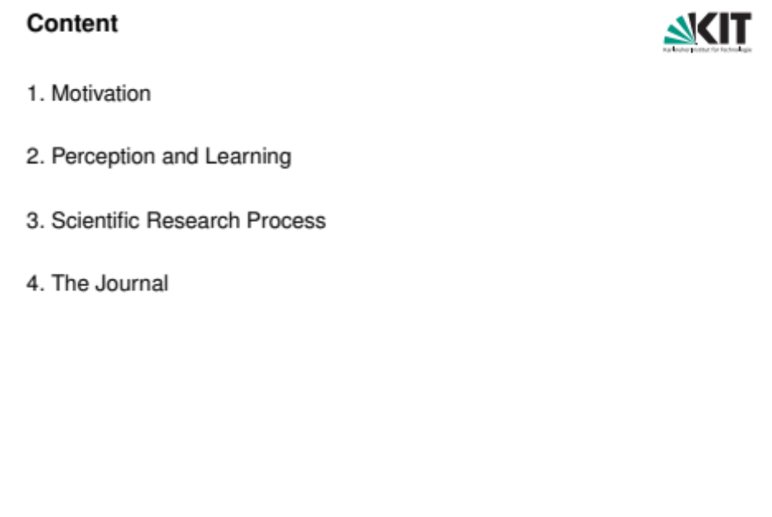

Content
Motivation
Perception and Learning
Scientific Research Process
The Journal

Slide 4

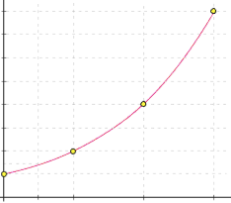


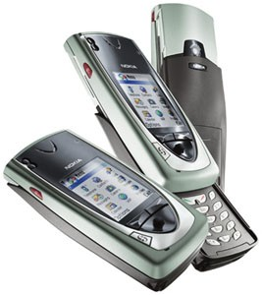

Technology Trends
Mobile/Wearable Computing
Clothes
Implants
Glasses/Watch
Internet
Embedded Systems
Intelligent
Houses/Cities
Cars
Infrastructures
Logistic
Libraries
Industry 4.0
Sensor Systems
Mobile Phones Voice over IP

Slide 5
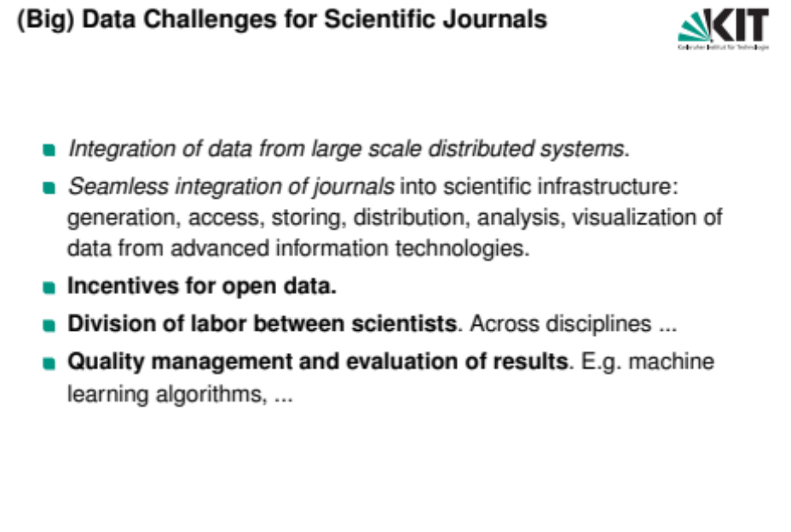
(Big) Data Challenges for Scientific Journals
Integration of data from large scale distributed systems.
Seamless integration of journals into scientific infrastructure: generation, access, storing, distribution, analysis, visualization of data from advanced information technologies.
Incentives for open data.
Division of labor between scientists. Across disciplines ...
Quality management and evaluation of results. E.g. machine learning algorithms, ...

Slide 6
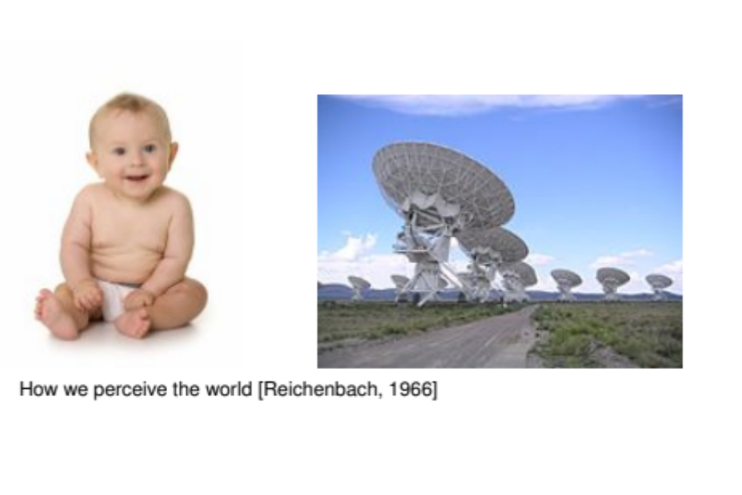


How we perceive the world [Reichenbach, 1966]

Slide 7




The Scientific Research Process
Human Learning Process
Perception Process
Learning Process
World
Data Set
World
Measurement Process
Scientific Research Process
Data Analysis Process

Slide 8
Marketing Research
Formulate problem
Determine research design
Design data collection methods and forms
Design sample,
collect data
Analyze and interpret data
Prepare
Research
report
Data Set
Marketing Research Process
e-resources, planning of schedule, recording, communcication, coordination, partner/problem
Scale inventory integrated
with literature, pro/con, mind map
access
Text elements, standard reports, graphics, literature, structure,
layout
Form generator
Addresses, e-panels, mass e-mail, reminder monitoring
Statistic scripts, reports, links to
guidelines
IT-Service Process
Measurement Process
Data Analysis
Interview training
Reuse of existing designs
How to use and setup
Incentives, checks for representativity
Rules for interpretation
Guidelines for writing
Organisational Learning
Expert advice for scale selection
Marketing scale development
Design of user interfaces and adaptive
interaction
Development of innovative sampling strategies
Design of methods of summarizing and interpreting results
Development of automatic meta data annotation

Slide 9
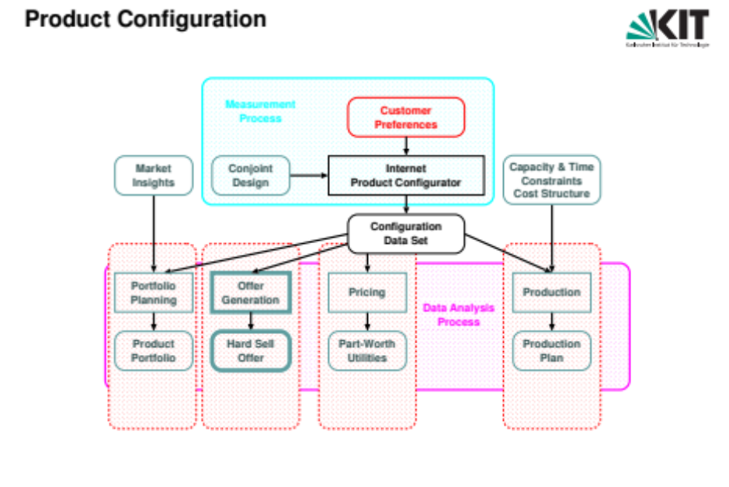






Product Configuration
Measurement Process
Customer Preferences
Market Insights
Conjoint Design
Internet Product Configurator
Capacity & Time Constraints Cost Structure
Configuration Data Set
Portfolio Planning
Offer Generation
Pricing
Production
Data Analysis Process
Product Portfolio
Hard Sell Offer
Part-Worth Utilities
Production Plan

Slide 10
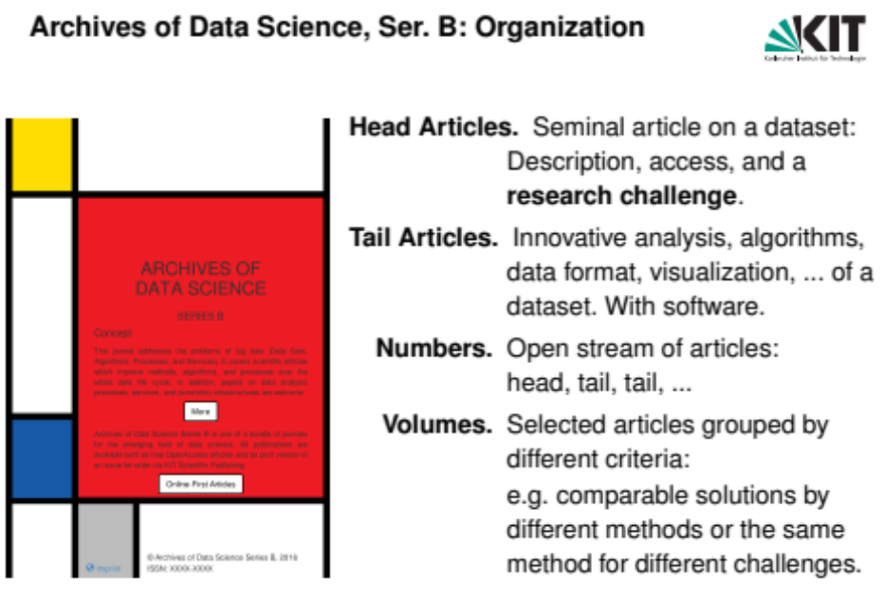
Archives of Data Science, Ser. B: Organization
Head Articles. Seminal article on a dataset:
Description, access, and a
research challenge.
Tail Articles. Innovative analysis, algorithms,
data format, visualization, ... of a dataset. With software.
Numbers. Open stream of articles:
head, tail, tail, ...
Volumes. Selected articles grouped by different criteria:
e.g. comparable solutions by different methods or the same method for different challenges.

Slide 11
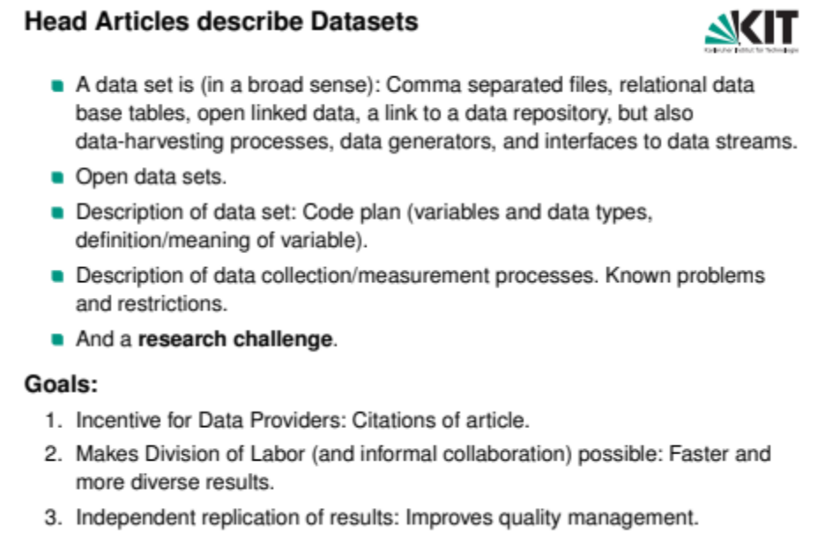
Head Articles describe Datasets
A data set is (in a broad sense): Comma separated files, relational data base tables, open linked data, a link to a data repository, but also
data-harvesting processes, data generators, and interfaces to data streams.
Open data sets.
Description of data set: Code plan (variables and data types, definition/meaning of variable).
Description of data collection/measurement processes. Known problems and restrictions.
And a research challenge.
Goals:
Incentive for Data Providers: Citations of article.
Makes Division of Labor (and informal collaboration) possible: Faster and more diverse results.
Independent replication of results: Improves quality management.

Slide 12
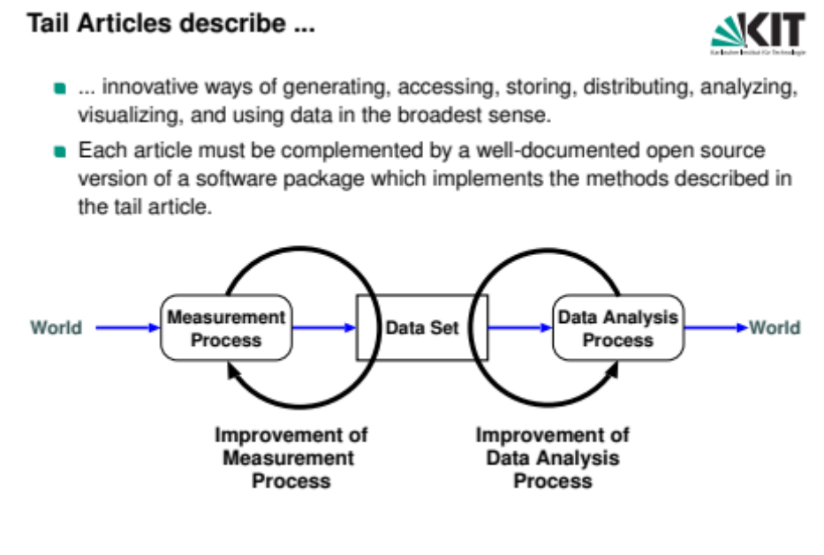
Tail Articles describe ...
... innovative ways of generating, accessing, storing, distributing, analyzing, visualizing, and using data in the broadest sense.
Each article must be complemented by a well-documented open source version of a software package which implements the methods described in the tail article.
Measurement Process
Data Analysis Process
World
Data Set
World
Improvement of Measurement Process
Improvement of Data Analysis Process

Slide 13
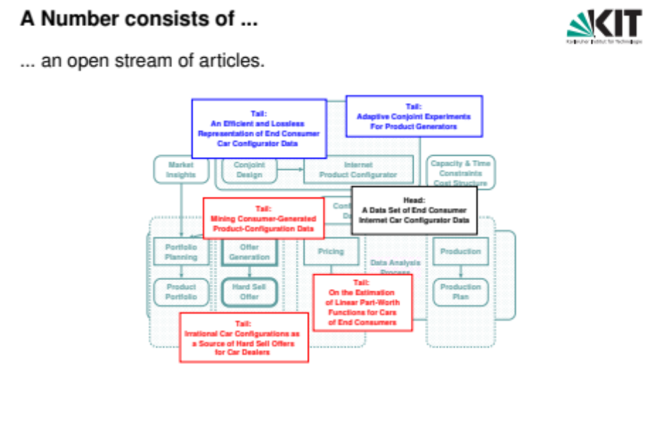




A Number consists of ...
... an open stream of articles.
Measurement
Customer
Process Preferences
Tail:
Adaptive Conjoint Experiments For Product Generators
Tail:
An Efficient and Lossless Representation of End Consumer Car Configurator Data
Market Insights
Conjoint Design
Internet Product Configurator
Capacity & Time Constraints Cost Structure
nfiguration ata Set
Head:
A Data Set of End Consumer Internet Car Configurator Data
Tail:
Mining Consumer-Generated Product-Configuration Data
Co D
Portfolio Planning
Offer Generation
Pricing
Production
Data Analysis
Process
Part-Worth Utilities
Product Portfolio
Hard Sell Offer
Tail:
On the Estimation of Linear Part-Worth Functions for Cars of End Consumers
Production Plan
Tail:
Irrational Car Configurations as a Source of Hard Sell Offers
for Car Dealers

Slide 14
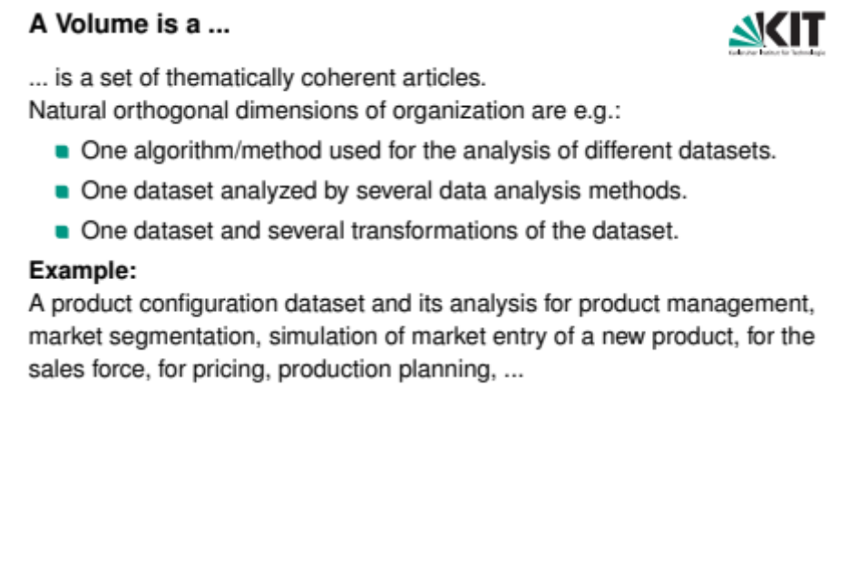
A Volume is a ...
... is a set of thematically coherent articles.
Natural orthogonal dimensions of organization are e.g.:
One algorithm/method used for the analysis of different datasets. One dataset analyzed by several data analysis methods.
One dataset and several transformations of the dataset.
Example:
A product configuration dataset and its analysis for product management, market segmentation, simulation of market entry of a new product, for the sales force, for pricing, production planning, ...

Slide 15
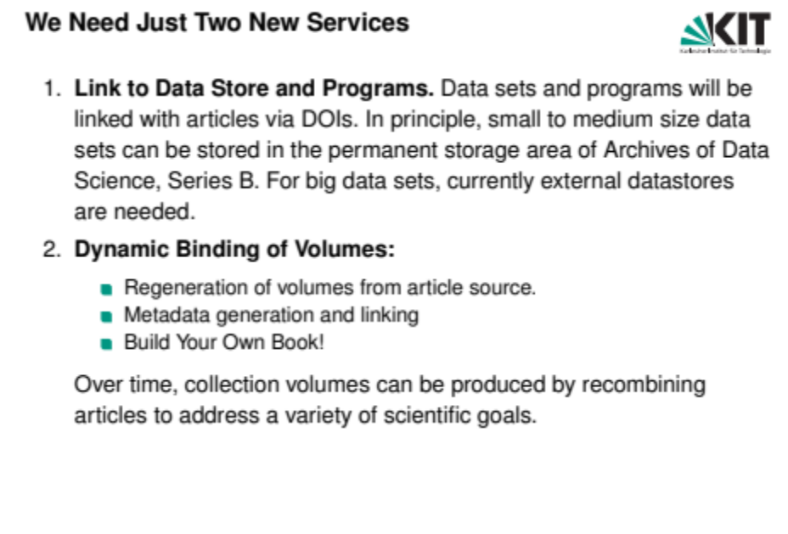
We Need Just Two New Services
Link to Data Store and Programs. Data sets and programs will be linked with articles via DOIs. In principle, small to medium size data sets can be stored in the permanent storage area of Archives of Data Science, Series B. For big data sets, currently external datastores are needed.
Dynamic Binding of Volumes:
Regeneration of volumes from article source. Metadata generation and linking
Build Your Own Book!
Over time, collection volumes can be produced by recombining articles to address a variety of scientific goals.

Slide 16
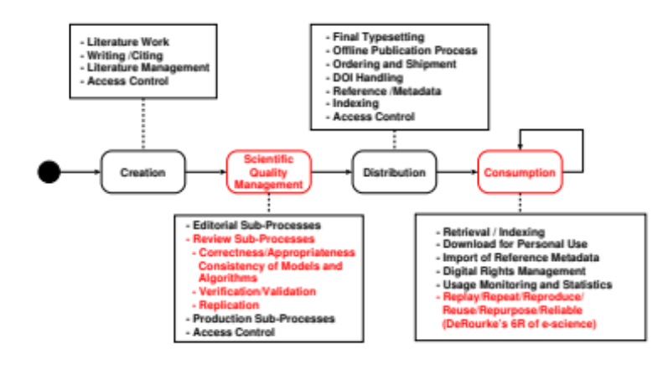
Quality Management
Literature Work
Writing /Citing
Literature Management
Access Control
Final Typesetting
Offline Publication Process
Ordering and Shipment
DOI Handling
Reference /Metadata
Indexing
Access Control
Scientific Quality Management
Creation
Distribution
Consumption
Editorial Sub-Processes
Review Sub-Processes
  Correctness/Appropriateness Consistency of Models and Algorithms
  Verification/Validation
  Replication
Production Sub-Processes
Access Control
Retrieval / Indexing
Download for Personal Use
Import of Reference Metadata
Digital Rights Management
Usage Monitoring and Statistics
Replay/Repeat/Reproduce/ Reuse/Repurpose/Reliable (DeRourke’s 6R of e-science)
Improved Quality Management: Open datasets combined with source code of analysis methods allow faster and better quality control as well as replication of results by reviewers and consumers.

Slide 17
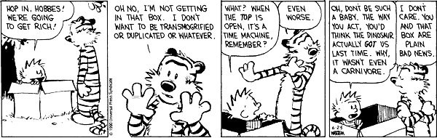
... Wish I Had a Time Machine!
Coming soon: http://www.archivesofdatascience.org/
Incentives to Publish Datasets Division of Labor
Two Feedback Cycles: Measurement and Analysis
Quality Management

Slide 18

References I
Reichenbach, H. (1966).
Experience and prediction : an analysis of the foundations and the structure of knowledge.
University of Chicago Press, Chicago, 6.impr. edition.

