Slide 1
Reproducibility, open data and evidence synthesis in clinical research
CESS 2016, Budapest
Tim Friede
Department of Medical Statistics
University Medical Center Göttingen

Slide 2
Background: Evidence-based medicine
The ultimate aim is to improve patient care
  by basing decision-making in clinical practice and in health care provision in general on sound, reliable evidence
  gained through well designed, conducted and analysed research studies
Quantitative empirical sciences among the pillars of modern medicine and biomedical research in particular
Hierarchy of evidence …

Slide 3
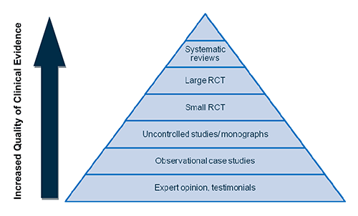
Hierarchy of evidence
From https://www.tga.gov.au/book/scientific-indications-what-evidence-do-you-need-support-your-scientific-indication

Slide 4
Systematic Reviews and Meta-analyses
The evidence on a particular research question available at a certain timepoint is summarized in so-called systematic reviews which can include meta-analyses formally integrating data from various studies on a particular research topic.
Steps involved in a systematic review
  (Electronic) searches of data bases (literature, clinical trial registries)
  Assessment of study quality
  Data extraction
  Meta-analysis, if applicable

Slide 5
To include or not to include?
Included studies
PICOS (Population, Intervention,
Control, Outcome, Study
design)
Quality assessment
(e.g. Cochrane risk
of bias tool)
Context (e.g. market
authorization, reimbursement)

Slide 6
Size of database vs. study quality
Size of database
Study quality

Slide 7
Size of database vs. study quality
No studies, but
those are of very
high quality …
Size of database
Study quality

Slide 8
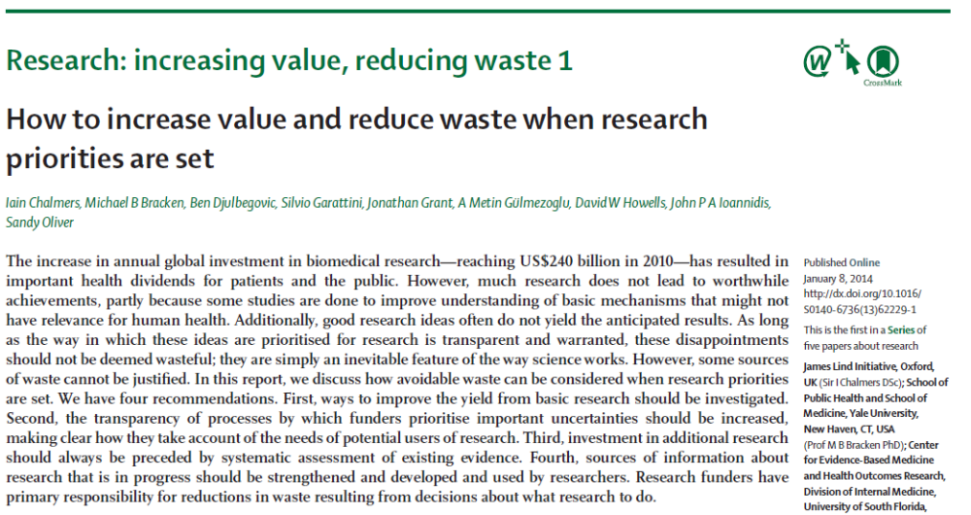
Reduce waste, increase value
Crisis in medical research (including basic sciences as well as clinical research): research perceived as wasteful (or at least inefficient) and results often not reproducible
Series of articles in The Lancet

Slide 9
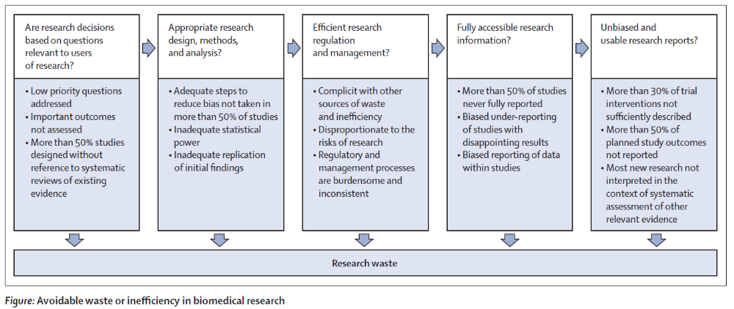
Reduce waste, increase value
Recommendations by Macleod et al (2014) Lancet to avoid waste in biomedical research:

Slide 10
Reduce waste, increase value
Recommendations by Macleod et al (2014) Lancet to avoid waste in biomedical research:

Slide 11
Reduce waste, increase value
Recommendations by Macleod et al (2014) Lancet to avoid waste in biomedical research:

Slide 12
Reproducibility
A number of approaches have been suggested to make research more reproducible including
  publication of data
  in the context of publishing in biostatistics: a number of journals have implemented reproducible research policies which include the publication of software code and data (see e.g. Hothorn et al (2009) Biom J)

Slide 13
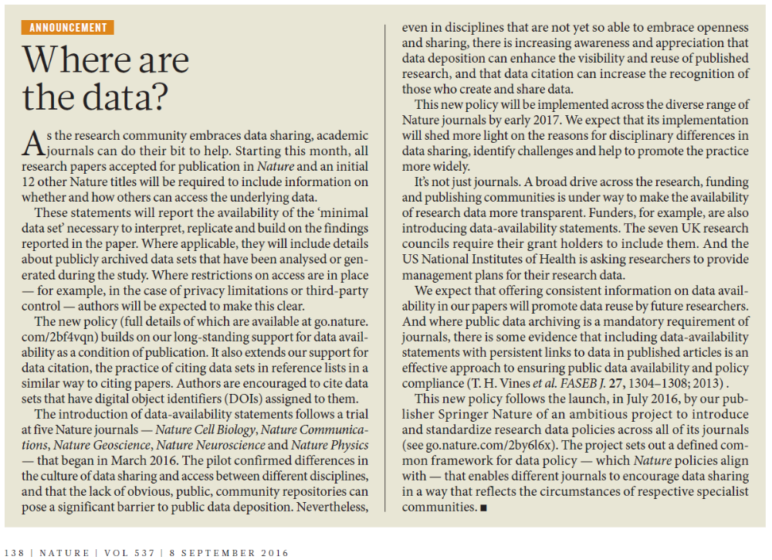
Open data: Recent example from nature

Slide 14
Open data and clinical trials
In the context of clinical trials (in particular those conducted by the pharmaceutical industry) the pressures have significantly increased over the past years to provide access to trial data which led to the establishment of data repositories (see e.g. Sudlow et al, 2016).
Examples for repositories
  clinicalstudydatarequest.com (CSDR.com)
  Yale University Open Data Access (YODA)

Slide 15
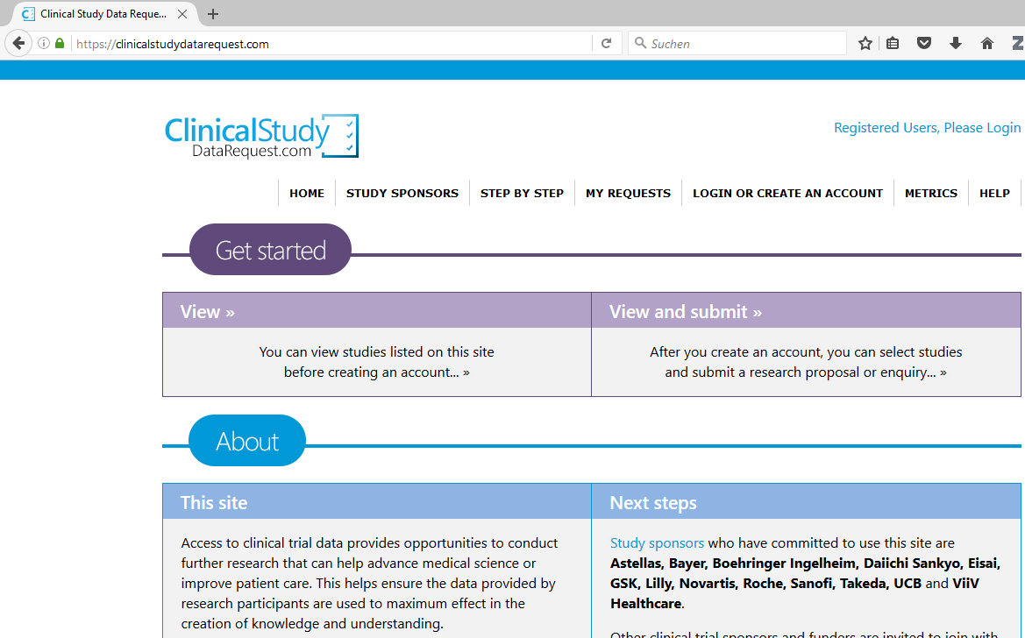
Example: Requesting Open data

Slide 16
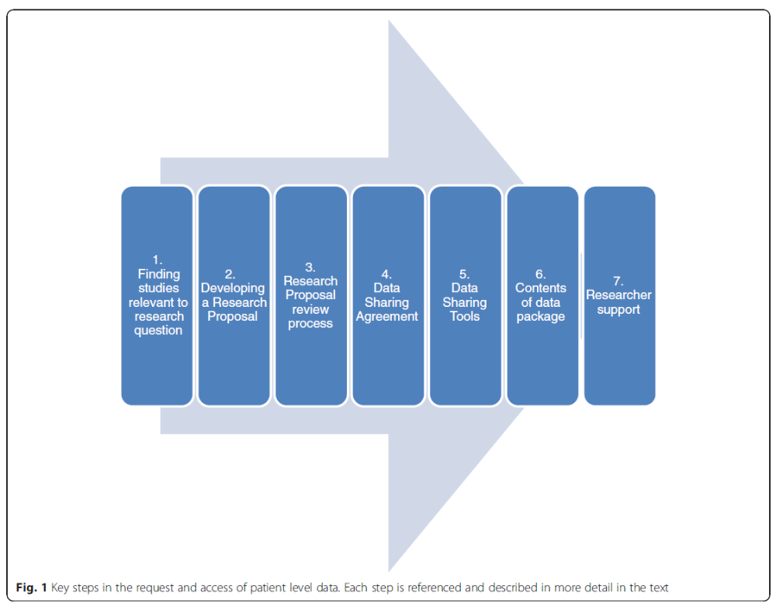
Key steps in requesting
and accessing clinical trial data
Figure from Sudlow et al (2016) BMC Med Res Meth

Slide 17
Evidence synthesis
Combined analysis of data from more than one study
  Meta-analysis: combining data from studies with similar design (e.g. randomized controlled trials)
  Generalized evidence synthesis (or cross-design synthesis): combining data from studies with different designs
Types of data
  Aggregated on study level (e.g. effect estimates with standard errors)
  Individual patient data (open data policies help here!)
  Advantages of individual patient data

Slide 18
Rare diseases and Evidence synthesis
Definitions of rare diseases (or orphan diseases)
  no universal definition of rare diseases
  in European Union: a disease affecting 5 in 10 000 people
  in USA: a condition affecting fewer than 200 000 people
Clinical research in rare diseases difficult
Evidence often scarce
  few small studies with varying designs
Evidence synthesis of particular interest (Friede et al, 2016)
  e.g. use of external controls, cross-design synthesis

Slide 19
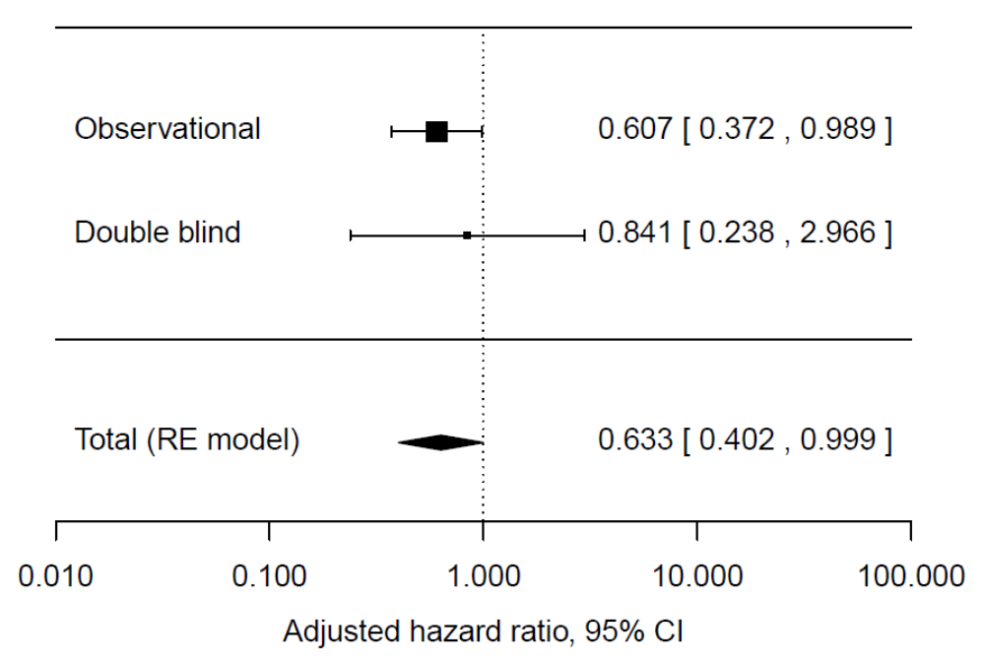
Rare diseases and Evidence synthesis
Example: Doxycycline in early Creutzfeldt–Jakob disease (CJD) (Varges et al (2016) JNNP, in press)
n=88
n=12

Slide 20
Electronic health records
Routinely collected data more readily available for research purposes, for instance in the form of electronic health records
Great value in particular in rare diseases (Chataway and Friede, 2016)
Developments have the potential of making research more efficient by potentially
  facilitating better planning of future studies
  reducing the number and size of clinical trials

Slide 21
Ethical considerations
Key concepts in clinical trials
  data protection: protecting the privacy of individuals
  informed consent: patients given appropriate information to make a decision on participation in clinical study
Open data: sharing and reusing data carries some risks for these key concepts in enabling clinical research
Biomaterials: in combination with clinical data
Necessary to develop and implement new concepts to protect the interests of patients (see e.g. Wegscheider and Friede (2016) for a discussion).

Slide 22
Conclusions
The advance in data capturing and storage combined with increasing analytical ability carries some promise to make clinical science more efficient and to strengthen the evidence base.
At the same time these developments require a new form a governance in terms of use and access of data to protect patients’ interests.

Slide 23
Some References
J. Chataway and T. Friede, The N-MOmentum trial: building momentum to advance trial methodology in a rare disease, Multiple Sclerosis Journal 22 (2016), 852–853.
T. Friede, C. Röver, S. Wandel and B. Neuenschwander, Meta-analysis of few small studies in orphan diseases, Research Synthesis Methods (2016), in press.
T. Hothorn, L. Held and T. Friede, Biometrical Journal and reproducible research. Biometrical Journal 51 (2009), 553–555.
R. Sudlow, J. Branson, T. Friede, D. Morgan and C. Whateley Smith, EFSPI/PSI Working Group on Data Sharing: Accessing and Working with Pharmaceutical Clinical Trial Patient Level Datasets – a Primer for Academic Researchers, BMC Medical Research Methodology (2016), in press.
K. Wegscheider and T. Friede, Do we consent to rules of consent and confidentiality?, Biometrical Journal (2016), submitted.

