Slide 1

Anonymity and risk of re-identification
of health data
Conference of European Statistics Stakeholders – session D5
Budapest, October 20th, 2016
Dominique Blum, MD
Secure data access centre (CASD)

Slide 2
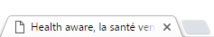
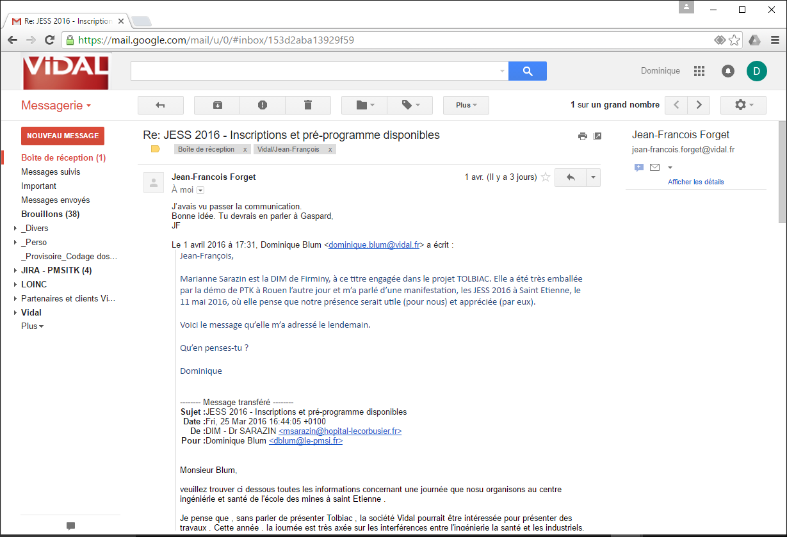

aware
HEALTH
2 stays
7 days 10 days
20 days
April
Hôpital Louis Pasteur
69700
47 years
male
Number of hospitalizations of your employee in 2015
Length of stay for each of them
Delay between his 2 stays
Month of hospital discharge for the first stay
Hospital name of the first stay
Postal code of your employee
Age of your employee
Gender of your employee
  HEALTH has retrieved his two medical records in 0.00381 seconds
      Click here to obtain his diagnoses
Instant retrieval of any medical record
among the 18 millions records of the 2015 national database
CAUTION !
As this website allows you to retrieve the medical records of a given employee despite the lack of any nominative identifier in the database, please be as accurate as possible when filling the fields.
choose in the list
choose in the list
Centre hospitalier de Poissy
Clinique Bonne Espérance
Hôpital Georges Pompidou
Hôpital Jean Minjoz
Hôpital Louis Pasteur
Hôpital Saint Jacques
Hôpital Saint Louis
Hospices civils de Lyon
La Pitié Salpétrière
Les Quinze Vingts
…
Source of data: the French national anonymous database for the payment of hospitals and clinics.
aware

Slide 3

aware
HEALTH
Instant retrieval of any medical record
among the 18 millions records of the 2015 national database
At first, please choose your payment method
or click here for a free trial
(2 remaining free trials)

Slide 4
aware
HEALTH
Instant retrieval of any medical record
among the 18 millions records of the 2015 national database
First medical record April 25, 2015
Principal diagnosis Drunk on the highway
Other diagnoses
Addiction to alcohol
Hepatitis
Second record May 15, 2015
Principal diagnosis Depression
Other diagnoses
Chronic hepatitis
Addiction to alcohol

Slide 5
This website is entirely fictitious,
and its existence would be forbidden
(in France…)
But building such a website using the French centralized "PMSI" program
is technically very easy

Slide 6
PMSI : the declarative part of the
French payment system of hospitalizations
Mandatory system
  inspired by the U.S. "DRG system" (Diagnoses Related Groups)
Concerns all the French hospitalization structures
  public (i.e. hospitals) : about 1 300
  private (i.e. clinics) : about 950
Applies to all the hospitalization stays
  about 18 millions stays by year
Includes, for each stay
  individual qualifiers, medical data and extra costs data
Source of data : the French
DRG-like system
Notes:
When anonymizing a set of individual data, if you want it to keep a maximum of interest for research purposes, you need two things :
keeping their original granularity (saying : the individual granularity)
being as much conservative as possible with their quasi-identifiers, in order to allow analysis (by gender, by age, by date of events, etc.)
Consequently, the risk for a given individual to be retrieved in the dataset by anyone who knows only a few quasi-identifiers which belong to him can be very high.

Slide 7
More details about the elementary data record
  Individual qualifiers
    aim: to allow cluster analysis and care pathways analysis
    include: age, gender, residence area, period of stay, length of stay, mode of discharge, "hashed" anonymized chaining identifier
  Medical data
    aim: determining what is the "medical group" which matches this stay, and its corresponding "standard price" (among ~ 2 800 "medical groups")
    include: the main and secondary diagnosis, surgical procedures, non surgical procedures
  Extra costs data
    aim: taking in account the costs not included in the "standard prices"
    include: expensive and not standard drugs, expensive and non standard exams
Source of data : the French
DRG-like system

Slide 8
Are the centralized data anonymized ?
Yes, of course !
When received by the French government agency
no name, no first name, no surname, no marital name
  only a "hashed" anonymized chaining identifier
no social security number, no national nor local ID number
no record number
no birth date
  only the age (in years) at the arrival
no postal address
  only the residence area code : an area containing at least 1 000 individuals
no date of arrival at the hospital nor date of discharge
  only the month of the ending date of the stay
  and the length of stay
plus the hospital or clinic identification
plus the elapsed time between successive stays (if applies)
To be or not to be anonymized, that’s the question

Slide 9
With such a combination for any given stay…
    ID of the hospital or the clinic
    month of the ending date of the stay
    length of stay
    mode of discharge (including death)
    age of the inpatient
    gender of the inpatient
    residence area code
    anonymized chaining and elapsed time between stays
  89% of the stays have a unique combination
100% when the inpatient has more than one stay
Even blurred, the individual qualifiers remain too discriminant

Slide 10
More blurring, less usability for researchers
Reducing accuracy of data by blurring or transforming them
  age ► ranges of age
  length of stay ► ranges of length
  residence area code ►indicator of the recruitment area
  month of the ending date of stay ► suppressed
  mode of discharge ► transforming the death mode into a neutral value
  etc.
in order to obtain only combinations of at least N people with at least n distinct pathologies (in other words : k-anonymity = N and l-diversity = n)
  the result can be a non re-identifying database, perhaps usable even as open data
  which can serves many uses : national and international benchmarking, regional comparisons, some research works, etc.
  but not usable for the payment system
  and not usable for "sharp" research works
The more you blur the data, the more you forbid their use for research.
Notes:
When anonymizing a set of individual data, if you want it to keep a maximum of interest for research purposes, you need two things :
keeping their original granularity (saying : the individual granularity)
being as much conservative as possible regarding their quasi-identifiers, in order to allow analysis (by gender, by age, by date of events, etc.)
Consequently, the risk for a given individual to be retrieved in the dataset by anyone who knows only a few quasi-identifiers about him can be very high.

Slide 11
Thank you for your attention!

