Slide 1

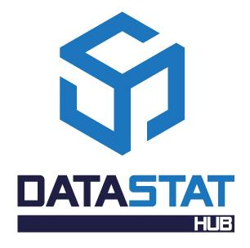

A tool for the automatic collection of administrative data to produce official statistics
Alessandro Capezzuoli, Emanuela Recchini
Conference of European Statistics Stakeholders
Budapest, 20-21 October 2016

Slide 2

1
Official statistics and data integration
2
Technology
3
Model
4
Architecture
5
Concluding remarks
DataSTAT Hub: a tool for the automatic collection of administrative data to produce official statistics
Alessandro Capezzuoli, Emanuela Recchini – Conference of European Statistics Stakeholders, Budapest, 20-21 October 2016

Slide 3


1. Official statistics and data integration
There is worldwide recognition of the increasing role played by administrative data in the production of more timely, more disaggregated statistics at higher frequencies than traditional survey data.
Introductory remarks (1)
The efficient use of all available information to produce timely, accurate and high quality statistics is a challenge for National Statistical Offices (NSOs), which are even more committed to developing methods and suitable tools for the production, collection, standardization and integration of different types of statistical data.
Bringing together information from different sources makes it possible to fill information gaps or provide insights which cannot be gleaned from unlinked data and to improve the knowledge and understanding of specific phenomena.
DataSTAT Hub: a tool for the automatic collection of administrative data to produce official statistics
Alessandro Capezzuoli, Emanuela Recchini – Conference of European Statistics Stakeholders, Budapest, 20-21 October 2016
1

Slide 4
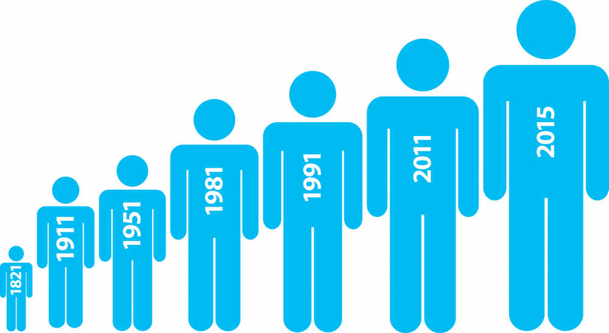
1. Official statistics and data integration
Introductory remarks (2)
Nowadays, the exploitation of administrative data for statistical purposes is a normal practice for a large number of NSOs. This improves the quality of statistical outputs, reduces the statistical burden on respondents and minimizes costs.
The Italian National Institute of Statistics (Istat) collects and manages a large amounts of administrative data from different sources, among which:
Italian Agency of Revenue
Bank of Italy
Ministries
Social Security Institutions
Government Institutions
Private Institutions
…
From 2009 to 2015, administrative data supplied to Istat have trebled
DataSTAT Hub: a tool for the automatic collection of administrative data to produce official statistics
Alessandro Capezzuoli, Emanuela Recchini – Conference of European Statistics Stakeholders, Budapest, 20-21 October 2016
2

Slide 5

1. Official statistics and data integration
The Italian legislation on data collection
According to the provisions of the Italian Digital Administration Code:
before proceeding to the collection of new data, public administrations are required to verify whether the information they need can be acquired through access to information already in the possession of other public authorities or public bodies.
the technical options for the usability of data are:
web access through the website of the supplier institution or an ad hoc thematic website
Interoperability among public administrations for data collection and data integration
the user can process data collected exclusively for the pursuit of its institutional goals; data transfer from one information system to another does not change data ownership
the transfer of a data from an information system to another does not change the ownership of the given
(Guidelines for the drafting of conventions on the usability Public Administrations data; Legislative Decree n. 82/2005, commonly referred to as the “Digital Administration Code”, modified by the Legislative Decree n. 235/2010)
DataSTAT Hub: a tool for the automatic collection of administrative data to produce official statistics
Alessandro Capezzuoli, Emanuela Recchini – Conference of European Statistics Stakeholders, Budapest, 20-21 October 2016
3

Slide 6
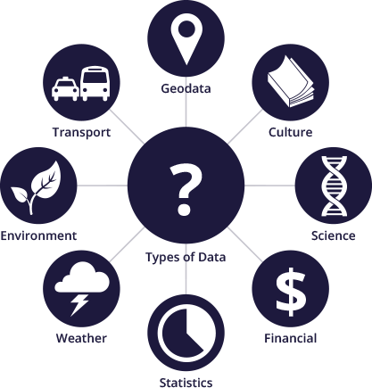

1. Official statistics and data integration
Administrative data collected by Istat
Data collected
by Istat are very different from each other in type, content and structure
DataSTAT Hub: a tool for the automatic collection of administrative data to produce official statistics
Alessandro Capezzuoli, Emanuela Recchini – Conference of European Statistics Stakeholders, Budapest, 20-21 October 2016
4

Slide 7

1. Official statistics and data integration
Data collection process (1)
DATA COLLECTOR
- manages data requests
- defines methods and standards
- manages reminders
- stores data and metadata
- standardizes and disseminates data
      DATA SUPPLIER
      - receives data requests
      - elaborates data requests
      - prepares data to be sent
      - sends data to data collector
DataSTAT Hub: a tool for the automatic collection of administrative data to produce official statistics
Alessandro Capezzuoli, Emanuela Recchini – Conference of European Statistics Stakeholders, Budapest, 20-21 October 2016
5

Slide 8

1. Official statistics and data integration
Data collection process (2)
Management of data requests and reminders
Complex IT infrastructure
Burden for data suppliers
Human resources for transactions management
Data collection through File Transfer Protocol (FTP)
Data uploading through an ad hoc website to manage reminders and data supply requests
THESE SOLUTIONS DO NOT PERMIT PROCESS AUTOMATION
DataSTAT Hub: a tool for the automatic collection of administrative data to produce official statistics
Alessandro Capezzuoli, Emanuela Recchini – Conference of European Statistics Stakeholders, Budapest, 20-21 October 2016
6

Slide 9
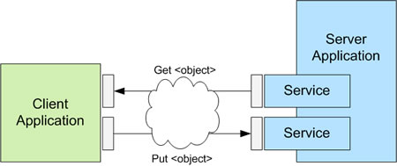
2. Tecnology
…the World Wide Web offers a possible solution!
HTTP (Hypertext Transfer Protocol), the set of rules for transferring files on the Web, can be conveniently used for data collection and data exchange.
It is a request/response protocol based on the client-server architecture.
Representational State Transfer (REST)
is not a standard, is just an architecture style for designing networked applications
defines a set of guidelines to use the HTTP protocol in order to perform 4 operations summarized in the acronym CRUD (Create, Read, Update, Delete), by means of an API (Application Programming Interface).
DataSTAT Hub: a tool for the automatic collection of administrative data to produce official statistics
Alessandro Capezzuoli, Emanuela Recchini – Conference of European Statistics Stakeholders, Budapest, 20-21 October 2016
7

Slide 10
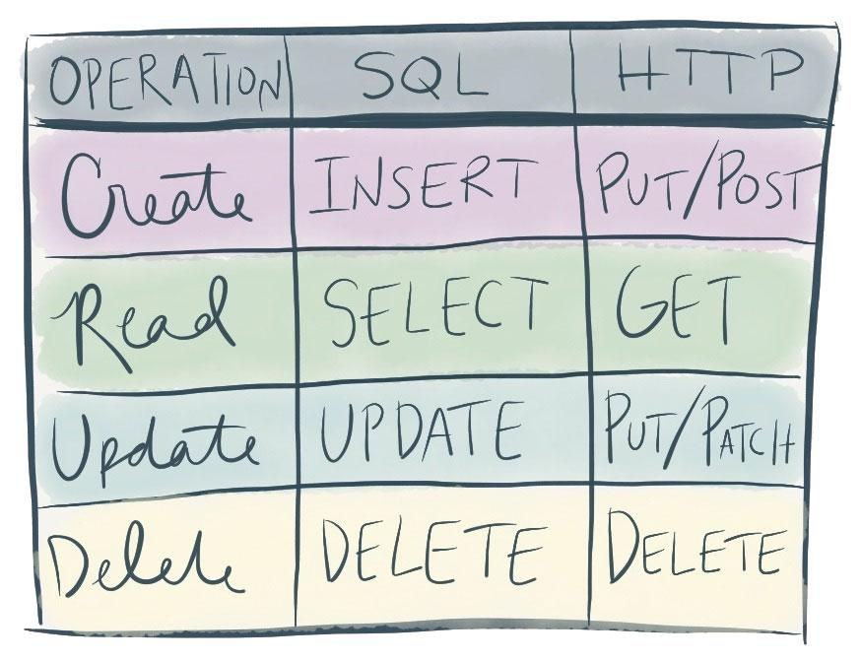
2. Tecnology
CRUD principles
REST is a service concept that may be summarized by the CRUD principles
REST allows data suppliers to create, read and update resources with a logic similar to that used to perform operations on any SQL database.
DataSTAT Hub: a tool for the automatic collection of administrative data to produce official statistics
Alessandro Capezzuoli, Emanuela Recchini – Conference of European Statistics Stakeholders, Budapest, 20-21 October 2016
8

Slide 11
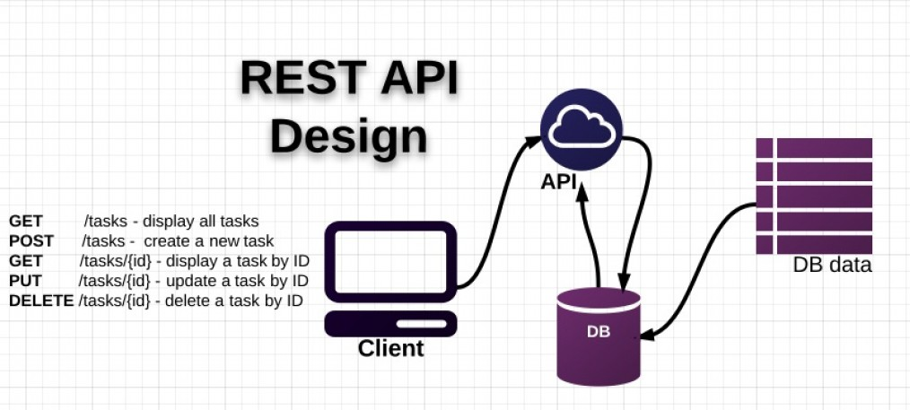
2. Tecnology
REST architecture enables users to separate relational DB from the client through an API, which exploits HTTP to transmit data and exchange information.
DataSTAT Hub: a tool for the automatic collection of administrative data to produce official statistics
Alessandro Capezzuoli, Emanuela Recchini – Conference of European Statistics Stakeholders, Budapest, 20-21 October 2016
9

Slide 12





3. Model
The different types of data, IT tools and skills of data suppliers require a model implying:
UNSTRUCTURED DATA - a model collecting data in their essence (key/value) is more convenient and immediate than defining multiple standards for data representation;
SCALABILITY - a highly extensible architecture is needed, in case of possible conceptual/architectural future upgrade;
INTUITIVE SCHEMA - the model should be easily applied by data suppliers, without resorting to complex studies of any imposed standard;
BIG-DATA-ORIENTED ARCHITECTURE - the system should be in line with big-data processing techniques;
INTEGRATION WITH MODERN IT TOOLS FOR BIG DATA - storage is closely linked to the tools used for semantic search, data analysis and data visualization. Elasticsearch, Hadhoop, Solr, Cassandra provide a complete integrated environment for managing them.
DataSTAT Hub: a tool for the automatic collection of administrative data to produce official statistics
Alessandro Capezzuoli, Emanuela Recchini – Conference of European Statistics Stakeholders, Budapest, 20-21 October 2016
10

Slide 13


3. Model
KEY/VALUE storage model
The format that is better suited for HTTP use is JSON (JavaScript Object Notation) to which different models for data representation can be associated. In particular, dealing with highly heterogeneous data, it is recommended to use a model to represent them in their simplest form: a key/value pair.
{
"keyspace" :
{
"columnfamily" :
{
"rowkey" :
{
"supercolumn" :
{
"column name" : "column value"
}
}
}
}
}
Statistical Key Value
Data Model
DataSTAT Hub: a tool for the automatic collection of administrative data to produce official statistics
Alessandro Capezzuoli, Emanuela Recchini – Conference of European Statistics Stakeholders, Budapest, 20-21 October 2016
11

Slide 14
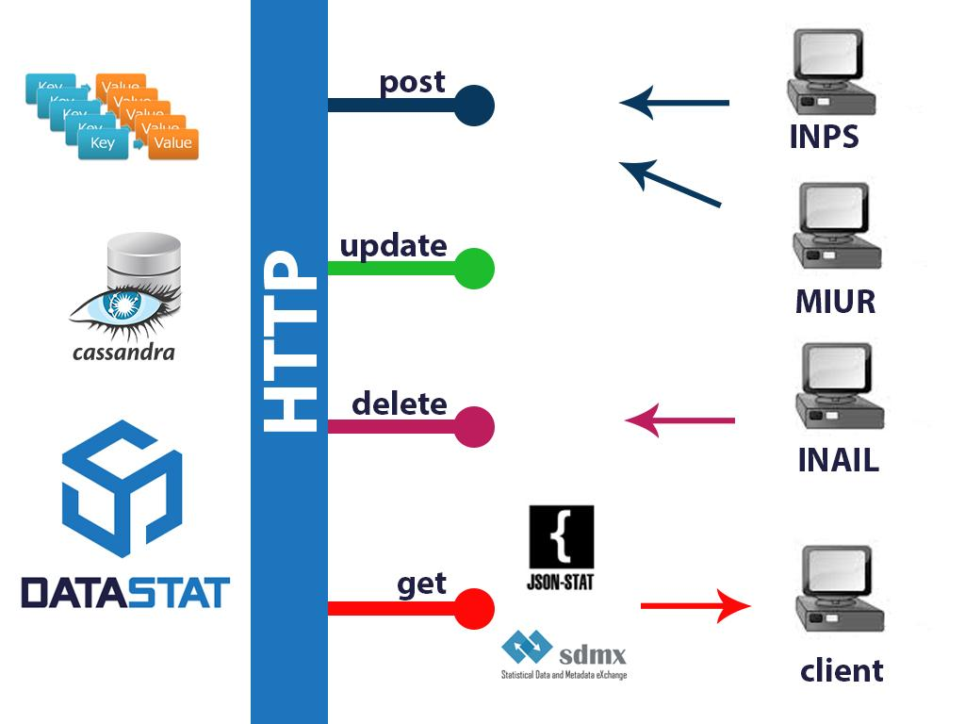
4. Architecture
DataSTAT Hub is a tool for data collection that takes advantage of the potential offered by HTTP 2.0 and REST architecture and exploits the methods offered by the CRUD architecture (Create, Read, Update, Delete).
DataSTAT Hub: a tool for the automatic collection of administrative data to produce official statistics
Alessandro Capezzuoli, Emanuela Recchini – Conference of European Statistics Stakeholders, Budapest, 20-21 October 2016
12

Slide 15
4. Architecture
Elasticsearch is an open source search engine that can be conveniently used for collection and release of data. Through Elasticsearch it is possible to index and map documents/data through querystrings to be sent via HTTP in JSON format.
Most entities or objects in most applications can be serialized into a JSON object, with keys and values. A key is the name of a field or property, and a value can be a string, a number, a Boolean, another object, an array of values, or some other specialized type such as a string representing a date or an object representing a geolocation.
DOCUMENT
INDEX / TYPE
Documents are indexed—stored and made searchable—by using the index API, which uniquely identify the document.
Mapping is the process of defining how a document, and the fields it contains, are stored and indexed.
MAPPING
DataSTAT Hub: a tool for the automatic collection of administrative data to produce official statistics
Alessandro Capezzuoli, Emanuela Recchini – Conference of European Statistics Stakeholders, Budapest, 20-21 October 2016
13

Slide 16
4. Architecture
DATA STORAGE
      Data contained in the index can be easily stored in a database that uses the Key/Value model (Eg. Cassandra)
Data suppliers can autonomously create data index, describe data content and perform any operation on them (put/update/delete/get)
DATA SUPPLIER
ELASTICSERACH
OUTPUT CHANNEL
Indexed data have an immediate dissemination channel which Elasticsearch is associated to as a powerful engine for searching among big data and, possibly, an API that standardizes the output
DataSTAT Hub: a tool for the automatic collection of administrative data to produce official statistics
Alessandro Capezzuoli, Emanuela Recchini – Conference of European Statistics Stakeholders, Budapest, 20-21 October 2016
14

Slide 17

4. Architecture
www. statisticlass.eu
      Datastat Hub applied to statistical classifications
DATA SUPPLIER
SEARCH ENGINE
REST WEBSERVICES
ELASTICSERACH
WIDGET / USERS INTERFACE
DataSTAT Hub: a tool for the automatic collection of administrative data to produce official statistics
Alessandro Capezzuoli, Emanuela Recchini – Conference of European Statistics Stakeholders, Budapest, 20-21 October 2016
15

Slide 18
5. Concluding remarks
DataSTAT Hub is a suitable and easy tool for the automated collection, standardization and integration of administrative data.
Reduction of burden on users: this hub does not require the knowledge of the internal data base since the updating is performed through the HTTP querystrings and can be used with any programming language; once created, the procedure will be used for each next data supply.
Reduction of costs in terms of employment of human resources for organizational, bureaucratic and IT management
By allowing us to overcome some critical issues related to the use of administrative data, including those connected with privacy and security, a tool such as DataSTAT Hub is time-saving and cost-effective.
It is a user-friendly tool developed by making use of open source technologies and can be conveniently shared among NSOs, while it is extensible to any other institution.
DataSTAT Hub: a tool for the automatic collection of administrative data to produce official statistics
Alessandro Capezzuoli, Emanuela Recchini – Conference of European Statistics Stakeholders, Budapest, 20-21 October 2016
16

Slide 19


THANK YOU FOR YOUR ATTENTION
FOR ANY
QUESTIONS
CONTACT US:
alessandro.capezzuoli@istat.it
emanuela.recchini@istat.it

