Slide 1
Data sharing at Deutsche Bundesbank:
The House of Microdata
Meike Becker and Anja Treffs
Deutsche Bundesbank, Statistical Information Management and Mathematical Methods

Slide 2
Why are Microdata relevant?
Deutsche Bundesbank collects a wide range of economic data which form the basis for
  monetary policy decision-making process
  macroeconomic & macroprudential analyses
So far: focus on aggregated data
But microdata are needed for:
    Taking into account the heterogeneity of the statistical units
    An accurate risk analysis (and implications for financial stability)
    Assessing the effects of regulatory measures

Slide 3

Status Quo of Microdata at Deutsche Bundesbank
Bundesbank produces a wide range of highly valuable microdata sets
Aggregated data: central information system
Microdata: silos of data collecting department
Microdata Set 1
Microdata Set 2
Microdata Set ..

Slide 4
Limitations
Data Storage
  No integrated data storage
  → No linking of data sets possible
Data Quality Assurance
  No standardized data set
  Documentation
  No general documentation available
  No routine update
  Resources
  Additional effort & expense by departments due to increase in demand of microdata
  IMIDIAS:
  Large-scale initiative aimed at making better use of existing data both, for policy analysis as well as for internal and external researchers

Slide 5

IMIDIAS: Integrated MIcroData Information and Analysis System
Competence
Research Data and Service Center (RDSC)
Governance
Infrastructure
House of Microdata (HoM)
Concept
Integrated Data Storage

Slide 6
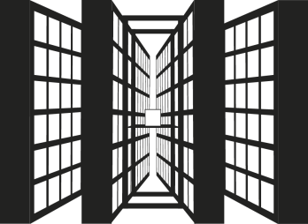
The House of Microdata (HoM)
IMIDIAS is based on an integrated microdata warehouse:
House of Microdata (HoM)
HoM is part of the existing statistical infrastructure for aggregated data at Deutsche Bundesbank

Slide 7
Data Diversity Requires Standardisation
Microdata Set 2
Microdata Set 3
Microdata Set 1
Microdata Set 4
House of Microdata

Slide 8
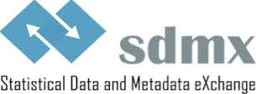
SDMX = Statistical Data and Metadata Exchange
International initiative aimed at standardising data exchange between international organisations and their member countries
Sponsor organisations:
BIS, ECB, EUROSTAT, IMF, OECD, UN and Worldbank
ISO-Standard since 2005 (17369:2005)
Used as information model for IMIDIAS
Source:sdmx.org

Slide 9
SDMX in a nutshell
Government statistics (GST)

Slide 10
SDMX in a nutshell
Frequency
Reference Area
Adjustment
Creditor sector
ESA item
Debtor sector
Valuation
describe
Government statistics (GST)

Slide 11
SDMX in a nutshell
Frequency
Reference Area
Adjustment
Creditor sector
ESA item
Debtor sector
Valuation
describe
Government statistics (GST)
leading to systematic and self-explanatory indicator keys ("core" of the SDMX)
SDMX-Key:
GST:A:AT:N:B0MFI:MAL:B1300:SA:H

Slide 12
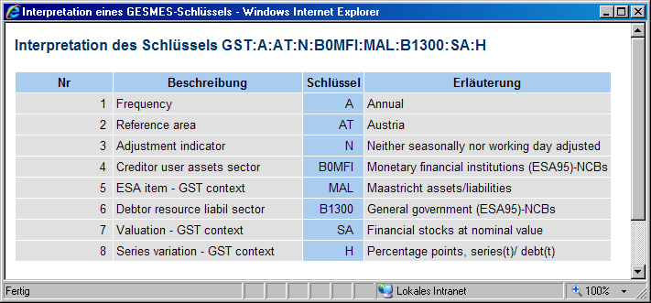
SDMX in a nutshell
Frequency
Reference Area
Adjustment
Creditor sector
ESA item
Debtor sector
Valuation
describe
Government statistics (GST)
leading to systematic and self-explanatory indicator keys ("core" of the SDMX)
Data Set Identifier
SDMX-Key:
GST:A:AT:N:B0MFI:MAL:B1300:SA:H
Interpretation:
No Description Key Explanation

Slide 13
SDMX in a nutshell
Frequency
Reference Area
Adjustment
Creditor sector
ESA item
Debtor sector
Valuation
describe
Government statistics (GST)
leading to systematic and self-explanatory indicator keys ("core" of the SDMX)
SDMX-Key:
GST:A:AT:N:B0MFI:MAL:B1300:SA:H
Interpretation:
No Description Key Explanation

Slide 14
SDMX in a nutshell
Frequency
Reference Area
Adjustment
Creditor sector
ESA item
Debtor sector
Valuation
describe
Government statistics (GST)
leading to systematic and self-explanatory indicator keys ("core" of the SDMX)
SDMX-Key:
GST:A:AT:N:B0MFI:MAL:B1300:SA:H
Interpretation:
No Description Key Explanation

Slide 15
SDMX in a nutshell
Frequency
Reference Area
Adjustment
Creditor sector
ESA item
Debtor sector
Valuation
describe
Government statistics (GST)
leading to systematic and self-explanatory indicator keys ("core" of the SDMX)
SDMX-Key:
GST:A:AT:N:B0MFI:MAL:B1300:SA:H
Interpretation:
No Description Key Explanation

Slide 16
Added value of SDMX
Harmonization & Standardisation:
  Uniform codelists & concepts form the basis for linking the different datasets
Classification System → efficient search in databases

Slide 17
The House of Microdata
Generic approach:
HoM can be used for any kind of data sets (statistical and non-statistical data, aggregated and microdata)
Multidimensional approach:
By using uniform code lists, SDMX offers an ideal means of linking and comparing data from different sources

Slide 18
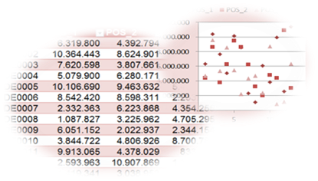
Using the Power of the SDMX Information Model
SDMX landscape
Analysis Software
Data
Interest rates
Interest rates
Securities holdings
Bank Lending Survey
              Set of rules
              to link HoM
              data sets and
              to form larger
              cubes for
              analysis
Data Integration
Securities Emissions
Master data
Banks
Profit and Loss
Banks
Securities (ISIN)
International Investment Position (securities)
Balance Sheet Items
Balance Sheet Items
Non financial institutions

Slide 19

Conclusion
IMIDIAS = Integrated MIcroData Information and Analysis System
  Initiative for bankwide data sharing
  House of Microdata (HdM)
  common platform for data sharing
  Integrated Data Storage
  SDMX as common information model
  → Standardization & harmonization
IMIDIAS enables better use of existing data both, for policy analysis as well as for internal and external researchers

Slide 20

Thank you for your attention!
Deutsche Bundesbank
Statistical Information Management and Mathematical Methods
meike.becker@bundesbank.de
anja.treffs@bundesbank.de

