Slide 1
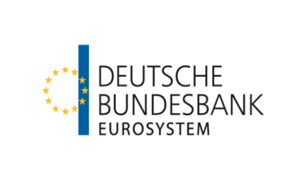
The Bundesbank’s Research Data and Service Center (RDSC): Gateway to Treasures of Microdata on the German Financial System
Rafael Beier – Deutsche Bundesbank
Conference of European Statistics Stakeholders – Budapest
October 20th, 2016

Slide 2
Introduction
  Historical Development
  Microdata Structure at Deutsche Bundesbank
  Main Tasks of the Bundesbank‘s RDSC
  Access to Bundesbank Microdata

Slide 3



1. Historical Development
Where do we come from?
The German Data Forum was established by the Federal Government
Bottom-up initiative of the research community and data producers
31 accredited
Research Data Centers
The first research data centers were established
Access to official statistics was virtually impossible, or very costly
1990s
1998
2002
2004
2016

Slide 4
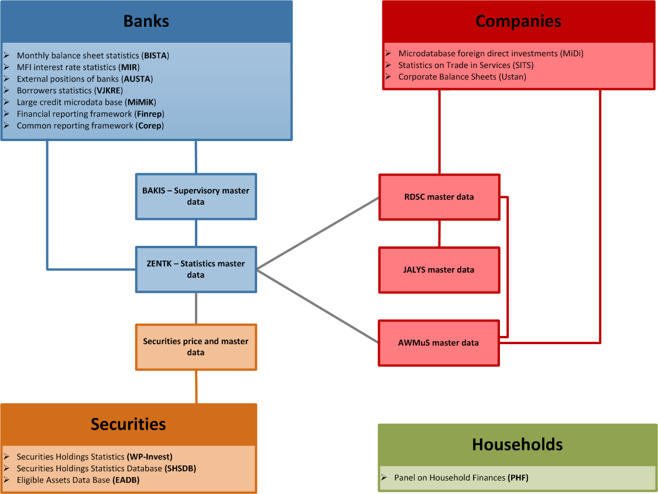
2. Microdata Structure at Deutsche Bundesbank
What treasures does the Bundesbank hide?
Monetary Financial Institutions (Banks)
Companies
Securities
Households

Slide 5

3. Main Tasks of the Bundesbank‘s RDSC
Who are we? What are we doing?
Data Producers
Survey studies
Official statistics
Research Data and Service Center
Data users
Main tasks of the Bundesbank’s RDSC
Generate (linked) micro data
Offer advisory service on data selection and data access (data handling, research potential, scope and validity of data)
Provide data access and guarantee data protection
Document data and methodological aspects of the data (metadata)
Work on own research projects (in close cooperation with the Bundesbank’s business areas and the Research Centre)
Organize conferences and workshops

Slide 6


4. Access to Bundesbank Micro Data
How do you find the secret treasures?
Off-Site Access | On-Site Access
Email, encrypted (Scientific Use File) | Remote Execution (only for MiDi data) | Visit the RDSC as Guest Researcher
De-facto anonymous | Weakly anonymous

Slide 7
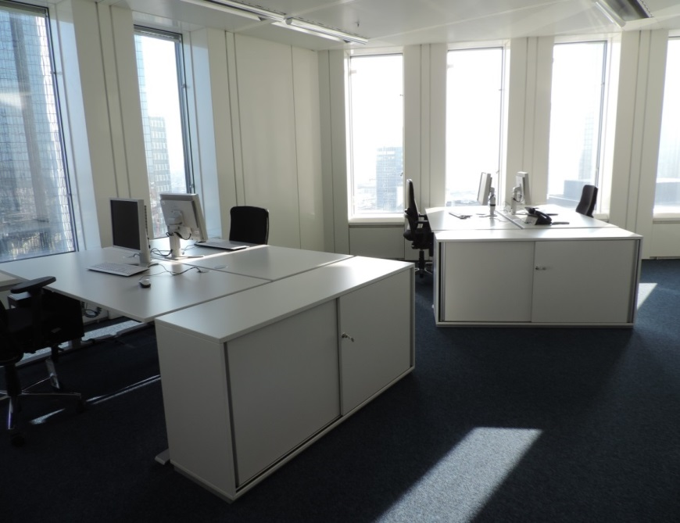
Contact
Where do you find us?
Thank you for your attention!
Rafael Beier: rafael.beier@bundesbank.de
Website: www.bundesbank.de\fdsz
Contact: fdsz-data@bundesbank.de

Slide 8
Annex 1: Selected Micro Data Offered in the RDSC
What do we offer?
Monthly balance sheet statistics (BISTA)
Granular information on loans and credits to other MFI, companies as well as households, containing credits, debt securities etc.
Microdatabase Direct Investment (MiDi)
Information on inward foreign direct investments (FDI) as well as outward FDI
Securities Holdings Statistics (SHS-Base)
Granular information on negotiable bonds and debt securities, negotiable money market paper, shares, participating certificates and investment fond certificates
Panel on household finances (PHF)
Survey on households’ wealth and finances in Germany

