Slide 1

Session D7: Big Data Analysis from Classification to Dimensional reduction
The curse of dimensionality in official statistics
Emanuele Baldacci, emanuele.baldacci@ec.europa.eu
Eurostat Director, Directorate B Methodology, Corporate statistical and IT services
Dario Buono, dario.buono@ec.europa.eu
Eurostat, Unit B.1: Methodology and corporate architecture
Fabrice Gras, fabrice.gras@ec.europa.eu
Eurostat, Unit B.1: Methodology and corporate architecture
Conference of European Statistics Stakeholders
Budapest, 20–21 October 2016

Slide 2

The curse of dimensionality
(coined by Richard E. Bellman in 1961)
When the dimensionality increases, the volume of the space increases so fast that the available data become sparse.
To obtain a statistically significant result, the amount of data needed often grows exponentially with the dimensionality.

Slide 3
Big Data, Huge Dimensions… Sparse Activities
  Dimensionality
  Big Data and Macroeconomic Nowcasting & Econometrics
  Selectivity methods
  Mobile phone data
  What's next?

Slide 4
Dealing with dimensionality in official statistics
 | Multiple sources: towards Model Based statistics
Type | Huge number of time series | High frequency time series | Huge number of dimensions
Problem | Reduction of dimensionality, data snooping | Extraction/decomposition of signal for high frequency data, mixed frequency | Curse of dimensionality (sampling, distance functions)
Aim | Early estimate, nowcasting, classification | Nowcasting, Data filtering and signal extraction of high frequency time series | Data mining: machine learning, clustering, classification
Possible methods | Shrinkage models, Factor model, Bayesian model, regression trees, panel modelling | Wavelet, ensemble mode decomposition, outliers detection, and extreme events theory, state space modelling, (U)-MIDAS | Bayesian inference, alternative distance, state space models

Slide 5
Dimensionality challenges
Data access, storage and dissemination
Data analytics
Moving towards more model based statistics while preserving robustness and quality of existing official statistics
NSIs actually need to pay more and more in the future attention to the "curse of dimensionality"

Slide 6
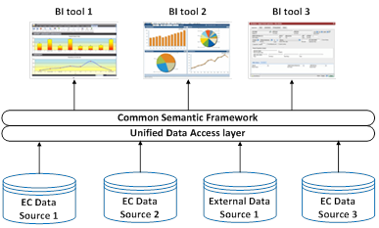


Data storage: possible solution is
Data Virtualisation

Slide 7
Data analytics: the way to go
Use of all the informational content included in models.
Model based statistics: trade-off between robustness and precision properties of model based statistics.
Assessment of scenario based on estimation of density functions.
Presentation of indicators based on clustering of some contextual variables.

Slide 8
The curse of dimensionality &
Data Modelling
Data snooping: among an infinite number of candidate models, presence of a winner
Distance: assessment of the distance relevancy in high dimensional space, use of Bayesian inference, embedding dimension of a problem (Taken's theorem).
High frequency data: at which frequency the signal is the most relevant
Data mining for selecting regressors

Slide 9
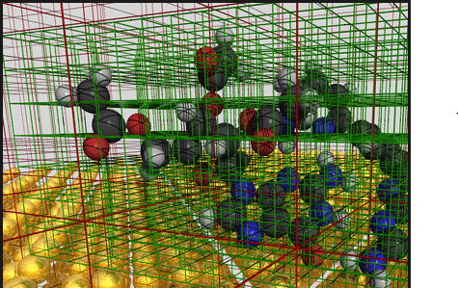
Eurostat (Sparse?) activities
Big Data Macroeconomic Nowcasting, 2016
Big Data Econometrics, 2017
Selectivity in Big Data sources, ongoing
"Assessing the Quality of Mobile Phone Data as a Source of Statistics", Q2016 joint-paper by Statistics Belgium, Eurostat and Proximus

Slide 10

Big Data Macroeconomic Nowcasting
Literature review on the use of Big Data for macro-economic nowcasting
Use of a typology based on Doornik and Hendry (2015):
  Tall data: many observation, few variables
  Fat data: many variables, few observations
  Huge data: many variables, many observations

Slide 11

Models race
Dynamic Factor Analysis
Partial Least Squares
Bayesian Regression
LASSO regression
U-Midas models
Model averaging
255 models tested using macro-financial and google trend data

Slide 12
Statistical Methods: findings
Sparse regression (LASSO) works for fat, huge data
Data reduction techniques (PLS) helpful for large variables
(U)-MIDAS or bridge modelling for mixed frequency
Dimensionality reduction improves nowcasting
Forecast combination: Data-driven automated strategy with model rotation based on forecasting performance in the past works well

Slide 13
Follow-up: Big Data Econometrics
Review of methods to move from unstructured to structured time-series data sets for various types of big data sources including filtering techniques for high frequency data.
Propose modelling strategies to be tested.
Carry out further empirical tests on possible data timeliness/accuracy gains.
Big data handling tool developed as R package.
Scientific summary for Big Data Econometric strategy.

Slide 14
Open econometric questions
Time | Shrinkage model to select variables
t0 | X₅ | X₁₂₃ | X₂₁₅
t1 | X₅ | X₁₂₃ | X₂₁₅
t2 | X₅ | X₁₃ | X₂₁₅
t3 | X₅ | X₁₃ | X₂₅
… | … | … | …
tn | X₃ | X₁₃ | X₂₅
Informational content of the various selected variables along time?
How to choose the time span for estimating the model?

Slide 15
Big Data sources Selectivity:
Main Issues
Self-selection and the resulting non-probability character of the data.
Discrepancies between big data populations and the target population.
Identification of statistical units (target population indirectly observed).
How to deal with representativeness and coverage of Big Data for sampling purposes.

Slide 16
Big Data sources Selectivity: Proposed methods (so far…)
Pseudo-design approach–reweighting (calibration, Pseudo-empirical likelihood, weighting)
Modelling approach (M-quantile models, Model based in calibration, Bayesian approach, Machine learning approach)
Record linkage
New study in 2017 to go further

Slide 17
Example (1): Selected big data sources and basic characteristics that can be derived from the data.
Characteristic | Mobile | Twitter | Google Trends
Gender | possible | limited | very limited
Age | possible | limited | very limited
Residence | precise | limited | very limited
Occupation | limited | limited | very limited
Marital status | limited | limited | very limited
LFS category | limited | limited | very limited
Spatial aggregation | municipality | regional/cities | regional/cities

Slide 18
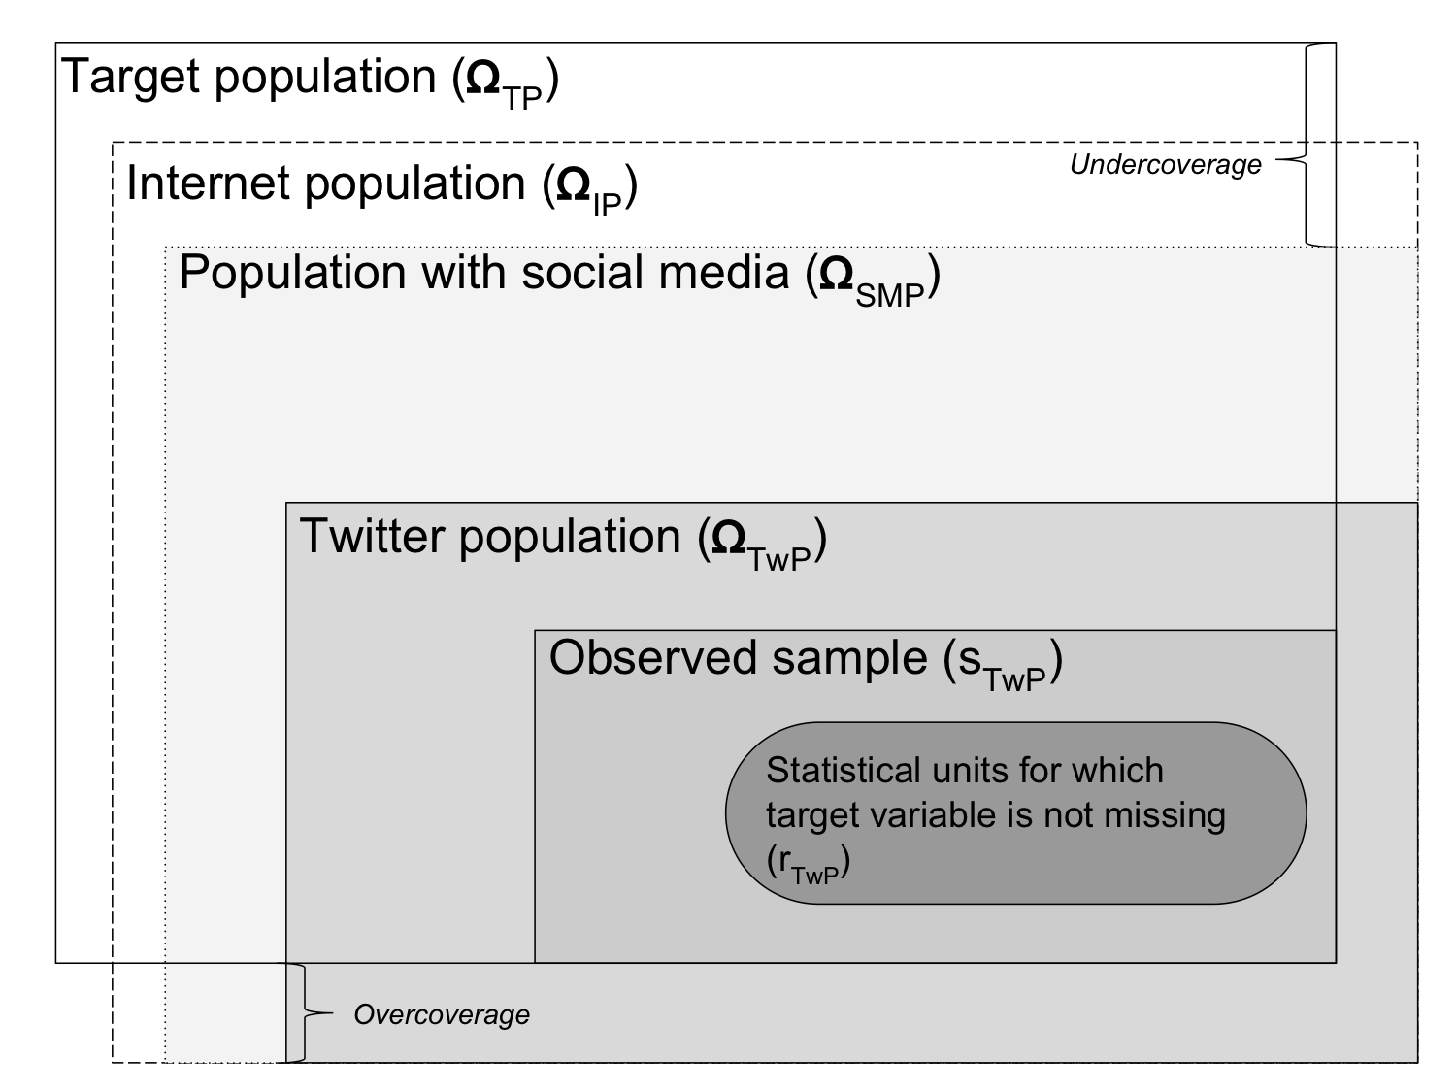
Example (2): Target population and twitter population

Slide 19
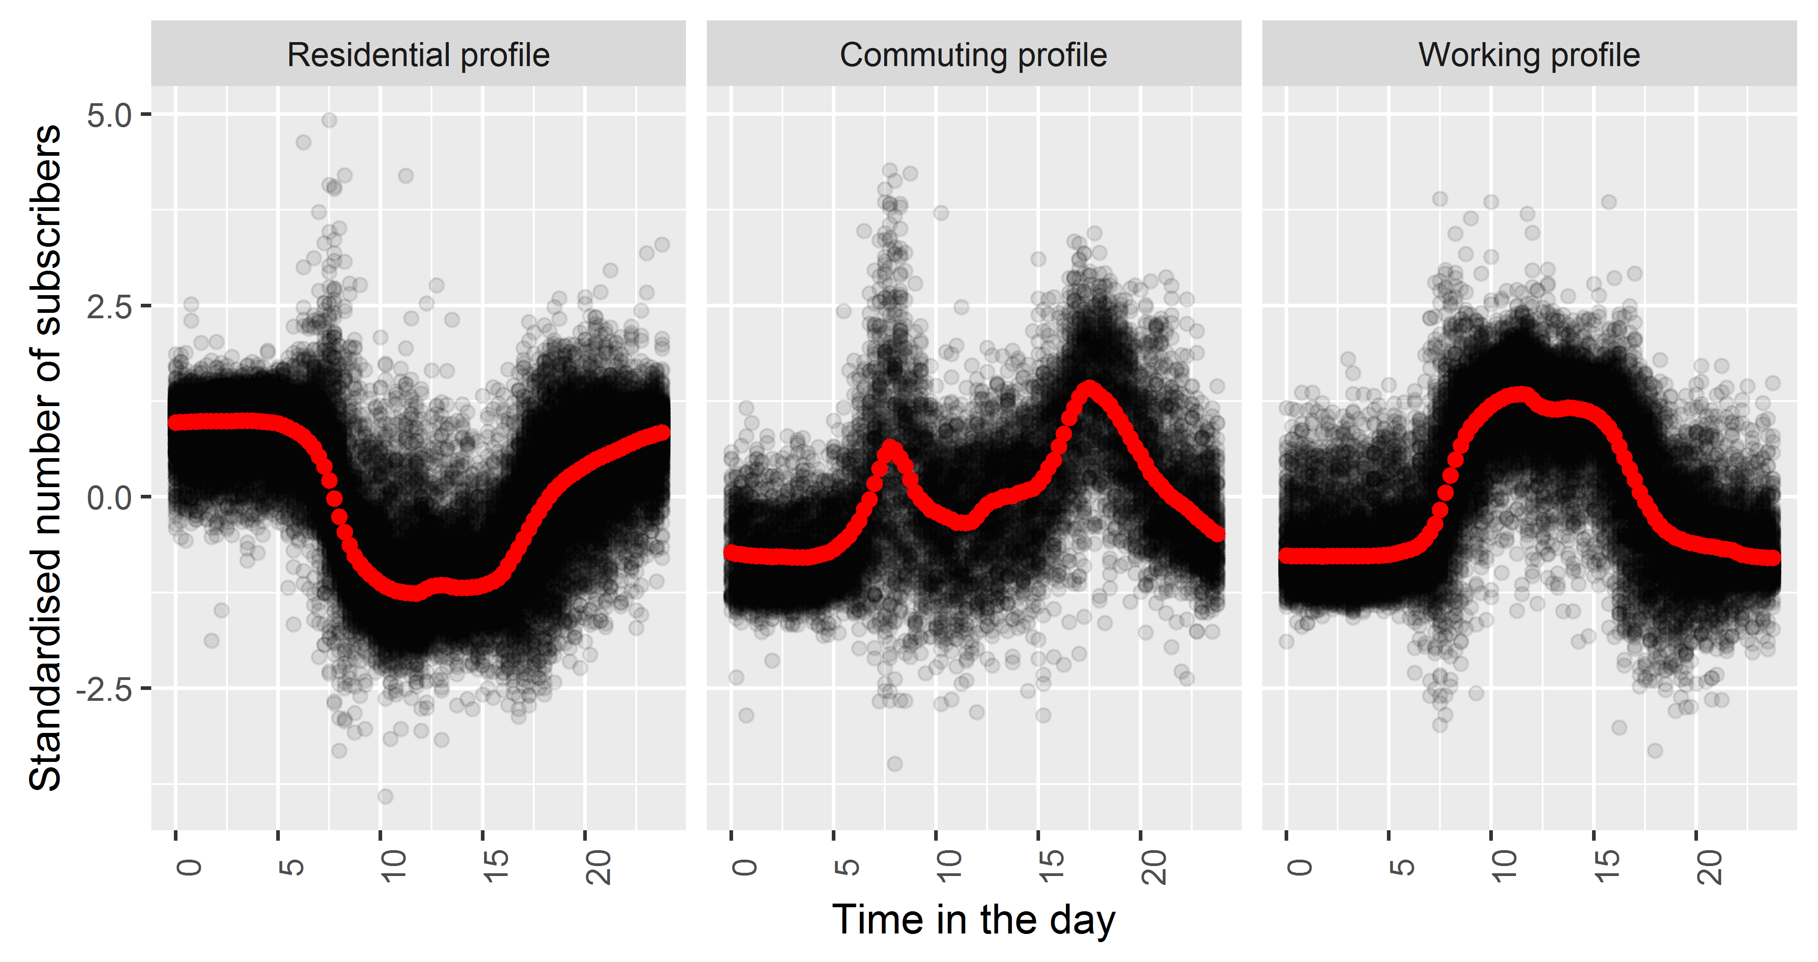
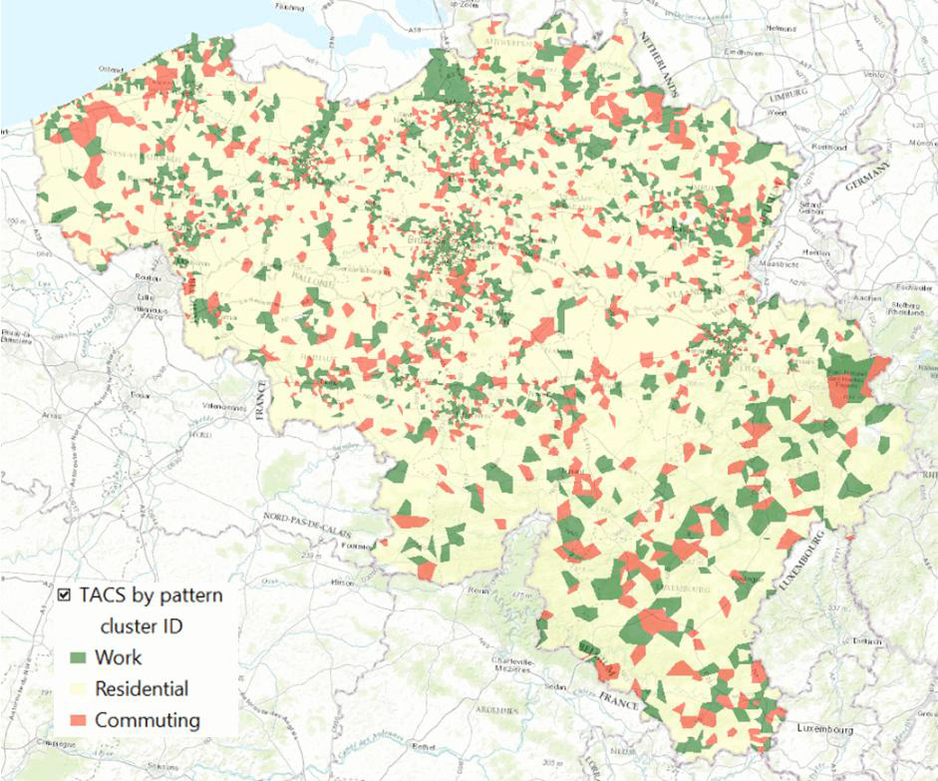
Mobile Phone data: Clustering Time Series
(1) Assessing the Quality of Mobile Phone Data as a Source of Statistics http://www.ine.es/q2016/docs/q2016Final00163.pdf
Scaling: Standardization
Distance measure: Euclidian
Applied Technique: K-means
Applied Technique: K-means, Euclidian distance after standardisation of time series
Objectives: find patterns enabling the classification of geographical areas in work, residential and commuting area

Slide 20

More Eurostat Big Data activities
  List of pilot projects (Specific Grant Agreement)
  Web scraping: job vacancies ; enterprise characteristics
  Smart meters: electricity consumption ; temporary vacant dwellings
  Automatic Identification System (Ships)
  Flight Reservation Systems for true Origin/Destination
  Amadeus Database
  Aircraft Tracking System
  Satellite system to receive flight positions from aircrafts
  Wikipedia as source for statistics: Cultural and regional statistics

Slide 21


What's next
  European Big Data Hackathon ,15-17 March 2017,Brussels
  European Statistical Training Courses in 2017

Slide 22
ESTP courses supporting big data (2017)
Q3
Big data sources - Web, Social media and text analytics
Q1
Q2
Introduction to big data and its tools
Hands-on immersion on big data tools
Nowcasting
Q4
Advanced big data sources - Mobile phone and other sensors
Q2
Q2
Q1
The use of R in official statistics: model based estimates
Can a statistician become a data scientist?
Time-series econometrics
Big data courses
Methodology courses
Activity
Notes:
Actual date will be known in November 2016

Slide 23
Thank you for your attention
Questions welcome
References:
Clément Marsilli Variable Selection in Predictive MIDAS Models, Document de travail 520, Banque de France, https://www.banque-france.fr/uploads/tx_bdfdocumentstravail/DT-520.pdf
Eurostat, Big data and macroeconomic nowcasting, preliminary results presented at the ESS methodological working group (7 April 2016, Luxembourg) http://ec.europa.eu/eurostat/cros/content/item21bigdataandmacroeconomicnowcastingslides_en
M. Verleysen, D. François, G. Simon, V. Wertz, On the effects of dimensionality on data analysis with neural networks https://perso.uclouvain.be/michel.verleysen/papers/iwann03mv.pdf
Summary Statistics in Approximate Bayesian Computation, Dennis Prangl https://arxiv.org/pdf/1512.05633.pdf
Big data CROS portal
http://ec.europa.eu/eurostat/cros/content/big-data_en

