Slide 1


A research project proposal: “Data for qolexity: big data, nowcasting and the construction of wellbeing indicators“
Enrico di Bella
University of Genoa

Slide 2
The social indicators movement
Fifty years passed since the “Social Indicators Movement” of the 1960s-1970s started to describe social phenomena.
Land K.C. & Michalos A.C. (2015). Fifty years after the social indicators movement: has the promise been fulfilled? An Assessment and an Agenda for the Future, forthcoming in Social Indicators Research.
The Social Indicators Movement realized most of its agenda, but there is still much to do, not only to improve exiting social indicators, but also to introduce new ones designed on the new societal forms that are far different from the one in which the “Social Indicators Movement” was born.

Slide 3
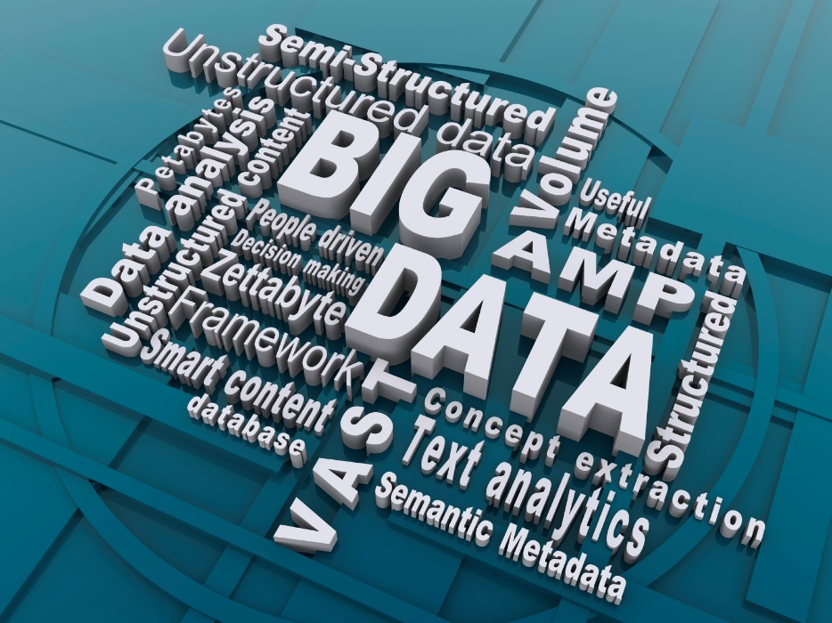
The digital era and Big Data
According to IBM in 2012, 2.5 billion gigabytes of data were generated every day and roughly 90% of the data in the world today has been created in the last two years alone.
Most of these data is unstructured:
Text
Voice
Pictures
Video
…

Slide 4
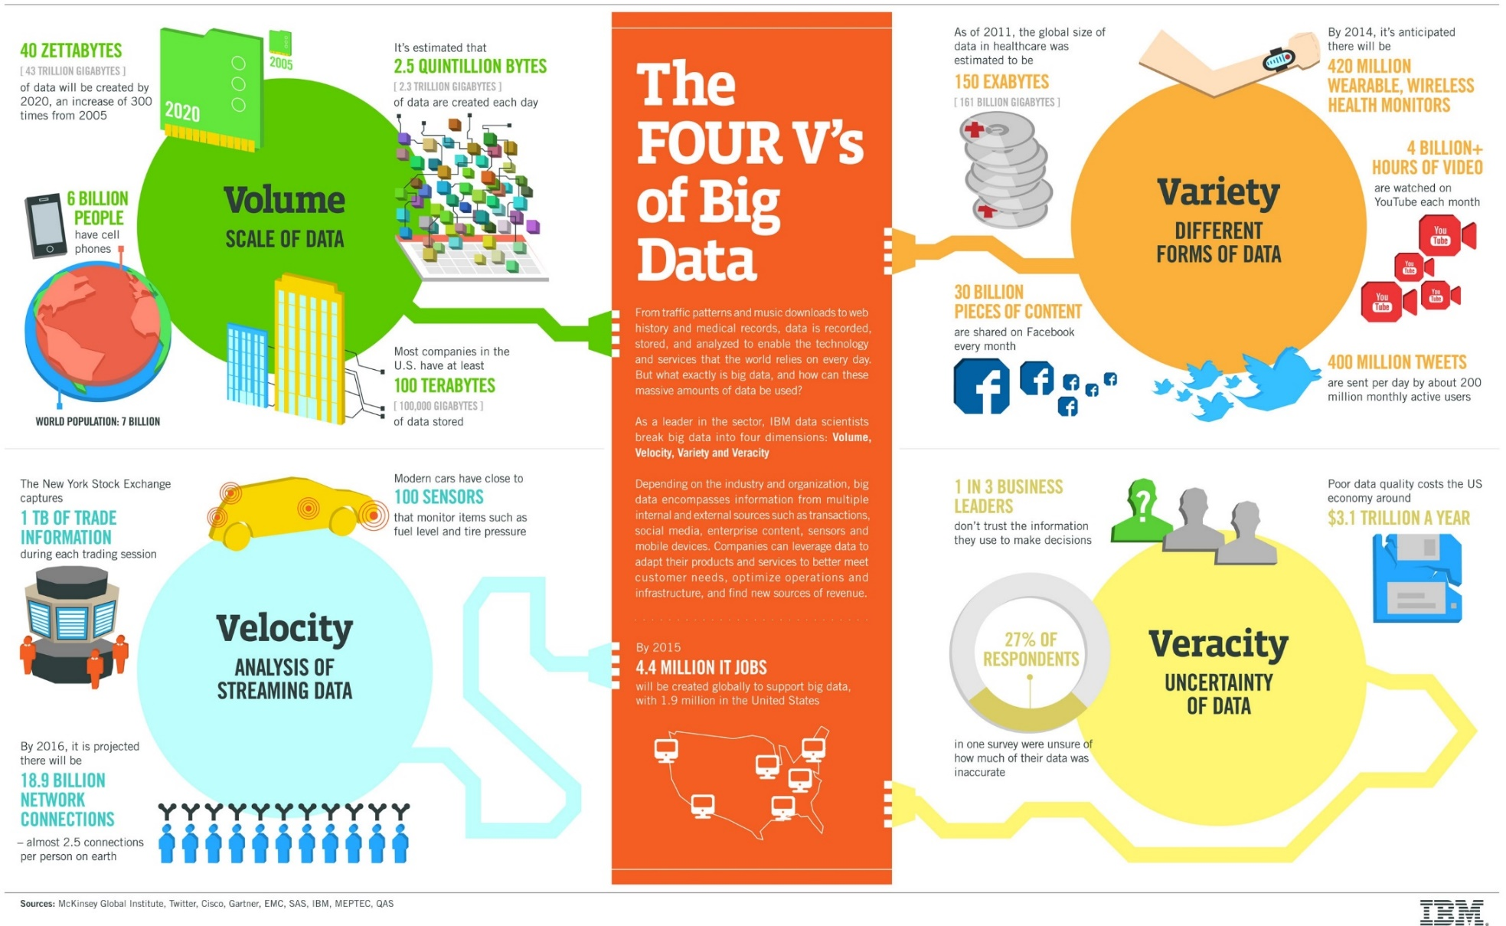
The fuor V’s of Big Data

Slide 5
Metadata analysis of big data papers
Scopus is a well-known abstract and citation database of peer-reviewed literature: scientific journals, books and conference proceedings by Elsevier.
We queried the Scopus database to identify actual trends in Big Data research.
Q1: «Big data» in TITLE-ABS-KEY
Q2: Big data sources
Q3: Big Data and Sustainable Development Goals

Slide 6
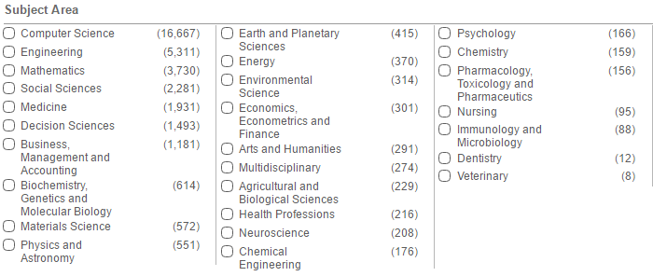
Q1: «Big data» in TITLE-ABS-KEY
Mid-sept 2016: 21,691
Mid-oct 2016: 23.059
D: 1,368 paper in 1 month!
A review of big data papers is not actually possible!

Slide 7
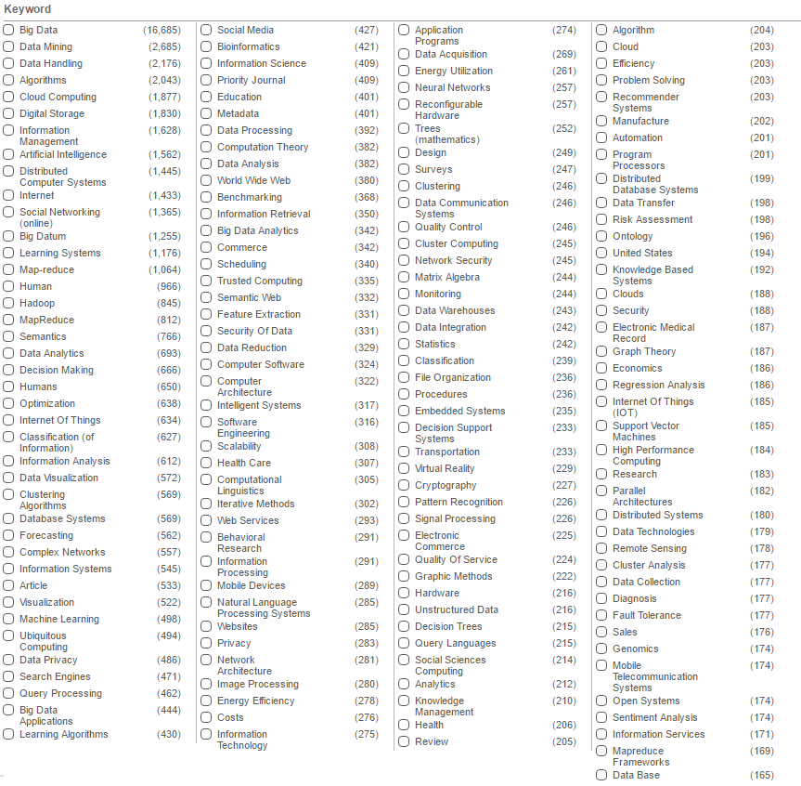
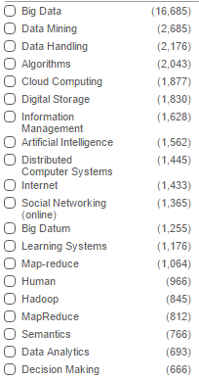
Q1: «Big data» in TITLE-ABS-KEY
Top 20 keywords
KEY
WORDS

Slide 8
Q2: Big Data sources
Data Source | Papers | Social Sciences papers | Scopus query in the “Title, Abstract and Keywords” field
Satellite Images | 195 | 28 | "satellite" OR "satellite image" AND "big data"
Mobile phone | 197 | 33 | "mobile phone" OR "cell phone" AND "big data"
Online search | 65 | 3 | "web search" OR "online search" AND "big data"
Social Media | 2,037 | 301 | "social media" OR "social network" OR "twitter" OR "facebook" OR "instagram" AND "big data"
Twitter | 512 | 87 | "Twitter" AND "big data"
Facebook | 251 | 46 | "Facebook" AND "big data"
Online search extended | 373 | 57 | "online search" OR "web search" OR "blogs" OR "news" AND "big data"
Sensors | 1,445 | 88 | "sensors" AND "big data"
Text Mining | 222 | 22 | "text mining" AND "big data"

Slide 9
Q3: Big Data and SDG
 | SDG | Number of papers | % papers in Social Sciences
1 | No Poverty | 14 | 14%
2 | Zero Hunger | 132 | 11%
3 | Good Health and Well-Being | 1,799 | 8%
4 | Quality Education | 839 | 26%
5 | Gender Equality | 110 | 11%
6 | Clean Water and Sanitation | 29 | 21%
7 | Affordable and clean energy | 346 | 7%
8 | Decent work and economic growth | 183 | 19%
9 | Industry, Innovation and Infrastructure | 3,308 | 10%
10 | Reduced inequalities | 254 | 15%
11 | Sustainable cities and communities | 1,428 | 14%
12 | Responsible Consumption and production | 4 | 50%
13 | Climate Action | 169 | 12%
14 | Life below water | 332 | 13%
15 | Life on land | 137 | 20%
16 | Peace, Justice and strong institution | 423 | 26%

Slide 10
Big Data and Social Indicators
Most of existing literature is focused on software and computational issues
Really few papers are focused on statistical issues and on the procedures to build social indicators from big data
Nevetheless there are the well known “promising results”:
  Big data may properly approximate social phenomena making it even possible to save money from official statistics surveys (e.g.. in developing countries using satellite images)
  Big data may be used to improve estimation precision (e.g.: small area estimation)
  Big data may be used and combined to provide nowcasting (very effective in monetary economics)
  …

Slide 11
Big Data and Official Statistics
Official Statistics | Big Data
High data quality standards (e.g.: The European Statistics Code of Practice by Eurostat) | No defined data quality standards
Sampling schemes well-defined | Being mainly process produced data, subject to unpredictable non-sampling errors
Theoretically funded cause-effect interpretations | Empirically based correlation analysis (-> which implications to policy making?)
Official statistics is publicly funded for common interest | Big Data are mainly private
Ethical issues related to privacy, idenity, confidenciality and traspency trated accordingly to the codes of practice. | Ethical issues not really addressed yet (28 national laws and the forthcoming General Data Protection Regulation)

Slide 12
Research proposal
The big data revolution on social indicators is still far from being visible because statistically rigorous works that really discuss on how big data may be used to improve statistical analysis of social phenomena are still few.
Which is the actual potential of big data for social indicators?
  Big data take into account multiple dimensions (qolexity)
  They are available in a (sort of) continuum and they may provide timely information
  They may provide a higher territorial detail
But “Big data needs a big theory to go with it”:
  Big Data quality and mapping for the definition of Social Indicators
  How it is possible to make all these data “cooperate” and which is their innovative contribution to the actual informative system (e.g. nowcasting)
  How Big Data can complement or substitute actual social indicators in a complete perspective (not based only on correlations but on constructs)
How can we socialize private Big Data?
Which is the impact of Big Data on Privacy and the aforesaid Ethical Issues?
Actual partners: 4 Universities from Italy and 2 from EU.

Slide 13
Contacts and references
Enrico di Bella
enrico.dibella@unige.it
Department of Economics and Business Studies
University of Genoa
di Bella E., Leporatti L., Maggino F. (in press). Big Data and Social Indicators: actual trends and new perspectives, forthcoming in Social Indicators Research.
Land K.C. & Michalos A.C. (2015). Fifty years after the social indicators movement: has the promise been fulfilled? An Assessment and an Agenda for the Future, forthcoming in Social Indicators Research.

