Slide 1
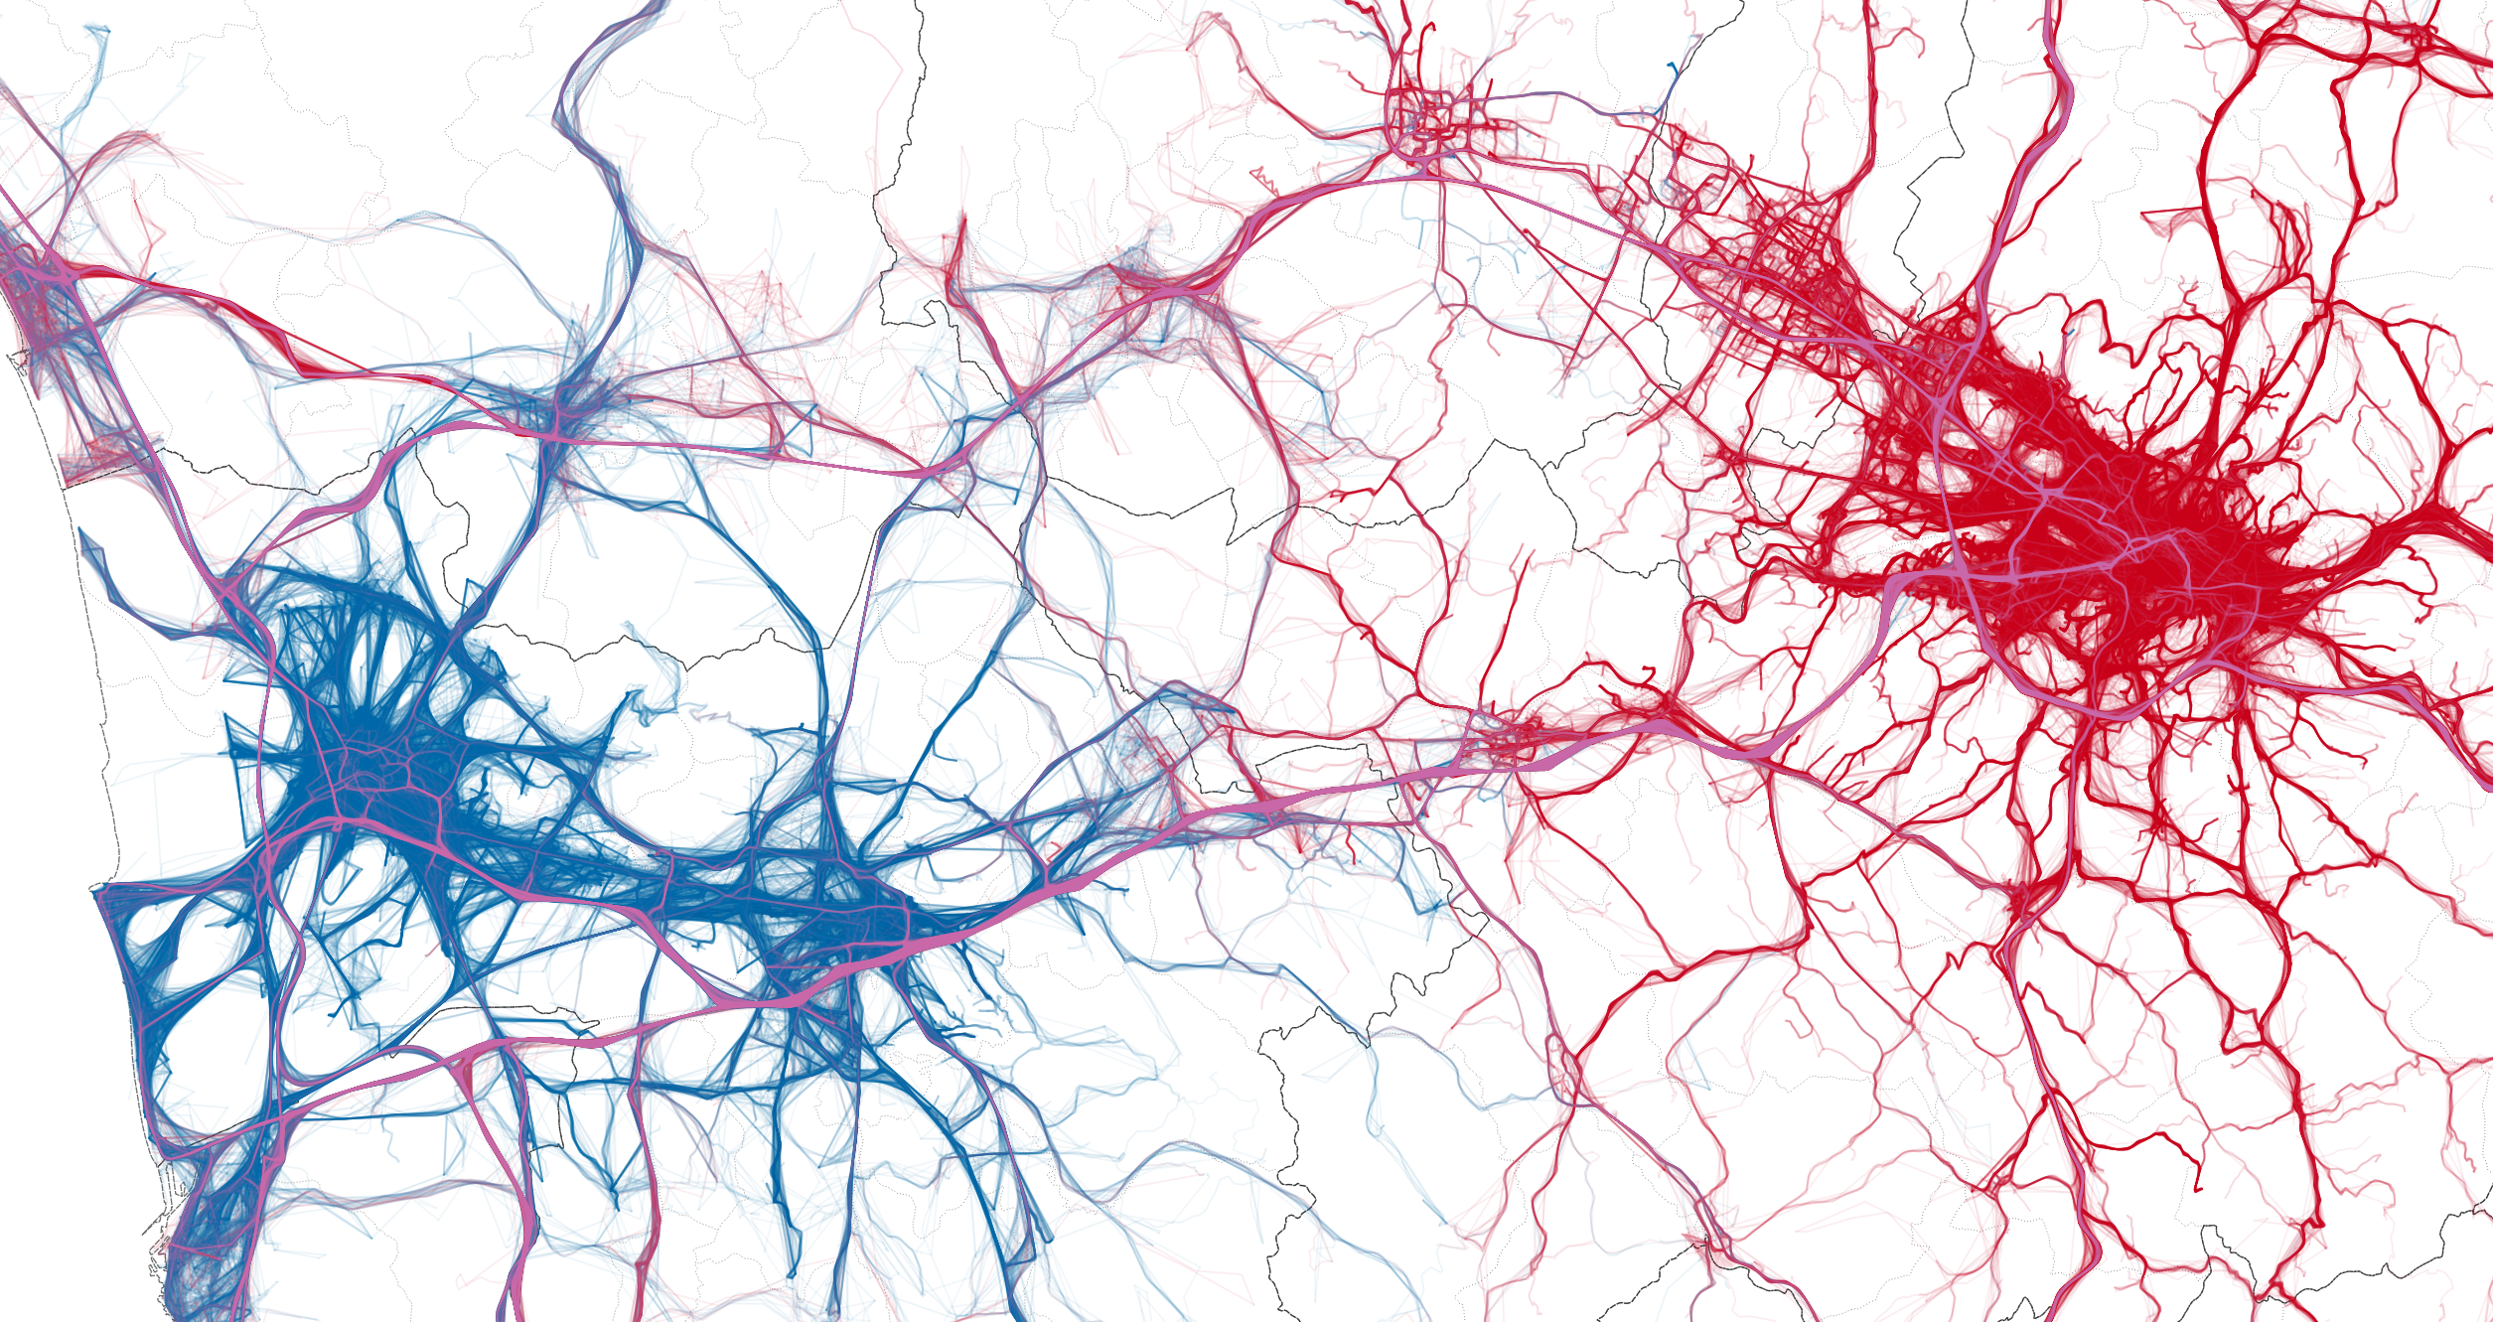

An analytical framework to nowcast well-being using Big Data
Luca Pappalardo
www.lucapappalardo.com
@lucpappalard
University of Pisa
ISTI-CNR

Slide 2
Why Big Data?
Notes:
The GPS tracks of car travels originating in Pisa (red) vs. the GPS tracks of car travels originating in Florence (green) (viz by KDD LAB)

Slide 3
A support to surveys
Surveys don’t scale to fine spatio-temporal resolution
Surveys don’t adapt to power law distributions:
  Impossibility to study wealth distribution with samples
  50 guys own the same wealth of 3.5 billion people
Millennials do not respond to surveys!

Slide 4
Are human mobility patterns associated to well-being?
Notes:
The purpose of the study I am gonna present you today is to understand the relationships between human mobility and the socio-economic development of a territory. In order to do that we performed a data-driven study in France exploiting the access to mobile phone data provided by the Orange Telecom provider.

Slide 5
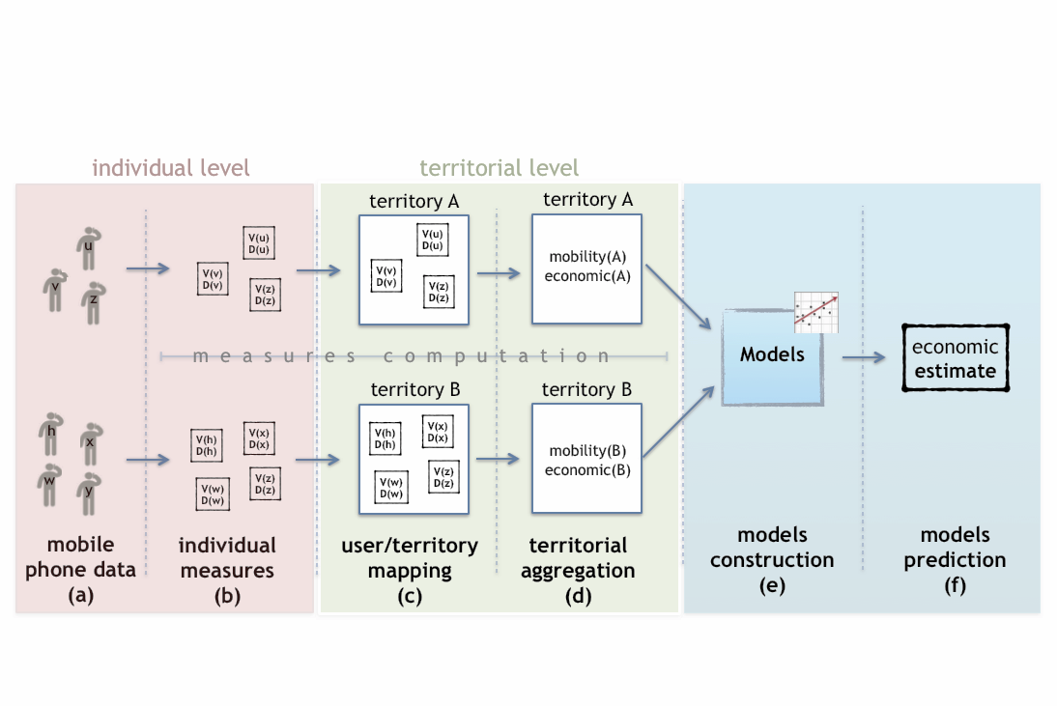
The analytical framework

Slide 6

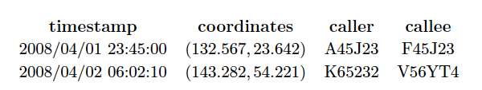
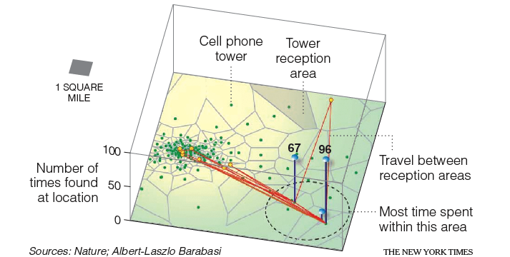
mobile phone data
dataset
20M users
1G calls
45 days
Notes:
Out dataset, provided the Orange company, contains information about more than 60 million calls made by 6 million users during a period of observation of 45 days (september-october 2007)

Slide 7


Individual measures
      Mobility volume:
      the characteristic distance traveled by individuals
      Mobility diversity:
      the predictability of individuals’ movements
Notes:
In the mobility context, we used the radius of gyration as measure of volume, which gives the characteristic traveled distance of a given user, a measure of how far she is from his center of mass. For the diversity measure we used the mobility entropy, that is the equivalent of the social diversity in the mobility context: it tends to one when a user starting from a location can go in many different other locations, while it is zero when a given user, starting from a location, goes always in the same destination. The higher the entropy, the lower the predictability of the user’s mobility.

Slide 8
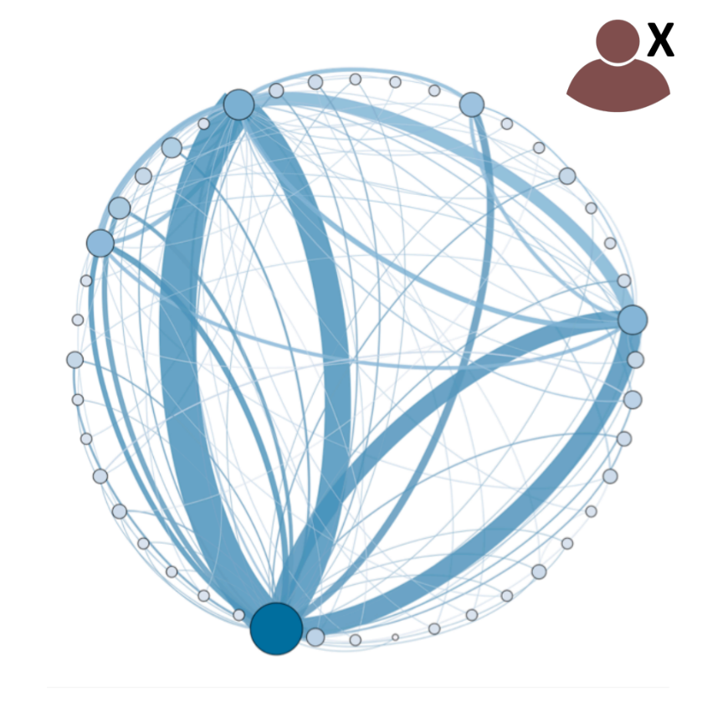
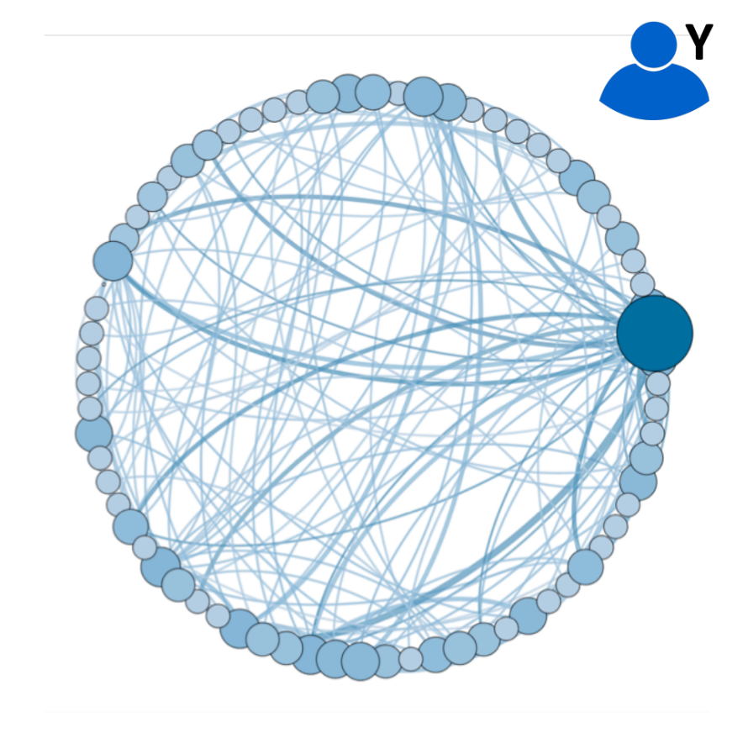
Low Diversity
High Diversity

Slide 9

user/territory mapping
home locations are the most frequent towers during nighttime (8 p.m. – 3 a.m.)
We assign each individual’s home location to the corresponding municipality
Paris

Slide 10
territorial aggregation
We aggregate the measures of individuals in the same area by the mean
We considered external indexes of economic development (source: INSEE):
  Deprivation index
  Per capita income

Slide 11
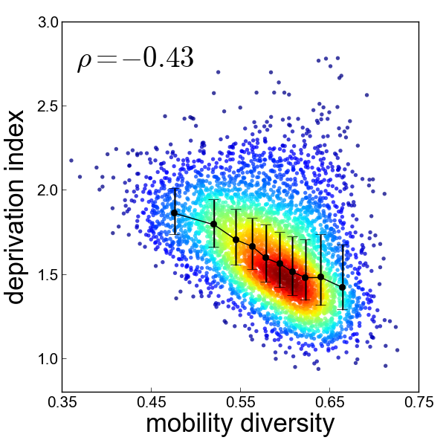
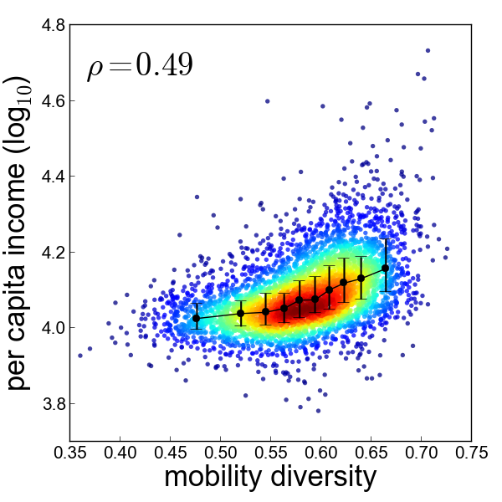
Mobility diversity vs well-being
Notes:
We investigate the correlations between the aggregated mobility measures and the four external socio-economic indicators. We see from the figures that a clear tendency emerges, in this case for mobility entropy: the higher the mobility entropy the lower the deprivation index.

Slide 12
Predictive models
Regression
predicting the exact value of well-being
R² = 0.42 (deprivation)
R² = 0.25 (income)
Classification:
predicting the class of deprivation
acc = 0.61 (deprivation)
acc = 0.54 (income)

Slide 13
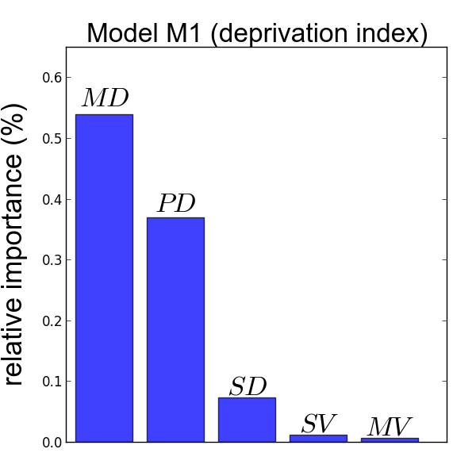
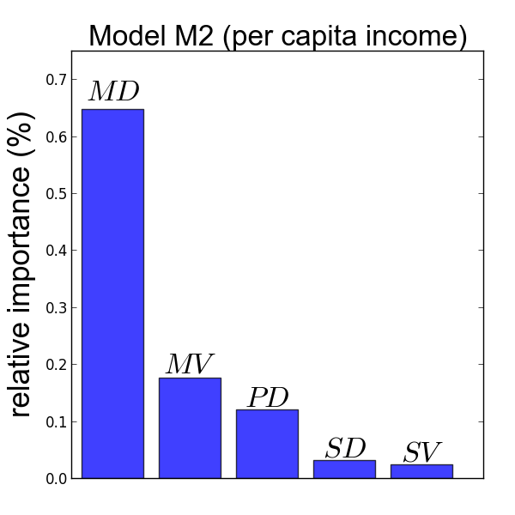
Mobility diversity matters!

Slide 14
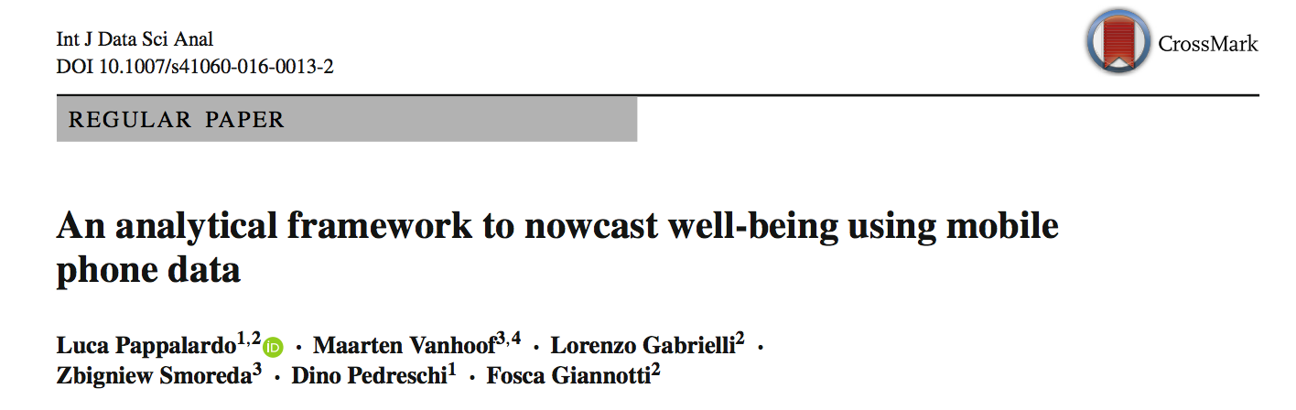
International Journal of Data Science and Analytics
2016
https://link.springer.com/article/10.1007/s41060-016-0013-2
Notes:
The purpose of the study I am gonna present you today is to understand the relationships between human mobility and the socio-economic development of a territory. In order to do that we performed a data-driven study in France exploiting the access to mobile phone data provided by the Orange Telecom provider.

Slide 15


SoBigData.eu transnational access
SoBigData invites researchers and professionals to apply to participate in Short Term Scientific Missions (STSMs).
We welcome applications from individuals with a scientific interest, professionals, startups and innovators that may benefit from training in data science and social media analytics.

Slide 16

Big Data can be a valid support to surveys
human mobility patterns are associated to well-being…
…especially
mobility diversity

Slide 17
Thank you!
Luca Pappalardo
www.lucapappalardo.com
www.sobigdata.eu
@lucpappalard
University of Pisa
ISTI-CNR

