Slide 1
Using Big Data for Social Statistics:
OECD initiatives, with an application to US subjective well-being data
Fabrice Murtin
OECD Statistics Directorate
CESS 2016, Budapest

Slide 2
The OECD ‘Smart Data’ Strategy
From Big Data…: the OECD recently launched numerous projects using new types of data (e.g. geospatial, social media, web-scrapping) through partnerships with other organisations (ESA, Facebook, Google, AirBnB…)
…to Smart Data: new ways of combining old and new data are explored (e.g. nowcasting of income distribution)
Examples:
  A Civil Tension Indicator tracking news from Reuters and AFP and using automatic text analysis (Development Centre)
  Use of geospatial data for measuring air pollution or urban density (Environment/Governance Directorates)
  Use of smartphone data to understand geographical mobility

Slide 3
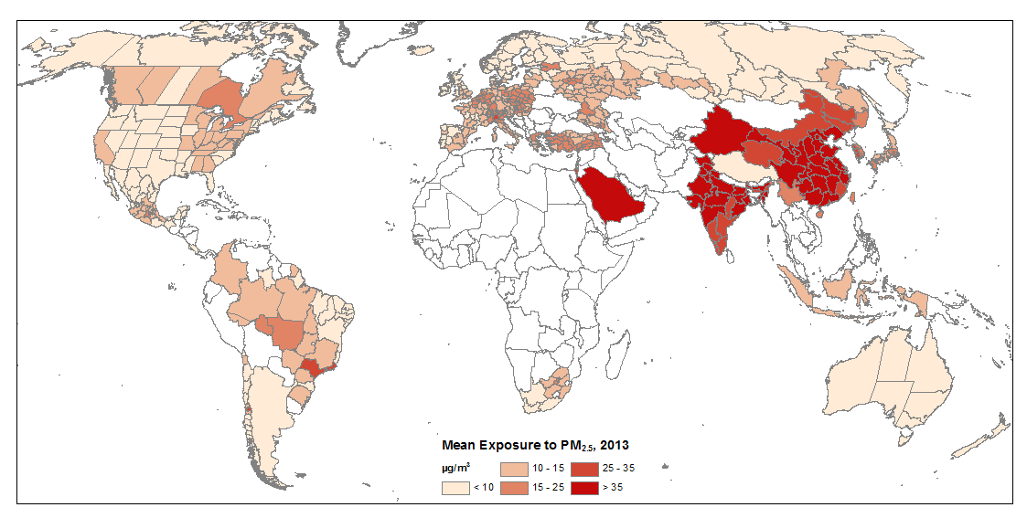
Examples of OECD Big Data projects
Exposure to fine particles (PM2.5) in the air, 2013

Slide 4
Some Pros of Big Data
Timeliness: OECD « Timeliness Initiative » as part of broader “Smart Data” Strategy (Income Distribution, SWB for other countries than the US)
Granularity: Big Data yield new insights at local level, e.g. CPI or housing prices at regional level (ITA), structure of city amenities (US)
Reflect behaviour: Big Data are often based on traceable human behaviour, e.g. internet searches are actions that may reveal people’s concerns and shed light on the proximate determinants of SWB; same consderatins apply to phone/satellite data

Slide 5
Internet data as a good illustration of pros
Internet data are timely, available at regional/MSA levels, and reflect actual behaviours
A case-study by the OECD Statistics Directorate: tracking weekly SWB-data (GWP) in the US
  download Google search frequencies of some keywords (from Google Trend) associated with subjective well-being (SWB)
  pool keywords into 11 categories covering important aspects of life (e.g. financial security, family stress, job market, personal security, summer leisure…)
  explain and predict 10 survey-based (GWP) indices of positive and negative subjective well-being in the US with time-series for these 11 search-categories

Slide 6
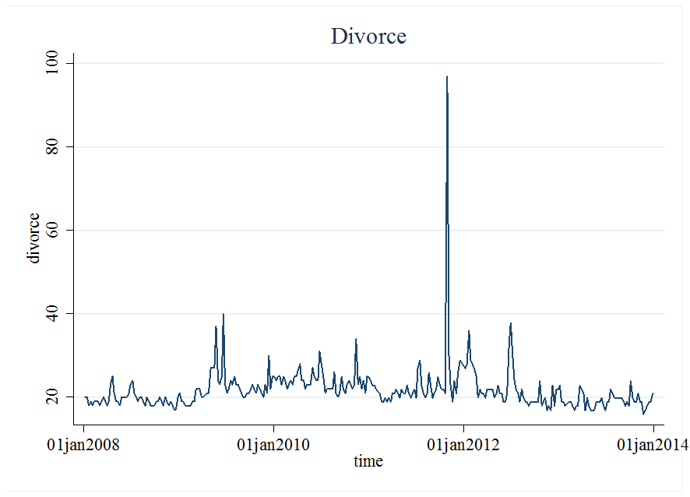
Challenges (1)
Noisy data: search frequencies for many keywords display erratic changes
October 31, 2011: Kim Kardashian files for divorce from Kris Humphries after 72 days of marriage

Slide 7
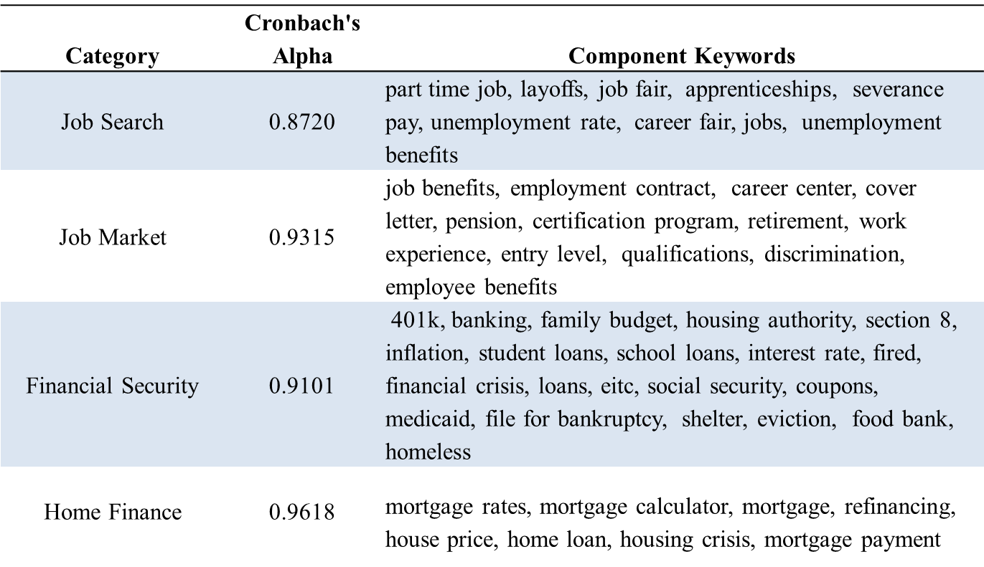
Challenges (2)
Data volume is huge: we start with 554 keywords and classify them by categories -> reduce high-dimensionality and enhance quality of signal
Data may be unstable and hard to access: Google time series require privileged access, are not stable over time due to change in search-algorithm etc…

Slide 8
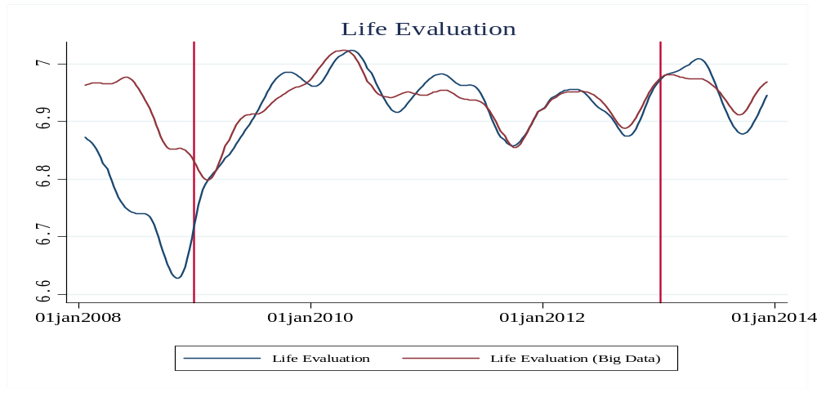
Findings
The model displays good ‘out-of-sample’ prediction for the 10 SWB variables
Overall, keywords associated with job search, financial security, family life and leisure are the most important internet predictors of SWB-data in the US
Challenge: can the same model be used to predict SWB in other OECD countries?
Test
Training sample
Test

Slide 9
Conclusions
An emerging trend…: a big data revolution is on course
…with promises and pitfalls : i) access to new information; ii) granularity and timeliness; ii) high learning cost (data treatment and optimal use)
For time being, Big Data provide a complement to official statistics, with sometimes uncertain legal status

