Slide 1

New Methodological Challenges in the
Era of Big Data
Maurizio Vichi
Department of Statistical Sciences
Sapienza University of Rome
em: maurizio.vichi@uniroma1.it
CESS 2016, BUDAPEST
Notes:
Cluster Analysis has received in the last years growing attention in new fields of application such as medicine ecology and in general in bioinformatics. New and recent fields of research have been developed such as model-based clustering, support vector machine, visualization, data mining and pattern recognition. In this presentation I will concentrate on new and recent clustering methods with the common statistical feature to specify a clustering model for the data to estimate it with the least-squares estimation approach which will turn to be an operation research problem to optimize an objective function under a set of constraints necessary to specify the clustering model.
I will divide the presentation in three parts: the clustering of the statistical units from dissimilarity data; the clustering of the two modes (units and variables) of the observed data; and third the clustering of the histories of the units and the evolution of the clusters when longitudinal data have been observed.

Slide 2
Outline of the presentation
How Statistics is changing
Big Data (V,V,V) VS (C,C,C)
Reduction model
New Methodologies
Multi-mode clustering;
Clustering & Dimensionality Reduction: Model-based Composite indicators;
Concluding remarks

Slide 3
Changes of Statistics due to
Two R|evolutions
3

Slide 4
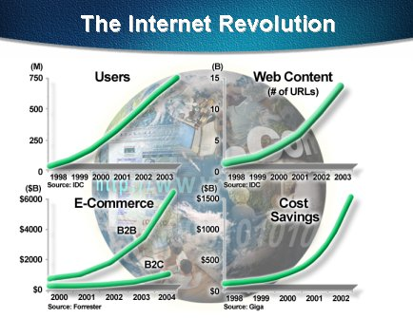
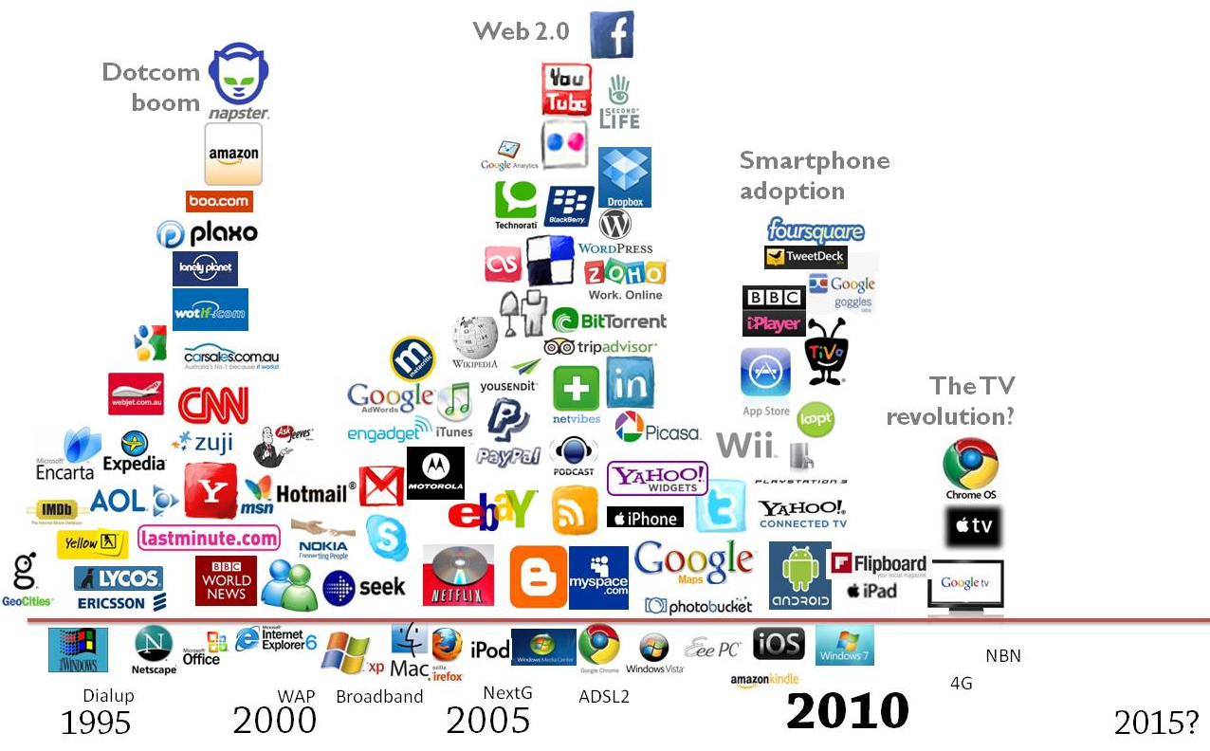
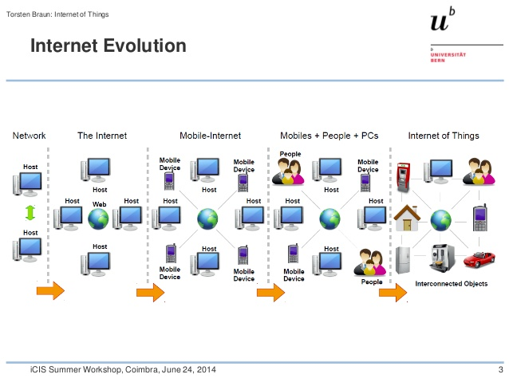


First R|evolution: Internet & the Data deluge
Strong Increase
USERS, WEB CONTENT, E-COMMERCE
COST SAVINGS
Internet of Things
From connecting Computer
To connect things
Statistics should promote a
SEMANTIC WEB
that provides standards for sharing data and reuse data for different applications, for enterprises, for statistics purposes and scientific communities
4

Slide 5
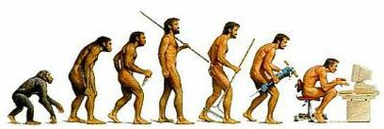
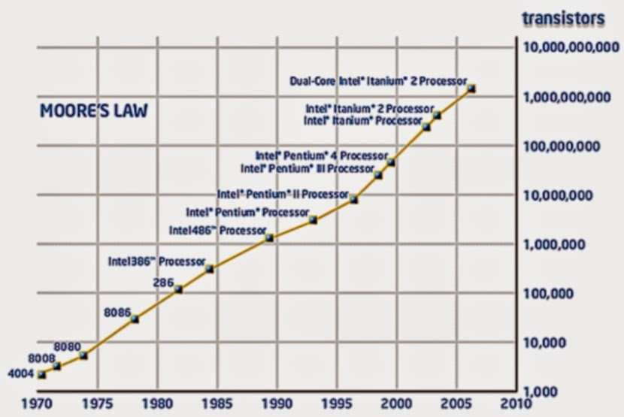
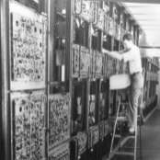
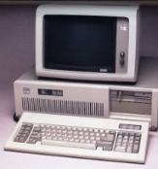

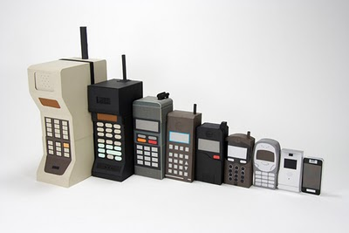
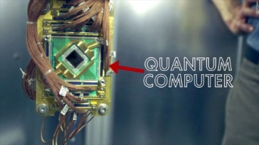


Second R|evolution: Computer and New Technology
speed of the computer would double every 18 months and the costs would decrease by half every 2 years.
Parallel computing directly included in the new CPUs
increases the possibility to parallelize modern computer intensive statistical methodologies that use independence such as resampling
Quantum computing with molecules that encode bits in multiple states . The QC naturally perform myriad operations in parallel, using only a single processing unit.
Quantum Computers and parallel computing very helpful for computer intensive statistical methods (simulation resampling)
5

Slide 6
STATISTICS BEFORE AND AFTER R|evolutions
Small samples vs Large samples or Populations
Classical statistical Inference vs Computer-intensive statistical inference
Phenomena Univariate and bivariate vs Multivariate Phenomena in space and time domains
6

Slide 7
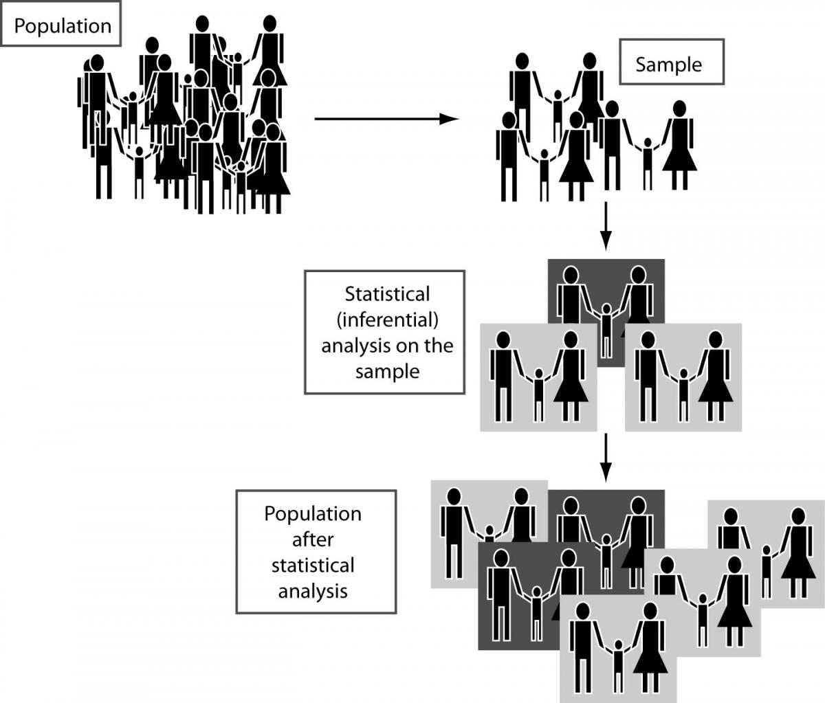


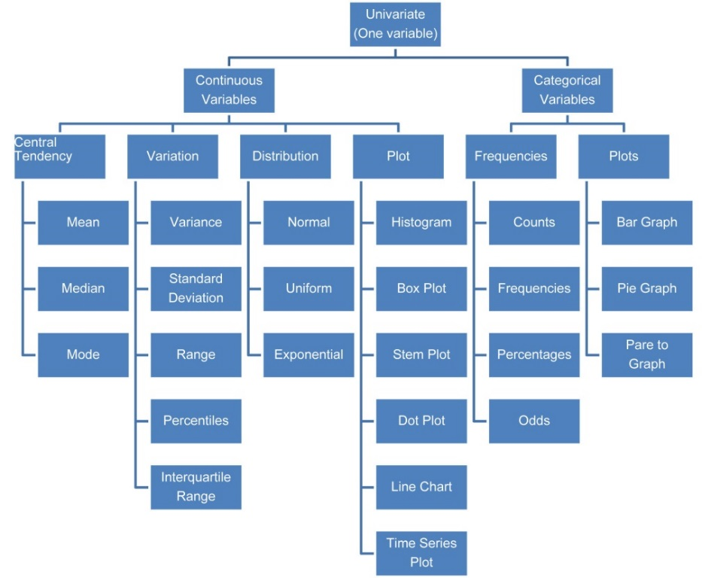
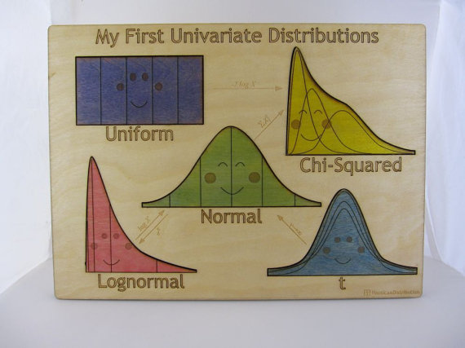
Statistics before R|evolutions
Economic, social and other real phenomena described by one or few indicators
Inference mainly on Univariate and Bivariate random variables
Extensive use of parametric statistics
especially under normality hypotheses
Statistics based only on Mathematics and Probability
Small Samples
Manual data collection
7

Slide 8
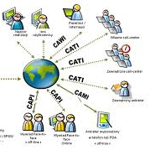
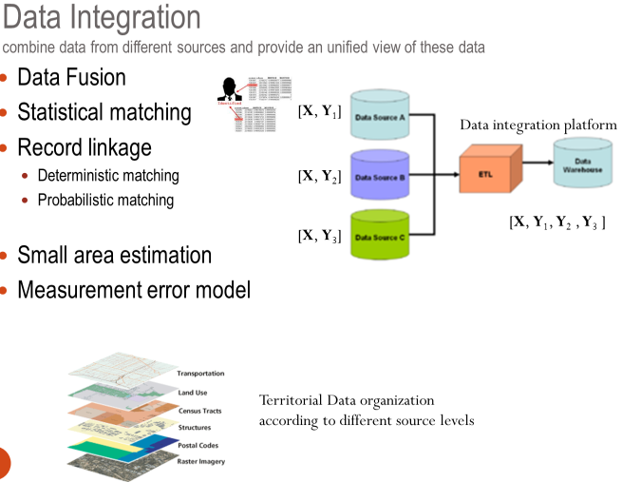
Statistics after R|evolutions
Statistics based on Mathematics, Probability and Computer Science (Computational Statistics)
Computer-intensive statistical Inference (Jackknifing, Bootstrapping, Cross-validation, permutation tests)
Economic, social and other real phenomena
described in their full complexity
BIG DATA: interconnect data
Large Samples
Electronic and Automatic data collection
8

Slide 9
BIG DATA
in Computer Science are specified by the V’s
VOLUME, VELOCITY & VARIETY
of information assets that require new form of processing for decision-making
(Gartner, 2012)

Slide 10
BIG DATA
in Statistics are identified by the three C’s
CONNECTIVITY, COMPLEXITY & COMPUTABLE MODEL
of data,
that are needed to: (i) create Big Data, (ii) clearly represent a real phenomenon; (iii) statistically transform Data into Information and Information into Knowledge.

Slide 11

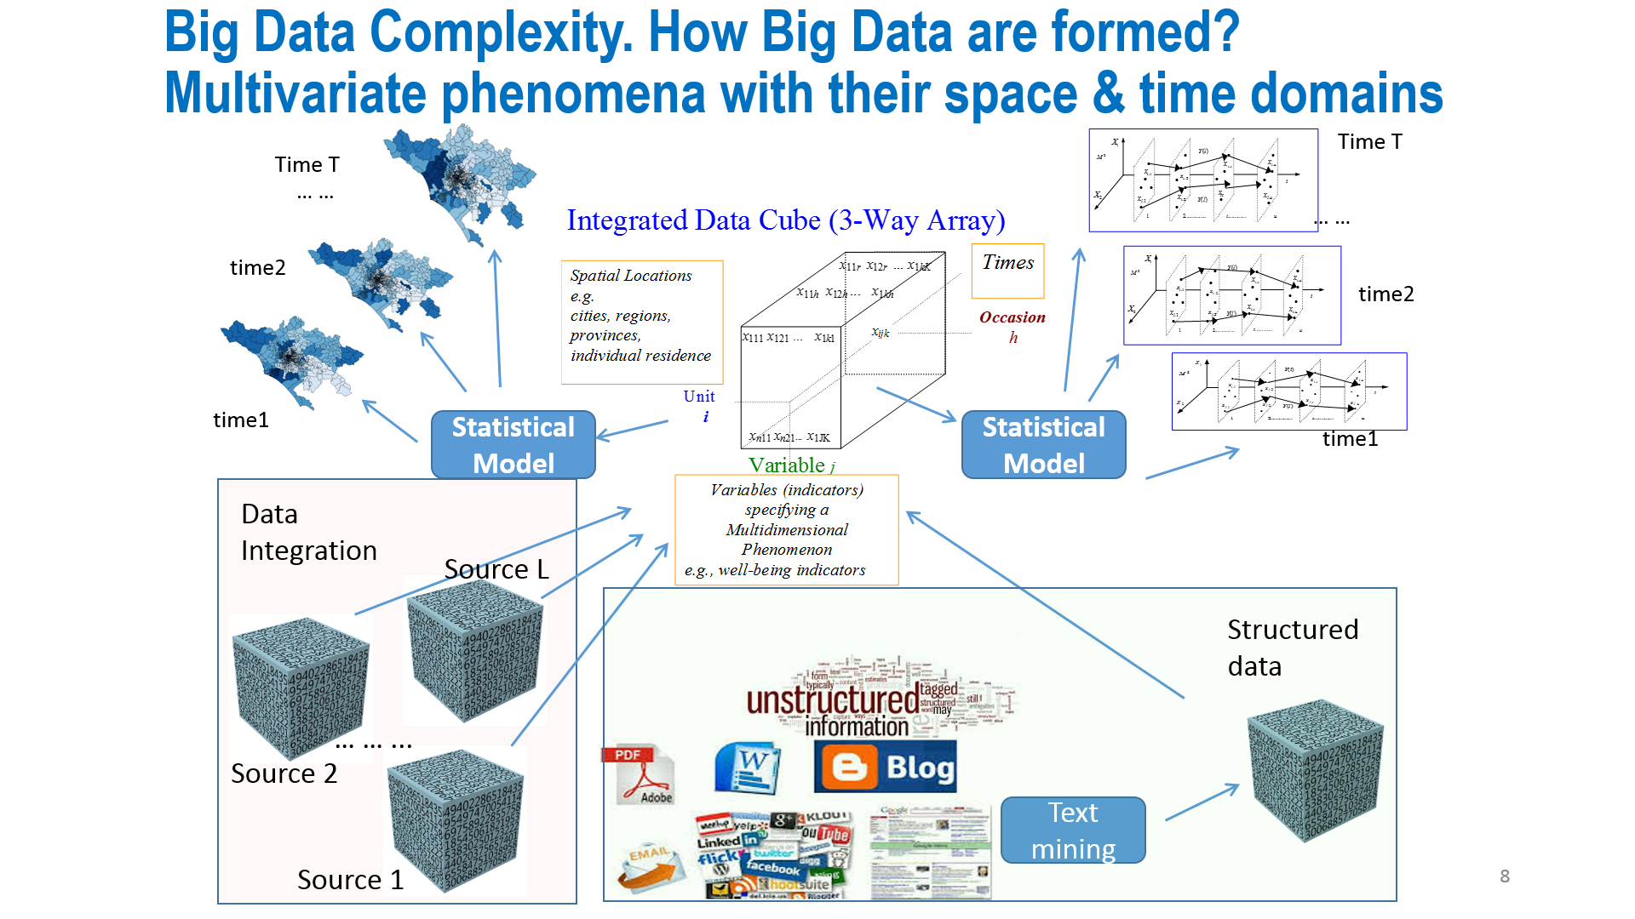
CONNECTIVITY, (to create Big Data)
need to link data by:
data Integration, record linkage, data fusion
reuse of administrative data
link of data from different sources for better measurement
COMPLEXITY, (to describe phenomena)
need to use detailed data to clearly read phenomena
- Multidimensionality of phenomena observed
in time and space domains
- High dimensionality of data (volume)
COMPUTABLE MODELS, (to produce Knowledge for decision-making)
need to use Statistical Modelling, Statistical learning, Computer Intensive Statistics,
- To confirm a theory or explore the data and extract the knowledge

Slide 12
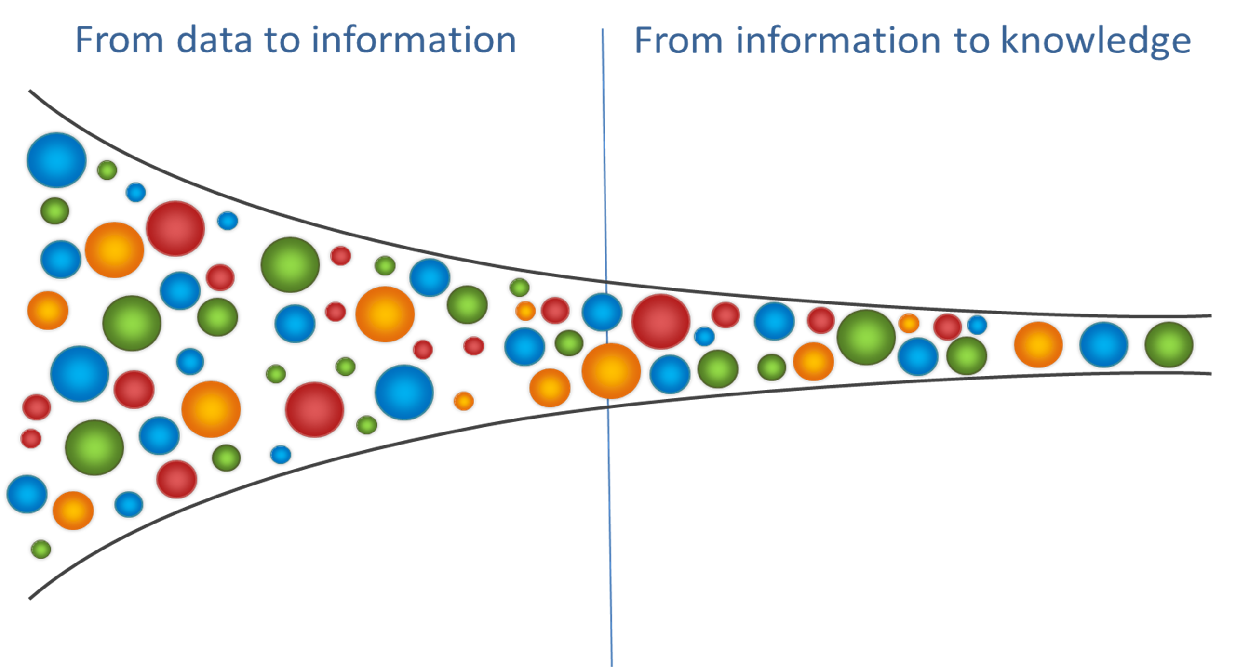
Following the Reduction of Complexity by Radermacher et al, 2016
12

Slide 13
Big Data = information + error (measurement)
Information = knowledge + residual (fitting deviation)
BIG DATA
ROBUST INFORMATION
MODEL-BASED
KNOWLEDGE
ROBUST INFORMATION
Big Data = information + error (measurement)
Information = knowledge + residual (fitting deviation)
13

Slide 14
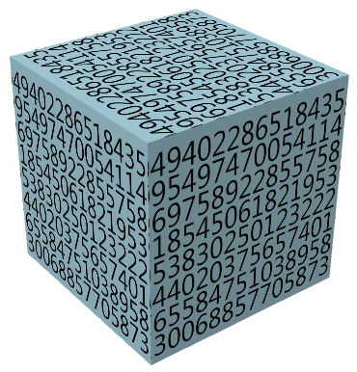



Big Data = information + error (measurement)
Information = knowledge + residual (fitting deviation)
Data Compression (reduce data of a given factor)
  Soft Data Compression (robustification)
  Soft Data Fusion
Statistical Modelling at the level of compressed data
  Dashboard, SEM, Composite Indicators,
  PCA, Factor Analysis, MCA,
  Classification (Discriminant analysis, trees, SVM),
  Multidimensional scaling,
Hard Data Compression (Data mining)
Taxonomy (science of classification)
Clustering to identify typologies of objects, variables, occasions
T
n
R
$$\overline{\text{Y}}$$
X
K
13
J
Q

Slide 15
BIG DATA
Statistical Big Data generation & analysis

Slide 16
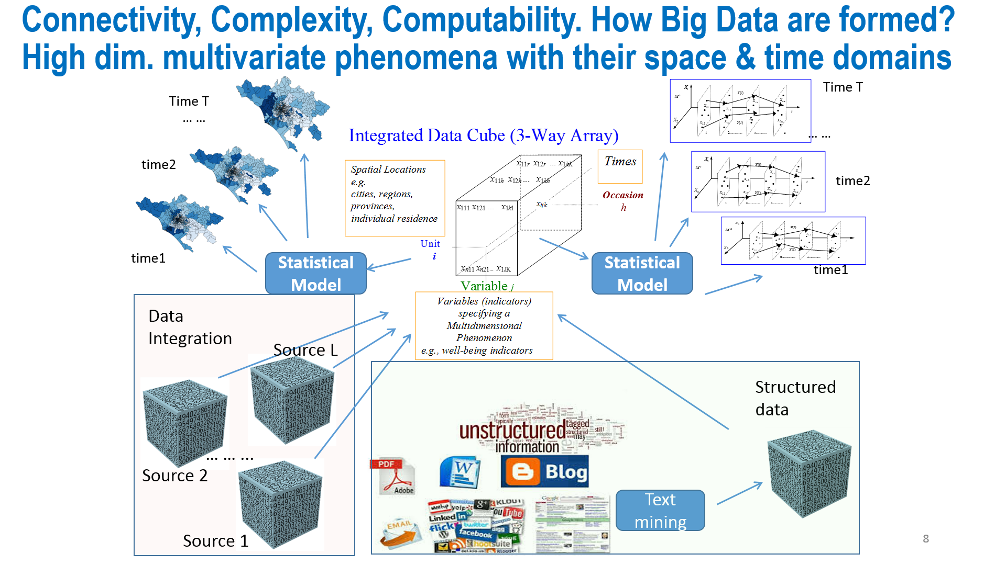
HOW BIG DATA ARE FORMED & ANALYSED
COMPUTABLE
MODEL
COMPLEXITY
COMPUTABLE
MODEL
CONNECTIVITY

Slide 17
NEW METHODOLOGIES

Slide 18
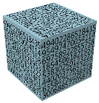
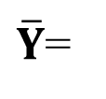
Multi-mode clustering for compressing data
1. Symmetric treatment of Units (Rows), Variables (Columns), occasions (Tubes)
Partitioning for Units
Partitioning for Indicators.
Partitioning for Occasions
Result: reduced set of K mean profiles for Units (Rows)
reduced set of Q mean profiles of Variables (Columns);
reduced set of R mean profiles of Occasions (Tubes);
Data
array
Partition of units (rows)
Membership matrix U
Centroid
array
X=
Multi-mode
Clustering
Partition of variables (columns)
Membership matrix V
$\overline{Y}$=
Partition of occasions (tubes)
Membership matrix W

Slide 19
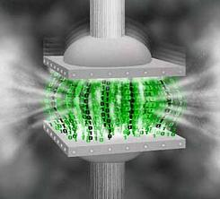
Why Multi-mode clustering?
Extract relevant information from Big Data
Data Compression (reduce data of a given factor)
  Soft Data Compression (robustification)
  Hard Data Compression (Data mining)
Taxonomy (science of classification) to identify typologies of objects, variables, occasions

Slide 20
Clustering & Dimensionality Reduction

Slide 21
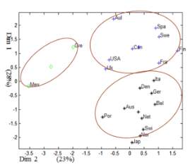

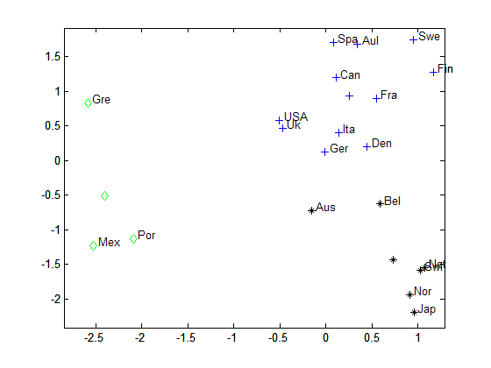
Clustering and Dimensionality Reduction
2. Asymmetric treatment of Units (Rows), Variables (Columns), occasions (Tubes)
Clustering for Units
Factorial methods for Variables and Occasions (COMPOSITE INDICATORS)
Result: reduced set of K means profiles for Units
reduced set of Q and R components (disjoint factors) for variables & occasions
Partition of units (rows)
Membership matrix U
X=
Clustering &
Dimension Reduction
Factors for variables
Loading matrix B
x₁₁₁ ...x_{1n1}
Factors for occasions
Loading matrix C
x₁₁₁ ...x_{1n1}

Slide 22
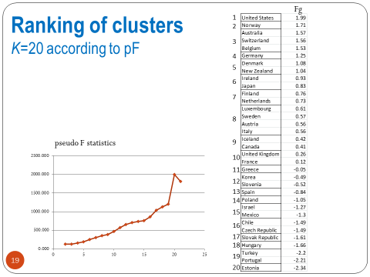
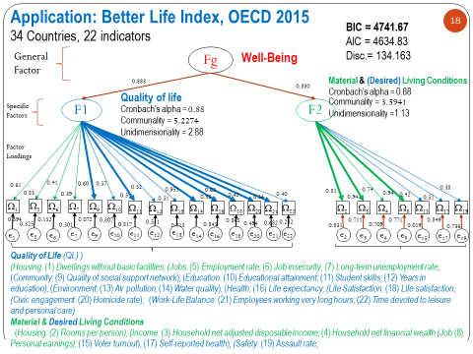
Simultaneous
Clustering & Hierarchical Composite Indicators

Slide 23
Concluding Remarks
INTERNET and TECHNOLOGIES are quickly EVOLVING
STATISTICS must follow more quickly the radical changes
dealing with
Connectivity (data integration)
Complexity (complete description of phenomena)
Computable models (use statistical models for knowledge)
NEW METHODOLOGIES
  take into account the multi-dimensionality of the phenomena and for each dimension of the data produce a modelling result
  (e.g., clustering, regression, factorial reduction …).
  FINAL REMARK: STATISTICAL EDUCATION becomes quickly obsolete
  A CONTINUOUS TRAINING IS NEEDED (adaptive & personalized)

Slide 24


