Slide 1
Could unofficial data sources offer a complementary lens to monitor cultural and creative activities?
Michaela Saisana
Valentina Montalto
CESS - Budapest, 20-21 October 2016

Slide 2
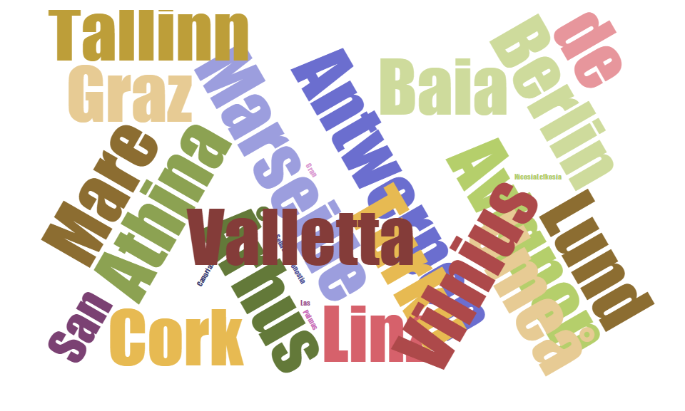
The Cultural and Creative Cities Monitor
(C3 Monitor)
2016 Edition

Slide 3
12 Policy Dimensions
Cultural Participation & Attractiveness
Innovation
Entrepreneurship & New Jobs
Material Living Conditions
OUTCOMES
Creative and Knowledge-based Workers
Cultural Venues & Facilities
Human Capital & Education
University Appeal
INPUTS
Openness, Tolerance & Trust
Sustainable Urban Design
Accessibility – local & international
Governance & Regulations
ENABLERS

Slide 4
Selection criteria
177 cities from 30 countries selected (28 EU + NO and CH)
89 European Capitals of Culture (up to 2019), or that were shortlisted to become one (up to 2021)
22 UNESCO Creative Cities
66 cities hosting at least two International Cultural Festivals

Slide 5
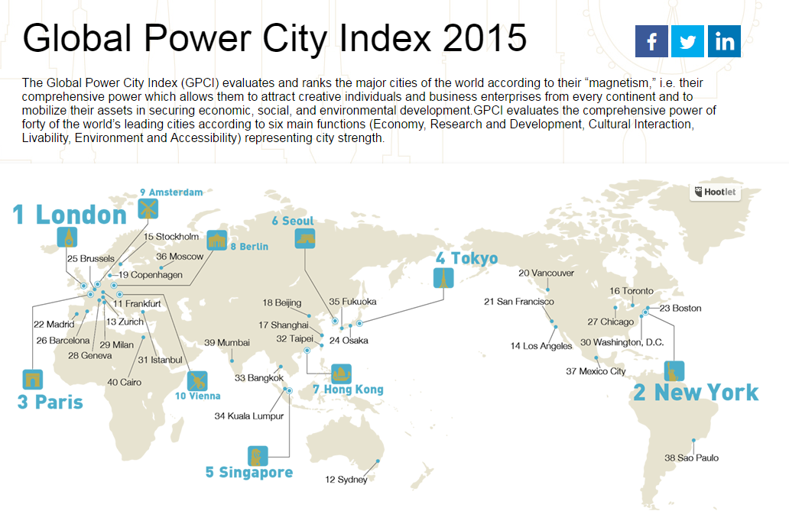




Turbulent growth of monitoring tools

Slide 6



Objectives of the C3 Monitor
Develop a common-evidence base at city level to:
  Illustrate the importance of culture and creativity to improving socio-economic perspectives and resilience for a diverse sample of cities.
  Support policy makers to identify specialisation strategies for their cities, assess policy actions and learn from peers based on comparable results.
  Stimulate new research questions and approaches contributing to the impact assessment of culture and creativity based on a pool of comparable data.

Slide 7
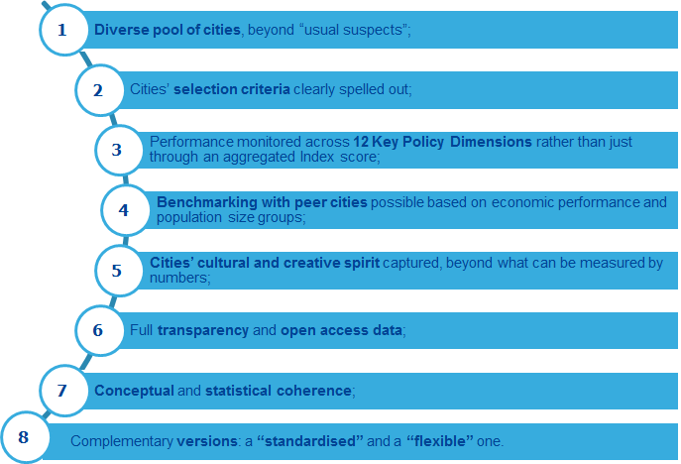
The 8 desired features

Slide 8

Methodology
Theoretical framework
  Literature review on culture, creativity & related indices
  Experts’ consultation
Data selection
  Very limited data at city level
  Accepted up to NUTS 3 level + NUTS 2 for governance
Data checking
  Outliers, missing data, and imputation based on peers (pop, GDP, employment)
Data processing
  Normalisation (0-100), weighting , aggregation, statistical coherence tests, uncertainty and sensitivity analysis
Visualisation
  Online Tool
  Reports (Policy, Tech.)
  Infographics

Slide 9
Data Sources
From Eurostat’s Urban Audit
(1000 cities)
177 cities
50 indicators
EUROPEAN COMMISSION
ADDITIONAL SOURCES
Eurostat
Urban Audit
Eurostat
Regional Statistics
Eurostat
Perception
Survey
Urban Data Platform
DG REGIO
ETER
Univ. Rankings
OECD
26%
24%
6%
12%
10%
16%
4%
2%

Slide 10
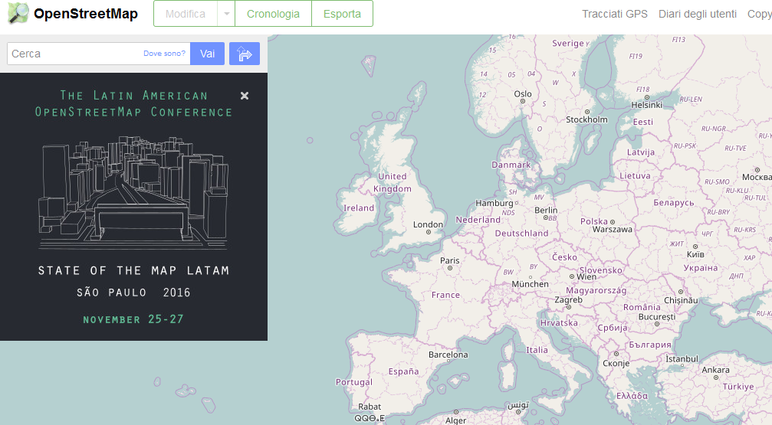


Non-official data sources are being explored
Arts, culture & creativity related events
Arts & culture venues (museums, concert halls, art galleries)
An App, to help gather citizens’ opinion and send suggestions to local authorities

Slide 11
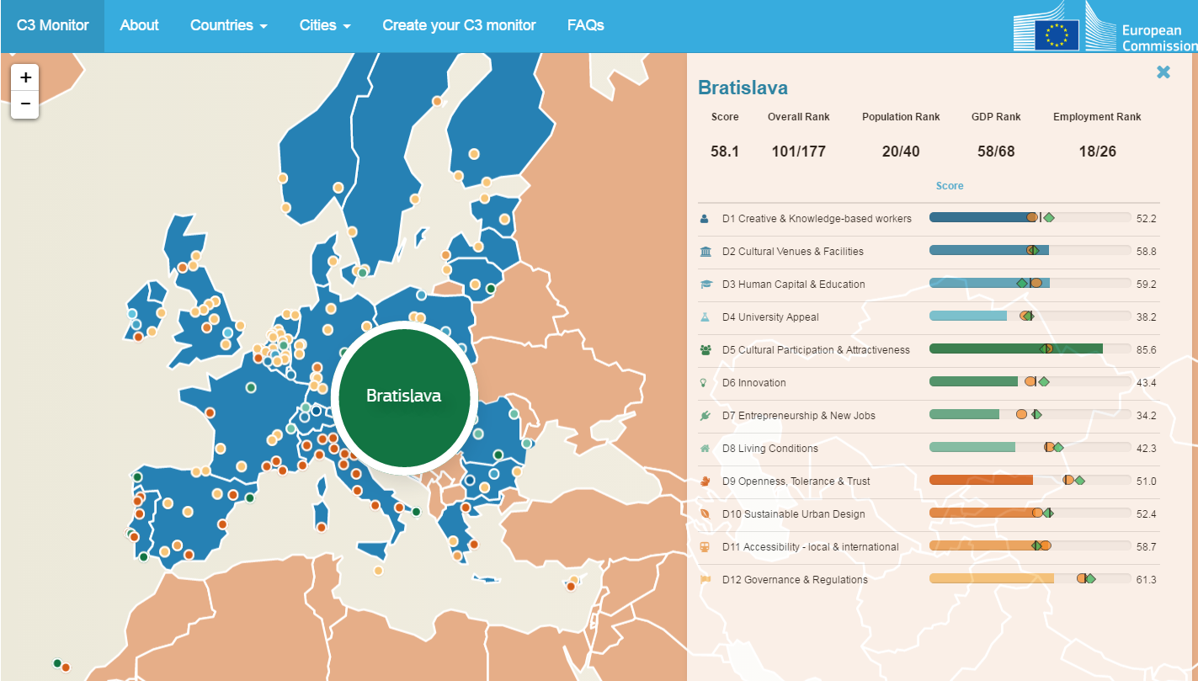
The C3 Online Tool
City xxx
City xxx

Slide 12
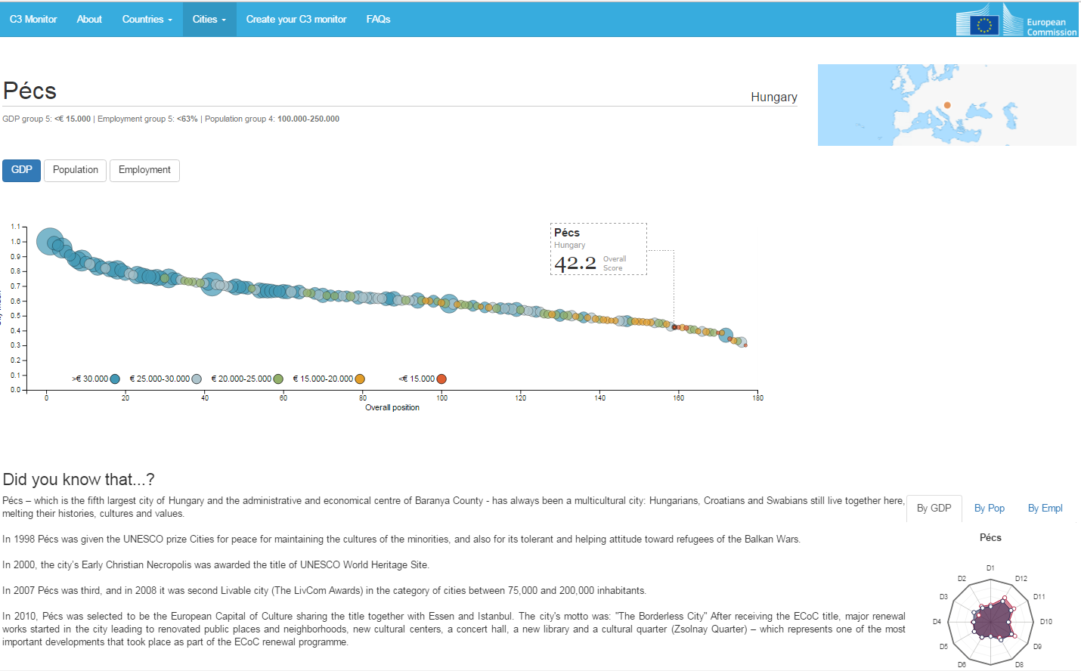
City page
A graph will show the city’s ranking position and allow for a comparison with similar cities in terms of GDP, population and employment rate

Slide 13
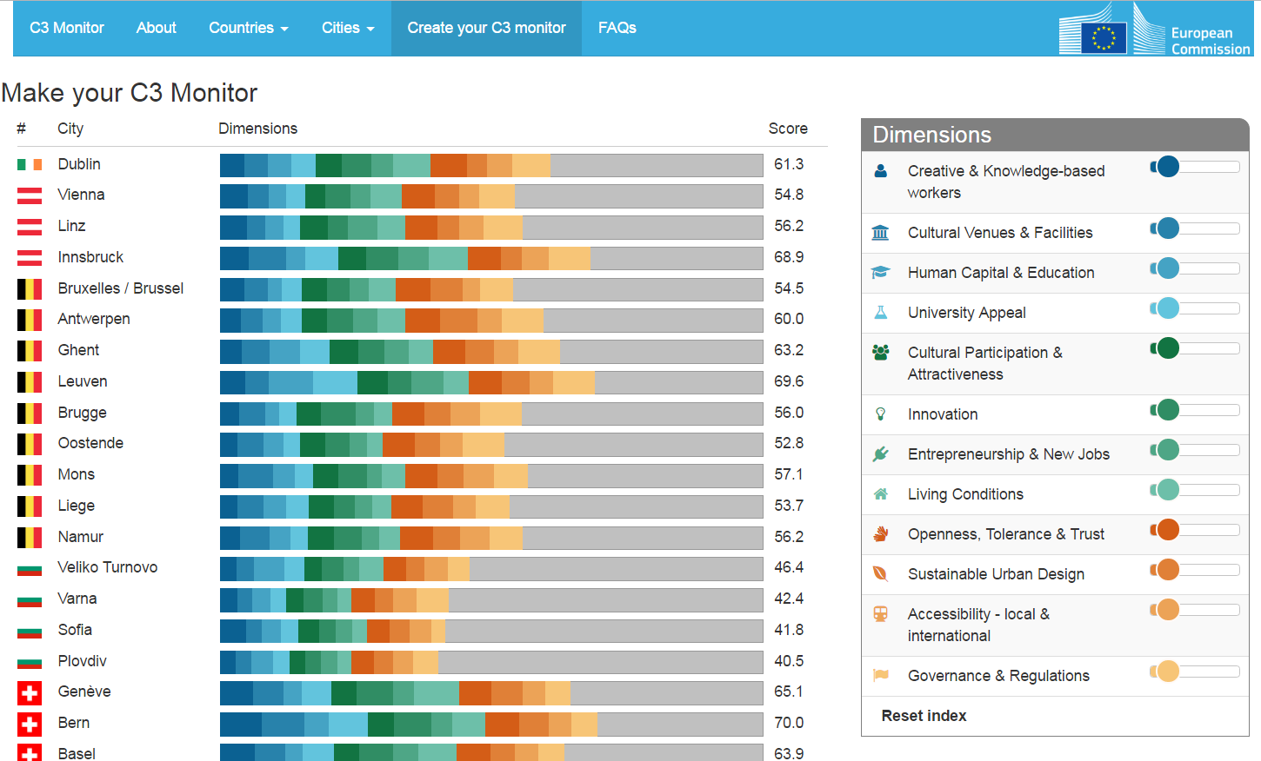
Make your Index page

Slide 14
Conclusions
  The C3 Monitor will provide both policy makers and researchers with a common-evidence base at city level;
  Its 50 indicators across 12 dimensions will allow monitoring a large and diverse sample of 177 Cultural and Creative Cities (CCC) across Europe;
  Still, the CCC concept remains extremely difficult to capture due to its multidimensional nature, as confirmed by statistical analysis;
  Big Data look promising – they could help complement official data and improve the Monitor’s capacity to keep track of CCC over time.

Slide 15
Next Steps
  OFFICIAL LAUNCH on 1st December in Brussels:
    Online Tool hosted on the COIN page:
    https://ec.europa.eu/jrc/en/coin
    Policy factsheet on key findings
    Detailed technical report
  Update every 2 years
Notes:
Big Data plan:
Work on classifications on OpenStreet Map in order to correctly classify facilities.

Slide 16






Stay in touch
EU Science Hub: ec.europa.eu/jrc
Twitter: @EU_ScienceHub
Facebook: EU Science Hub - Joint Research Centre
LinkedIn: Joint Research Centre
YouTube: EU Science Hub

Slide 17
Annex I
Indicator selection (snapshot: 2008-2015)
 | Dimension | Indicator | Source | Level
INPUTS | D1. Creative & Knowledge-based workers | Jobs in scientific activities (per inhabitant) | Urban Audit | City
 |  | Jobs in information and communication (per inhabitant) | Urban Audit | City
 |  | Jobs in arts and entertainment (per inhabitant) | Urban Audit | City
 | D2. Cultural Venues & Facilities | Cinema seats (per inhabitant) | Urban Audit | City
 |  | Theatres (per inhabitant) | Urban Audit | City
 |  | Public libraries (per inhabitant) | Urban Audit | City
 | D3. Human Capital & Education | Students enrolled in higher education (ISCED 6-7) (per inhabitant) | ETER | City
 |  | Graduates in Arts and Humanities (ISCED 6-7-8) (per inhabitant) | ETER | City
 |  | Graduates in ICT (ISCED 6-7-8) (per inhabitant) | ETER | City
 |  | Graduates (ISCED 6-7-8) (per inhabitant) | ETER | City
 | D4. University Appeal | Academic staff (per inhabitant) | ETER | City
 |  | Average appearances in university rankings (QS, Shanghai, Leiden, Times) (per inhabitant) | QS, Shanghai, Leiden, Times | City
 |  | Average number of ranked universities (in QS, Shanghai, Leiden and Times rankings) (per inhabitant) | QS, Shanghai, Leiden, Times | City

Slide 18
 | Dimension | Indicator | Source | Level
OUTCOMES | D5. Cultural Participation & Attractiveness | Tourist overnight stays in reg. accommodation (per inhabitant) | Urban Audit | City
 |  | Cinema attendance (per inhabitant) | Urban Audit | City
 |  | Museum visitors (per inhabitant) | Urban Audit | City
 | D6. Innovation | ICT patents (per inhabitant) | Regio. stats | NUTS3
 |  | High-Tech patents (per inhabitant) | Regio. stats | NUTS3
 |  | PCT patents (per inhabitant) | OECD | Metro
 |  | EUTM applications (per inhabitant) | Regio. stats | NUTS3
 |  | Community design (CD) applications (per inhabitant) | Regio. stats | NUTS3
 | D7. Entrepreneurship & new jobs | New enterprises born in ICT (per inhabitant) | Regio. stats | NUTS3
 |  | Jobs in new ICT enterprises born (per inhabitant) | Regio. stats | NUTS3
 |  | New enterprises born in science (per inhabitant) | Regio. stats | NUTS3
 |  | Jobs in new science born enterprises (per inhabitant) | Regio. stats | NUTS3
 |  | New enterprises in education and social activities (per inhabitant) | Regio. stats | NUTS3
 |  | Jobs in new edu/soc born enterprises (per inhabitant) | Regio. stats | NUTS3
 |  | New enterprises in arts and entertainment (per inhabitant) | Regio. stats | NUTS3
 |  | Jobs in new arts/enter. born enterprises (per inhabitant) | Regio. stats | NUTS3
 | D8. Living conditions | Median household income | Urban Audit | City
 |  | Average household income | Urban Audit | City
 |  | Area of living accommodation | Urban Audit | City
 |  | Dwellings lacking basic amenities (per inhabitant) | Urban Audit | City

Slide 19
 | Dimension | Indicator | Source | Level
ENABLERS | D9. Openness, Tolerance and Trust | Foreign graduates (% of high edu. graduates) | ETER | City
 |  | Doctoral foreign graduates (% of doctoral graduates) | ETER | City
 |  | Foreign academic staff (% of academic staff) | ETER | City
 |  | Foreign-born as a proportion of population | Urban Audit | City
 |  | Tolerance of foreigners (% that strongly agrees) | Per. Survey | City
 |  | Integration of foreigners (% that strongly agrees) | Per. Survey | City
 |  | People trust (% that strongly agrees) | Per. Survey | City
 | D10. Sustainable Urban Design | Built-up areas per inhabitant | Urban Data Platform (UDP) | City
 |  | Artificial areas (per inhabitant) | UDP | City
 |  | Green infrastructure (per inhabitant) | UDP | City
 |  | Residential, industrial and commercial areas per inhabitant | UDP | City
 |  | Share of residential, industrial and commercial areas | UDP | City
 |  | Share of green infrastructure | UDP | City
 | D11. Accessibility - local & international | Passenger flights | DG REGIO | City
 |  | Long distance (> 5000 km) passenger flights | DG REGIO | City
 |  | Potential road accessibility | DG REGIO | City
 |  | Direct trains to other cities | DG REGIO | City
 | D12. Governance & Regulations | Quality of Government | DG REGIO | NUTS 2
Notes:
Green infrastructure per capita: Green Infrastructure (GI) is defined as a strategically planned and delivered network of high quality green spaces and other environmental features that are structurally and functionally “interconnected and therefore bring added benefits and are more resilient”. GI includes natural and semi-natural areas, features and green spaces in rural and urban, terrestrial, freshwater, coastal and marine areas. GI is calculated by reclassifying the LUISA land use map and provided in square meters per capita. 2010 on
Built-up areas: Total surface of built-up areas (buildings detected by means of satellite imagery analysis) per inhabitant. 2012
Artificial areas: build-up areas cover the land classified as urban, industrial and abandoned urban and industrial. Besides the built-up areas, artificial areas cover the infrastructure and the green urban leisure land classes. This indicator gives artificial areas per inhabitant in square meters for a specific year. 2010 on
Residential…: Areas cover the land classified as urban, industrial and commercial, and urban green leisure. The indicator gives residential, industrial and commercial areas per inhabitant in square meters for a specific year.
2010 on

