Slide 1

Data use in the policy making process from a research institute viewpoint
Andras Molnar
Head of Horizontal Analysis Department
Conference of European Statistics Stakeholders
Budapest, 2016.10.20-21.

Slide 2
Who we are…
Collect&manage data
Support polcicy making
Member of the Official Statistical Service
  Perform statistical data collection: seed, feed, food processing capacity, machinery market, inputs
Market price information
Liaison Agency of Farm Accountancy Data Network (FADN)
  Place of extended data collection beyond EU obligations
Administrative data
  Integrated administration and control system
  Electronic livestock registration
Impact assessment of policy intervention/programs
  RDP
  CAP post 2020 modelling
Research initiatives supporting legislation development
  Risk management, irrigation
Spatial information
  Irrigation
  Climate-change

Slide 3
Current trends in data needs&use
NEEDS
Increase ability to produce more detailed statistics
Time series
Data quality&consistency
Less burden on data collection and up-to-date
SOLUTIONS
Use of multiple sources, data-warehousing
  Classification is the key to link different sources
Complete data history
Rules, codes, descriptions
Efficiency in processing (engines, automatic)

Slide 4
Data Dimensions: Classifications
Variable:
Production
Subject:
Other Gainful Activity
Unit:
Quintals
103
Type:
Processing of cow’s milk
Year:
2015
ID:
HU768.7.75195
<table letter>_<group>_<category>_<column>_<unit>
L_PR_261_MD_Q

Slide 5
Challenges of data management
Development of comparable/standard processes
Promote central, „intelligent”, non-personal research ID to link different sources but keep anonymity
Maintenance of classification
Harmonization of quality frameworks
Harmonization of legal requirements

Slide 6
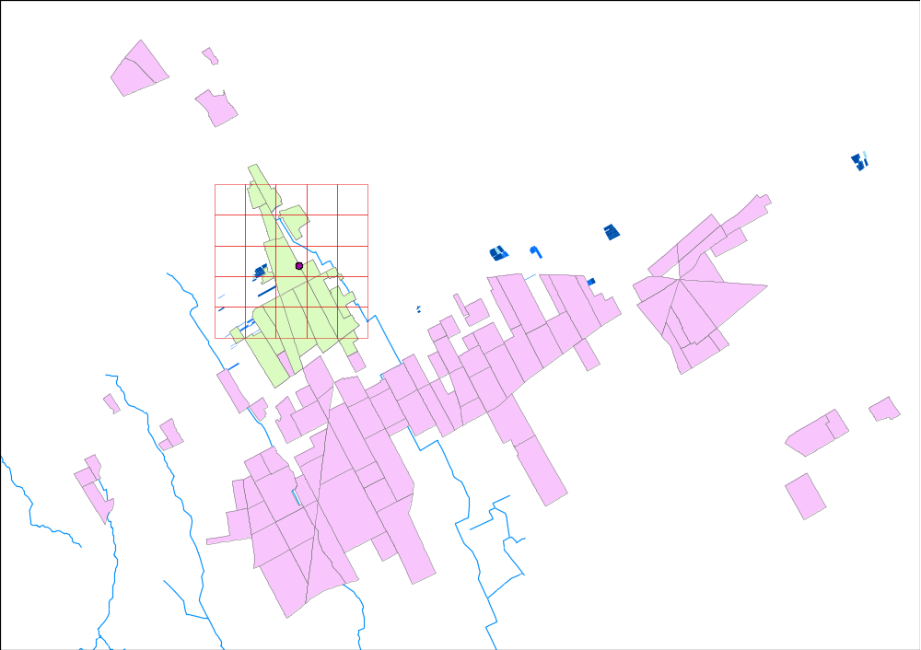
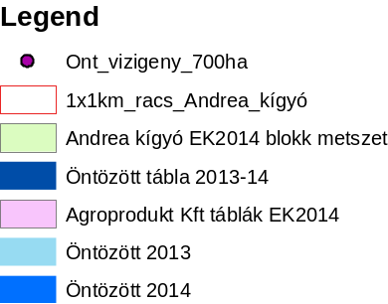
Limits of simplification

Slide 7
Data Processing & Control
Source
Pre-Processing
Staging
ETL
DWH
ETL
DM
Data disclo-sure
Dimension validation
Measure validation
History
Attribute creation
Aggre-gation
Outlier control
Classifi-cations
Validation rules
Classifi-cations
Business rules
Outlier rules
Data management
Source: WUR

Slide 8
Take home message
Increasing needs of integrated data use
Classification is the key! …and the process of IDM
Usability: researchers will have to easily ‘construct’ their information (BI, documentation)
Open data: is a challenge in terms of „marketing”…
Data ownership ≠ Data use
Technology is ready, legislation needs to follow!

