Slide 1
Challenges in the Use of Administrative
(and “Big”) Data for Statistical Purposes
Dániel Vértesy
Conference of European Statistics Stakeholders
Budapest, 20–21 October 2016

Slide 2
Overview
What is the broader context? a tale of two innovations
The opportunities and realities in using administrative data for policy
In the context of two examples from a users’ perspective:
  Composite indicators
  Counterfactual impact evaluation

Slide 3
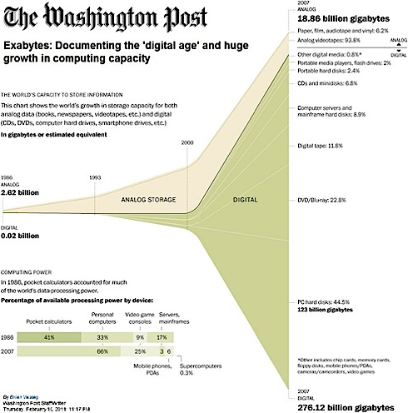
A tale of 2 innovations
(1) A technological innovation:
data revolution in the digital age
  Improvements in
  computing power &
  data storage
  Increased capacity
  Cheaper access
=>Diffusion of “Big Data”
“Exabites: documenting the digital age...” The Washington Post, 10 Feb 2014

Slide 4


A tale of 2 innovations
(2) A Social (organizational) innovation:
the rise of the “audit society” (Power, 1994)
Diffusion of ‘New Public Management’ theory & practice;
Performance-based budgeting, evidence-based policies
Demand for frequent measurement of efficiency and productivity to ensure better spending
Rise in human resources in science and technology
Amplified by the financial crisis

Slide 5

Computing power & storage capacity
  Lowers entry barriers to data collection, dissemination, combination
  Breaks natural monopoly of statistical data provision
    More distributed, but
    More heterogeneous in quality
  Facilitates computation-intensive analyses

Slide 6

The “audit society”
  Increased demand for performance measurement
    at multiple levels: from the shop-floor to the country-level
  Globalization => benchmarking
    comparison of ever-more distant things
  Calls for greater accountability of policies
    Ex ante legitimization of intervention; ex-post demonstration of success
    ‘Bang for the Buck’ vs. Big Brother!

Slide 7

A transition to manage!
Challenges to official statistics:
Respond to policy demand for timelier, more fine-grained data
(in competition with private or non-official data providers)
How to manage big data, while assuring quality?
(accuracy, and reliability, timeliness, accessibility, coherence and comparability, etc.)
Challenges to researchers:
improve methods to combine data from multiple sources, avoid GIGO; study social outcomes using fine-grained data
Ensure replicability [confidentiality; continuously updated data]
Challenges to policy makers:
Ensure the robustness of evidence
Confront publics skeptical of facts
JRC

Slide 8
Why is administrative data of interest for evidence-based policy making?
Better measure issues of interest / monitor policy
Use them as novel indicators
Augment existing indicators [i.e., improve coverage, timeliness...]
Understand causal relationships in economic and social processes
Evaluate the impact of policy interventions
Developing & Composite Indicators
Experience at the JRC
Microeconomic Evaluation

Slide 9



Administrative data for research purposes
Examples of admin data:
academic participation and outcomes,
employment, earnings and retirement,
health care services,
demographic events, etc.
<-> Other sources of “big data”:
Commercial and transactional data
Sensor data from e.g. satellites
Tracking data from e.g. mobile telephones or GPS
Behavioral e.g. on-line search
Opinion e.g. comment on social media, etc.

Slide 10
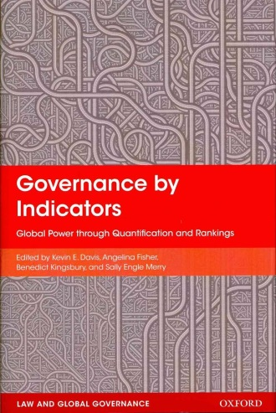
[1] Data -> Indicators for policy monitoring
“The burgeoning production and use of indicators in
global governance has the potential to alter the forms,
the exercise, and perhaps even the distribution
of power in certain spheres of global governance”
Indicators = a numeric representations of the real world
“a named collection of rank-ordered data that
purports to represent the past or projected
performance of different units.” (Davis et al., 2012)
Used for benchmarking, evaluation = for policy purposes
Abstraction: quantification involves modeling assumptions
METADATA is crucial to keep track of information loss

Slide 11

Indicators <=> Policy: a two-way interaction
    Indicator development is shaped by policy needs / discourse
    Indicators, in turn, influence policy discourse
indicators are embedded in a socio-political context; reflect the policy discourse (Godin, 2002)
“Goodhart’s law”: when an indicator becomes the target, it stops being a good indicator
The “agora model” (Barré, 2001, 2010): indicators are debating devices – it’s the process that matters!
=> Continuous development process
...enter ADMINISTRATIVE DATA...

Slide 12
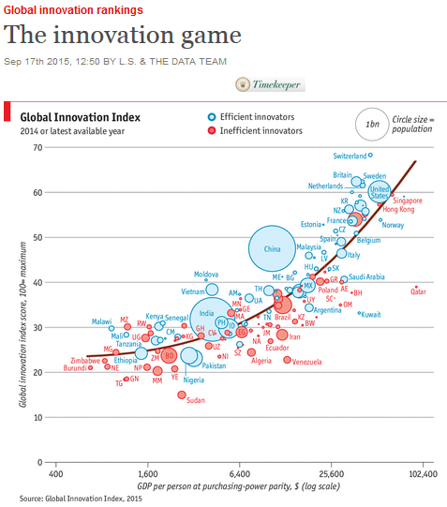

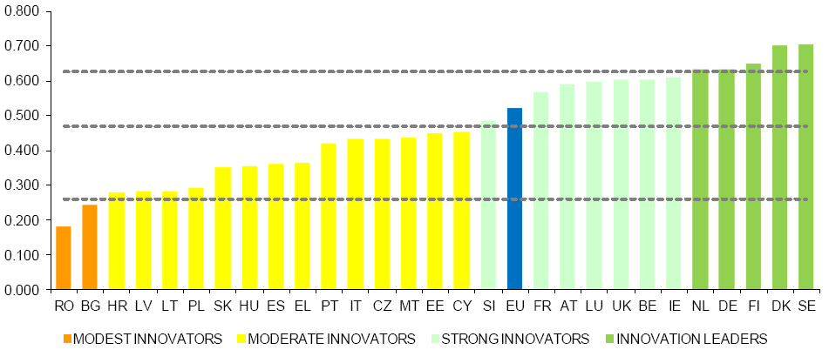
Using admin data in scoreboards and composite indicators
...To see the big picture / raise awareness
Usually other forms of big data, rather
than administrative data are used...
offers scalability, improvements in
coverage, timeliness, etc.
Challenge: deal with greater
heterogeneity in quality
<= Methodologies developed for
integrating data from multiple sources
are relevant!
Notes:
I want to address the issue of QUALITY...

Slide 13
Composite Indicators
Advantages:
  Support decision makers by summarizing complex or multi-dimensional issues
  Provide the “big picture”, highlight common trends
  Measure a latent phenomenon that is not directly measureable
  Attract public interest by benchmarking
Pitfalls:
Offer misleading, non-robust policy messages if they are poorly constructed or misinterpreted
May invite politicians to draw simplistic policy conclusions
Easier to “manipulate” than individual indicators; the selection of sub-indicators and weights could be the target of political challenge
The development process helps
Better understand how a
system functions
Identify latent dimensions,
overlaps, redundancies or
trade-offs between components
Assessing their quality and validity is particularly relevant

Slide 14
“Composite indicators sit between analysis and advocacy, but
quality discriminates the plausible from the rhetorical” (Saltelli, 2007)

Slide 15
The Quality of Composite Indicators
Quantification (modelling) involves making normative choices
Indicators are intrinsically linked to policy priorities!
Normative choices affect:
the concept;
the operationalization;
accounting for information loss
Developers and users should be fully aware of the normative choices
What actors to include?
Which measure is more relevant?
What indicators to include
How to address data quality issues?

Slide 16

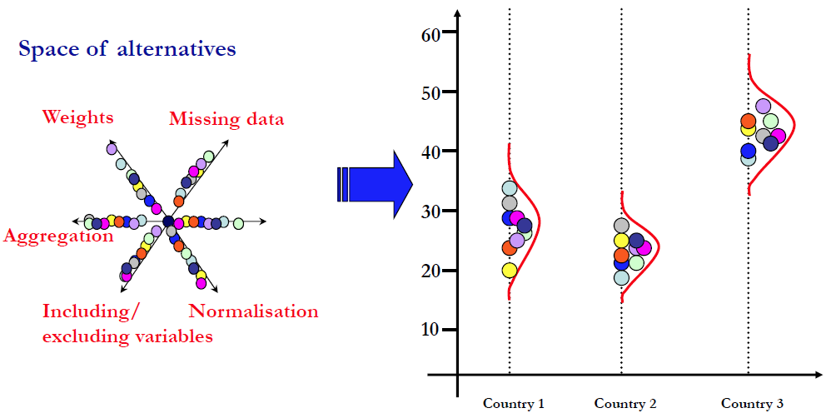



The Importance of Uncertainty and
Sensitivity Analyses
Refined methodology of audits – robustness and sensitivity
analyses (i.e. Saisana et al, 2011; Paruolo et al, 2013)
See also: Saltelli (2007); Saisana et al (2005)

Slide 17
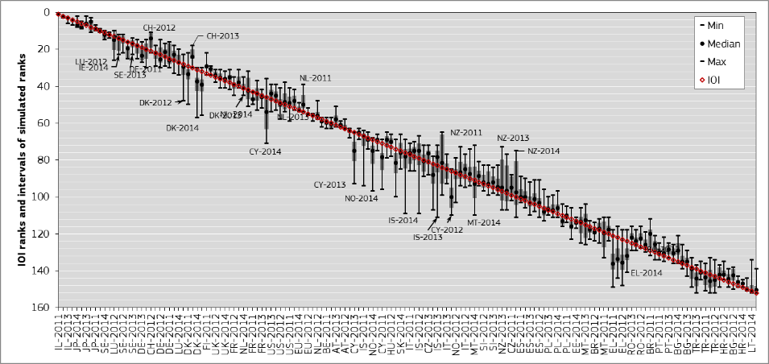
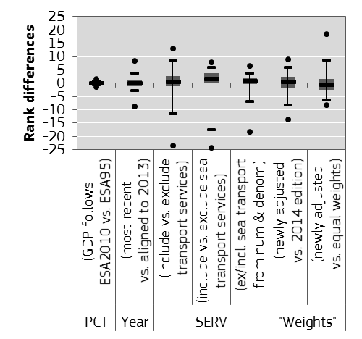
Uncertainty analysis
Indicators obtained from different sources are of different quality.
there may be more than 1 way of specifying a certain indicator
uncertainty in the measurement;
The uncertainty is carried over to the aggregate(s)
Administrative data, like any data, introduces some degree of uncertainty.
We can – and should – measure to what extent the modelling choices influence aggregate scores and country rankings!
See also: Paruolo et al (2013); Saisana et al (2011);

Slide 18
Conclusions – Composite indicators
Opportunities in using admin – and “big” – data:
Can improve quality of policy messages from certain aspects (timeliness, coverage, etc.) of official statistics
But need to be careful with the “noise” it may introduce
Needs to be measured, applying sensitivity and robustness analyses
Realities:
Systematic use of admin data for monitoring purposes requires regular access to reproducible large micro-data sets which is costly

Slide 19
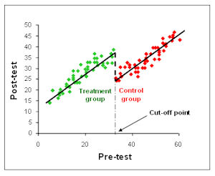
[2] Data -> Impact evaluation
What was the impact of a policy intervention?
=> Counterfactual impact evaluation
“What would have happened to those receiving
the intervention if they had not in fact received the program?”
As we cannot observe the group with and without the intervention, the key challenge is to develop a counterfactual –
  that is, a group which is as similar as possible (in observable and unobservable dimensions) to those receiving the intervention.
  This comparison allows for the establishment of definitive causality – attributing observed changes in welfare to the program, while removing confounding factors.
=> Study necessitates obtaining fine-grained /individual-level/ data!

Slide 20
Admin data for research use: Opportunities
Administrative data vs. Survey data
Larger (full population vs. census)
  more sophisticated research designs; ability to capture important rare events
  Inherent longitudinal structure
    Follow individuals over time if collected regularly
  Higher quality
    Less affected by non-response; attrition bias; under-reporting less of a problem; already subject to accuracy tests
  Easier to link with other data [unique IDs]

Slide 21
Admin data for research use: Realities
Access to admin data = still a privilege
  Still underused for research purposes
  Access locations: very few [costlier than you think!]
Linking different data-sets multiplies difficulties
access, possibility of re-identification, etc.
  Privacy & security concerns
Political concern about publishing negative results
The more concrete, the more concerned
The less analyses carried out, the more attention one result garners
If the “audit society” demands more evidence on policy impacts, it has to invest in necessary micro-data infrastructure & statistical literacy

Slide 22

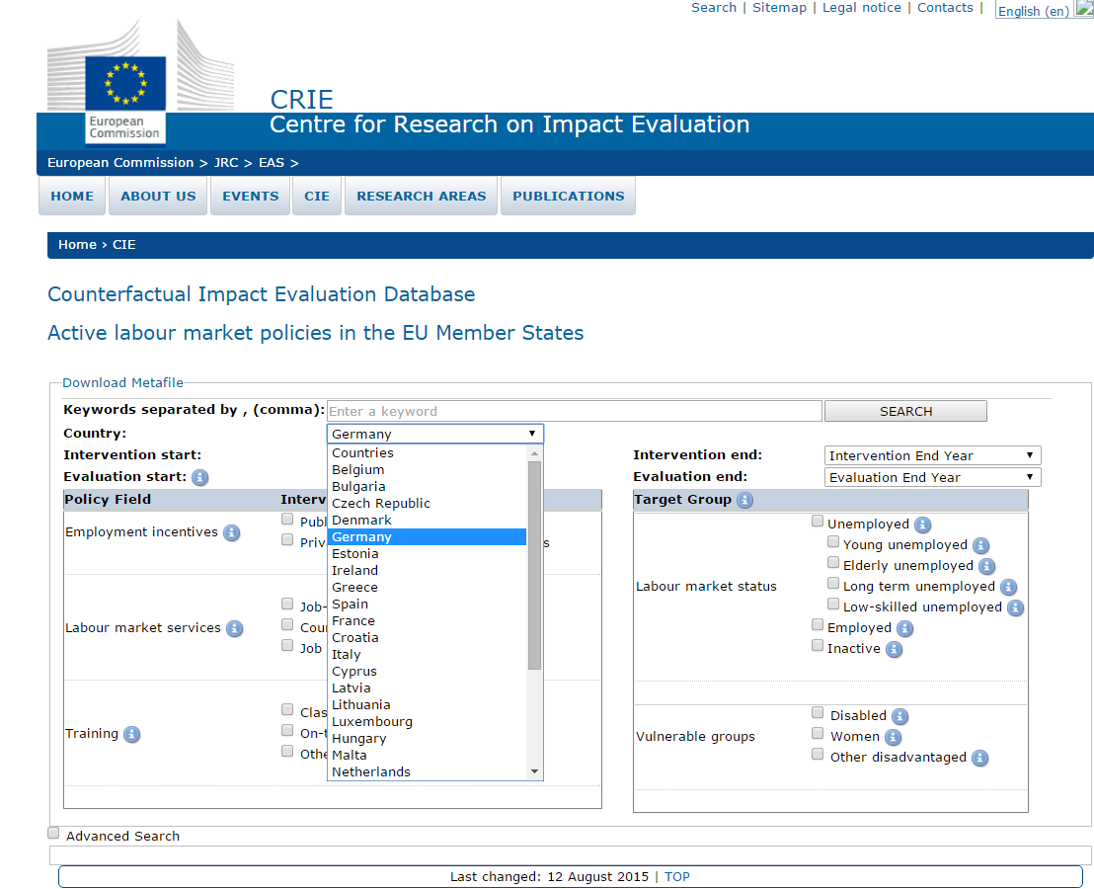
Counterfactual Impact Evaluation Archive
Focus on employment, social inclusion and education policies
173 delegates from 33 countries
11 % from the European Commission
33 % from Universities
56 % from Governmental Institutions
61 scientific papers, mostly on labour market and social inclusion programmes
See also: The work of The World Bank
on Counterfactual impact evaluation

Slide 23
Conclusions – Impact evaluation
Administrative micro-data, especially when combined with other sources of big data, and the use of advanced methods for statistical analyses offer unprecedented insights into social processes, thereby strengthening evidence-based policy making.
At the same time, the "net" social benefits depend on the ability to ensure that concerns of privacy, and confidentiality are fully respected.

Slide 24
Conclusions (cont’d)
How to govern the use of admin data responsibly? (J. Simon, 2016)
  Deal with ethical issues?
How to develop the infrastructure for sharing the data?
How to ensure greater access to the researcher community?
    Who decides access, based on what criteria?
    How to provide access? (physical infrastructure, capacity, support better geographical distribution through secure remote connections, conducting checks?)
    Who can / should bare the costs?
    NSOs sufficient?
  How to ensure quality and privacy throughout the process?
    Checks, monitoring to ensure safety; while help disseminate results in a timely manner
  Develop competencies
    for regulation; for statistical literacy – interpreting indicators, uncertainties

Slide 25
Back to the two innovations
How to deal with the diffusion of the 2 innovations...?
  Beyond regulations, develop competencies
    for regulation;
    for statistical literacy:
    interpreting indicators, results, uncertainties...
    reflexivity
    ...in the society at large / policy makers

Slide 26

THANK YOU
FOR YOUR ATTENTION!
 daniel.vertesy@jrc.ec.europa.eu
 http://ec.europa.eu/jrc/en/coin
Composite Indicators Research Group (JRC-COIN); European Commission, Joint Research Centre (JRC)

Slide 27
References
D. Card et al , R. Chetty, MS Feldstein, and E.Saez, Expanding access to administrative data for research in the United States. American Economic Association, Ten Years and Beyond: Economists Answer NSF's Call for Long-Term Research Agendas (2010).
D. Card, R. Chetty, et al, Expanding access to administrative data for research in the US. Amer. Econ. Assoc, Ten Years and Beyond: Economists Answer NSF's Call for Long-Term Research Agendas (2010)
L. Borchsenius, New Developments in the Danish System for Access to Micro data (2005)
V. Mayer-Schönberger and K. Cukier, Big Data. A Revolution That Will Transform How We Live, Work, And Think. New York: Houghton Mifflin Harcourt. (2013)
Zs. Cseres-Gergely, A. Scharle and A Foldessy, Evaluating the impact of a well - targeted wage subsidy using administrative data, Budapest Working Papers on the Labour Market 1503 (2015)

