Slide 1
 | Statistical Data on Population Research in Romania: User Experiences
Valér Veres
associate prof.
Babes-Bolyai University

Slide 2
Statistical datasources for research in Romania
Census data: www.recensamantromania.ro
Administrative data: INS (National Institute for Statistics)
Other Ministry or National Agency statistics (No public)
Vital statistics www.insse.ro /tempo_online
Migration statistics tempo_online

Slide 3
Census data: 2011
All people it should have to be interviewed by an enumerator during data collection period.
Depending on each individual situation, people should be classified in an unique category and his/her personal information should be fulfilled on a specific type of questionnaire. The four categories are:
-present person (P) or
-temporarily absent person (TA) or
-temporarily present person (TP) or
-person left for a long period of time (PPI)

Slide 4
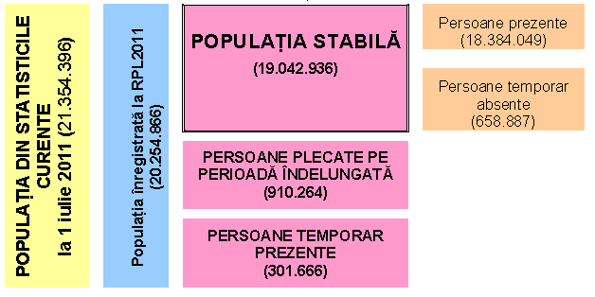
The figures

Slide 5
Data imputation
After processing the individual forms, the under-registration found in 2011 Census’s provisional results processing stage was confirmed.
Therefore, methods have been applied to ensure the census data completeness, using both the method of indirect collection from administrative sources and statistical techniques for imputation of data
There were 1,183 thousand persons not enumerated in the Population
and Housing Census of October 2011 (hereinafter, PH C 2011) and identified at
the administrative data sources level.
The main problem: no legal fondation for this action

Slide 6
The administrative data used for finalizing the results of 2011 Census:
The National Register of Personal Data (RNEP) – managed by the Directorate for Persons Record and Databases Management; •
Statement on obligations to pay social security contributions and income tax, and the nominal records on insured persons - D112 – managed by the National Agency for Fiscal Administration; (64%)
•Record of Employees - IM – managed by the Labor Inspectorate;
•CNPP database – managed by the National House of Public Pensions (CNPP);
•CNAS database – managed by the National Health Insurance House (CNAS); (11%)
•Tax Registration Statement / Statement for individuals who carry outeconomic activities independently or liberal professions – D70 - managed by the National Agency for Fiscal Administration;
Other ( beneficiaries of s state child allowance (16%), Database of enrolled students etc)

Slide 7
User problems with this data completions
The 1,183 thousand people have no self reported coltural or reproductive data:
Ethnicity
Other citizenship
Mother tongue
Religious afiliation
No. Of children ever born,
The age of the mother when the children was born
Marital status (if legal partnership)

Slide 8
The Disseminationof the results
Between december 2013 –may 2014: 4 printed definitive results volumes: Volume I : Usual resident population –Demographic structure – 62 tables included
Volume II : Usual resident population – Ethnic and confessional structure - 34 tables included
Volume III : Usual resident population – Socio-economic structure - 58 tables included
Volume IV : Buildings, dwellings, households - 53 tables included
V. General results population, households, dwellings (45 tables included, Englisg summarry version
Online results: http://www.recensamantromania.ro
Problems: Some data crosstabs are not available on the level of the counties, most of data are no available for the cities/ localities

Slide 9
Results for pay
We can command special corsstabulaton for costs:
Ex: Etnicity, for a specific city
Time for preparation of tables: 10-15 days.
Costs: 100-200 euro for a county level table, 4 variables (etnicity, sex, urban/rural multi-crosstabulation)

Slide 10
Other data sources: TEMPO Online
Online database: generally used, administrative data collection
Pay-system, some data are free of charge
Monthly prescription ot yearly (400 eur per year, for a civic association)
www.insse.ro /Tempo online
Content:
Population number etween censuses
Vital statistics
Migration statistics
Education, labor, health data
Economic, financial, labour force, companies data

Slide 11
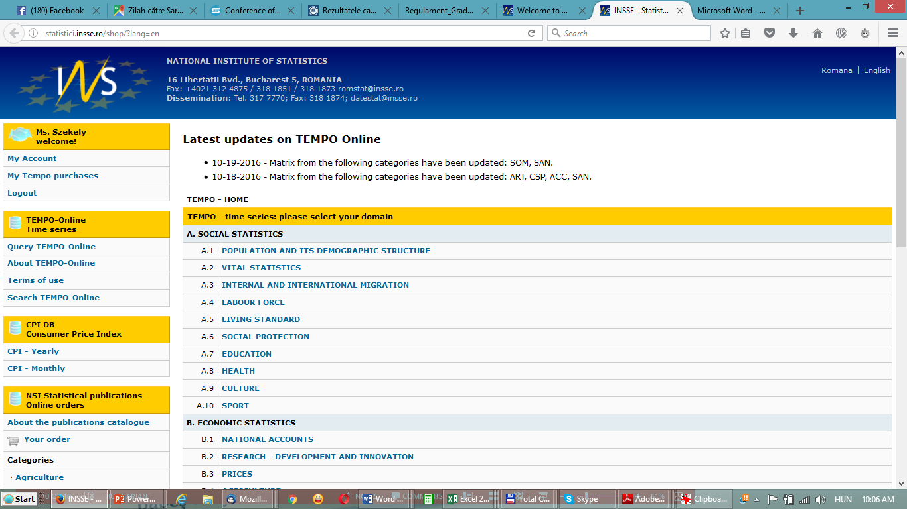

Slide 12
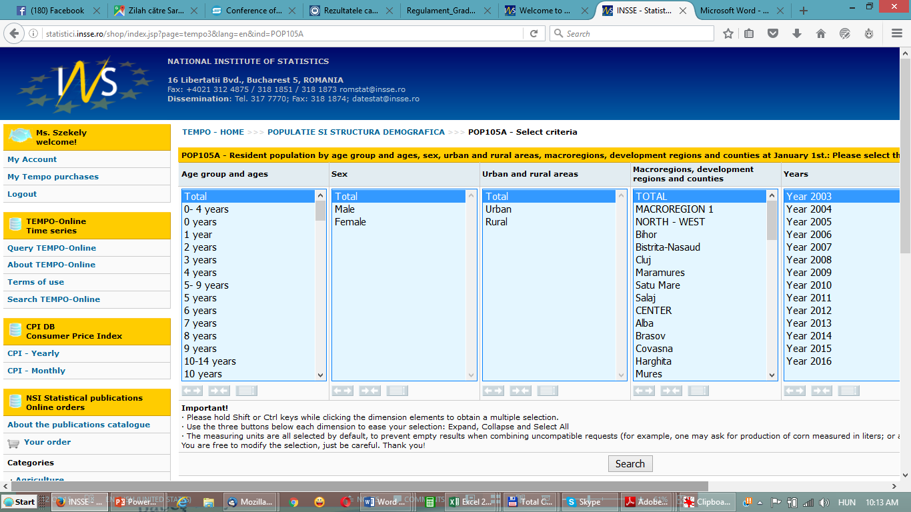

Slide 13
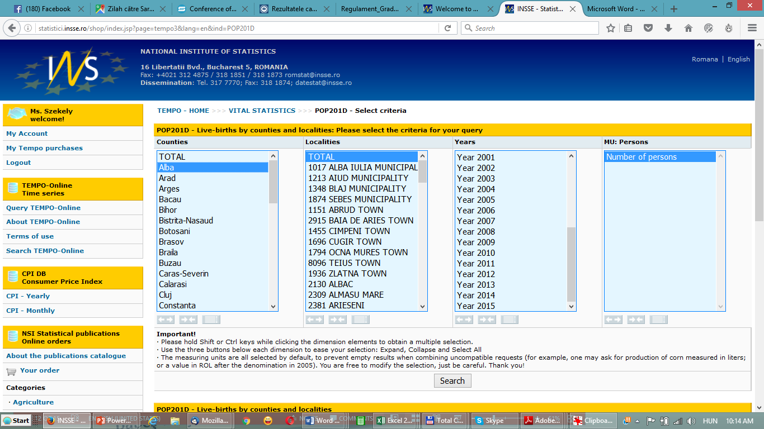

Slide 14
The quality of data in Tempo online
Some data are updated to late
No available data on locality level about the labour force,
Sometimes no data for counties

Slide 15
If no data in Tempo online
We can command for pay: crosstabulation with existing variables:
Ex: vital statistics data and ethnicity by counties, year, age group

Slide 16
The quality of the administrative data
No exact match between different data sources:
Ex: Tempo online and Educational data for Ministry of Education (Database of the enrolled students):
different time of raportation

Slide 17
Thank you for your attention!

