Slide 1

Migration statistics in Hungary
103rd DGINS Conference
Budapest, 21 September 2017

Slide 2
Scheme of presentation
1. Data sources of Hungarian migration statistics
2. Main driving forces of world migration
3. International migration in Hungary
4. The geographical aspects of migration in Hungary
5. Major challenges and development directions

Slide 3
Scheme of presentation
1. Data sources of Hungarian migration statistics
2. Main driving forces of world migration
3. International migration in Hungary
4. The geographical aspects of migration in Hungary
5. Major challenges and development directions

Slide 4
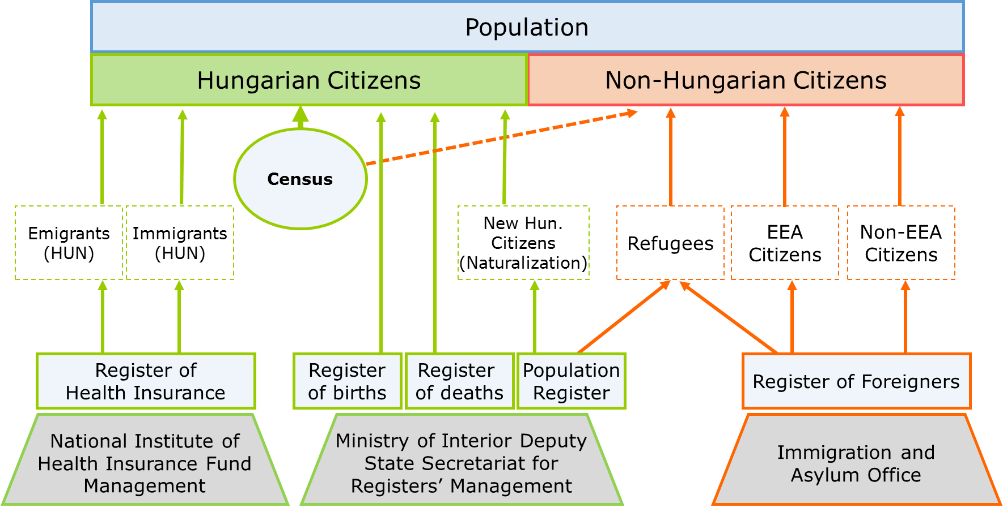
Data source of migration statistics

Slide 5
Changing world, changing human mobility
the population were interviewed
at the same settlement where they were born
*
* Micro Census

Slide 6
1. Data sources of Hungarian migration statistics
2. Main driving forces of world migration
3. International migration in Hungary
4. The geographical aspects of migration in Hungary
5. Major challenges and development directions

Slide 7
2. Main driving forces of world migration
population growth of developing countries, overpopulation, population inequality
globalization, the income gaps
geographical circumstances:
travel time has shortened, the transport fares become more and more affordable for the potential migrants
the accessibility to the global market and high wage areas revaluated.
Notes:
rapid development of information, transport technology and telecommunication

Slide 8
The foreign born population in the USA, 1960-2015
Source: United Nations

Slide 9
2. Main driving forces of world migration
population growth of developing countries, overpopulation, population inequality.
globalization, the income gaps.
geographical circumstances:
travel time has shortened, the transport fares are becoming more and more affordable for the potential migrants.
the accessibility to the global market and high wage areas revaluated.
decreasing and ageing population in Europe and in the developed countries, labour shortage.
Notes:
rapid development of information, transport technology and telecommunication

Slide 10
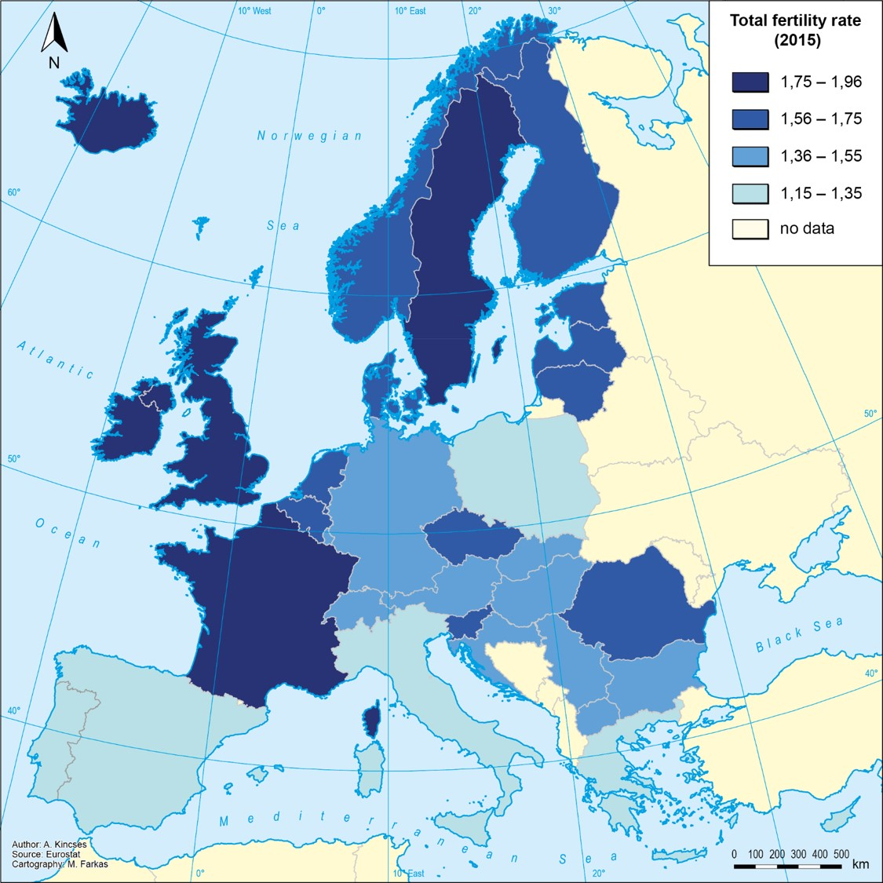
Total fertility rate, 2015

Slide 11
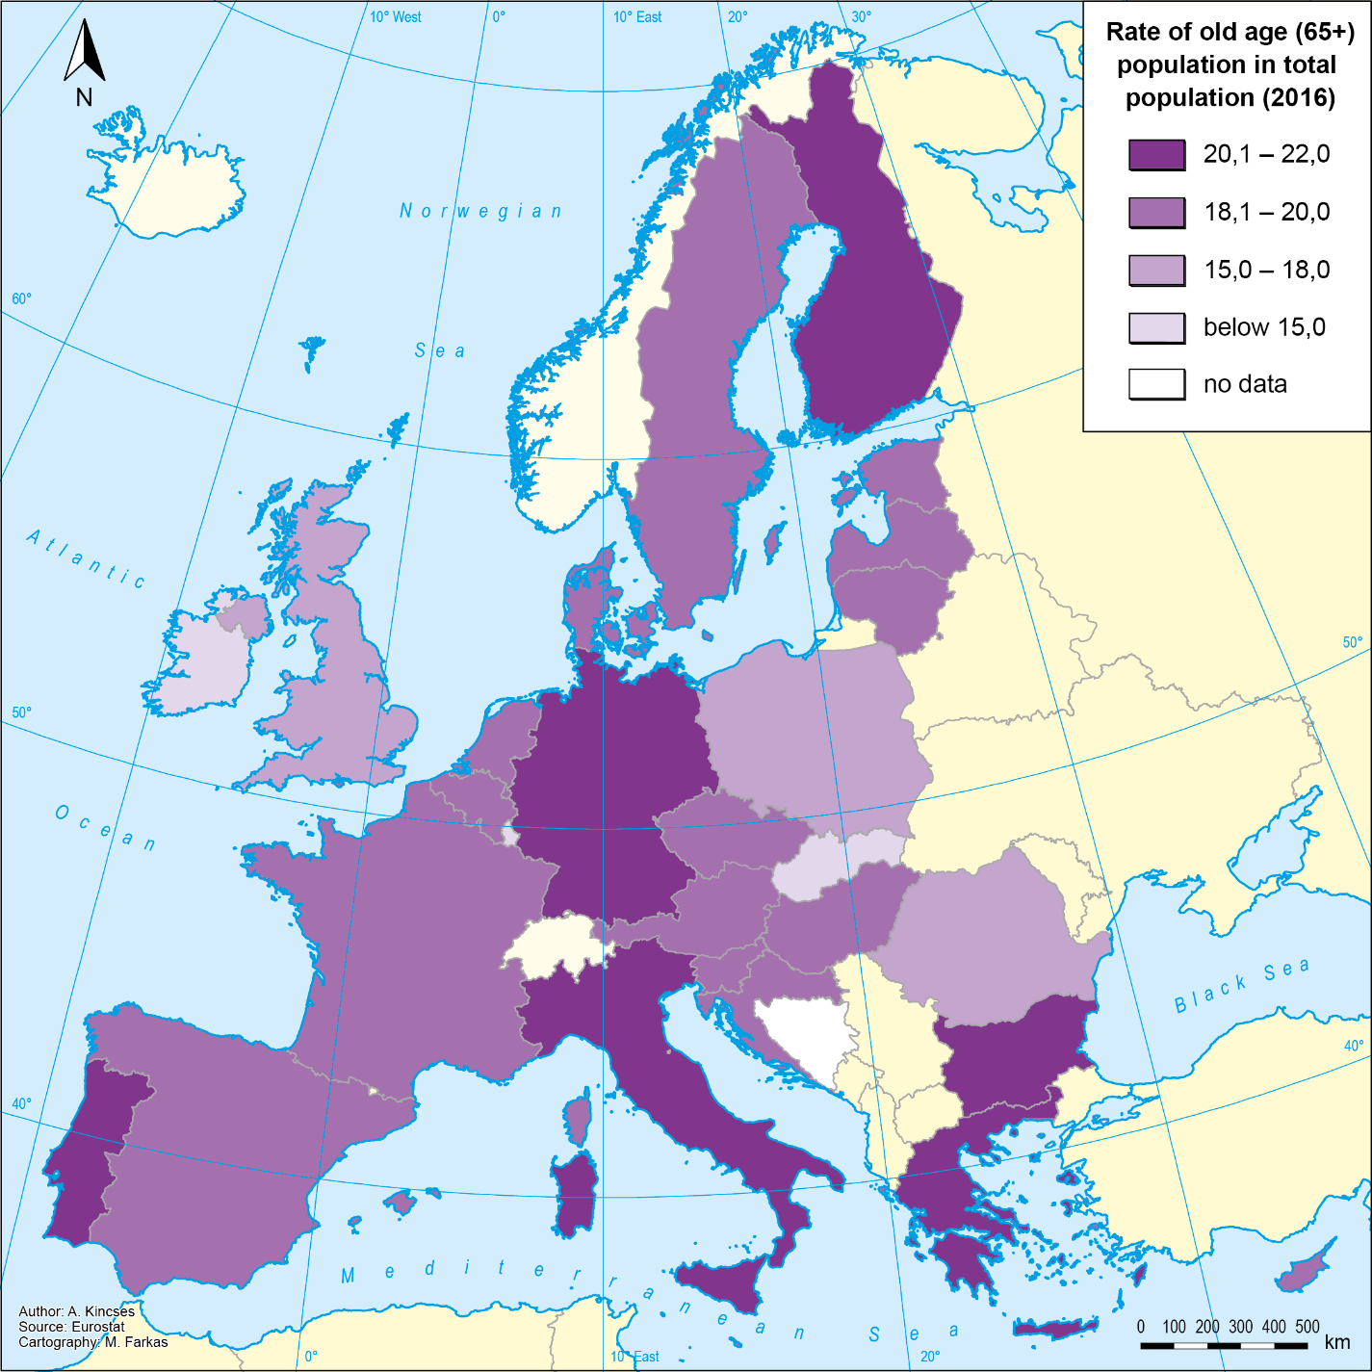
The share of elderly population, 2016
Notes:
Ide a 65+-os népesség-előrejelzések térképét szeretném (9-es számú kérés), 2015

Slide 12
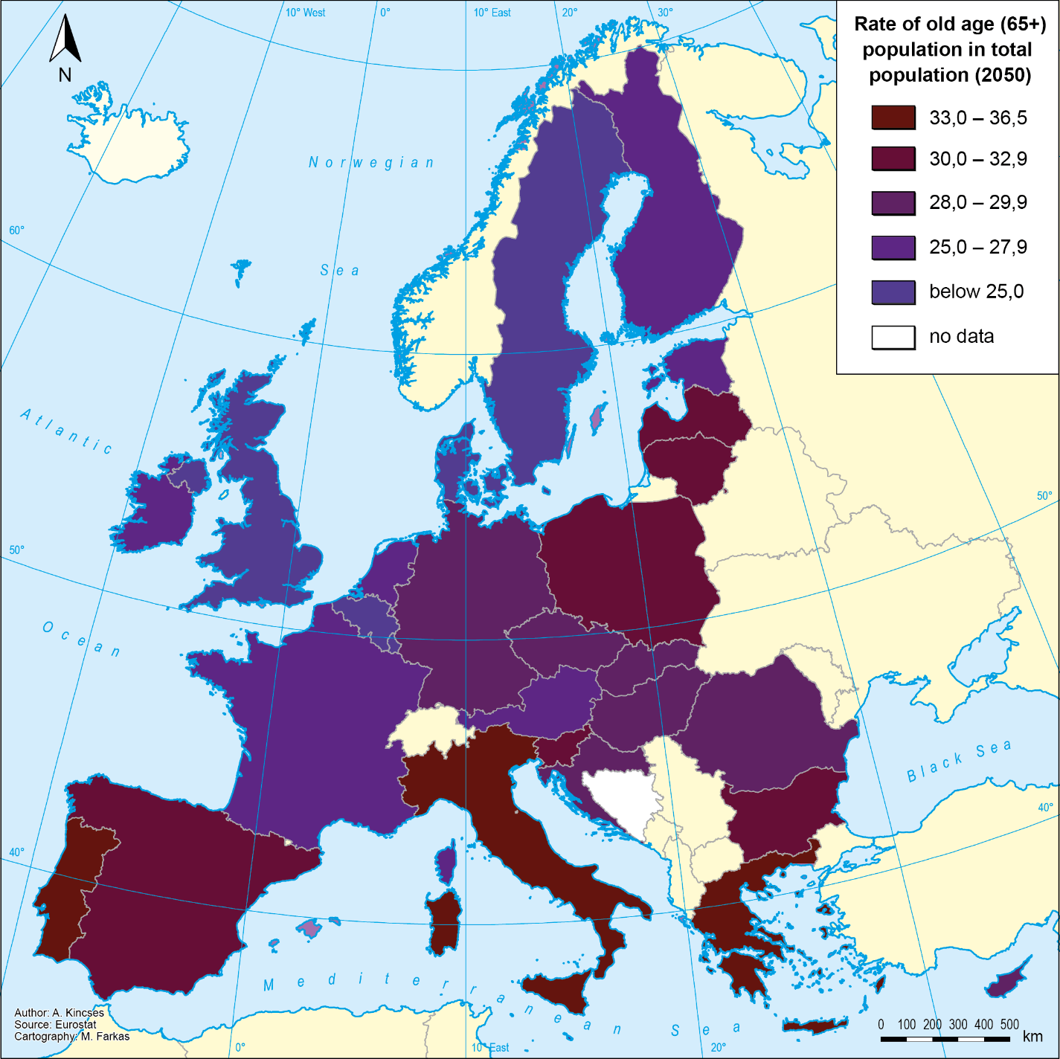
The share of elderly population, 2050
Notes:
Ide a 65+-os népesség-előrejelzések térképét szeretném (9-es számú kérés), 2015

Slide 13
2. Main driving forces of world migration
population growth of developing countries, overpopulation, population inequality.
globalization, the income gaps.
geographical circumstances:
travel time has shortened, the transport fares are becoming more and more affordable for the potential migrants.
the accessibility to the global market and high wage areas revaluated.
decreasing and ageing population in Europe and in the developed countries, labour shortage
Notes:
rapid development of information, transport technology and telecommunication

Slide 14
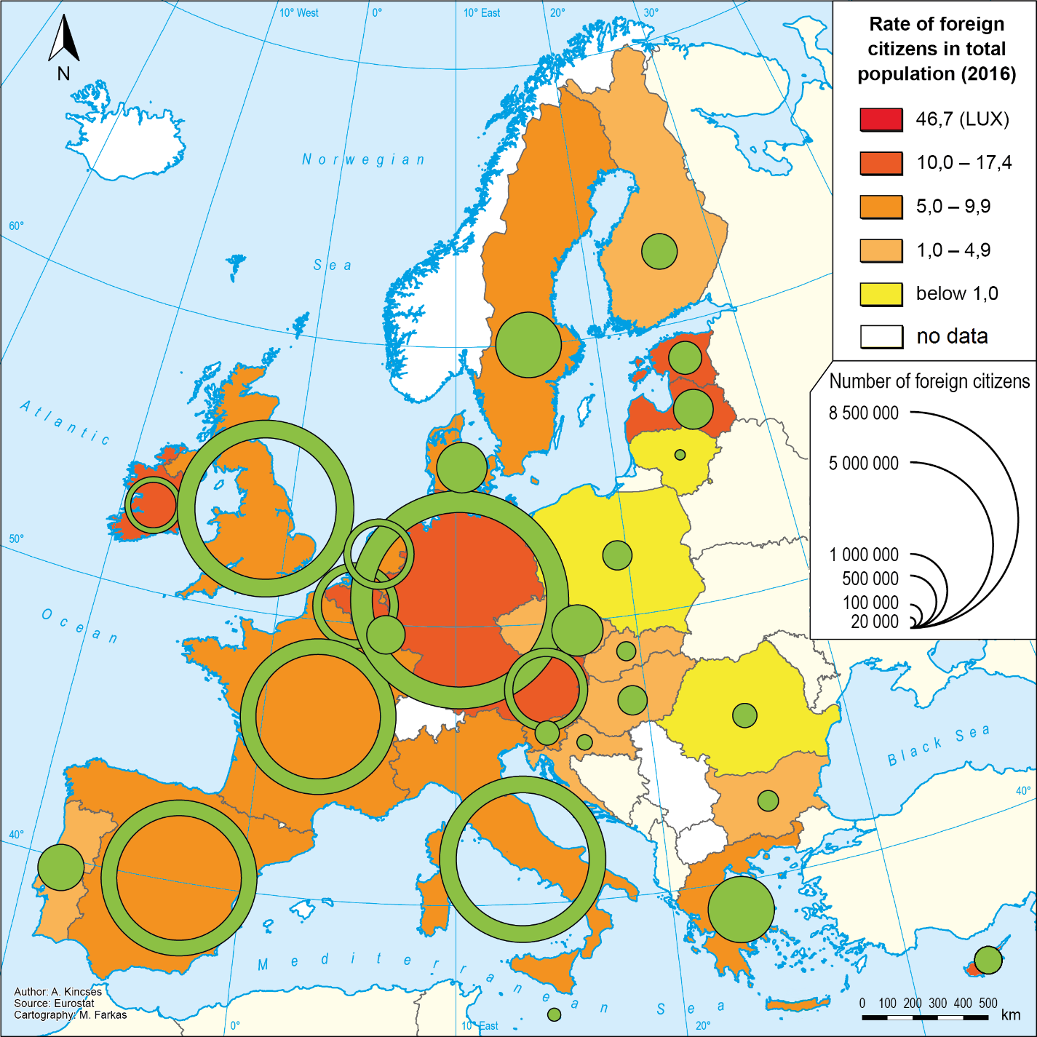
The share of foreign citizens in EU, 2016

Slide 15
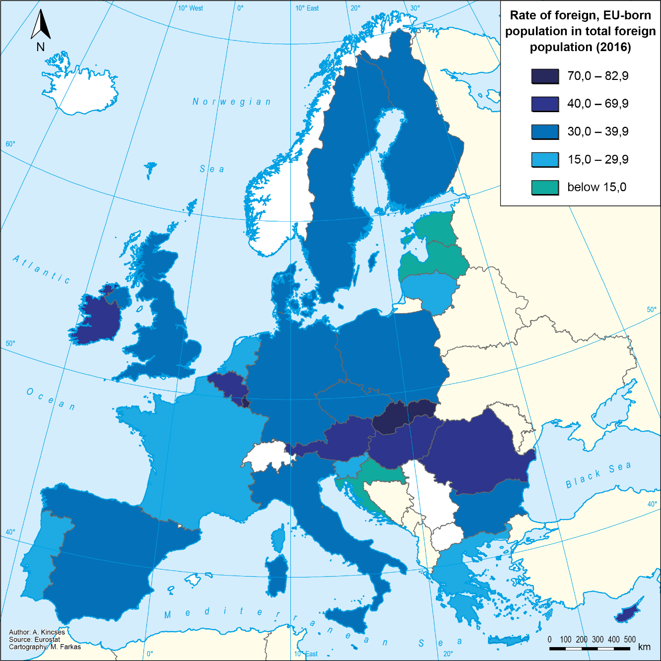

The share of European migrants in total foreign citizens, 2016
Notes:
5b pont: EU-s térképek; 10-es pont: Eu bevándorlók – EU arány

Slide 16
1. Data sources of Hungarian migration statistics
2. Main driving forces of world migration
3. International migration in Hungary
4. The geographical aspects of migration in Hungary
5. Major challenges and development directions

Slide 17
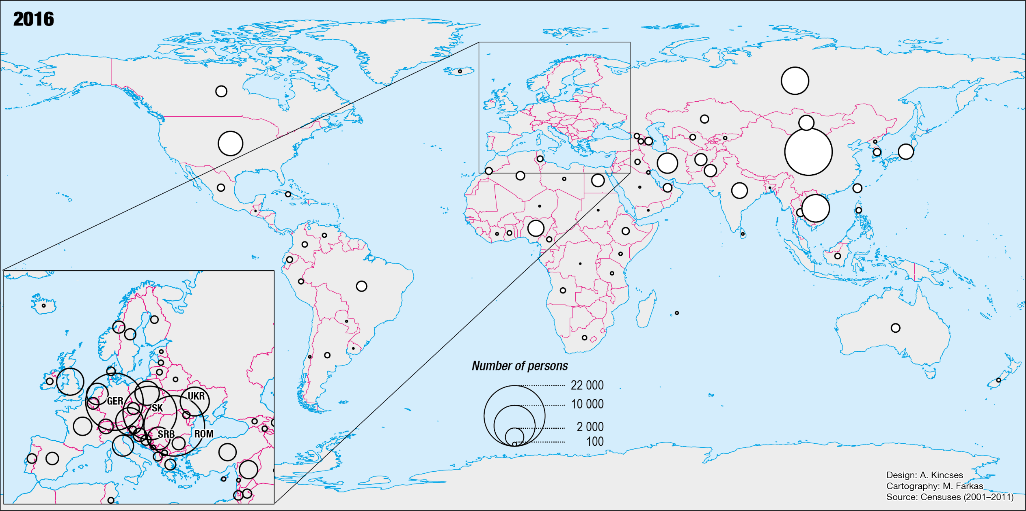
Foreign citizens in Hungary (150 000 prs) by country of origin, 2016
Notes:
5a térképek – külföldi
the source areas are expanding constantly
Of the 150 000 foreign citizens resident in Hungary on 1st January 2016 (1, 6% of total population) and the foreign born population was 350 000.

Slide 18
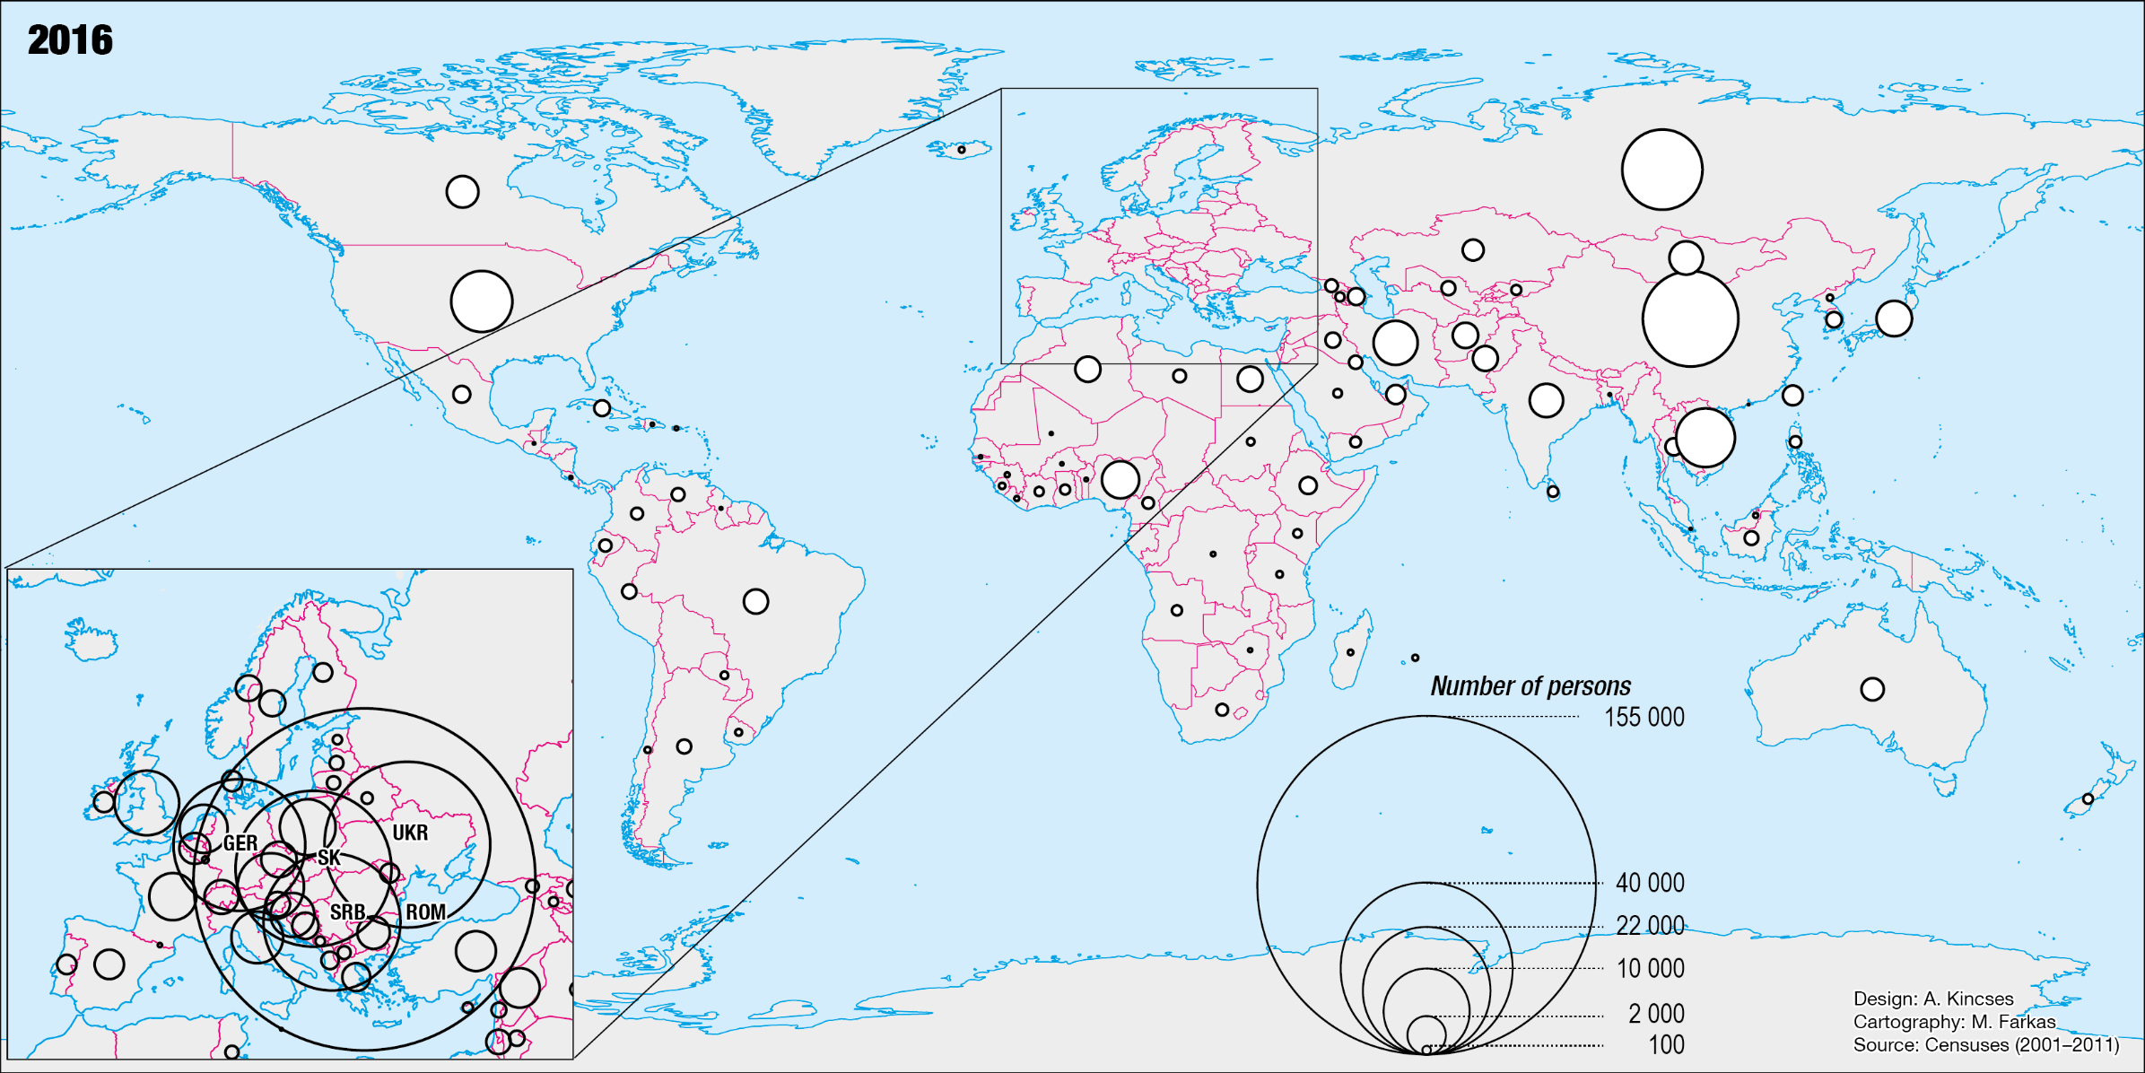
Foreign born population in Hungary (380 000 prs) by country of origin, 2016
Notes:
5a térképek – külföldön született

Slide 19
International migration in Hungary
The other side of the coin – Hungarian population living abroad
Expert estimation: 300 000-650 000 prs
HCSO estimation (Seemig* project): 350 000 prs
Mirror statistics: 595 000 prs
Main problems:
timeliness, lack of details, multiple enumeration;
* SEEMIG is a strategic project funded by the European Union’s South-East Europe Programme. www.seemig.eu
Notes:
11-es pont (megvan); 7-es pont: jó lenne becslés, esetleg saját
“An expert is a person who has made all the mistakes that can be made in a very narrow field.”
circulation, or the system of multiple and recurring migration appears in the arena of international migration.

Slide 20
Returning Hungarian citizens

Slide 21
International migration in Hungary
The other side of the coin – Hungarian population living abroad
Expert estimation: 300 000-650 000 prs
HCSO estimation (Seemig project): 350 000 prs
Mirror statistics: 595 000 prs
Main problems:
timeliness, lack of details, multiple enumeration;
new forms of migration emerge with globalization: circulation, or the system of multiple and recurring migration;
the international community of official statistics cannot always keep up with rapidly changing phenomena.
Possible solution:
Microdata exchange
Notes:
11-es pont (megvan); 7-es pont: jó lenne becslés, esetleg saját
“An expert is a person who has made all the mistakes that can be made in a very narrow field.”
circulation, or the system of multiple and recurring migration appears in the arena of international migration.

Slide 22
1. Data sources of Hungarian migration statistics
2. Main driving forces of world migration
3. International migration in Hungary
4. The geographical aspects of migration in Hungary
5. Major challenges and development directions

Slide 23
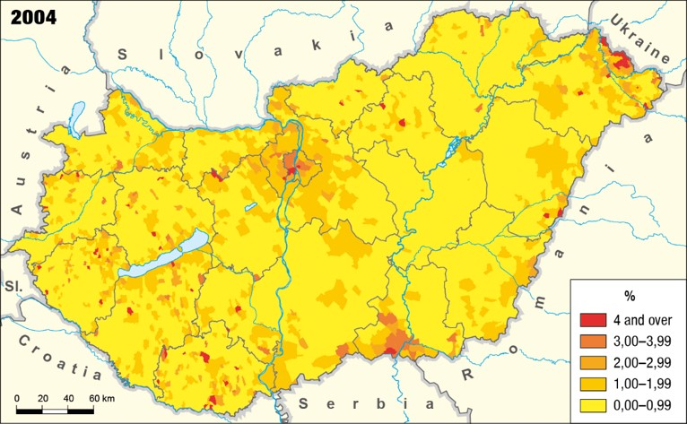
Number of foreign citizens per 100 inhabitants

Slide 24
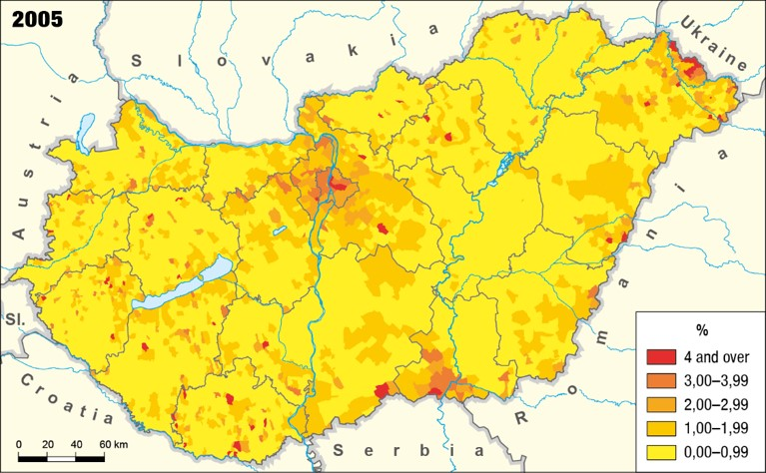
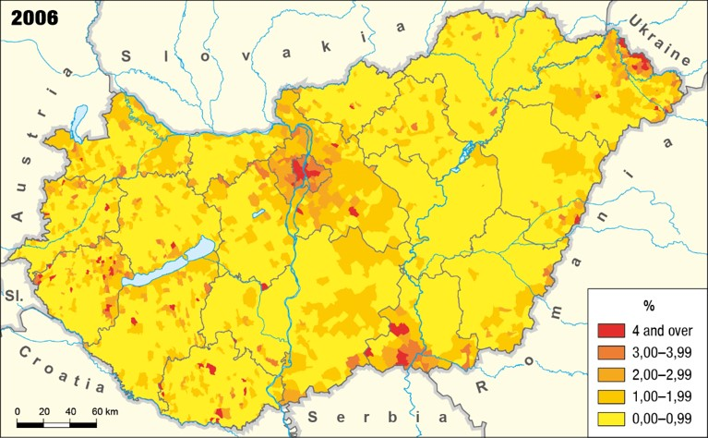
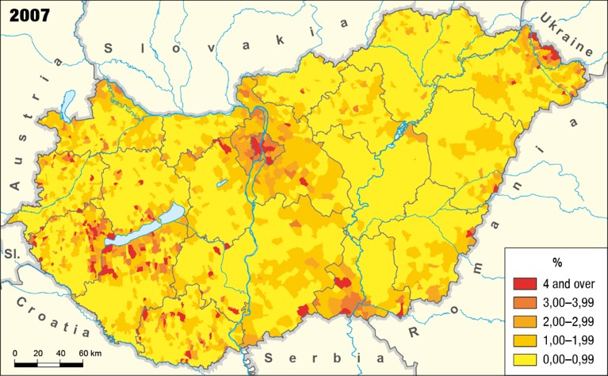
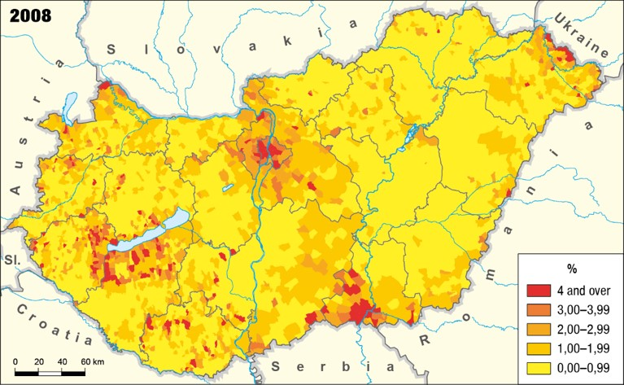
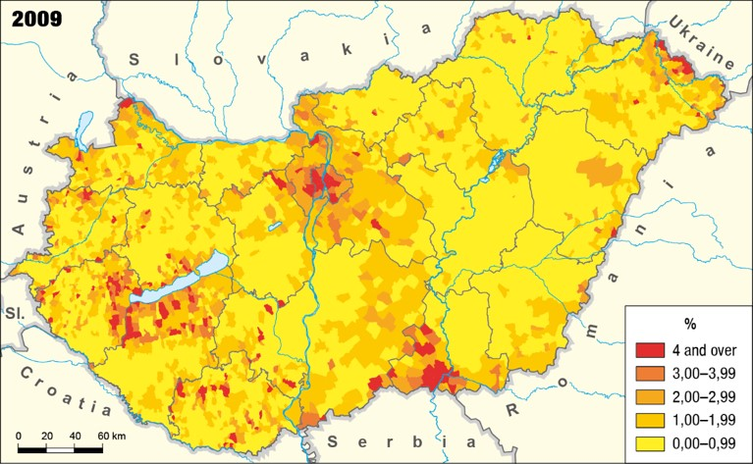
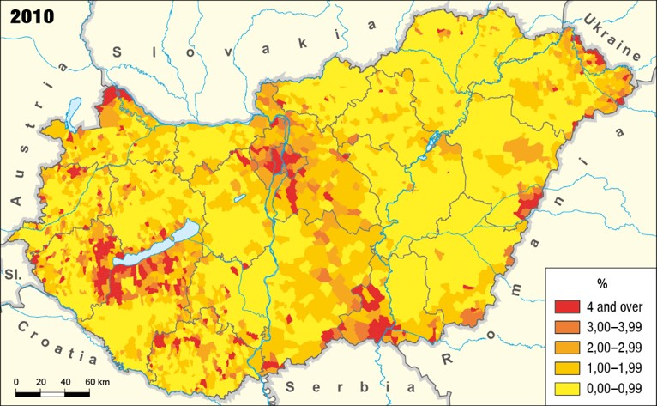
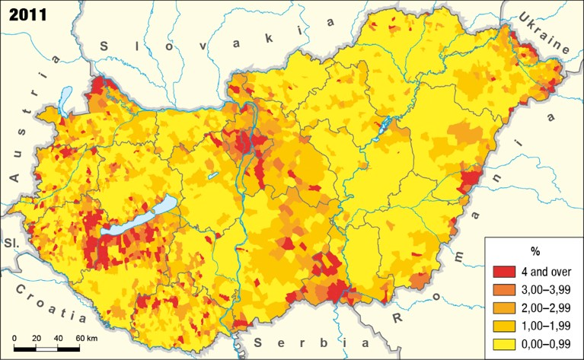
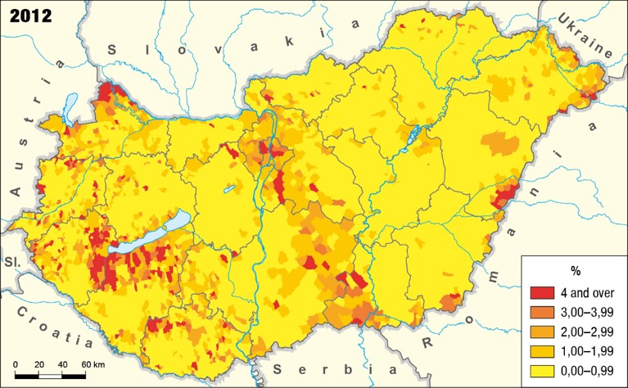
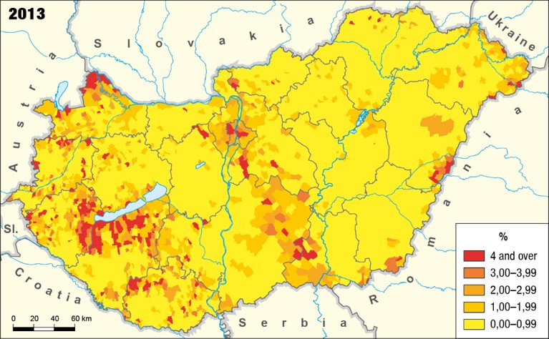
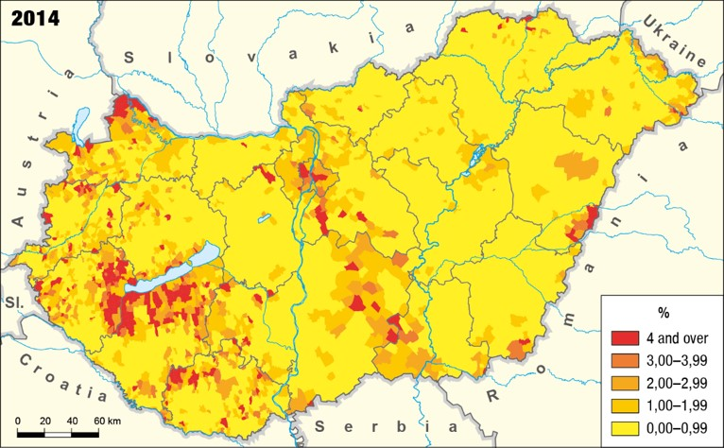


Number of foreign citizens per 100 inhabitants

Slide 25
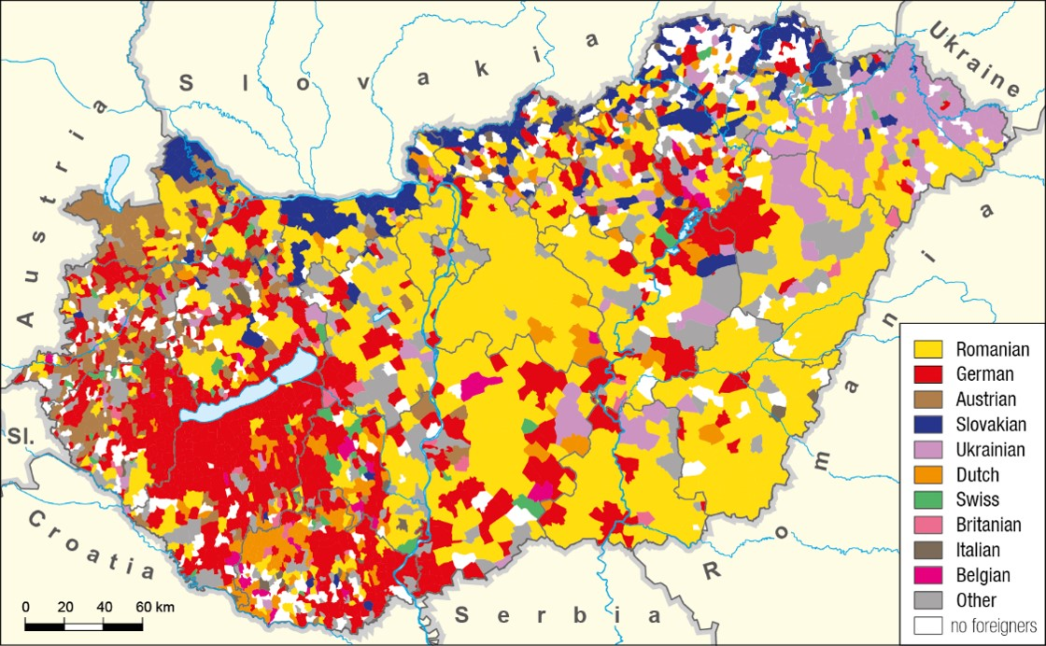
The settlements of Hungary, based on the highest number of foreign citizens living there, 2016
Notes:
5 g térkép – 2001
Waldo Tobler : "Everything is related to everything else, but near things are more related than distant things.” We can find typical groups on the map by citizenship.

Slide 26
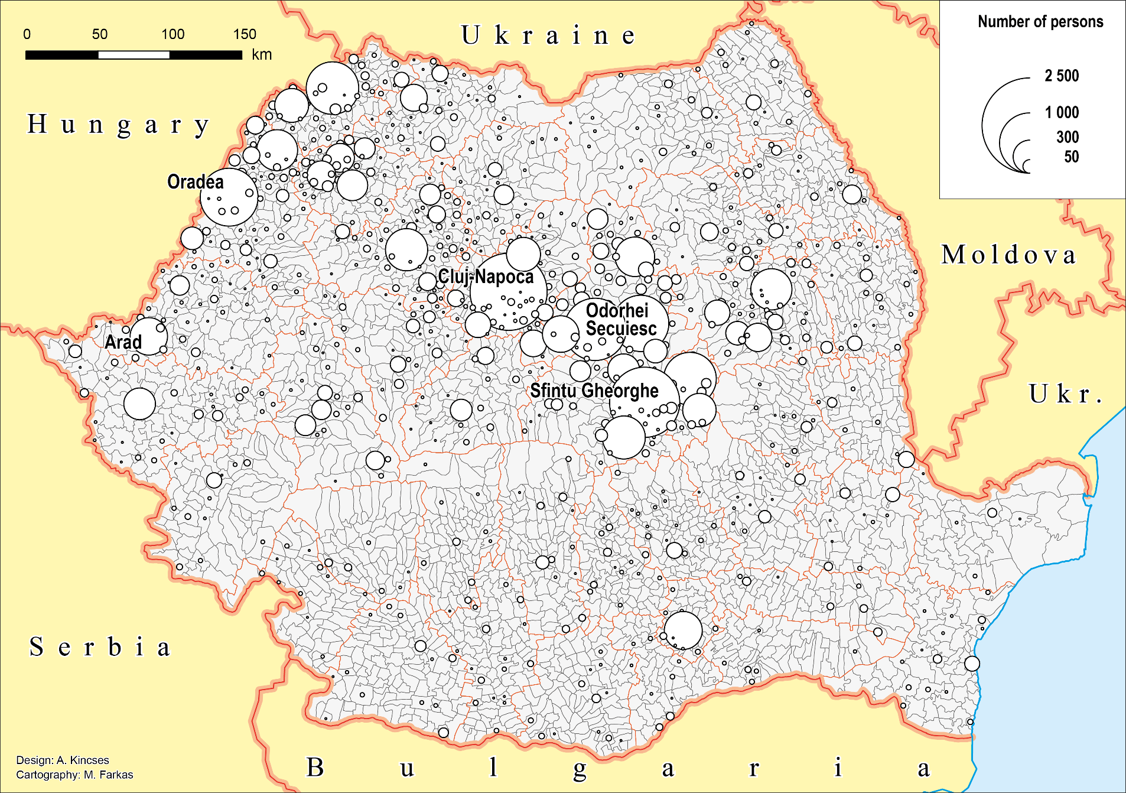
Romanian citizens living in Hungary by sending settlements, 2016
Notes:
5h térképek

Slide 27
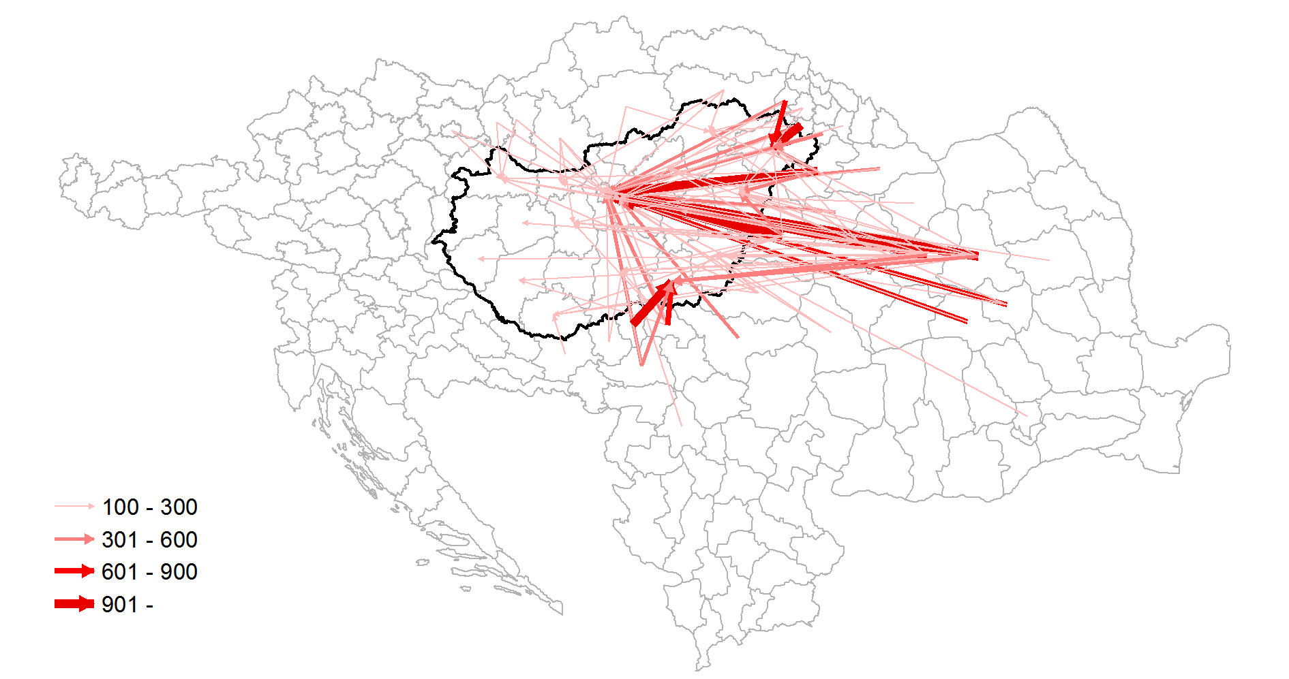
Spatial relationship between the sending and host regions at NUTS3 level, 1 January 2001
Slovakia
Ukraine
Austria
HUNGARY
Slovenia
Croatia
Romania
Serbia
Notes:
5j térkép
We can examine the relationship between the place of origin and current locations.

Slide 28
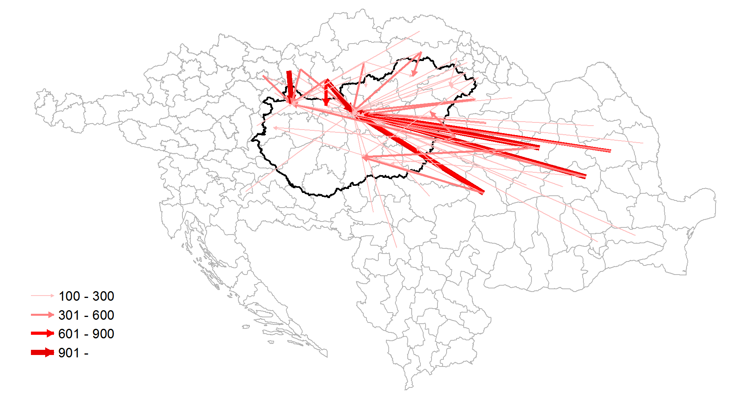
Spatial relationship between the sending and host regions at NUTS3 level, 1 January 2016
Slovakia
Ukraine
Austria
HUNGARY
Slovenia
Croatia
Romania
Serbia
Notes:
5j térkép
Budapest is the clear centre of immigration to Hungary, but also some regional hub has become stronger. We can further specify our examination.

Slide 29
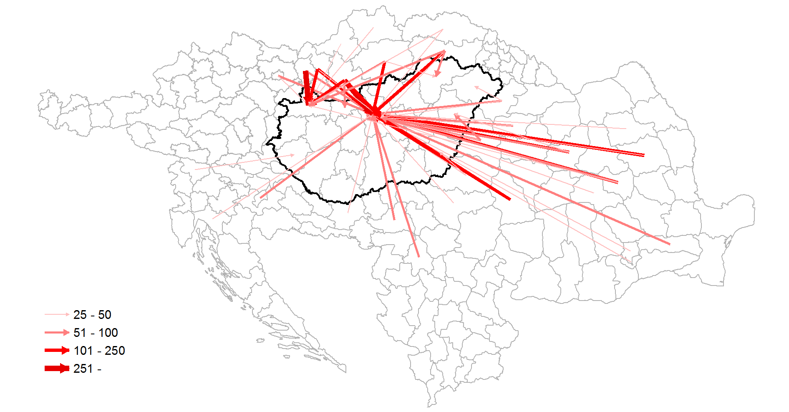
Spatial relationship between the sending and host regions at NUTS3 level according to higher education level (24+ aged)
1 January 2016
Slovakia
Ukraine
Austria
HUNGARY
Slovenia
Croatia
Romania
Serbia
Notes:
5j térkép

Slide 30
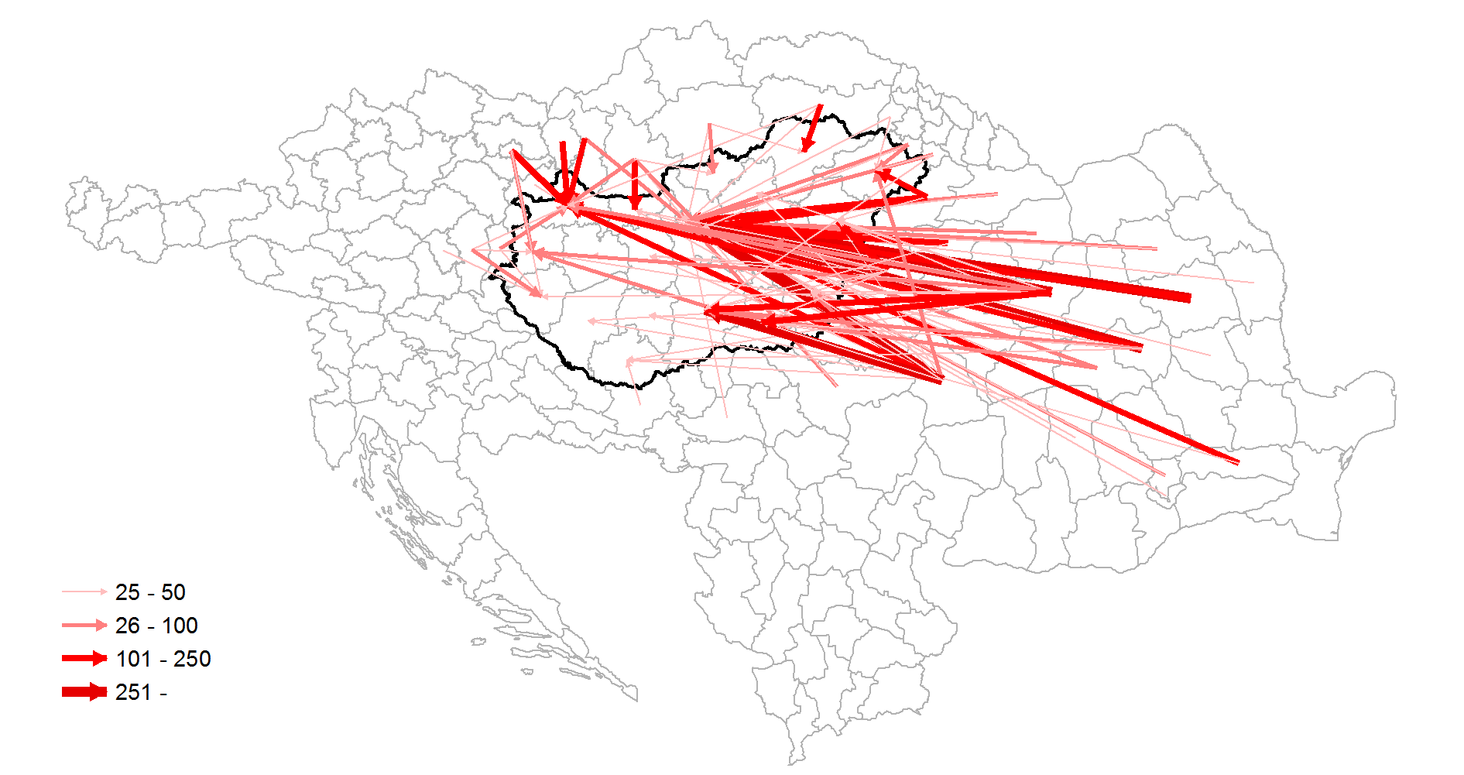
Spatial relationship between the sending and host regions at NUTS3 level according to primary education level (24+ aged)
1 January 2016
Slovakia
Ukraine
Austria
HUNGARY
Slovenia
Croatia
Romania
Serbia

Slide 31
1. Data sources of Hungarian migration statistics
2. Main driving forces of world migration
3. International migration in Hungary
4. The geographical aspects of migration in Hungary
5. Major challenges and development directions

Slide 32
5. Major challenges and development directions
To interpret the migration phenomenon as a system, which interlinks sending, host and transit countries.
To integrate or better integrate migration statistics into other statistical domains (well-being, income, consumption, poverty, labour market, health and demigraphic statistics).
To take into account the new forms of migration (circular migration).
To reconcile the definitions and methodology with the changing nature of migratory movements.
To reduce (eliminate?) asymmetries between the statistics of sending and receiving countries
To improve timeliness.
To enhance international cooperation and scientific collaborations.
To take advantage of Big Data sources.
Notes:
Budapest memorandum

Slide 33

Finding the right perspective to increase the quality

Slide 34
Thank you for your attention!
Áron Kincses
Deputy President, HCSO
103rd DGINS Conference Budapest, 21 September 2017

