Slide 1
Asymmetries in international migration flow data.
Reconciliation methods.
Frans Willekens
DGINS Budapest 2017, 21 September 2017

Slide 2
Outline
Milestone: Regulation 862/2007 on Community statistics on migration and international protection
Issue 1: emigration flow ≠ immigration flow (asymmetry)
Issue 2: concepts and measurement
Data reconciliation: challenges and approaches
Conclusion

Slide 3
Basis for data collection: Regulation 862/2007
Core set of statistics on international migration flows, population stocks of foreigners, the acquisition of citizenship, residence permits, asylum and measures against illegal entry and stay.
Statistics based on common definitions and concepts
Duration of stay criterion: 12 months (UN, 1998)
Scientifically based and well documented statistical estimation methods may be used

Slide 4
Migration flows in 2015 (EU28)
4.8 million immigrants, 2.4 million citizens from EU28 country (0.9 million reporting country + 1.4 million other country) and 2.4 million from non-member countries
2.8 million emigrant, 2.1 million citizens from EU28 countries (1.5 million reporting country, 0.6 million other EU28 country) and 0.6 million non-EU28 country

Slide 5
Immigration Germany; Emigration Poland
By previous / next place of residence
 | Immig Germany |  | Immig UK |  | Emig Poland
 | Total | EU28 | Total | EU28 | Total | EU28
1998 | 802 456 | : | 332 390 | : | 22 177 | :
1999 | 874 023 | : | 354 077 | : | 21 536 | :
2000 | 841 158 | : | 364 370 | : | 26 999 | :
2001 | 879 217 | : | 372 205 | : | 23 368 | :
2002 | 842 543 | : | 385 901 | : | 24 532 | :
2003 | 768 975 | : | 431 487 | : | 20 813 | :
2004 | 780 175 | : | 518 097 | : | 18 877 | :
2005 | 707 352 | : | 496 469 | : | 22 242 | :
2006 | 661 855 | : | 529 008 | : | 46 936 | :
2007 | 680 766 | : | 526 714 | : | 35 480 | :
2008 | 682 146 | : | 590 242 | : | 30 140 | :
2009 | 346 216 | : | 566 514 | : | 229 320 | :
2010 | 404 055 | : | 590 950 | : | 218 126 | :
2011 | 489 422 | : | 566 044 | : | 265 798 | :
2012 | 592 175 | : | 498 040 | : | 275 603 | :
2013 | 692 713 | 405 459 | 526 046 | 219 669 | 276 446 | 205 022
2014 | 884 893 | 468 274 | 631 991 | 286 821 | 268 299 | 185 186
2015 | 1 543 848 | 513 244 | 631 452 | 295 285 | 258 837 | 183 561

Slide 6
Migration from Poland to Germany and UK
 | Immigration from Poland |  | Emigration to Germany and UK
 | Data Germany and UK |  | Data Poland
 | Germany | UK | Germany | UK
1998 | 82 049 | 32 | : | :
1999 | 90 168 | 42 | : | :
2000 | 94 105 | 877 | : | :
2001 | 100 522 | 1 950 | 16 900 | 208
2002 | 100 968 | 1 288 | 17 806 | 254
2003 | : | 3 534 | 15 013 | 282
2004 | 139 283 | 16 985 | 12 646 | 543
2005 | 159 157 | 51 915 | 12 317 | 3 072
2006 | 163 643 | 58 468 | 14 950 | 17 996
2007 | 153 589 | : | 13 771 | 9 165
2008 | 131 308 | 60 105 | 17 951 | 22 352
2009 | : | 35 016 | : | :
2010 | : | 31 578 | : | :
2011 | : | 36 632 | : | :
2012 | : | 31 431 | : | :
2013 | : | 29 177 | : | :
2014 | : | 35 042 | : | :
2015 | : | 42 403 | : | :

Slide 7
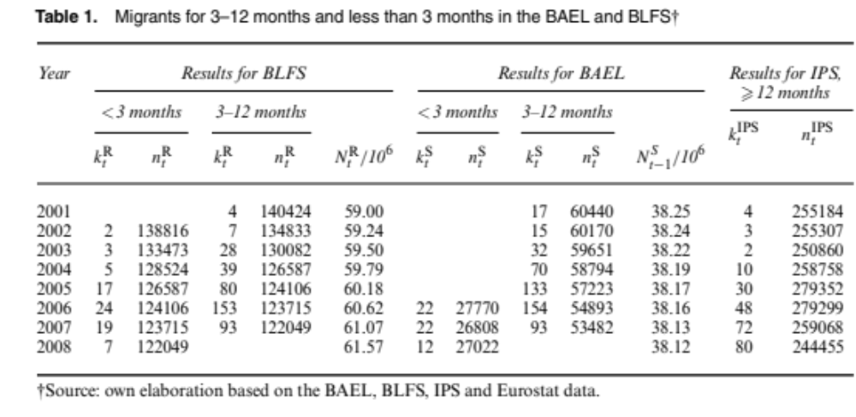
Source: Wiśniowski , 2017
Emigration rate Poland: 93/53482 = 0.0017; Number emig: 29.000
Immigration rate UK: 93/122049 = 0.0008 Number immig: 46.500

Slide 8
Migration flow from LFS: problems
Coverage (e.g. UK: no communal establishments; sample of persons staying at least 6 months)
Undercount (e.g. emigration of complete households)
Measured: actual duration of stay / absence
(IPS: intended duration of stay)

Slide 9
concepts and measurements

Slide 10
Coverage and undercount
  Population covered: coverage is complete if no subpopulation is left out
  Population count: presence vs observation
    Persons may not be counted (undercount) or may be counted twice (overcount)
  Event count: occurrence vs observation
    Events (immigrations and emigrations) in a given period are not counted (undercount) or may be counted twice (overcount)

Slide 11
  The observation/counting process
  Event is observed if
      It is reported (by person experiencing the event)
      Mandatory or voluntary reporting
      Motivation to report
      It is registered
      By authorities
      By electronic device
        Radio-frequency identification (RFID)
        At border crossing (NSEERS in USA and Entry-Exit System (EES) in EU)
        Continuous tracking (chip in ID card or implant)

Slide 12
  The observation/counting process
    Authentication: determine/verify identity of person
      Identifiers:
        Document (e.g. identity card, passport)
        Biometric identifiers (e.g. finger print, retina scan)
        Unique number (e.g. national number, social security number, National Insurance Number, fiscal code )

Slide 13
Place of residence (address)
  Definition is not inclusive
      Duration (degree of permanence) (visitor, temporary, permanent)
      Activity
      Legality (authorisation)
  Duration of stay: duration threshold
      UN (1998): Usual residence: 12 months
        Temporary residence: 3 – 12 months
      Countries have their own duration of stay criteria
        (Since 2009, most EU Member States use harmonized definition (UN definition) Regulation (EC) No 862/2007)
      Actual and intended duration of stay are used

Slide 14
Place of residence (address): other issues
  Usual residence vs legal residence (domicile)
      Census vs population register
  Residence for tax purposes
  Lawful residence (Authorisation of stay): visa, residence permit or other proper documentation
  (unauthorised/undocumented/irregular/illegal immigrants)
  Absence of address (homeless)
  Multiple residences
    Residence: usual, secondary, actual
    Seasonal (e.g. snowbirds; resident tourists)
    Transnationals
Regulation 1260/2013: requests feasibility studies on use of UN definition of usual residence

Slide 15
Data Reconciliation

Slide 16
Challenges (measurement and estimation)
True values are unknown (latent variables)
Validity: result is what one is supposed to measure
Accuracy: results is close to true values (implies no bias)
Reliability: repeated measurements lead to same results
Comparability: differences in concepts, measurement and/or estimation methods lead to incomparable data/statistics

Slide 17
Approaches to data reconciliation
Collaboration between data producers: harmonisation of concepts and measurements
Scientific methods
    Numerical methods: constrained optimisation (Find migration counts that are as close as possible to immigration flow data and emigration flow data, that gives more weight to data perceived to be relatively accurate, and that meet constraints imposed on total flows (Poulain; MIMOSA))
    Statistical modelling

Slide 18
Statistical modelling
Observed counts ∽ True counts and measurement errors
Migration model (model of true counts)
    True counts predicted by spatial interaction model (gravity model)
Measurement error model
    Two measurement error models: immigration and emigration
    Measurement error predicted by sources of error
Raymer, J., Wiśniowski, A; Forster, J.J., Smith, P.W.F., and Bijak, J. (2013) Integrated modeling of European migration. Journal of the American Statistical Association 108,503:801-819.

Slide 19
Measurement error model: predictors
Coverage
    Two coverage types: standard, excellent
      Some countries are assumed to have good coverage (Nordic) (use of individual mirror data)
  Undercount
    immigration: two categories: low, high
    Emigration: two categories: low, high
  Duration of stay criterion
    5 categories; 0 (no time limit), 3, 6, 12 months, permanent
  Other sources of error
    Included in variance of error term of measurement error model

Slide 20
Measurement error model: predictors
Expert judgments: Sources of error by country and their impact of sources of error on measurement error
Bayesian method to combine data from different sources
      Estimates of migration flows
      Indicator of precision (1/variance)

Slide 21
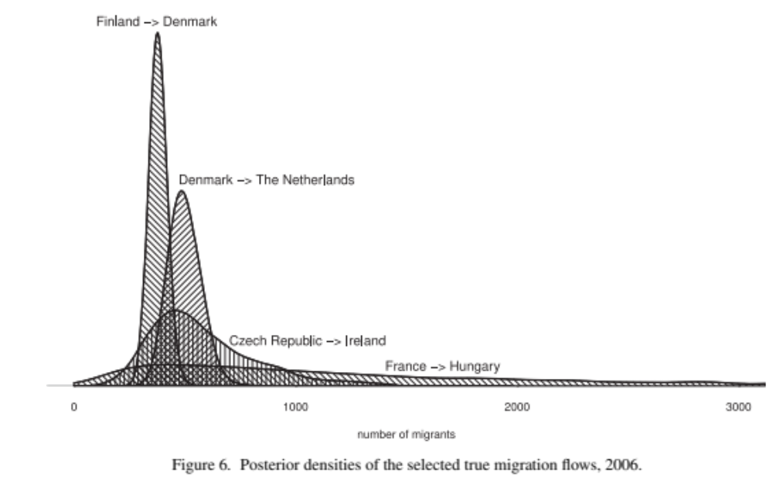
Result: counts estimates of true migration flows

Slide 22
Case study: migration from Poland to Germany
Emigration flow data: 13,771 (2007)
Immigration flow data: 153,589 (2007)
MIMOSA (De Beer et al., 2010): 110,701 (2002-2007)
IMEM (Raymer et al., 2013): 116,200 (2002-2008)

Slide 23
Conclusion
Migration flows: immigration flow data and emigration flow data
Immigration data better than emigration data
Strategies to improve data quality
    Collaboration: mirror data; information sharing
    Statistical modelling
      Distinguish observations and true flows
      Relate measurement errors to sources of error
      Combine data from different sources, including expert judgments
      Adopt Bayesian approach

Slide 24
thank you
Willlekens@nidi.nl

