Slide 1

Migration Statistics based on Admin Data. Opportunities and Challenges.
The Danish Case
DGINS 2017 – Budapest September 21st.

Slide 2
Historical landmarks
1966: New Statistical Law gives access to register data
1968: National Civil Registration System (CPR)
1970: Last survey based census
1975: Business register established (CVR)
1976: Decision to establish a Building and Dwelling Register (BBR)
1981: Worlds first fully register based census

Slide 3
Register structure and data
Income
People
Education
Social Benefits
Employment
Central Person Register
(CPR)
Health
Turnover
Dwellings
Central Enterprise Register
(CVR)
Buildings and housing
(BBR)
Enterprises
Long time series of high quality

Slide 4

Challenges
ADMIN DATA IS A PRODUCT OF LEGAL REGULATIONS AND ADMINISTRATION OF THE LAW

Slide 5

Asylum seekers

Slide 6

Are not included in the Danish population register

Slide 7
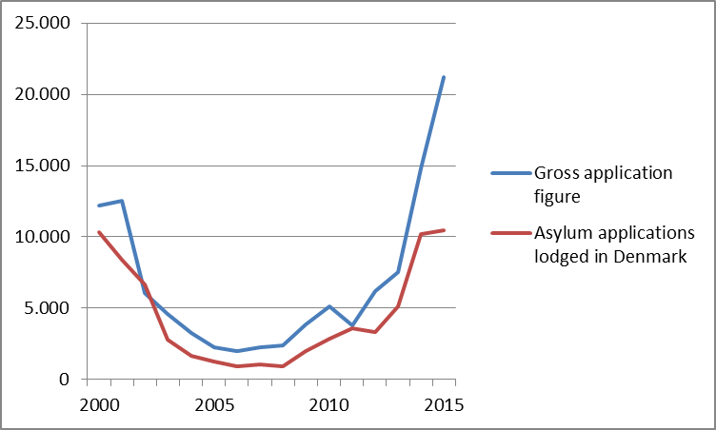
There is actually a lot of them…..

Slide 8
BUT !
The average time from seeking asylum to a first decision was in 2016 165 days i.e. below the 1 year limit
548 out of 10.846 took longer than 1 year
And 1.067 was appealed
Case: in August 2016 9.316 persons had a pending application.
Of these 223 person had applied more than a year ago
223 is equal to 0,004 percent of the population

Slide 9

Late de-registration
17 % OF ALL EMIGRATION IN YEAR X
WILL BE REGISTERED
LATER THAN FEBRUARY IN YEAR X+1
– ESPECIALLY EMIGRATIONS

Slide 10
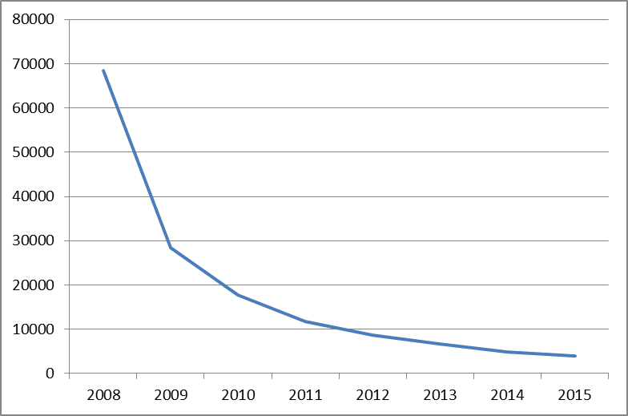
No signs of activity – 2008 =>

Slide 11

Over-coverage
# OF PEOPLE WITH NO SIGNS OF ACTIVITY IN THREE YEARS = 18.000
2/3 DANES
THE NORDIC SYSTEM OF MIGRATION REGISTRATIONS DOES IMPACT THE NUMBER
EQUAL TO 0,32 PER CENT OF THE POPULATION

Slide 12


In conclusion

Slide 13

This is it
Niels Ploug
Statistics Denmark
npl@dst.dk

