Slide 1
2021 Population Census and migration statistics in Spain.
Why exchanging microdata?
National Statistics Institute (INE)
Spain

Slide 2
Summary
The population register (“Padrón”). How it Works
2. The next 2021 population census in Spain.
3. Foreign population in Spain. Examples of recent findings
4. Exchange of (individual) data between countries?
What kind of data could be exchanged?
To do what with them?

Slide 3
1.1 The Population Register in Spain (“Padrón”). How it works
By Law, all people living in Spain must be registered in the municipality where they live (without any legal or administrative restriction)
Since May 1996 municipal registers are integrated into a national database managed by INE
Why are people interested in being registered?:
Because it provides access to education, social services, health system, municipalities services. It is a proof of residence for all purposes
Why are people interested in getting deregistered (when they leave the country)?
no benefits => not many deregistrations made by citizens
Administrative deregistration procedures are applied

Slide 4
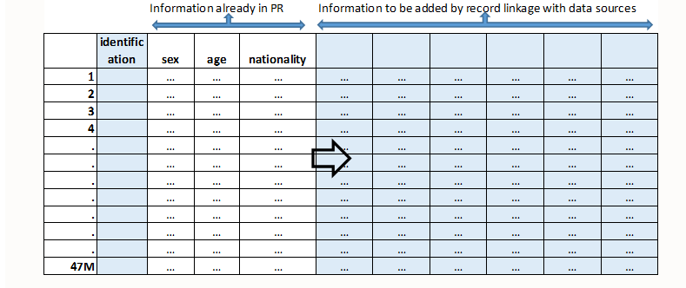
2. The Population and Housing Census 2021
Largely based on administrative registers: Padrón + (many) other sources
The census Project in two dimensions:
1. Adding variables to the Population Register (columns)
2. How many people?

Slide 5
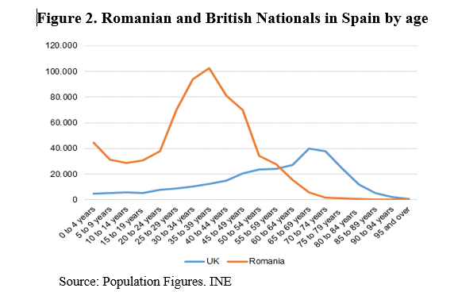
3. Foreign population in Spain. Examples of recent findings
According to population figures just released (obtained from the population register):
Almost 10% of resident population in Spain are foreign nationals:
First two (EU):
Romanians : 678,000
Britons: 294,000
Foreign Population by citizenship (January 1st, 2017)
Total Population |  | 46,528,966
Foreign Population |  | 4,424,409
Romania |  | 678,098
Morocco |  | 667,189
United Kingdom |  | 294,295
Italy |  | 203,118
China |  | 177,738
Ecuador |  | 145,879
Germany |  | 141,523
Colombia |  | 139,213
Bulgaria |  | 126,436
France |  | 103,062
Portugal |  | 100,822
Ukraine |  | 94,770
Bolivia |  | 76,060
Russia |  | 71,959
Argentina |  | 71,622
Romanians: Labour-related migration
UK Nationals: retired people
Source: Population Figures. INE

Slide 6
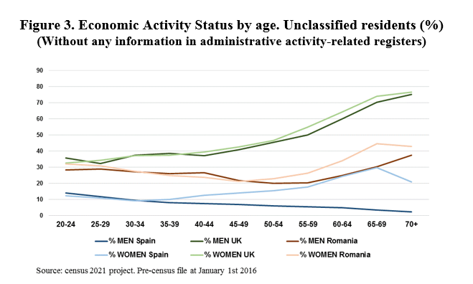
3. Foreign population in Spain. Examples of recent findings
Census 2021 Project: The result of linkng “Padrón” with all economic activity-related administrative registers (data for province of Alicante, 1,84 million inhabitants, 19% foreign)
Unclassified
in working ages:
~ 35 % British
~ 25 % Romanians
10 % Spanish
What if we link these records with Romanian sources?
6/11

Slide 7
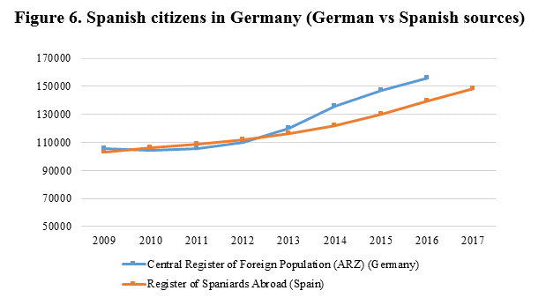
3. Foreign population in Spain. Examples of recent findings
This is what (German and Spanish) oficial figures say about Spanish people in Germany:
Could we link the German AZR register with Spanish Padrón to detect reasons for discrepancies or double counts?
But also….
…Circular migration
And also….
Background of migrants (educational attainment, previous Jobs in Spain…)

Slide 8

4. Exchange of data. How?
What are we proposing to exchange?
Flows?
Stocks?
200 countries X 200 countries?
Let’s make it easier
We propose to conduct pilot projects
ONLY FOR STATISTICAL PURPOSES (no deregistrations foreseen)!!!!
Legal aspects to check and (if needed) overcome. Statistics laws and Data Protection Agencies

Slide 9
4. Exchange of data
What would we do?
We may exchange microdata with countries having or not a population register
But we need to link Individual Data between Member States: PERSONAL data (name, address, date of birth, place of birth?
(We do not have foreign ID number for linking with foreign sources but linkage may work with these data)
To do what with these data?
At least, for quality assessment. We can use this information to detect weakest points of the population register
Even better: We can improve figures. No deregistrations but registers not counted in statistics!!

Slide 10
How to start?
- Billateral exchanges of information ?
- Countries interested to make pilot projects …
- Eurostat …

Slide 11


