Slide 1
Immigration from a family perspective.
Opportunities and limitations in (official) statistics
Amparo González-Ferrer
Spanish Research Council (CSIC)
Population Department

Slide 2
The big question: what we do want statistics for?
To better understand socially relevant phenomena such as migration, family dynamics and the interaction between the two
To design, implement, monitor and evaluate policies aimed at regulating those phenomena
Research should aim at using statistics in a way that both goals are enhanced:
  by opening up new manners to collect relevant statistics
  by providing helpful interpretations of available ones***
Notes:
Eurostat has made a great job in encouraging improvement of statistics in this particular area, and the effort made at the national level is apparent for those of who have been working on family and migration for more than a decade… However, there is always, of course, room for improvement and the intention of my talk is to put on the table some ideas that, in my opinion, should explored in the next future in order to both:
These statistics provide the basis for the development and monitoring of EU policymaking in a number of different areas, including: the impact of migration on labour markets, migrant integration, the development of a common asylum system, the prevention of unauthorised migration, and trafficking of human beings.

Slide 3
State of art & Recommedations
Type of Statistics | Some family-related aspect | Good Practices
Administrative data (registered based)
→ residence permits | Yes - family reasons | Kinship tie Distinction EU-nonEU sponsors
→ annual flows of acquisition of citizenship | Yes - through marriage
→ information on asylum applicants and asylum decisions | Yes – accompanying family members
→ statistics related to the enforcement of immigration legislation | NO
Data based on Census & Surveys
→ annual flows of immigrants and emigrants | … | PoB of parents Age at arrival
→ statistics on migrant integration (EU-LFS) | Not directly (except ad-hoc!) | Migrant status Reasons
Improvements
New statistics | Relevant Variables

Slide 4
Legal versus socio-demographic approach to migration statistics
Statistics that reflect only/mainly legal distinctions:
  often omit a big part of the social phenomena we need to understand
  provide biased views on the profile of migrants classified in each legal category with regard to their motivations & integration trajectories
  make difficult to conduct meaningful cross-national comparisons
We should make progress towards a socio-demographic approach rather than only a legal approach (OECD latest report)

Slide 5
Some insights from existing research on:
1. Flows, size & sequence of family-linked mig
2. Links between family-link mig & integration

Slide 6
Size & sequence of family-linked inflows, Germany 1962-1981

Slide 7
Size & sequence of family-linked inflows, Germany 1962-1981
Actual Family Links (Spouse & Children)
versus Category of Admission

Slide 8
Size & sequence of family-linked inflows, Spain 2000-2007
ENI2007
Reunified Spouses
ENI2007
Reunified
Minor Children
Actual Family Links (Spouse & Children)
versus Category of Admission

Slide 9
Conclusions (I)
Migrants choose the door of entry that offers them more chances of admission
Having relatives is not always the easiest, quicker or more convenient way to get admission
Motives for migrate are multiple and not mutually exclusive (family & work), esp. for women
  Category of admission do not necessarily reflect real reasons for migration & role of family links in promoting migration --- Residence Permits for FR
  Combining statistical sources helps to understand different dimensions of family-related migration & avoids missinterpretations

Slide 10
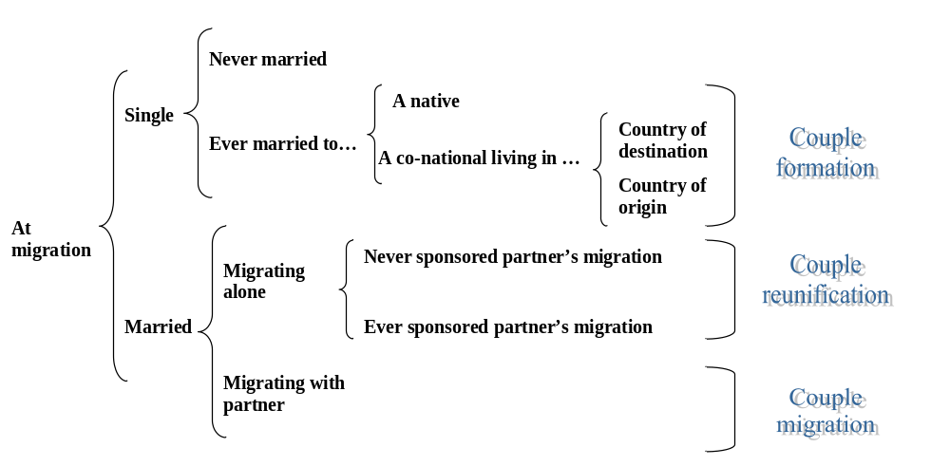
Links between family-link migration & integration

Slide 11
Type of adult family-linked migration to Spain, ENI 2007
FAMILY FORMATION
BEFORE
ARRIVAL
FAMILY FORMATION IN SPAIN
NOT MARRIED
AT ARRIVAL:
75% of total!

Slide 12
Self-declared reasons for migration in Spain: males & females

Slide 13
Effect of family-migration trajectory on female employment (ENI 2007, Spain)
ODD RATIOS. Controls: all but legal status

Slide 14
Family reunification vs. Formation, Netherlands 1995-2003 (% total)
Source: Nicolaas & Sprangers, 2004 (in González-Ferrer 2008).

Slide 15
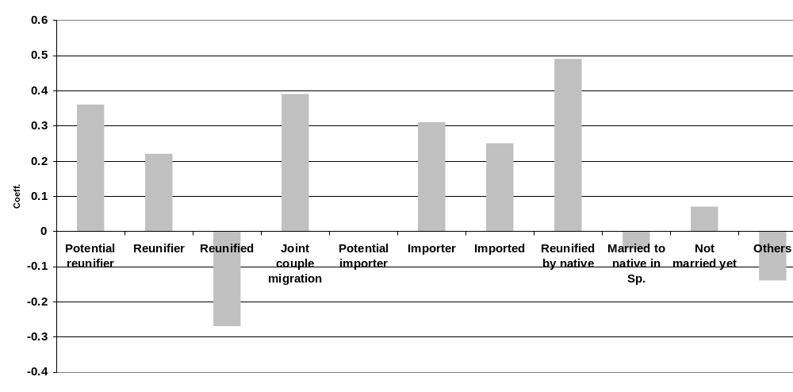
Effect of family-migration trajectory on male employment (ENI 2007, Spain)
Ref. Married in Spain to another immigrant
Coefficients. Controls: all but legal status

Slide 16
Link betw. family migration trajectory & integration
Determinants of immigrant employment are strongly gendered
Relevance of family-migration trajectories is crucial in explaining female employment in the long run
Unexpected direction of effects of family-migration trajectory:
    Work-oriented: Pioneers within the couple BUT also REUNIFIED WIVES!
    Family-oriented: IMPORTED WIVES

Slide 17
Conclusions (II)
Absent info on actual family links excludes possibility to understand relation family & integration
Legal category of admission poorly reflect actual reasons for migration & labour quality of immigrants but rather the effect of immigration policy
When admission categories are taken as proxy for migration reasons
  the estimated effect is fully endogenous to immigration policies
  Biased & misleading conclusions and sterotypes are provided on the link family-migration-integration
Immigration policies have consequences beyond their declared goals: controlling numbers ends up modifying the profile & integration process

Slide 18
Conclusiones
4. Legal category of admission poorly reflect actual reasons for migration & labour quality of immigrants but rather the effect of immigration policy
If conditions for legal migration & family reunification are very hard to meet & make difficult labour participation
    Legal Entry & Legal Family Reunification associated with Negative Selection with regad to labour market characteristics
    Current legal status masks the effect of such negative effect of legal entry
5. Omission of current legal status may bias our assesment of category of admission categories
6. Not completely country-specific

Slide 19
State of art & Recommedations
Type of Statistics | Some family-related aspect |  | Good Practices
Administrative data (registered based)
→ residence permits | Yes - family reasons | Kinship tie Distinction EU-nonEU sponsors
→ annual flows of acquisition of citizenship | Yes - through marriage
→ information on asylum applicants and asylum decisions
→ statistics related to the enforcement of immigration legislation
Data based on Census & Surveys
→ annual flows of immigrants and emigrants |  | PoB of parents Age at arrival
→ statistics on migrant integration (EU-LFS) | Not directly (except ad-hoc!) | Migrant status Reasons
Improvements
New statistics | Relevant Variables
No. of Applications | Age at migration Age groups 14 Relationship to other parent
 | Date marriage Date Partner Mig FR vs. FF
In the EU around 1 out of 5 TCN is a minor
BUT the y are not properly identified

Slide 20
Opportunities for improvement
Number of applications
Self-declared reasons for migration
Key Dates – date marriage/union formation & partners’ & children’s date of migration
Systematic inclusion of Age at Migration
Age groups that allow identification of (TCN) minors

Slide 21
THANK YOU VERY MUCH
FOR YOUR ATTENTION

