Slide 1
Impact of duration of stay definition on migration levels
Frans Willekens
DGINS Budapest 2017, 21 September 2017

Slide 2
Outline
Theory: migration = relocation with duration of stay criterion
Numerical illustration
Migration from Poland to Sweden
Conclusion

Slide 3

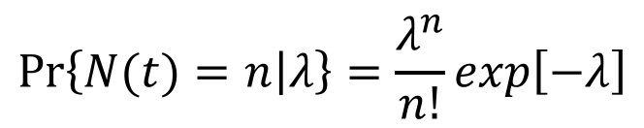
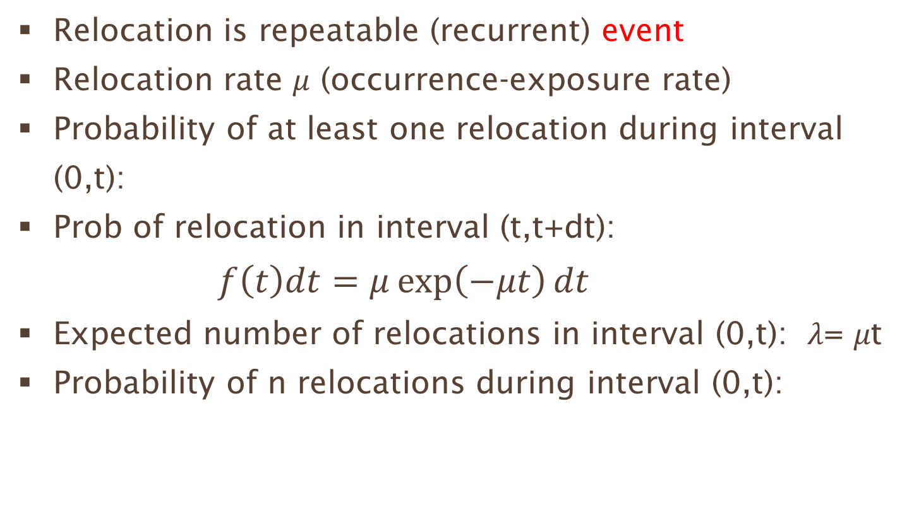
Modelling of count data: introduction
Relocation is repeatable (recurrent) event
Relocation rate 𝜇 (occurrence-exposure rate)
Probability of at least one relocation during interval (0,t):
Prob of relocation in interval (t,t+dt):
$f\left(t\right)dt=μ\exp\left(−μt\right)dt$
Expected number of relocations in interval (0,t): 𝜆= 𝜇t
Probability of n relocations during interval (0,t):
$$F\left(t\right)=1−exp⁡(−μt)$$
$$\operatorname{Pr}\left\{\left.N(t)=n\right|λ\right\}=\frac{λ^{n}}{n!}exp\left[−λ\right]$$
$$λ=E\left[N(t)\right]=μt; Var\left(N\right)=λ$$

Slide 4
Migration: relocation followed by minimum duration of stay
Minimum duration of stay of d_{m} years
    d_{m} ={0, 0.25 (3 months), 0.5 (6 months), 1, 10}
dead time (blocked time) (d_{m}) = time after each event during which the system does not record another event -> count loss
    Relocation (event) that occur during the ‘blocked time’ are lost
    In renewal theory, the counter is called “Type I counter” (e.g. Geiger counter to count radioactive impulses) (Pyke, 1958)

Slide 5
Literature
Cox, D., Isham, V. (1980). Point Processes. London: Chapman and Hall, p. 102
‘Blocked time’
Pyke, R. (1958) On renewal processes related to type I and type II counter models. Annals of Mathematical Statistics, 29(3):737-754
Distinction: “and event has happened” and “an event has been registered”
‘Type I counter’: counter in which deadtime is produced only after event has been registered’ (or detected)
He, S., G. Yang, K.T.Fang and J.F. Widmann (2005) Estimation of Poisson Intensity in the Presence of Dead Time. Journal of the American Statistical Association, 100(470):669-679

Slide 6
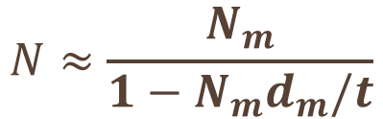
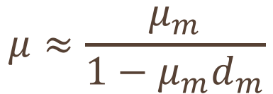
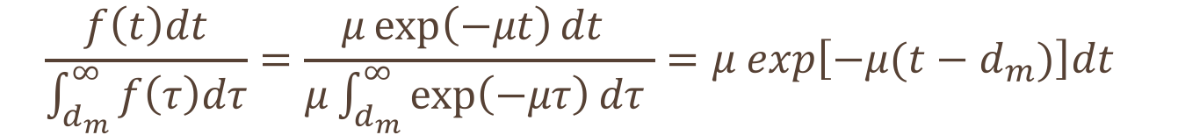
Migration: relocation followed by minimum duration of stay
Probability of measuring a relocation at time t (t > d_{m})
= exponential distribution shifted by d_{m}
Expected time between measurements: 1/𝝁 + d_{m}
True number of relocations during observation period (0,t):
with N_{m} the observed number of relocations during interval (d_{m},t)
and 𝝁 the event (relocation) rate and 𝝁_{m} the detection rate
$$\frac{f\left(t\right)dt}{\int_{d_{m}}^{∞}{f\left(τ\right)dτ}}=\frac{μ\exp\left(−μt\right)dt }{μ\int_{d_{m}}^{∞}{\exp\left(−μτ\right)dτ }}=μ exp\left[−μ(t−d_{m})\right]dt$$
$$N≈\frac{N_{m}}{1−N_{m}d_{m}/t}$$
$$μ≈\frac{μ_{m}}{1−μ_{m}d_{m}}$$

Slide 7

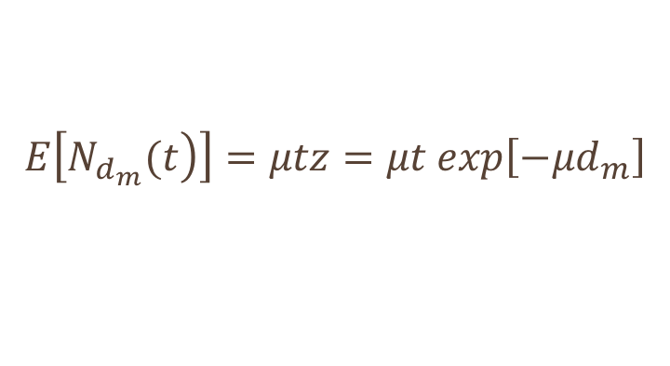
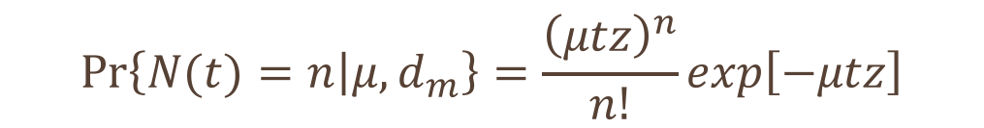
Migration = relocation with duration threshold
Probability of n migrations in (0,t)-interval if the duration threshold is d_{m}
$$\operatorname{Pr}\left\{\left.N(t)=n\right|μ,d_{m}\right\}=\frac{{\left(μtz\right)}^{n}}{n!}exp\left[−μtz\right]$$
where $z=exp\left[−μd_{m}\right]$ is the probability of no relocation within d_{m} years
Migration rate: z𝜇
Expected number of migrations during the interval of length t
$$E\left[\left.N_{d_{m}}(t\right)\right]=μtz=μt exp\left[−{μd}_{m}\right]$$

Slide 8
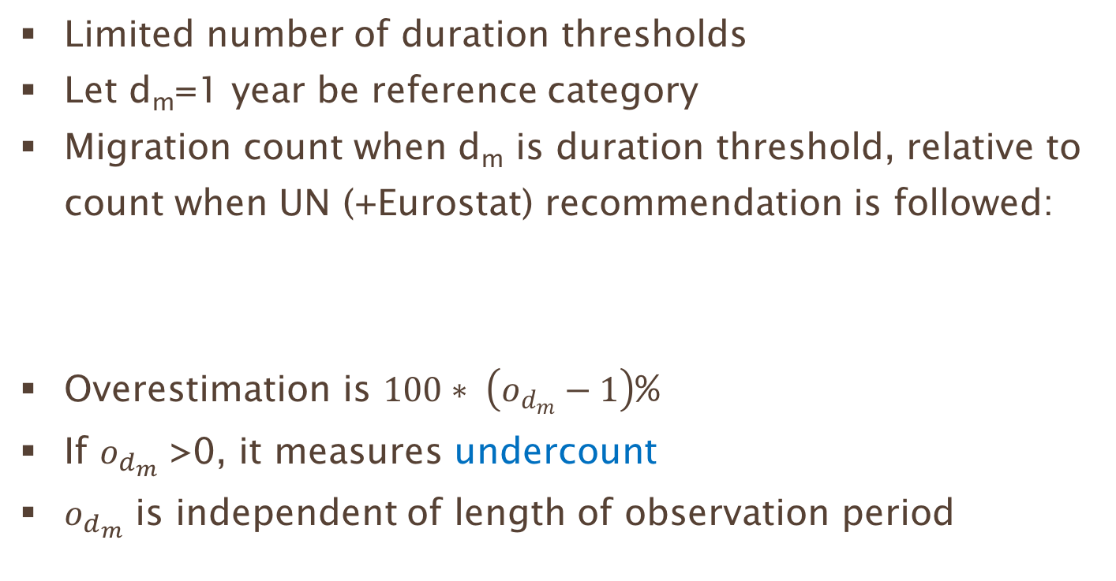
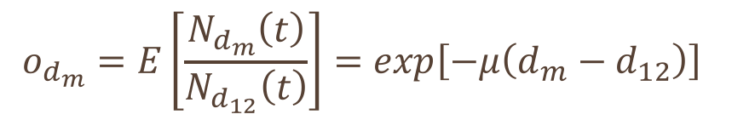
Migration: relocation with duration threshold
Limited number of duration thresholds
Let d_{m}=1 year be reference category
Migration count when d_{m} is duration threshold, relative to count when UN (+Eurostat) recommendation is followed:
Overestimation is $100∗ \left(o_{d_{m}}−1\right)$%
If $o_{d_{m}}$ >0, it measures undercount
$o_{d_{m}}$ is independent of length of observation period
$$o_{d_{m}}=E\left[\frac{N_{d_{m}}\left(t\right)}{N_{d_{12}}\left(t\right)}\right]=exp\left[−μ\left(d_{m}−d_{12}\right)\right]$$

Slide 9
Migration: relocation with duration threshold
Relocation intensity µ =0.2
Overestimation 10%: Migration count is 10% higher than with a duration threshold of 1 year (UN recom.)
Overestimation by duration threshold
 | relocation rate
Threshold | 0.2 | 0.1
0 | 1.22 | 1.11
0.25 (3 months) | 1.16 | 1.08
0.5 (6 months) | 1.1 | 1.05
1 (12 months) | 1 | 1
5 (60 months) | 0.44 | 0.67
10 (120 months) | 0.17 | 0.41

Slide 10

Migration from Poland to Sweden, average 2002-2007
Emigrations reported by Poland:
    Total to EU18+EFTA: 22,306
    To Sweden: 303
Immigrations from Poland reported by
    EU18+EFTA: 217,977
    Sweden: 3,718
Population Poland: 38 million
Poisson model of migration from Poland to Sweden
    Emigration rate: 303/38million = 7.97e-06
    Overestimation:
$$o_{d_{m}}=0.9999282$$

Slide 11

Hypothetical case in which Poisson model results in correct over(under)estimation
    Emigration rate 0.2
    Duration threshold 13.5 years (=‘permanent’)
    Overestimation:
    Polish data underreport underreport the true migration flow to Sweden by 92 percent.
$$o_{d_{m}}=0.082085$$

Slide 12
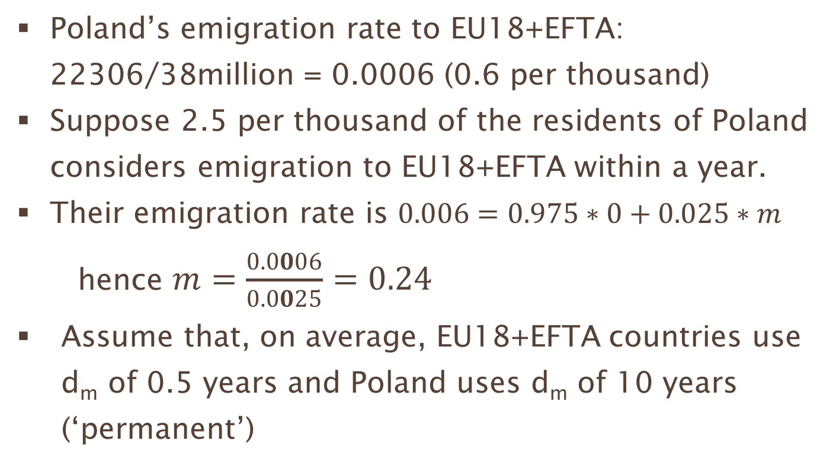
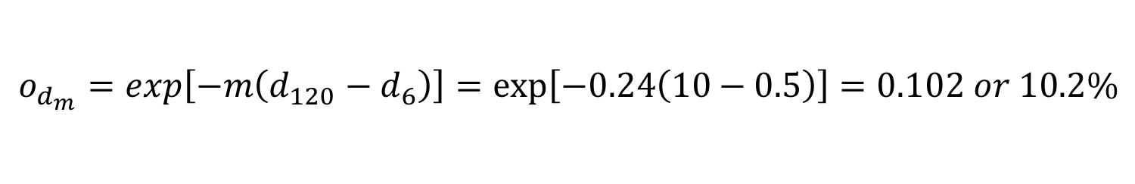
Mover-stayer model of Poland’s emigration to EU18+EFTA
Poland’s emigration rate to EU18+EFTA: 22306/38million = 0.0006 (0.6 per thousand)
Suppose 2.5 per thousand of the residents of Poland considers emigration to EU18+EFTA within a year.
Their emigration rate is $0.006=0.975∗0+0.025∗m$
    hence $m=\frac{0.0006}{0.0025}=0.24$
  Assume that, on average, EU18+EFTA countries use d_{m} of 0.5 years and Poland uses d_{m} of 10 years (‘permanent’)
$o_{d_{m}}=exp\left[−m\left(d_{120}−d_{6}\right)\right]=\exp\left[−0.24\left(10−0.5\right)\right]=0.102 or 10.2\%$

Slide 13
Mover-stayer model of Poland’s emigration to EU18+EFTA
    Poland’s reporting of emigration (22,306) is about 10 percent of immigrants count reported by EU18+EFTA (217,977)

Slide 14

Mover-stayer model of Poland’s emigration to Sweden
During the observation period (2002-2007), 1.7 percent of the emigrants from Poland emigrated to Sweden.
Suppose residents of Poland have a slight preference for Sweden -> emigration rate to Sweden is 0.27 (instead of 0.24).
8.8% of migration from Poland to Sweden is reported by Poland
Close to observation: 303/3718=0.082
$o_{d_{m}}=exp\left[−0.27\left(10−1\right)\right]=0.088$

Slide 15
Mover-stayer model should replace Poisson model
Wiśniowski (2017, p. 193) considers ‘the maximal fraction of the population that can emigrate in a given year’ (considering emigration data of sending country and immigration data from receiving country) and sets is to 0.02.

Slide 16

Expert judgment vs mover-stayer model
Mover-stayer model
    Proportion movers (mobile): 6%
    Observation period: 1 year
    Emigration rate for movers: 1.8 (move every 6 months)
    Emigration rate for stayers: 0.1
    E[N_{dm}] = 0.94*0.1*exp(-0.1*d_{m})+0.06*1.8*exp(-1.8*d_{m})
    Proportion of migration with duration threshold of 1 year reported when threshold d_{m} is used: E[N_{dm}] / E[N₁]
$$E\left[\left.N_{d_{m}}(t\right)\right]=μtz=μt exp\left[−{μd}_{m}\right]$$

Slide 17
Model and expert judgment: comparison
Table 1. True migration flow (UN definition) as fraction of recorded flow. Expert judgments, Poisson model and mixture model
Duration threshold | Experts judgment | Poisson model (𝛍=0.24) | Mixture model
No time limit 3 months 6 months 12 months Permanent (p)) 5 years 10 years | 0.51 0.61 0.81 1.00 1.64 | 0.79 0.84 0.89 1.00 2.61 8.67 | 0.51 0.64 0.77 1.00 1.80 2.98

Slide 18
Conclusion
Duration of stay criterion in definition of migration has large impact on migration counts
Poisson process with duration threshold = blocked Poisson process (blocked time or dead time)
Blocked Poisson model cannot describe the differences in migration counts
Mover-stayer model can describe the differences in migration counts
Mover-stayer model also describes outcome of expert judgments

Slide 19
thank you
Willlekens@nidi.nl

