Slide 1
Data integration and harmonization for measuring migrations in Italy: new perspectives towards a continuous Census
Giorgio Alleva
20th and 21st September2017
DGINS Conference

Slide 2
Figures on migration
Inflows of non-EU foreigners continue to decline: in 2016 almost 227,000 new permits were issued, nearly 5% fewer than in the previous year.
3.7 million non-EU foreigners held a residence permit in Italy on January 1, 2017 (about 217,000 less than in 2016): the largest groups were Morocco (454,817), Albania (441,838), China (318,975), Ukraine (234,066) and The Philippines (162,469).
More than 1 million resident foreigners are Romanian citizens
More than 5 million resident foreigners (around 8.3% of the total resident population) in Italy on January 1, 2017
Giorgio Alleva – Budapest, 20 et 21 September 2017

Slide 3
Inflows by reason
In this period work permits issued decreased sharply, from 56.1% in 2007 to 5.7% in 2016
In 2016, Nigeria, Pakistan and Gambia were the countries of origin of most of the people holding permits issued for asylum and other humanitarian reasons: they represented 44.8% of all permits issued for this reason
Instead, requests for asylum and for other humanitarian reasons continued to grow: in 2016 they represented 34.3% of new inflows, whereas in the 2007 they were only 3.7%
Giorgio Alleva – Budapest, 20 et 21 September 2017

Slide 4
The acquisition of citizenship
From 2012 to 2016, naturalized citizenship increased rapidly. In 2012, more than 65 thousand citizens were naturalized; in 2016, almost 202 thousand
35.8% of new citizens in 2016 were people who previously had Albania (36,920) or Morocco (35.212) as their nationality
39.9% of new Italian citizens in 2016 were people under 20 years of age
Giorgio Alleva – Budapest, 20 et 21 September 2017

Slide 5

The road towards data integration and harmonization
Before EU Regulations
After EU Regulations
The production of new estimates not available before
Stimulation of dialogue:
  among different Institutions
  among Member States
  within Istat
Gentlemen’s
Agreement
Giorgio Alleva – Budapest, 20 et 21 September 2017

Slide 6

Best practice after EU regulation:
the example of residence permits
Residence permits data
Residence permits data
In the past
Nowadays
collection
collection
Data transmission
Ministry of Interior
ISTAT
Ministry of Interior
Data transmission
ISTAT
Data validation
elaboration
elaboration
Better quality of numbers!
elaboration
elaboration
Different numbers!
dissemination
dissemination
dissemination
dissemination
Eurostat
Notes:
.

Slide 7
Best practice after EU regulation:
the example of citizenship acquisition
Until 2010
Since 2011
Ministry of Interior
Individual data on acquisitions for marriage and residence (age, previous citizenship, sex)
Ministry of Interior
Individual data on acquisitions for marriage and residence (age, previous citizenship, sex, tax code)
Istat
integrates data from Ministry of Interior with the ones from:
Population register (Anagrafe)
Municipality lists for different years (t-1 and t)
Record linkage of individual data records to identify changes in citizenship (many information about individuals)
Foreign population balance
Aggregate data on acquisitions at municipality level by sex
Istat
integrates data from Ministry of Interior with the ones from:
Foreign population balance
Aggregate data on acquisitions at municipality level by sex
Data transmission
Data transmission
Record linkage
Istat estimations for Reg. 862/2007
Data for all kinds of citizenship acquisition
by age, sex and previous citizenship
Istat estimations of better quality for Reg. 862/2007
Data for all kinds of citizenship acquisition
by age, sex and previous citizenship
Istat estimations for other needs
Data for various territories and for type of acquisition (marriage, residence, transmission and choice)
Giorgio Alleva – Budapest, 20 et 21 September 2017

Slide 8



Best practice after EU regulation:
dialogue among Member States
Trilateral agreement Romania-Eurostat (Spain and Italy) on the exchange of methodological best practices and provisional summary data in order to prepare the migration data required under Regulation (EC) 862/2007
Istat
Data transmission of migration flows from and to Romania
INSSE
INE
Estimates based on
ISTAT and INE data
Giorgio Alleva – Budapest, 20 et 21 September 2017

Slide 9
New perspectives on the integration of base registers, a continuous census and social surveys
The modernization process is based on the extensive access to administrative data in accordance with a strategic choice to invest in a register-based approach to industrialization
Advantages:
reduced costs
reduced response burden
better quality, timeliness and completeness
This process placed the Registers Integrated System (RIS) in the middle of the data production process. Thus, the Base register of individuals, households, enterprises, addresses, etc. is enriched with information collected by the thematic registers.
The integrated system supports a higher level of analysis and better quality of the information collected, linking the economic and social phenomena at micro level
Giorgio Alleva – Budapest, 20 et 21 September 2017

Slide 10
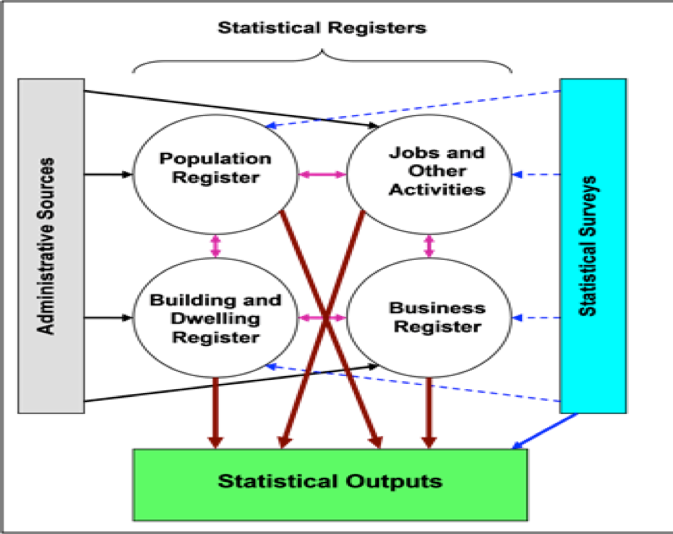
The combined use of registers and surveys data
The target infrastructure is based on four Basic registers (Individuals and households, Economic units, Geographical/territorial units, Activities). These have links with each other which, in turn, connect them to the administrative sources from which they are derived
The combined use of register and survey data
The data collected in the field are not the only source for the production of final results, but they are one of the sources used to enrich:
the quality of the registers
the integration of new information (not substitute variables)
the accuracy of the final outputs
Giorgio Alleva – Budapest, 20 et 21 September 2017

Slide 11
Census and Social Surveys Integrated System
Synthesis
Population & PR
Census and Social Surveys Integrated system (CSSIS)
Master Sample
Output of Yearly Census Estimates
First phase survey round
Second phase survey round
Over-coverage
Population
Under-coverage
RIS
?
Population
Prototype RIS
Replaceable
Variables
?
Area
Population
Coverage
LFS
Partially Substitutable
LCS
List
Not substitute
Variables
&
Over-coverage indicators
EUS
Harmonized
Specific
CES
Variables
From the prototype………………………………………….....to Register

Slide 12
Social group: low–income households with foreigners
The group of low-income households with foreigners is constituted of those households where there is at least one non-Italian citizen. They are nearly 2 million (7.1 percent) for a total of 4.7 million individuals (7.8 percent).
Three-quarters of households with at least one foreign component fall into this group. With a disadvantage of 40%, this group is the poorest among those identified.
Giorgio Alleva – Budapest, 20 et 21 September 20 17

Slide 13
New perspectives for measuring migration and social exclusion
Linking records from administrative and sample sources creates a dialogue between the "longitudinal" potential of the registers with information regarding behaviors, attitudes and opinions derived from the surveys.
Special attention to naturalized foreign citizens. Among the renewed survey, the one on second generations will be carried out by Istat in 2019.
The social climate surrounding immigrants and the attitudes towards foreign communities is another relevant field that require ad hoc sample surveys.
Special attention on improving migration data in the context of the 2030 Agenda for Sustainable Development Goals (SDGs).
Re-designed sample surveys to examine processes of inclusion/exclusion of foreigners in Italy with specific attention dedicated to the issue in traditional surveys and new surveys.

