Slide 1

Planning for an increased use of
administrative data in censuses 2021 and beyond to produce statistics on migrants
Dominik Rozkrut
Central Statistical Office of Poland
103rd DGINS Conference
Budapest, 20-21 September 2017

Slide 2
Census objectives
Satisfying user needs, especially in terms of data that can only be based on a census
Providing precise data on the smallest administrative territorial units
Analysis of demographic and social processes in between the censuses
Data for international needs and comparisons
Reliable sampling frame for next years

Slide 3
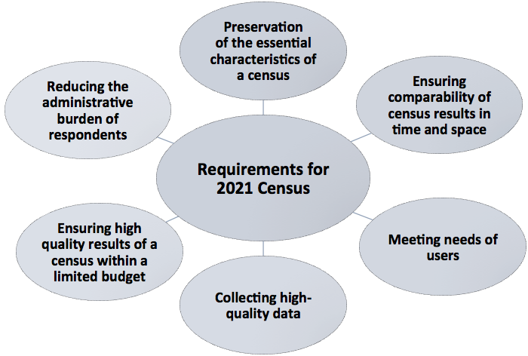
Requirements for 2021 Census

Slide 4
How to deal with the requirements?
New methods of generating statistics
  New sources of data
  New techniques and technologies
Identification of new data sources
Linking data from different sources
Use of administrative registers
Matching new sources to user needs

Slide 6
National and international user needs
National needs:
  information important for socio-economic policies
  information important for regional and local policies
International needs:
  EU membership
  other international organizations and associations

Slide 7
Possibilities related to the use of administrative registers in 2021 Census
Create fast, accurate, comprehensive statistics able to describe complex and rapidly changing phenomena
Providing statistics satisfying user needs
Improving the efficiency of statistical production
Focus on innovation
Maintaining the brand of public statistics

Slide 8
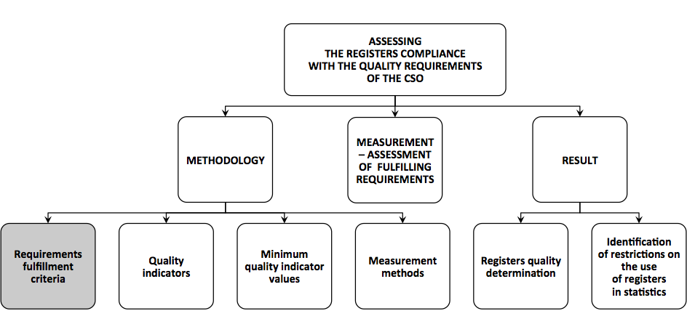
Approach to the assessment of the usefulness of administrative registers as a source of data for 2021Census

Slide 9
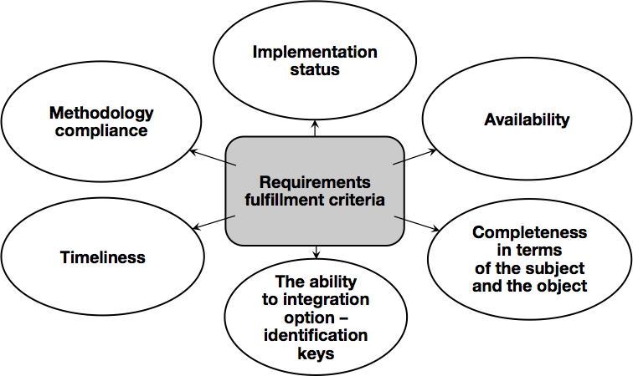
Approach to the assessment of the usefulness of administrative registers as a source of data for 2021Census

Slide 10
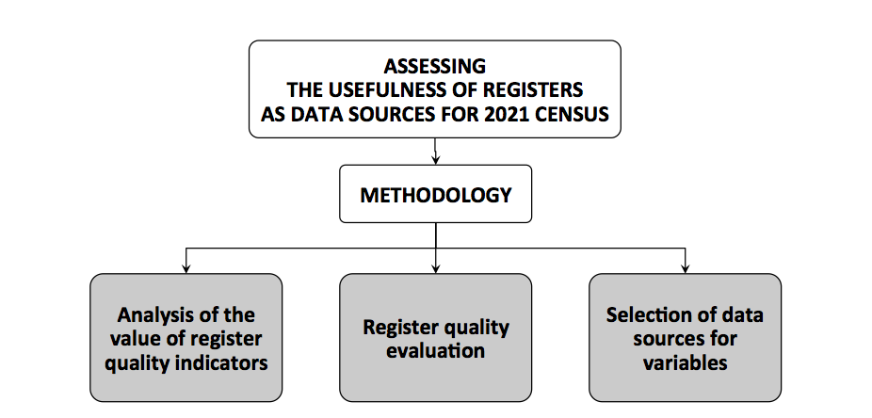
Approach to the assessment of the usefulness of administrative registers as a source of data for 2021Census

Slide 11
Conceptual model of
Statistical Population Register
testing and implementing new solutions and methods of variables derivation from administrative registers
developing methodological assumptions enabling to keep migration statistics and population estimates of the actual place of residence, as well as the structure of the population
identification and implementation of quality indicators for data sources on the basis of created system of related statistical variables on the basis of administrative registers
defining the requirements and recommendations for the construction of a coherent statistical system based on administrative registers, including processes for data processing

Slide 12
Conceptual model of
Statistical Population Register
List of persons connected with the address-dwelling list
Several domains (thematic areas)
List of persons based on the integration of data from multiple heterogeneous sources – two types of registers:
  reference registers („core") - characterized by the highest data quality, completeness and timelines
  supporting registers - other registers, the thematic scope of which meets the needs of statistics.

Slide 13
Statistical Population Register
Phase I - improving the quality of sources
Phase II - generation of statistical variables
Phase III - analysis of microdata quality
  Quality of the register is determined
    quality of data sources
    processing mthods.

Slide 14
Quality assessment of constructing processes
of Statistical Population Register

Slide 15
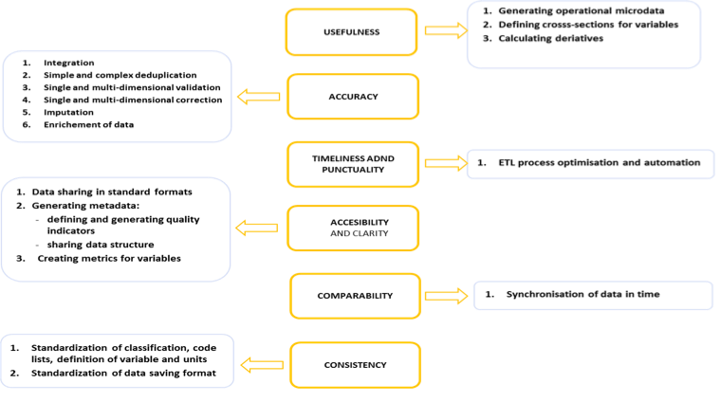

Slide 16
Multi-level approach to obtain the values of exemplary variables

Slide 17
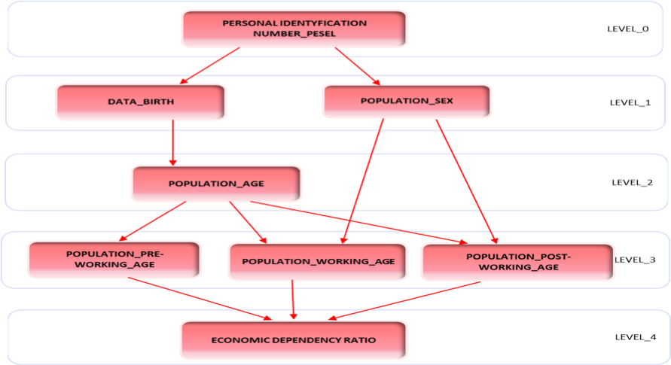

Slide 18
Statistical Population Register - domains
Status and demographic characteristics of the population,
The population in collective living quarters and the homeless persons
Education,
Economic activity of persons,
Commuting to work,

Slide 19
Statistical Population Register - domains
Disability,
Country of birth and citizenship,
Internal and international migration,
Nationality, language and religious affiliation (denomination),
Households and families
Status and characteristics of the dwelling stock
(dwellings and buildings).

Slide 20
List of migration variables existing in administrative registers
1.country of birth, 2.country of citizenship, 3.way of acquisition of Polish citizenship 4.country of previous citizenship (in case of acquisition of Polish citizenship), 5.fact of ever resided abroad, 6.year of arrival in Poland (for persons ever resided abroad), 7.place of residence abroad - country (for persons ever resided abroad), 8.number of years of the last stay abroad (for persons ever resided abroad), | 9.place of previous residence, 10.date of residing in a current place, 11.place of residence one year prior to the census, 12.country of permanent residence (temporary immigration), 13.period of stay (temporary immigration), 14.year of arrival in Poland (temporary immigration), 15.does the immigrant stay in Poland for the first time (temporary immigration), 16.country of stay (temporary emigration), 17.period of absence (temporary emigration), 18.year of departure (temporary emigration).

Slide 21
Statistical Population Register
- registers used for migration statistics
Reference registers („core registers”),
  Population register (PESEL)
  National Taxpayers Register
  Social Pension System
  Health Insurance System
  „Stay” register (POBYT)

Slide 22
Statistical Population Register
- registers used for migration statistics
Supporting registers - data sets run by central bodies responsible for:
  labour (on the employment of foreigners)
  science and higher education (on fereign students and university graduates)
  education (on foreign pupils in primary and secondary schools).

Slide 23
Thank you for your attention

