Slide 1
Using administrative sources for statistics on migrants – a UK perspective
Sarah Crofts
Head of Migration Analysis and Development of Sources
Office for National Statistics, UK

Slide 2
The UK context

Slide 3
Measuring international migration
A border survey ‘The International Passenger Survey’
Captures migration intentions and other characteristics
High level figures supplemented by adjustments:
  Asylum seekers (administrative source)
  Ireland land border crossings (administrative source)
  Methodological adjustment for changes in intentions

Slide 4
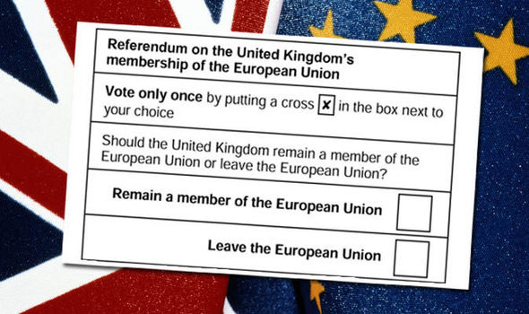
The Big Story of 2016
Image from Express.co.uk

Slide 5
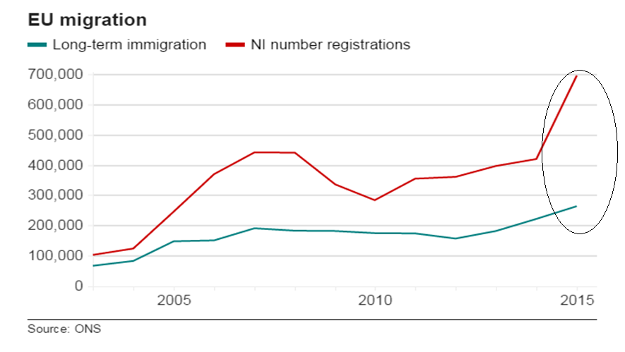
Example 1 : EU immigration

Slide 6
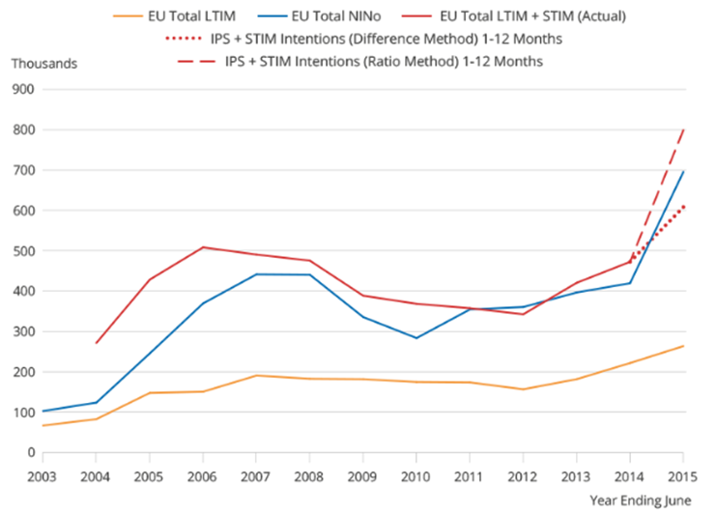
Comparison of short and long-term migration estimates with NINo allocations to overseas nationals

Slide 7
Her Majesty’s Revenue and Customs (HMRC) – Tax data
‘Real time information’ – employers inform HMRC every time they pay their employees
Used as proxy indicator for migrant workers, including year of arrival and duration in the UK
Linked with nationality when applying for National Insurance number helps identify migrants
Does not cover self-employed (reported separately)

Slide 8
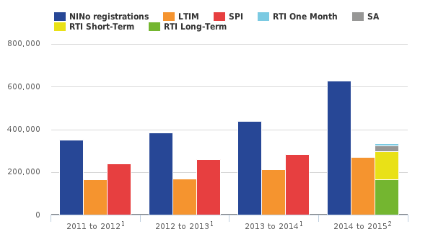
Adding to the evidence
Notes:
It showed that there were approximately equal numbers of short-term migrants as long-term – supporting our conclusions.
(The green bar shows long-term and the yellow bar shows short-term)

Slide 9

Example 2 : International students
Notes:
International students contribute around £25 billion to the UK economy
They make up 19% of all students at UK universities
Encouraging international students to the UK (who contribute to net migration) is a challenge to policies that aim to reduce net migration.

Slide 10
The Student Migration Issue (non-EU)
Source: International Passenger Survey, Office for National Statistics

Slide 11
New administrative source - ‘Exit Checks’
Advanced Passenger Information
Visa system
Expired study visas from April 2015 to March 2016
Matched with API to identify departure record

Slide 12
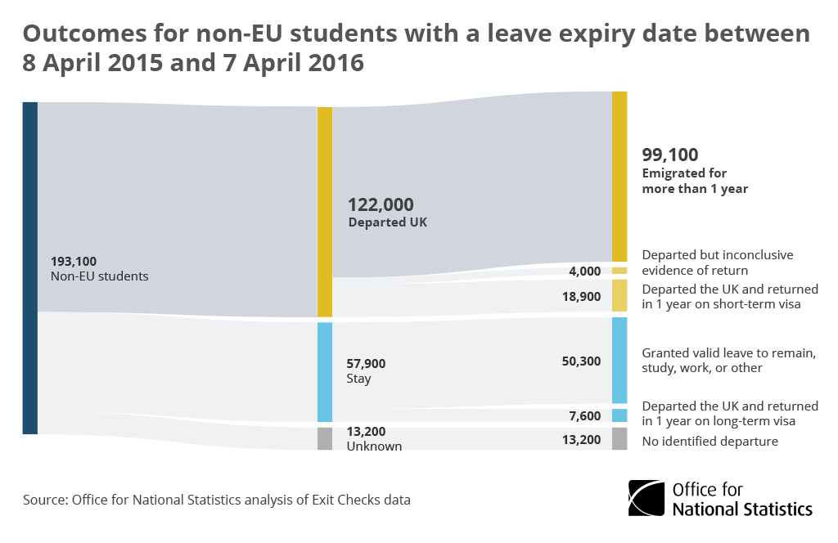
Exit Checks
51%
2%
10%
26%
4%
7%

Slide 13
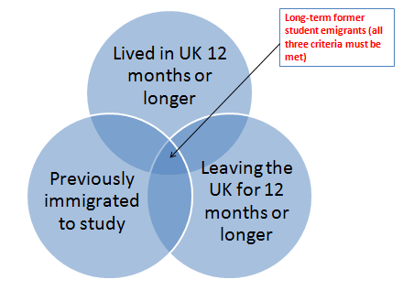
Why are the IPS emigration numbers lower…?
To be identified as an emigrating student they need to say:

Slide 14
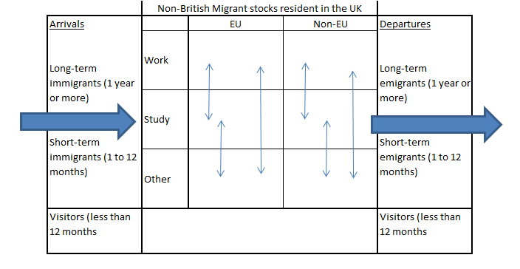
A data challenge : Migrants’ lives are complex…

