Slide 1
Opportunities for transformation of official statistics from an ESS perspective
Walter J. Radermacher
Director-General of Eurostat
Budapest, 20 October 2015

Slide 2
Areas of transformation
Legislation: revision of the European statistics law
Strategy: ESS Vision 2020
Modernisation frameworks: business, social and agricultural statistics
Programming: extension of the European Statistical Programme (ESP)
Governance: VIG, VIN, ESF…
Quality management: quality assurance, peer reviews, TQM
Self-reflection: 'Vienna Group'

Slide 3
Legislation in European statistics
2015 revision of Regulation (EC) No 223/2009:
  Professional independence
  Recruitment / dismissal of top management
  Coordination of national statistical systems
  Administrative data
  Commitments on Confidence in Statistics
Legislative Architecture
Streamlining
'Lisbonisation'

Slide 4
Drivers for ESS Vision 2020
Data revolution
New metrics
Price of statistics
Future
of Europe
Digital transformation
Globalisation
Quality vs. resources
Enhanced economic governance
New data sources
Complex reality
Reduced budgets
Evidence based policy making
Competition among data providers
Geo-details
Cutting
the red tape
Objectives, thresholds, quality requirements
Notes:
What are these challenges that triggered common reaction initiated with the ESS Vision 2020?
1. Data revolution – new technologies – competitive pressure – rapidly increasing flood of data from various sources – potential to improve timeliness, relevance and response burden – but uncertain quality – what role for official statistics?
2. New metrics – global phenomena that cannot be described with traditional indicators based on purely national data – need for reorientation of analytical focuses and for new statistical products with different geo-levels
3. Price of statistics – quality is never cheap – change=investment – but resources are shrinking – response burden expected to be reduced – data expectations rising – how to keep quality high and preserve this competitive advantage?
4. Future of Europe – policy targets are increasingly quantitative and based on statistical evidence – highest quality and quick delivery expected and assumed – notably in EU's enhanced economic governance

Slide 5
Key areas of the ESS Vision 2020
Users
better understand and address user needs
be a global partner and leader for innovation
build strategic alliances with public and private partners
Quality
abide with the European Statistics Code of Practice
enhance quality management
assess the usability and quality of source data
promote quality of European statistics
New data sources
exploit potential of new data sources
invest in new IT tools and methodology
continue to improve existing data collection methods
Production process
further intensify the collaborative partnership of the ESS
further identify and implement standards for statistical production
adopt enterprise architecture as a common reference framework
advance in sharing IT services and infrastructure
benefit from exchange of (micro)data, while fully respecting statistical confidentiality
Dissemination
adopt new dissemination and communication strategy
create a data pool of European statistics
optimise ESS portfolio of products and services
promote European statistics as a brand

Slide 6

The ESS Vision 2020 portfolio
ESS Vision 2020
FRAMEWORKS
SIMSTAT
ADMIN
BIGD
REDESIGN
ESSC
ESDEN
VALIDATION
DIGICOM
SERV
ESBRs

Slide 7
ESS Vision 2020
FRAMEWORKS
ESSC
FRIBS
Social Statistics
Agricultural Statistics
Modernisation frameworks

Slide 8
European Statistical Programme (ESP)
2013-2017

Slide 9
ESP extension 2018-2020
foreseen in the ESP 2013-2017 Regulation
adjustment with the MFF (2014-2020)
consistent with the revised European statistics law
opportunity (and challenge) to update the priorities and budget

Slide 10
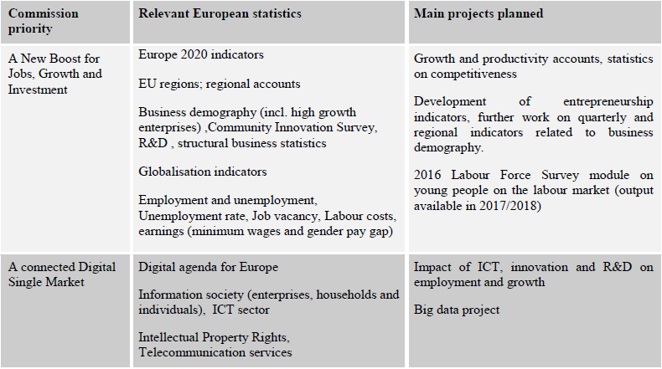
EU priorities

Slide 11
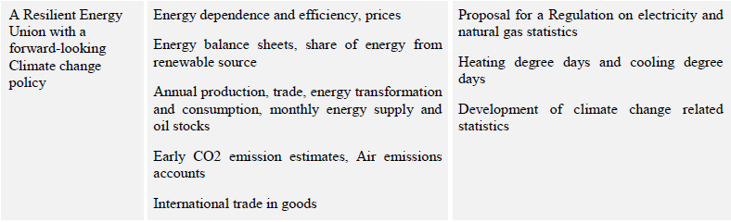
EU priorities

Slide 12
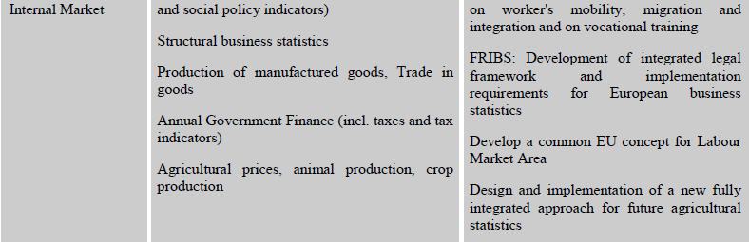
EU priorities

Slide 13
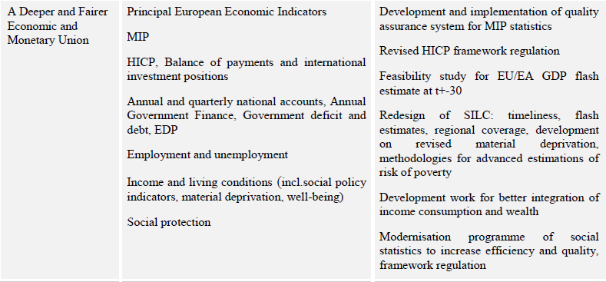
EU priorities

Slide 14
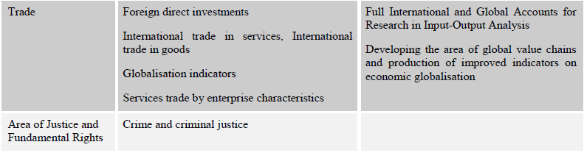
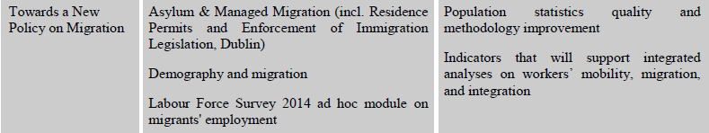
EU priorities

Slide 15
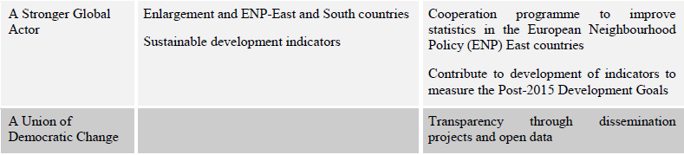
EU priorities

Slide 16
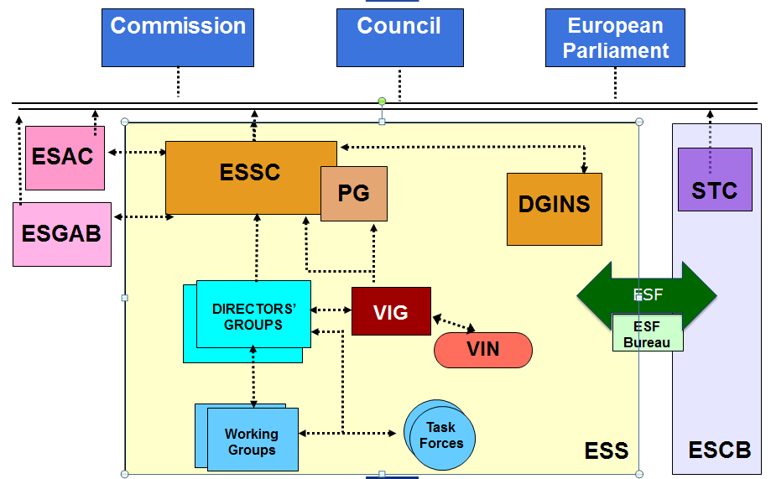
ESS governance 2015

Slide 17
Quality management
Code of Practice
Quality assurance framework QAF
Peer Reviews
Branding – Labelling
Indicator sets, methodology, quality
Streamlining / integrated reporting
TQM
Compliance reporting
Sanctions / fines

Slide 18
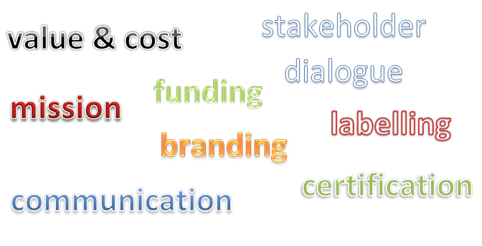
Reflection on the future of official statistics
Informal high-level brainstorming sessions in Vienna and Amsterdam
Keywords:

Slide 19

Building together the ESS
Administrative data
Communication
Governance
Users
Big Data
Validation
Data warehouses
Methods
Services
Quality
Enterprise Architecture
Standards
Network

Slide 20
