Slide 1
Benefits of sharing good practices with other NSI’s - from the perspective
of a new EU member state
Marko Krištof – Director General
Budapest - 20.10.2015.

Slide 2
CBS and preaccesion assistance
Croatian Bureau of Statistics is an autonomous government administrative organization, with 534 employees and a total budget of 13.4 € million (2015).
1.7 € million (12,6 % of total budget in 2015) is coming from various EU sources (primarily preaccesion funds).
During the whole pre accesion period, CBS has participated in total 35 projects with total contracted value of 21.2 € million.
Total 213 statistical areas were modernised
Notes:
Preaccesion period has started in

Slide 3
Why is sharing good practices so important?
It reduces costs
It saves time
It reduces redundant effort
It helps avoid making same mistakes twice
It improves existing concepts
It promotes standardisation of processes and procedures
It provides new perspectives
It is beneficial for all parties
„Share your knowledge.
It is a way to achieve immortality.” Dalai Lama XIV

Slide 4
Exchange of EU solutions implementation in Croatian Statistical System
IT solutions
CBS has developed the concept of Integrated Statistical Information System (ISIS) and its first components in cooperation with Statistics Sweden (SCB), through a SIDA project (in 2005).
ISIS is a muliticomponent interoperable IT system, with CROMETA - central metadata repository and management tool as core data processing component.
CROMETA is based on METANET (2000-2003) reference model, and it combines descriptive and process oriented metadata, with general statistical methodologies and concepts, but also general metadata describing organisation structure and rights of access.

Slide 5
Classification management system (KLASUS)
Solution for organising, storing and implementing statistical classifications (KLASUS) is developed on the basis of solution from Statistics Portugal (INE)
Neuchâtel Terminology Model (currently GSIM Statistical Classifications Model) was used as a template.
Classifications are managed from competent department and available for use within and outside of CBS.
KLASUS combines classification hierarchies, connecting tables, classification codes and code books and search tools.

Slide 6
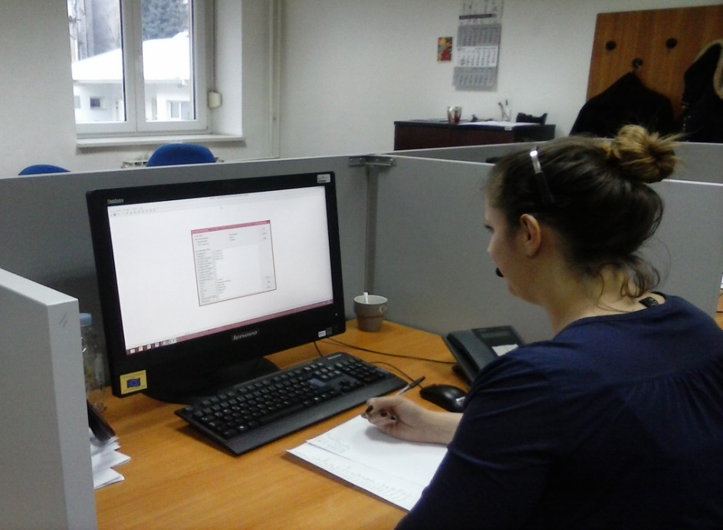
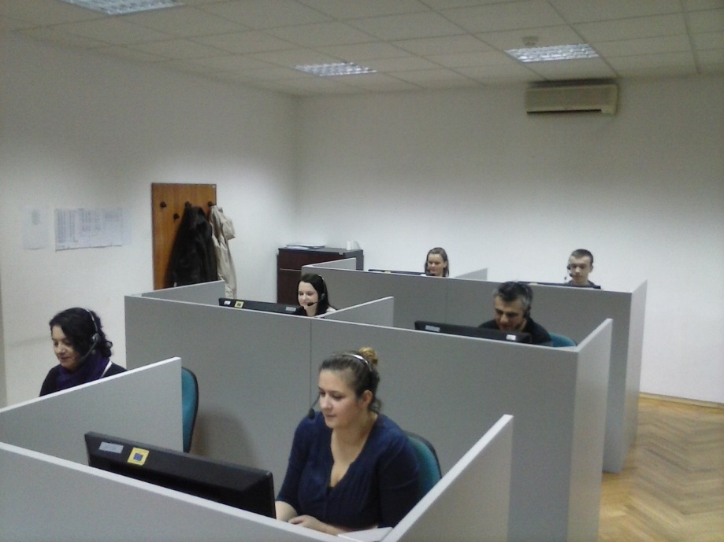
Computer assisted interviewing (CAI)
CBS has developed the CAPI/CATI system of interviewing following the example from Statistics Finland
Sampling experiences are used from Statistics Spain
Software used is purchased from Statistics Netherlands (licensed software)

Slide 7
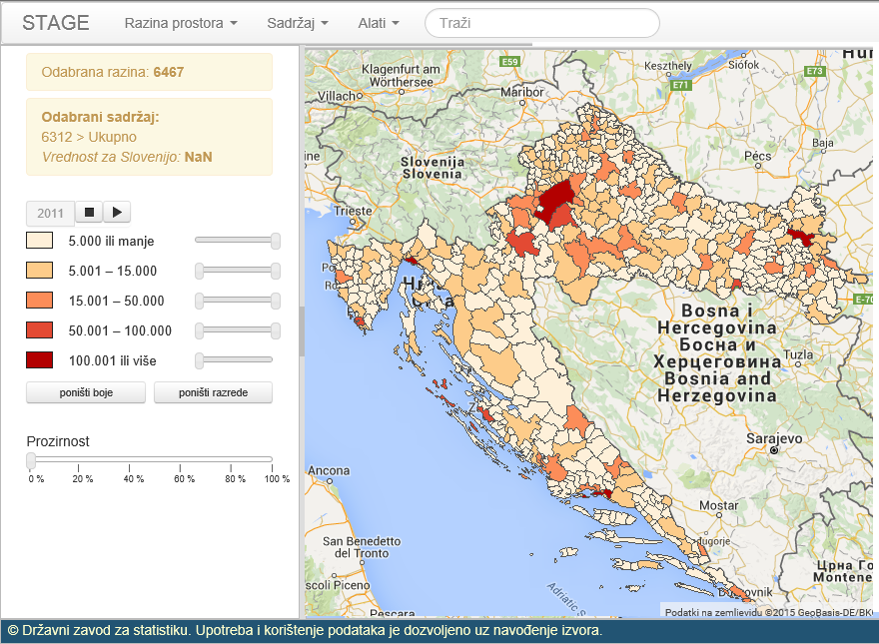
Merging geoinformation with statistical data
GRIDS - methodology for merging geospatial information and 2011 Census data is coming from Bulgaria
STAGE – software for dissemination and interactive analysis of geospatial data (open source) software developed by SURS and Slovenian geodetic administration (it uses PC-Axis as a data source)
To be published on CBS site in November 2015

Slide 8
Statistical data protection
System of access to confidential statistical data for scientists is a compilation of best practices from a number of NSIs, on the basis of example from Republic of Slovenia.
For the purpose of anonymization of result tables, CBS uses Tau-Argus – software from Statistics Netherlands, while its implementation and education on usage was acquired from SURS Slovenia.
CALMAR – Neyman allocation macro (SAS) – INSEE France
CLAN – Bethel allocation macro (SAS) Statistics Sweden

Slide 9
Quality information database (DBQI)
For the puropose of quality reporting, CBS has used IPA project to develop the system of automated quality reporting. The project team was lead by an expert from the SURS Slovenia.
The database stores reference metadata for the purpose of quality reporting. It incudes concepts that are taken from Euro-SDMX Metadata Structure (ESMS) and ESS Standard Quality Report Structure (ESQRS), which are applied in the ESS Metadata Handler.
DBQI was offered to SURS, which is about to implement it in Slovenian statistical system.

Slide 10
Thank you for your attention Marko Krištof, Director General Tel: + 385 (1) 4806 295 Fax: + 385 (1) 4812 740 E-mail: ravnatelj@dzs.hr

