Slide 1
Organisational design and transformation approach
Developing a business model
Organisational transformation framework
Designing strategic HR for NSIs

Slide 2
1. Developing the business model

Slide 3

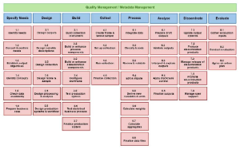


Where to look for help ?

Slide 4
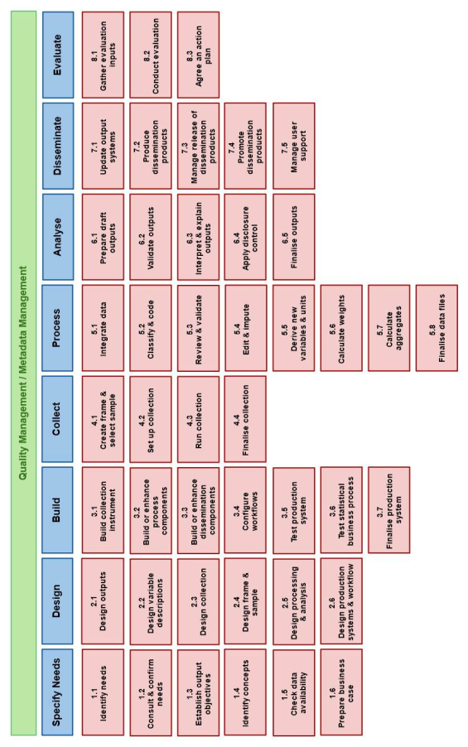
Generic statistical Business Process Model (GSBPM)

Slide 5
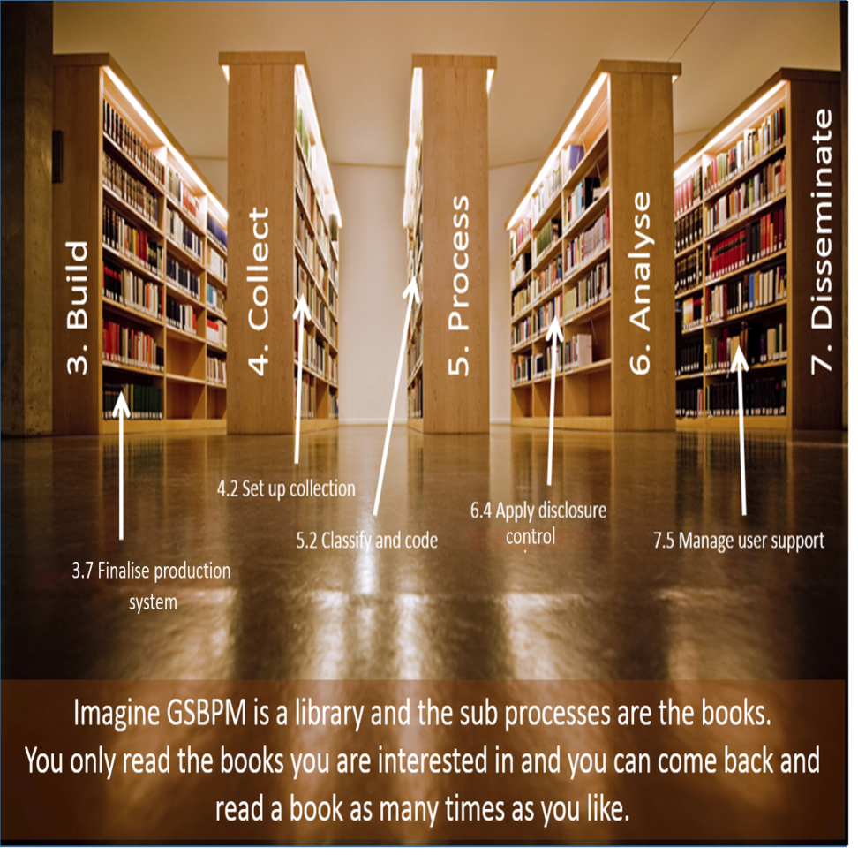
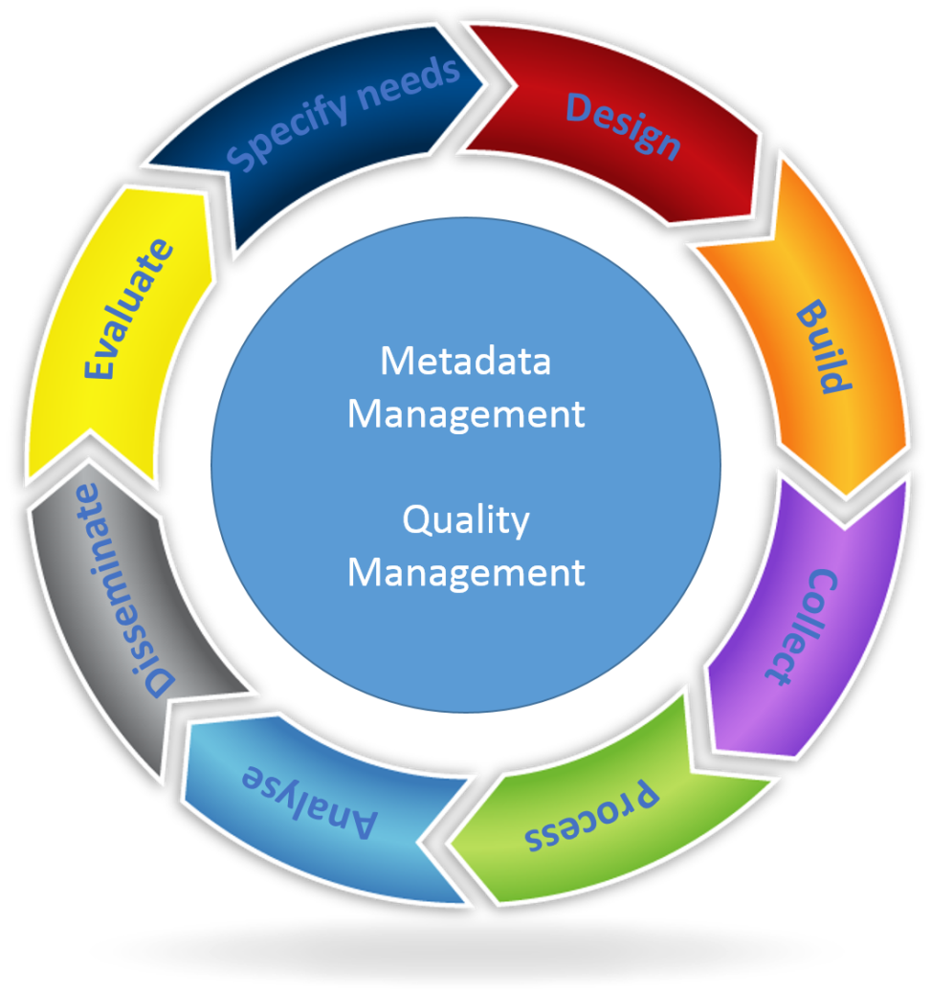
Other representations of GSBPM

Slide 6
GSBPM model

Slide 7
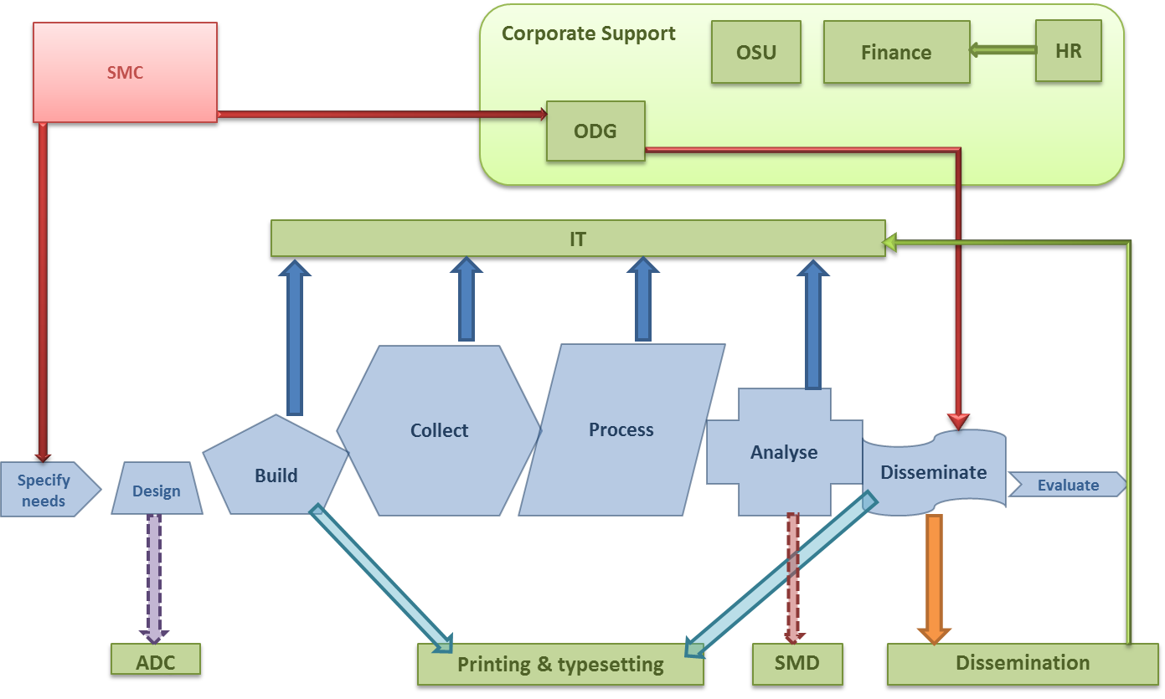
As is model ?
We can map our processes to the GSBPM, but…

Slide 8
To be model
Where do the statistical overarching processes sit?
Quality Management
Metadata management
Data Management
Specify needs
Design
Build
Process Data Management
Collect
Process
Analyse
Disseminate
Evaluate

Slide 9
2. Transformation Framework

Slide 10
Where do overarching/support processes fit? GAMSO

Slide 11
Customers
Strategy & leadership (Directorate)
Statistical Processing
Quality Management Framework
Quality Assurance
Metadata management
Process Data Management
Specify needs
Design
Build
Collect
Process
Analyse
Disseminate
Evaluate
Data Management
Business Support & Capability Building
Corporate Support
Coordination & Irish Statistical System wide support
Finance
Methodology
Quality Framework Management unit
HR
Marketing
Administrative Data Centre
IT
Transformation & Performance
Office services
Communications
Procurement
Data Office
Dissemination
Legal
LDU
Typesetting
Printing

Slide 12
Designing HR Architecture
Strategic Principles
Key Pillars of Strategic HR
Strategic Workforce
Planning
People and Performance
Empowerment and Engagement
Relationships
Learning and development
Culture and Values

