Slide 1
Round table discussion
My three main aspects proposed for discussion:
1. „Environment” of HR strategic planning
International
National (mostly = public administration policies)
Institutional
2. „People”
„Generation Y”: Challenges and opportunities for HR
Is staff rotation a successful tool?
3. „Procedures”
Assessment activities: how is staff evaluation working? (General public assessment vs. ideas of HR in Statistics Offices?)

Slide 2
1. „Environment” of HR strategic planning
International
Importance of HR management is an emerging issue (perform better, be more up-to-date, align competencies to demands while the organisation shall consume less resources).
IT development is opening new doors for supporting the HR activity.
Process based approach, need to facilitate the reuse and sharing of methods, components, processes and data repositories, standardise
Free up resources for new developments by harmonising our knowledge based on international standards and aligning technologies and methods.
National
Opportunities for individual actions are rather limited in a very centrally managed (and financed) public administration. The level of policy centralisation determines the majority of tools and possible actions.
Public administration development programs (like the „Magyary-Program” in Hungary) influence all bodies while statistics office’s needs may be sometimes different (institution’s professional independence)
Less space for differentiating in promotion, remuneration or other motivation tools.
Institutional
Internal expectations are usually aligned to an office-wide strategy, HR needs to serve the goals.
Committed leadership is a key
Usually the resource limitations are strong, there are no „soft” boundaries, real chances for negotiation on numbers are low.
Age (and educational) composition of staff is an essential point of further planning
Is there a special committment, culture or „folklore” among staff that has an effect throughout the organisation? (Is it hip to be statistician?)

Slide 3

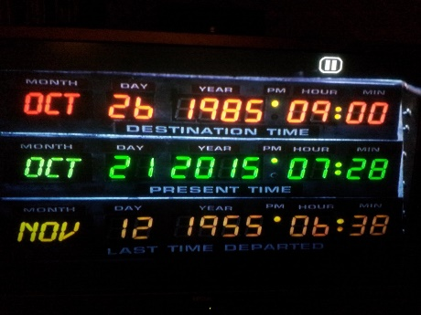




2. „People” – The „Generation Y” issue
I am a „Generation X” member, born in 1975. What is important to me?
For example: today, on the 21st October 2015…
Marty McFly goes Back To The Future – Hill Valley, CA

Slide 4
2. „People” – The „Generation Y” issue
…and what is important to a „Generation Y” member today? *
Who are they?
Born between ~1980-1999, the first generation heavily using computers and groving up discovering the internet, social media etc.
What are their usual properties and what do they want?
Mobility, IT experience, respecting the environment and nature, motivation, the demand for feedback in their work, direct relation between performance and rewards, straight communication. They want to feel well at their place of work, they are ready to switch easily if they get better offers, a balance of work and private life is a must, but often they are stamped as „carreerists”…and they need a boss they can look up to!
In HCSO their annual turnover number is increasing, while in other generations the staff is more stabile.
An e-questionnaire was sent out for employees under 35 (124 answers) + exit interviews with Generation Y people, leaving HCSO.
The main factors, important for them are:
  1. balance of work and private life
  2.-3.-4. Stability, good personal relations with staff and boss
  5. Challenging tasks
  6. opportunity for development and training
  7. Good salary (BUT better salary is a main reason for leaving to a better place)
  … however, it would be most important for them to receive additional remuneration for additional achievements, and acknowledgement from their boss.
Their most wanted services would be:
  Flexible working hours, working from home on some days, a more ergonomic workplace, a place to relax or do some sports in the office
*a research carried out in HCSO by Gábor Csutorás, Head of the HR section

Slide 5
2. „People” – The staff rotation issue
Good Maybe No way
…the most flexible group of our employees say, that it is:
… and the more satisfying work they have, rotation plays
the less role in their expectations.
Staff rotation has a very ambivalent judgement on both employee and management side.
*a research carried out in HCSO by Gábor Csutorás, Head of the HR section

Slide 6
3. „Procedures”
Concerning HR there are centrally managed assessment rules in public administration
Are we able to define what we specifically want to assess in individual performance?
How different are statistics offices?
What tools does HR managament offer and how do we live with that?
  Can we make managers interested?
  Can we make our employees interested?
  Do managers get / need feedback on their own work (180 degree assessment) ?

