Slide 1


Round Table:
Training the new generations and rejuvenating the older generations of Statisticians
Maurizio Vichi, President FENStatS, University la Sapienza
Dr Péter Kovács, Head, Department of Statistics and Demography, University of Szeged
Éva Kriszt Rector, Budapest Business School
Antonio Ottaiano, Chief of the Unit of Technical coordination, ISTAT
Tamás Rudas, Head, Department of Statistics, Eötvös Loránd University, Budapest
Budapest, 20-21 October 2015

Slide 2
Training the new generations and rejuvenating the older generations of Statisticians
Position of the discussion
There is an increasing interest on Statistics in Information Society (global data diffusion; use of interactive technologies connecting people and things)
The next challenges for innovation, competition and productivity require people with deep data analytic skills (McKinsey report of 2011)
Workers in the 21st century must have a stock of information-processing skills (PIACC OECD survey of Adults Skills of 2013)

Slide 3
Statisticians have different professions according to areas where statistics is applied with specific methods
Environment
Agriculture,
Ecology, Forestry,
Animal Populations
Health &
Medicine
Genetics, Clinical Trials,
Epidemiology,
Pharmacology
Physical
Sciences
Astronomy,
Chemistry, Physics
Informatics
JOB MARKET
DEMOGRAPHER
SOCIAL STATISTICIAN
DATA JOURNALIST
ACTUARY
ENTERPRISE ANALYST
STATISTICAL MARKETER
OFFICIAL STATISTICIAN
COMPUTATIONAL STATISTICIAN
EXPERIMENTAL DESIGNER
ENVIRONMENTAL ANALYST.
ECONOMETRICIAN
QUANTITATIVE ECONOMIST
FINANCIAL ECONOMIST
BIOSTATISTICIAN
EPIDEMIOLOGIST
MEDICAL STATISTICIAN
PSYCHOMETRICIAN
FINANCIAL ANALYST
RISK MANAGER
DATA SCIENTIST
DATA ANALYST
Government
Economics,
Social Science
Population, Law,
Society
Business
& Industry
Economics, Marketing
Finance, Banking,
Insurance

Slide 4
First Question
Which skills are needed for a modern statistician and which combination of innovative learning and teaching techniques Universities should offer to train a final competent worker?
How does this evolution of the society influence the production of official statistics and what skills are needed?

Slide 5
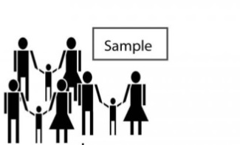
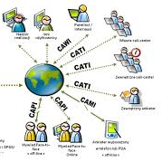




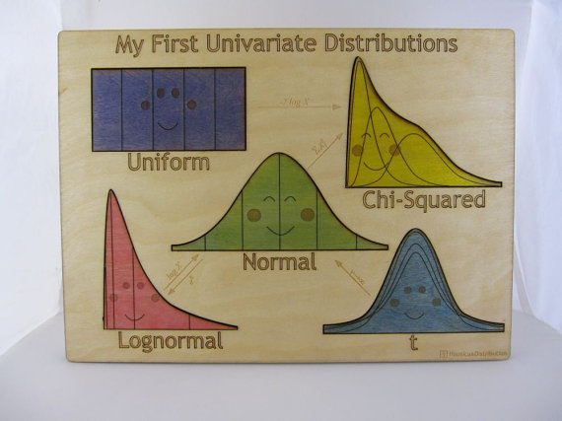
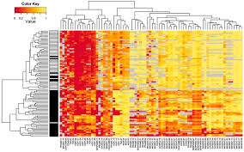
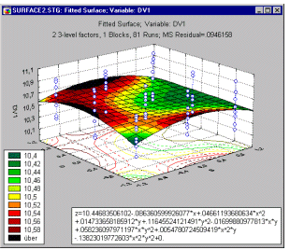
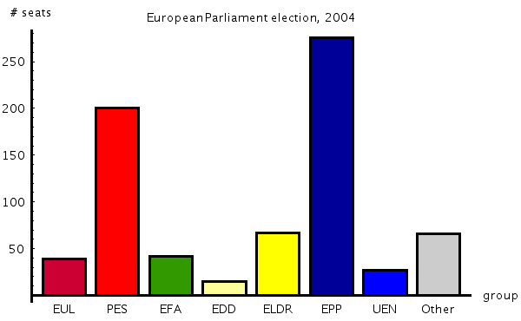
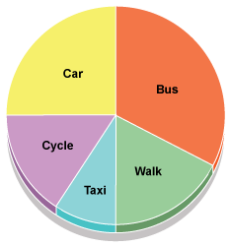
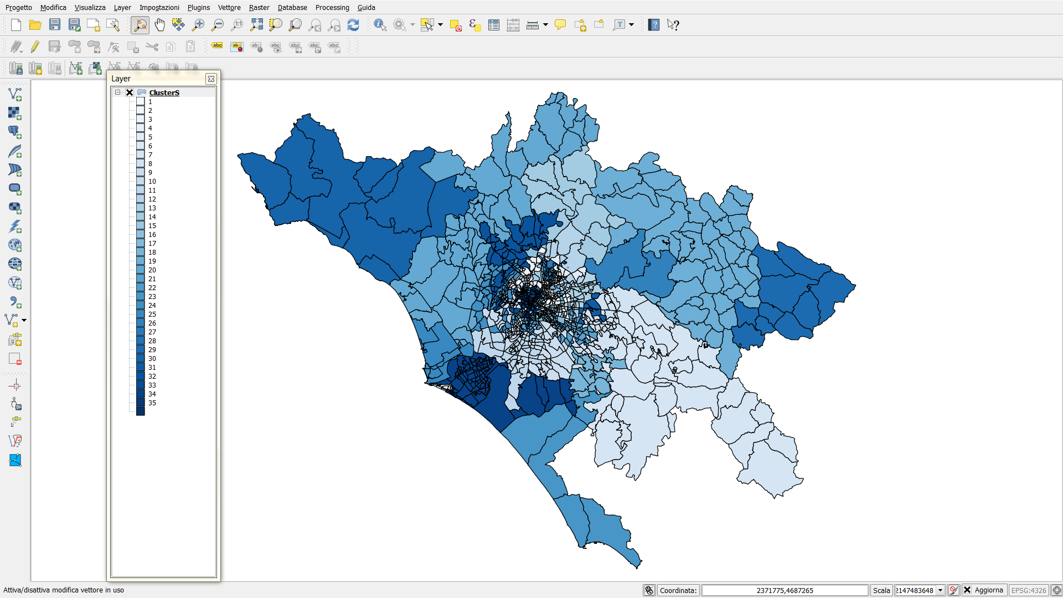
STATISTICS IS QUICKLY CHANGING
Small samples vs Large samples
Classical statistical Inference vs Computer-age statistical inference (resampling, mcmc, bagging)
Univariate & bivariate statistics multivariate statistics, computer intensive methods
Phenomena Univariate & bivariate vs Multivariate Phenomena in space & time domains
Automatic data collection
Manual data collection

Slide 6
Statistics is rapidly changing for the fast technological innovations and methodologies need to take advantage of such progresses.
Statistics learning outcomes of Bachelors and Masters become quickly obsolete
a lifelong-learning approach in Education is needed (continuous retraining along the life).

Slide 7
Second Question
What kind of retraining and requalification can be thought for revamping the older generation of statisticians?
How can be organized a statistical training with a lifelong learning approach that can be added to the education degree attained? Is the online and distance learning the solution?

