Slide 1
Issues and challenges of statistical education in higher education
Peter Kovacs
Associate professor
Department of Statistics and Demography,
Faculty of Economics and Business Administration,
University of Szeged, HUNGARY

Slide 2






Trends of information society

Slide 3
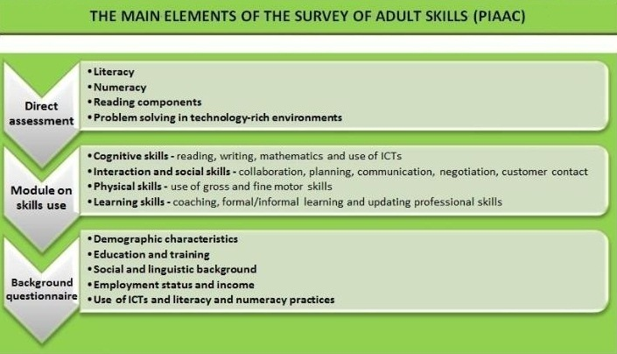
OECD ADULT SKILL SURVEY
http://www.oecd.org/site/piaac/mainelementsofthesurveyofadultskills.htm#SkillsUse

Slide 4
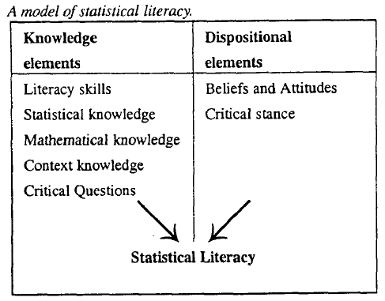
Statistical literacy
Gal (2002): ability to interpret, critically evaluate, and communicate about statistical information and messages
Statistical literacy
Statistical reasoning
Statistical thinking

Slide 5
Actuality
IASE 2016 Roundtable Conference: Promoting understanding of statistics about society, 19 – 22 July 2016, Berlin, Germany
Promoting Civic Engagement via Exploration of Evidence: Challenges for Statistics Education project (Joachim Engel, Iddo Gal, Jim Ridgeway, Pedro Campos, Rolf Bihler, Peter Kovacs)
Civic engagement: „working to make a difference in the civic life of our communities and developing the combination of knowledge, skills, values and motivation to make that difference. It means promoting the quality of life in a community, through both political and non-political processes.” (soruce: NYT)

Slide 6
Issues (1): output
What are the outcome requirements?
  In professional terms / in general terms
  Target jobs: wide spread
  Demands on skills, knowledge levels

Slide 7
Tertiary education should develop
Statistical literacy, thinking, reasoning
Professional knowledge level
Attitude
Soft skills: communication, team work, „translation”, ect.

Slide 8
Issues (2): students
Do we know who we teach?
Gould’s (2010) research, statistical data have different meanings for today’s students than for students 5-10 years ago. X-Y-Z generation problem?

Slide 9
Issues (3): IT
teaching material?
  Data revolution: problem from the real life
  Importance of IT tools:
    data sources, softwares, visualisation
The usage of IT tools is crucial, but, at the same time, our aim is to teach a way of statistical thinking and not a program or platform!

Slide 10
Issues (3): Big data
Trendy, but…..
Course contents
Is it a statistical problem?
high level of statistical literacy+statistical reasoning & thinking= Data scientist?

Slide 11
Recommendation to revising statistical curricula by Jim Ridgway
Devote more space to open data
Work with multiple data sources
Illuminate current curriculum content with examples from the data revolution
Use Internet resources to invigorate teaching
Teach about, and with, interactive graphics
Teach with, and about, familiar technologies
Engage with modelling
Decrease the time allocated to hypothesis testing
Place more emphasis on decision-making and risk
Introduce multivariate data early
Implications of the Data Revolution for Statistics Education, International Statistical Review (2015)

Slide 12
Post training program
online
Clarify Complexity
Usage of new techniques
Meaning and adaptation
Training for educators too

Slide 13
Thank you for your attention!
kovacs.peter@eco.u-szeged.hu

