Slide 1


Statistical Literacy dr. Éva Sándor-Kriszt rector of Budapest Business School
Official statistics: New opportunities for
transformation – innovation and cooperation
Budapest, 20-21 October 2015
ROUND-TABLE: Training the new generations and rejuvenating the older generations of statisticians

Slide 2
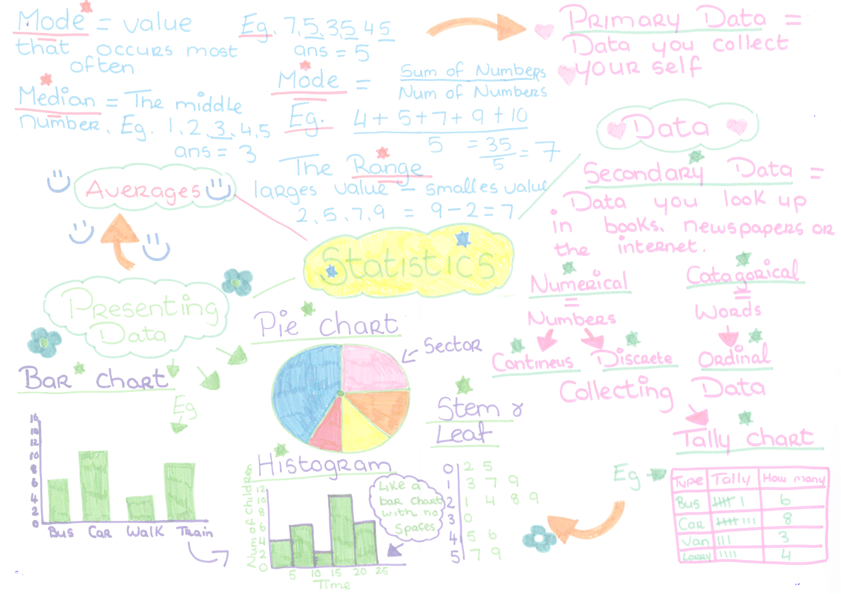
Imperatives of the 21st century
Global skills:
  Linguistic skills (English as lingua franca)
  Intercultural skills ( intercultural sensitivity)
  IT – skills ( to handle digital technologies, internet)
  ‟statistical skills” (to read and interpret data and information)

Slide 3

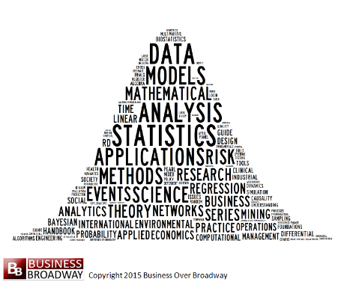
Statistics Literacy
Similarly to ‟linguistic literacy”, ‟intercultural literacy” , ‟IT literacy” we need to introduce a new literacy – compulsory in our age:
STATISTICAL LITERACY
which is a skill
  to read information
  to handle data
  to select information
  to find and identify the necessary information
  to analyse information/data
  to properly interpret information and data
  to apply gained information

Slide 4



Why has Statistical Literacy gained such an importance in the 21 ct?
Because in the digital age the question is
not how to access information / data, but rather
how to select information / data in order to access the necessary one
how to access information / data in the most effective way?

Slide 5



BBS Statistics courses include:
Content:
  Descriptive Statistics
  Applied Probability and Statistical Methods
  Business statistics
Methods:
  Regression Analysis
  Multiple regression
  Nonparametric Statistics
  Busiess and Economic Time Series
  Claster Analysis, ets.
Applications: Hungarian Central Statistical Office outcentre Chair at
Budapest Business School

Slide 6


How to keep up with the changes?
Short courses
Special training programs
E-learning courses
Blended courses
LL (life-long) programs – distance/evening/part-time
Sharing good practices

Slide 7

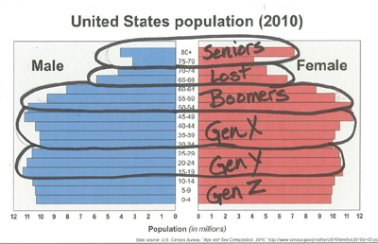
Good-Practice: ‟Innovate or Die”
case-study competition at BBS
Event: Students’ competition
Task: To solve a case-study
Topic: How to attract generation Y and generation Z to an upgrade course (on banking…but this could be substituted by ‟on statistics”/‟on data-base analysis”, etc..)
Type of task: Not simulated but real-life situations
Result: Exciting, new innovative ideas – greatly appreciated by companies

Slide 8


Recommendations
Employers should clearly formulate and provide their needs in the field of statistical knowledge and skills
These skills should be integrated into the course-content of HE programmes
Statistical skills and knowledge upgrade (certified) should be a requirement for promotions

Slide 9

Thank you for your attention!
www.bgf.hu

