Slide 1
Communicating the meaning of indicators to decision makers, media and general public
Aurel Schubert
Director General Statistics
European Central Bank
Round table discussion – Can communication save official statistics?
World Statistics Day
Budapest, 21 October 2015

Slide 2
Some takeaways for central banking statistics from Lisbon
The Lisbon Memorandum
Given […]
  “the challenge of understanding statistical indicators as a transformation of quantitative information into knowledge and to see these as one element in the 'information' package together with qualitative information and expert analysis”
The DGINS […]
  Stress the importance of a clear distribution of roles between policy makers and statisticians. Policy makers define policy objectives and targets while statisticians work independently on the statistical development of indicators. Close cooperation between policy making and statistical spheres needs to be ensured […] This should be an iterative process with statisticians being involved from an early stage.
  11. “Underline the need for caution if producing or communicating composite indicators, which aggregate individual indicators of different nature and that are measured in different units. […]”

Slide 3
Headline indicators as part of ECB’s monetary policy strategy
ECB’s inflation target and M3 reference rate
The primary objective of the ECB is to maintain price stability. The ECB aims at inflation rates of below, but close to, 2% over the medium term.
The monetary policy strategy is based on two pillars
  economic analysis (broad set of indicators)
  monetary analysis
    old days: quantitative reference value for the growth of the broad monetary aggregate M3 (4.5%)
      inflation: 2%
      trend potential output growth of 2-2½%
      trend decline in M3 income velocity of ½-1%
    today: regular mentioning of the M3 actual growth rate in the President’s Introductory statement to the press conference; reference value less prominent with the Asset Purchase Programme

Slide 4
Composite cost of borrowing indicators
Monetary and financial statistics
Used to accurately assess borrowing costs for non-financial corporations and households per country
Based on MFI interest rate statistics and comparable across countries
Four basic categories of lending rates
  short-term and long-term lending rates (NFC + HH not split)
  rates for non-financial corporations and households for house purchase
An important tool for assessing the retail bank interest rate pass-through in the euro area

Slide 5
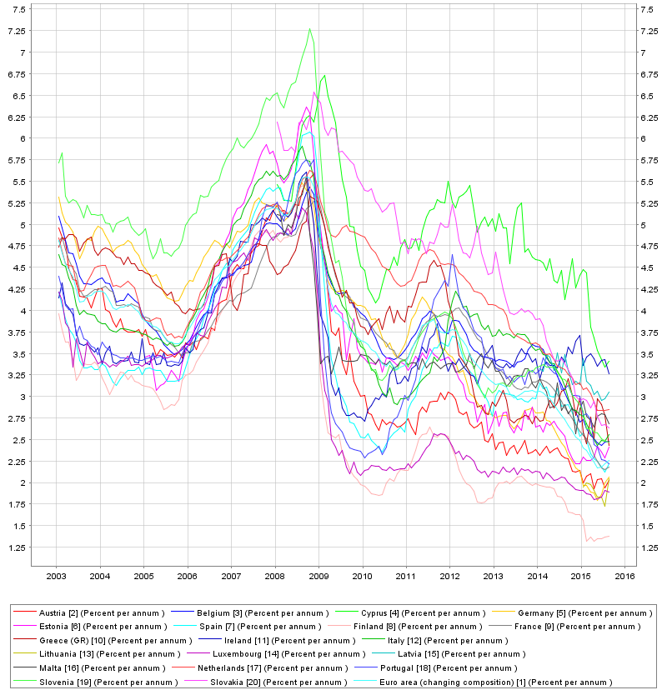
Composite cost of borrowing (households in euro area Member states)

Slide 6
Financial integration indicator (FINTEC)
Financial integration - FINTEC
Price-based FINTEC
Money markets
Bond markets
Equity markets
Banking markets
Quantity-based FINTEC
Inter-bank markets (money and banking)
Bond markets
Equity markets

Slide 7
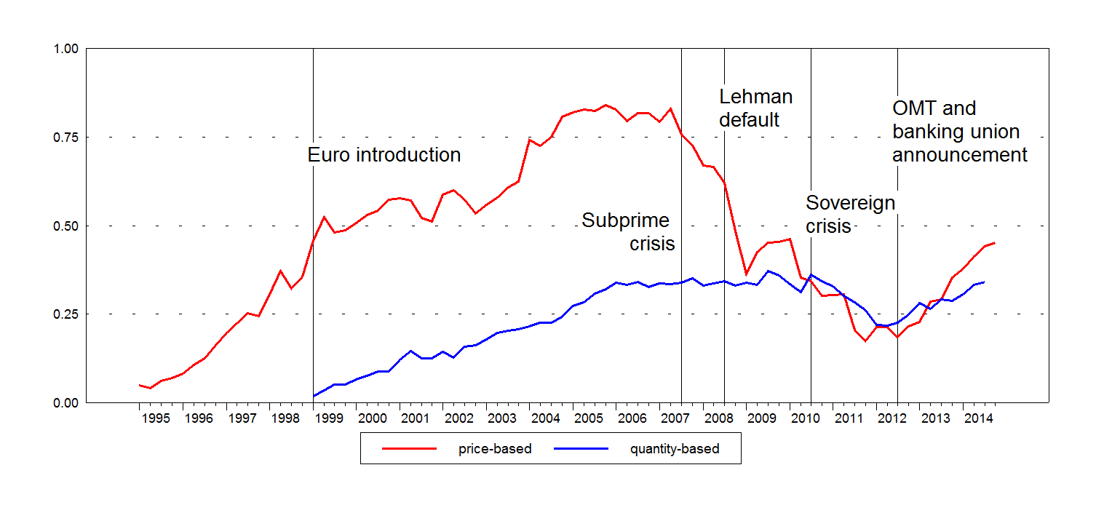
Financial integration indicator (FINTEC)
Financial integration - FINTEC

Slide 8
Risk Dashboards for the European Systemic Risk Board
The ESRB Dashboard
Set of 50 quantitative and qualitative indicators of systemic risk in the EU financial system, grouped into six risk categories
  Interlinkages and composite measures of systemic risk
  Marco risk
  Credit risk
  Funding and liquidity
  Market risk
  Profitability and solvency
Key communication instrument of the ESRB and an important element in meeting the accountability requirements vis-à-vis the public at large
Not a mechanical early-warning system – should be accompanied with appropriate analysis
“Heat maps” are being developed to detect country-specific vulnerabilities.

Slide 9
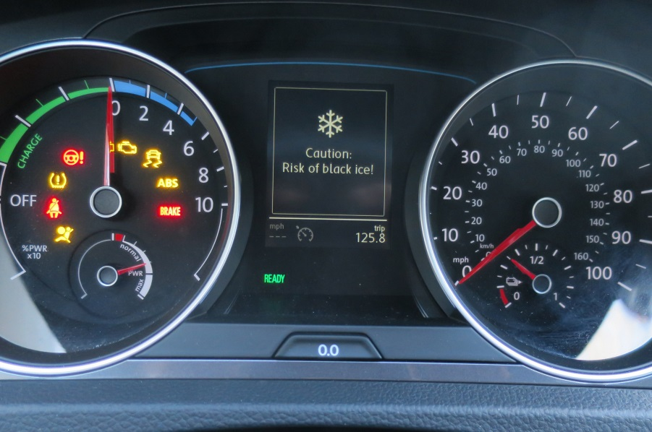

Discussion points
Round table discussion – Can communication save official statistics?
Do we create knowledge with such indicators?
How to arrive from a traffic light system to policy conclusions?
Can policy be based on these indicators?

