Slide 2
Redesigning the LFS
Solving the puzzle
Martijn Souren
May 16 2019

Slide 3

The puzzle

Slide 4
The puzzle
The players:
Output
Eurostat
Datacollection
Questionnaire
designer

Slide 5
The puzzle
The players:
Output
Eurostat
Datacollection
Questionnaire
designer

Slide 6
Piece 1: Output
Output
Variables and frequency
Q: Quarterly
Y: Yearly
2Y: 2-Yearly
H: Household
M: Modules

Slide 7
Piece 2: Subsampling
2Y part of subsample Y
M part of subsample
Y and 2Y
M together with
minimum set H
Sub-sampling
Output

Slide 8
Piece 2: Subsampling
Wave 1
Q: Quarterly
Y: Yearly
2Y: 2-Yearly
H: Household
M: Ad-hoc
Wave 2
q: quarterly by dependent interviewing
Wave 4
Wave 5
q: quarterly by dependent interviewing
q: quarterly by dependent interviewing
q: quarterly by dependent interviewing
Wave 3

Slide 9
Piece 3: Modes
Output
Modes
Sub-sampling

Slide 10
Piece 3: Modes
CAWI/CATI/CAPI
CATI
CATI
CATI
CATI

Slide 11
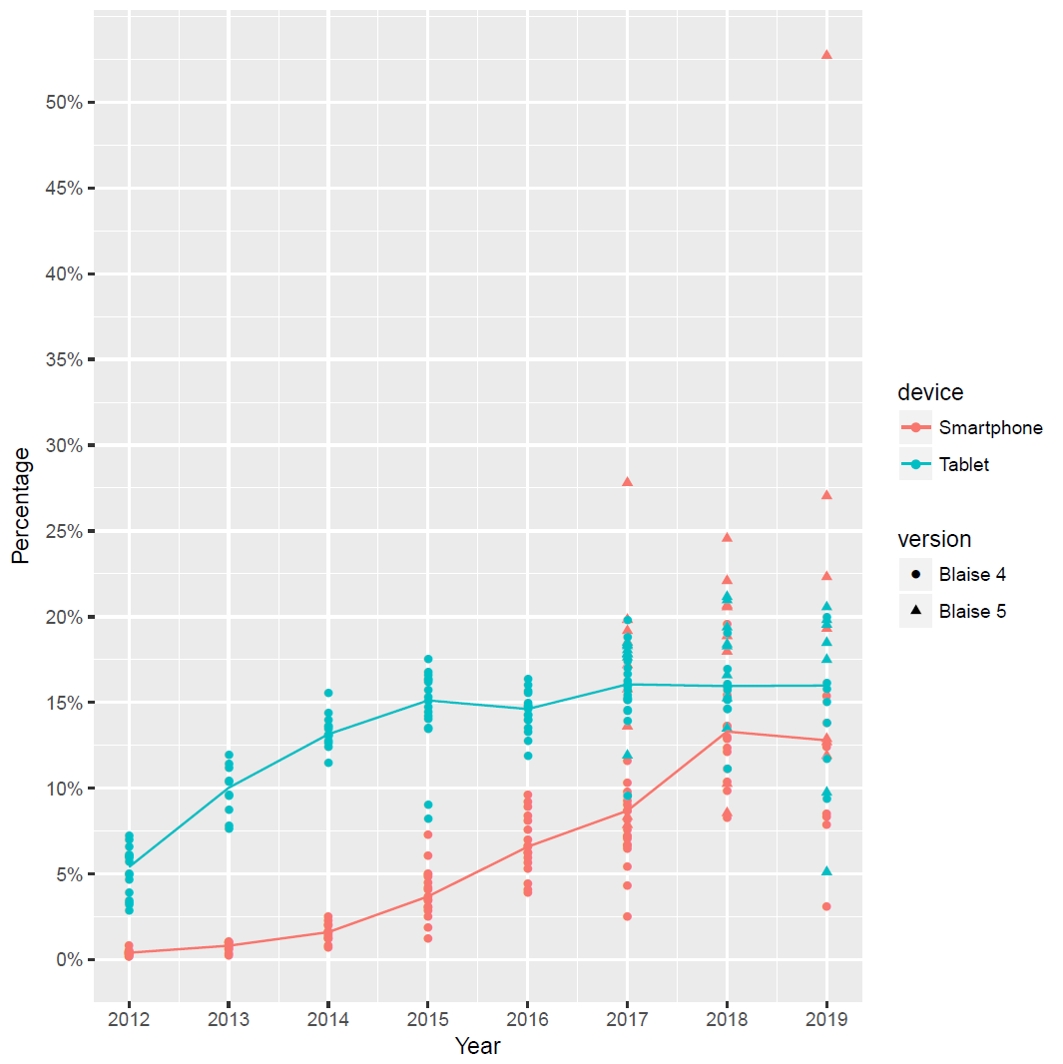
Piece 3: Modes

Slide 12
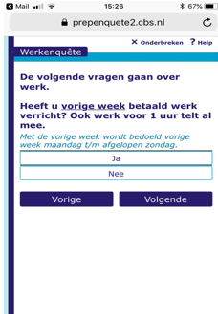
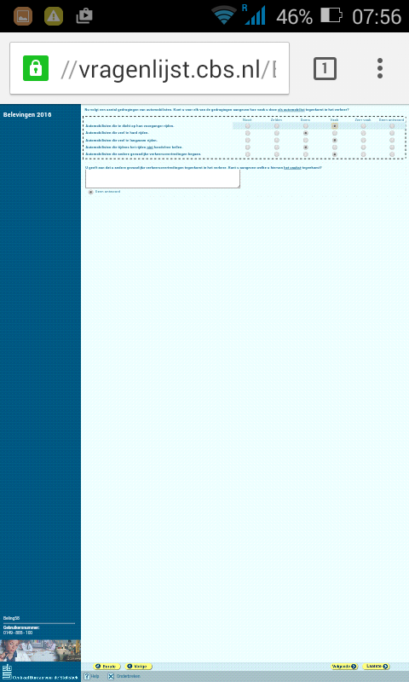
Piece 3: Modes

Slide 13
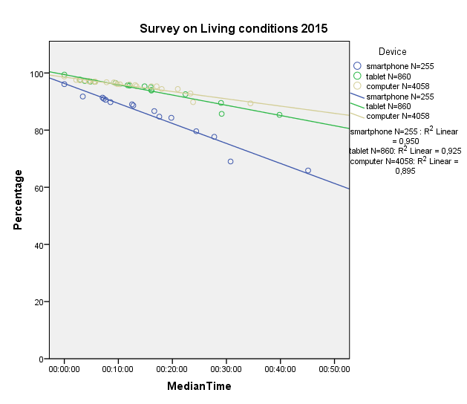
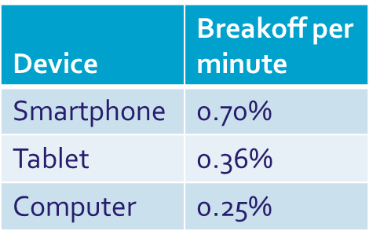
Piece 3: Modes

Slide 14
Piece 2/3: (Sub)sampling and Modes
Output
Modes
(Sub)-sampling

Slide 15
Piece 2/3: (Sub)sampling and modes
CAWI/CATI/CAPI
CAWI/CATI
CAWI/CATI
CAWI/CATI
Mobile lay-out
Mobile lay-out
CAWI/CATI
Mobile lay-out
Person Sampling
As short as possible
Minimum proxy and attrition
Mobile lay-out
As short as possible
Mobile lay-out
As short as possible
As short as possible
As short as possible

Slide 16
Piece 2/3: (Sub)sampling and modes
Wave 1
Q: Quarterly
Wave 2
q: Quarterly by dependent interviewing
H: Household
Wave 4
Wave 5
q: Quarterly by dependent interviewing
q: Quarterly by dependent interviewing
q: Quarterly by dependent interviewing
h: minimum set by dependent interviewing
Y: Yearly
Wave 3
2Y: 2-Yearly
M: Ad-hoc

Slide 17
Piece 4: Questions
Output
Modes
(Sub)-sampling
Questions

Slide 18
Piece 4: Questions (Y)
TEMPREAS Labour contract
TEMPAGCY Labour contract
MAINCLNT Dependent self-employed
VARITIME Dependent self-employed
SUPVISOR ISCO
SIZEFIRM NACE
LOOKOJ Wanting work
HWWISH Wanting work
NEEDCARE Wanting work

Slide 19
Piece 4: Questions (Y)
HATFIELD Education
HATWORK Education
HATYEAR Education
WAYJFOUN Looking for work
STAPROPR Retro
NACEPR2D Retro
ISCOPR3D Retro
HOMEWK Workplace
INCGROSS Register

Slide 20
Solution
Questions
(Sub)-
sampling
Modes
Output
2Y part of Y
M part of Y and 2Y
M with min. set H
Mobile devices Respondent friendly

Slide 21
Solution
Wave 1
P1:
QY: Quarterly and yearly
Wave 2
From P2:
qy: Quarterly and yearly by dependent interviewing
H: Household
Wave 4
Wave 5
qy: Quarterly and yearly by dependent interviewing
qy: Quarterly and yearly by dependent interviewing
qy: Quarterly and yearly by dependent interviewing
Wave 3
2Y: 2-Yearly
M: Ad-hoc
h: minimum set

Slide 22
Questions
?

