Slide 1
Redesigning the LFS
Omnimode and B1-language

Slide 2
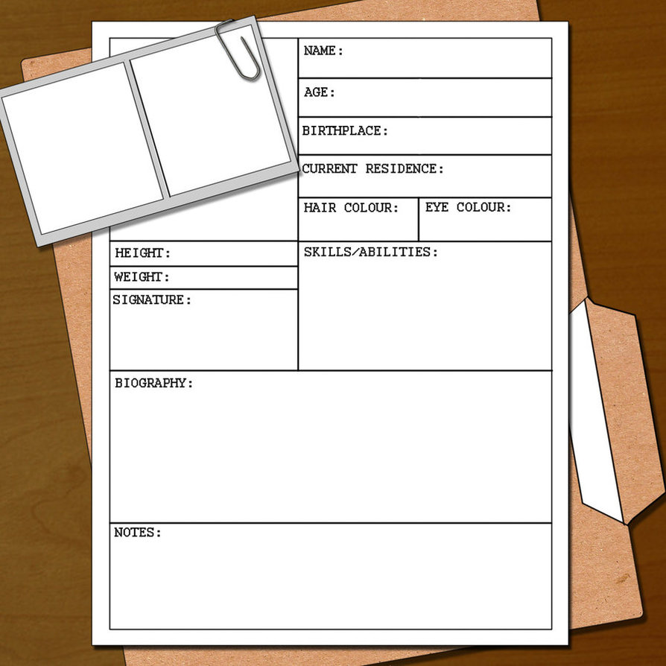


Madelon Cremers
Survey Designer!
Dec 2007 – now: Statistics Netherlands
Data collection (Persons- and householdsurveys)
First involvement LFS: pilot CAWI 2010
Notes:
First time here at this workshop. Been involved with the LFS for quite a long time. Been looking forward to this moment:

Slide 3
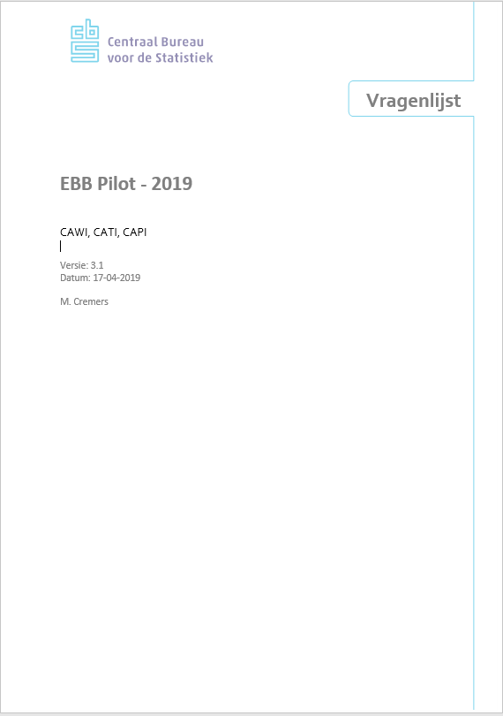
NEW

Slide 4

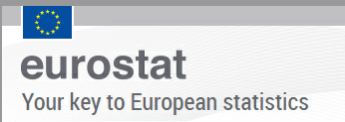



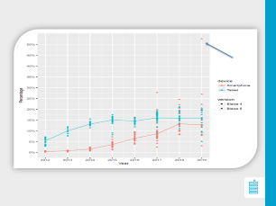
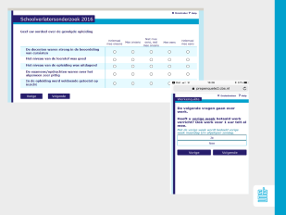
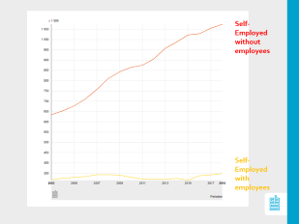
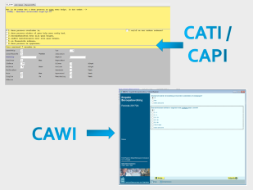
Why we need a new LFS...
Lessons learned!

Slide 5
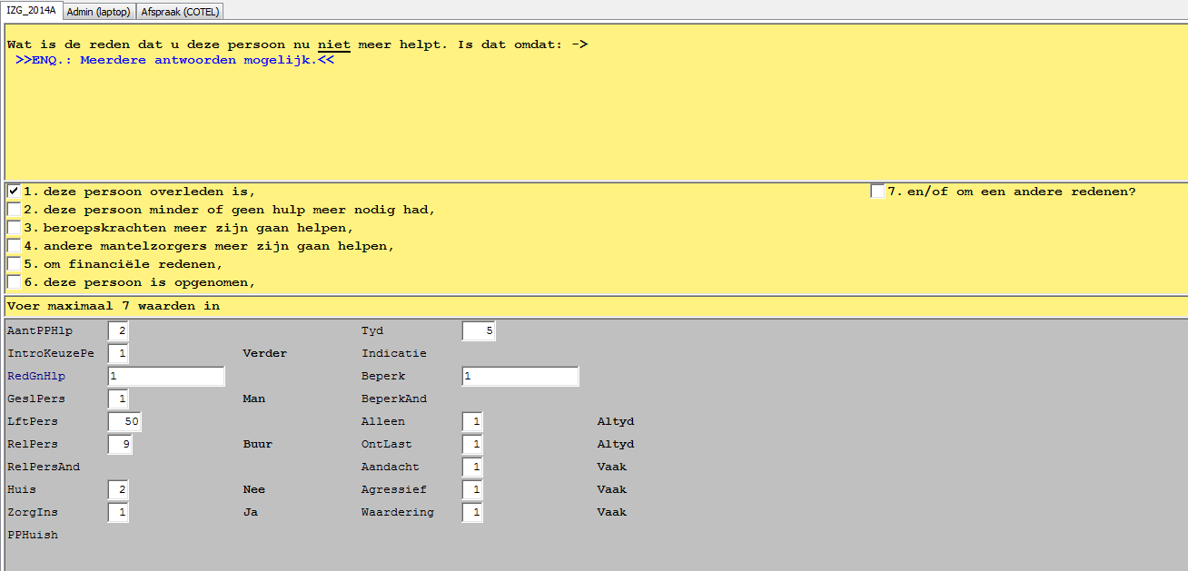
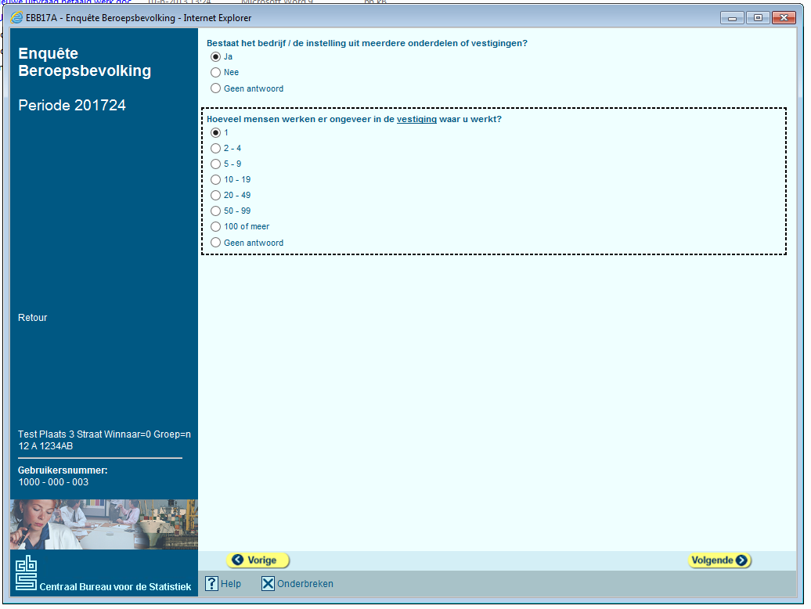
CATI /
CAPI
CAWI

Slide 6
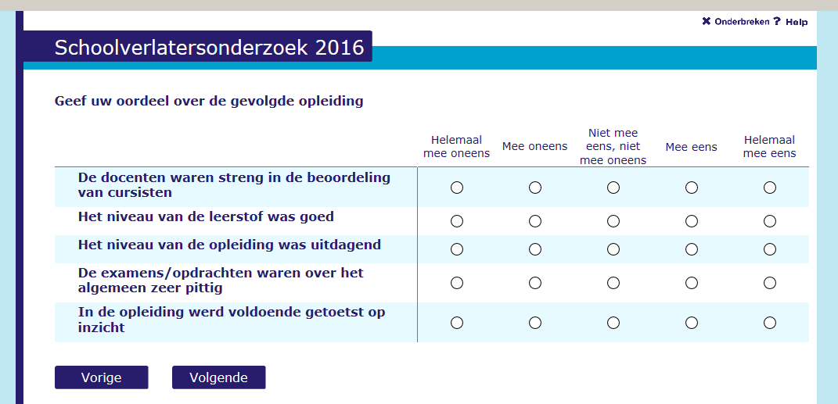
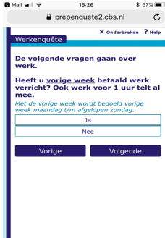

Slide 7
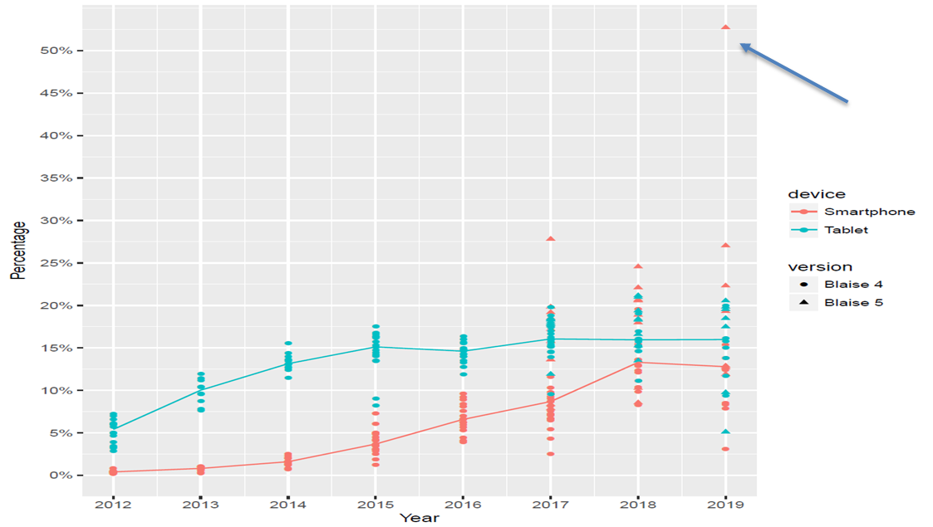

Slide 8
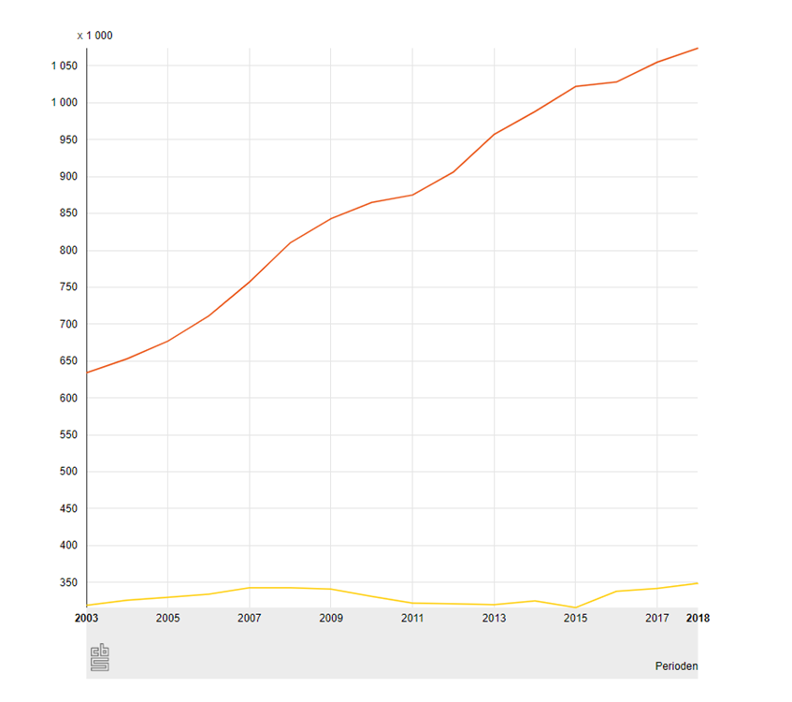
Self-Employed without employees
Self-Employed with employees

Slide 9
Goal
A brief, simple and clear survey
One design for CAWI, CATI & CAPI: minimal mode-effects
Suitable for several devices (PC, Tablet, Smartphone)
Complies (as much as possible) to the new regulations
Notes:
So what are these practical challenges we encouter. I named only a few in relation to mixed mode design.
(1) Often a mode is simply added to an existing questionnaire. The existing modes then become “leading”.
(2) Even when you are allowed to redesign a questionnaire, often you cannot make any rigorous changes to the questions because analysts fear it will lead to a deviation from trend.
(3) A client often demands that a question should be asked in a certain way. Even when you have valid arguments that the proposed question is going to cause problems (e.g. too difficult or mode effects), ultimately the client is king.
(4) A CAWI questionnaire looks different and works in a different way than a CATI or CAPI questionnaire.
Hidden non-response
Checks
Tables
Technical limitations
Survey management system requirements
(5) Decisions we make have consequences for the rest of the organisation and we do have to consider them beforehand.
User friendly for the interviewers (both CAPI and CATI),
will the survey automatically work in our survey management system or do we need customised solutions,
will the data-processing department be able to combine the results from the different modes and clean the data,
will the analysts be able to work with the data
will the questionnaire be “future proof”.
(6) Both factors determine how much effort we can invest in our survey design.
The deadlines are strict. Crossing them will delay fieldwork which basically isn’t an option. Unfortunately, clients do often cross their deadlines.
Budget also determines which modes are chosen to conduct the research. As a survey designer, you simply have to find a way to make it work.
Faced with the challenge: how can we design our suveys more quickly. We reconsidered our designing process.

Slide 10
How do we redesign the LFS?
1. Improving Survey Practice
Omnimode design: one design for all modes and devices
2. Improving the content of the LFS
B1-language, CAWI (and mobile) first

Slide 11


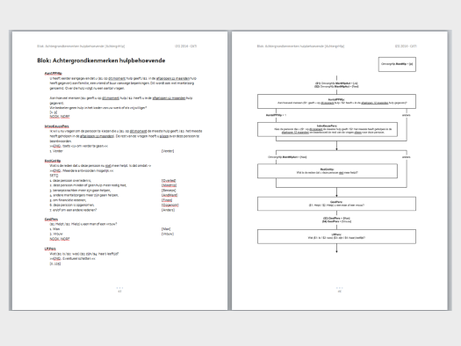
1. Omnimode
CATI (1978) and CAPI (1987)
CAWI (2008)
CATI/
CAPI
CATI/
CAPI
Notes:
Around 2008 we introduced the first CAWI survey at StatNeth.
Though we work from an unimode principle (i.e., same questions in every mode), we quickly discovered that there were many differences between CATI/CAPI and CAWI.

Slide 12
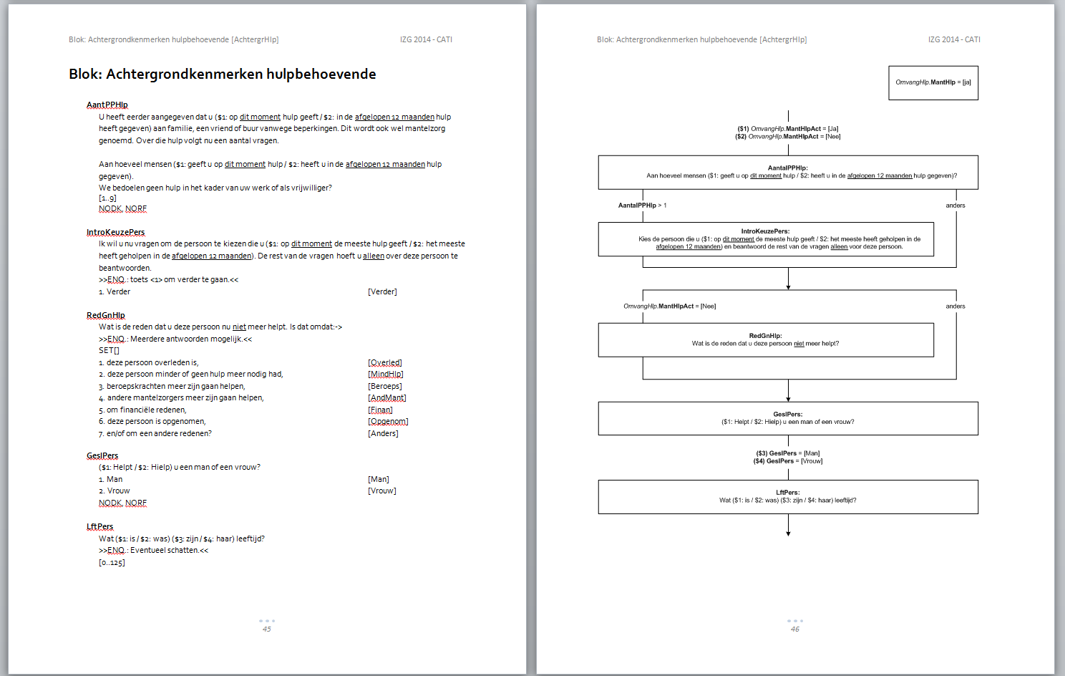

Slide 13
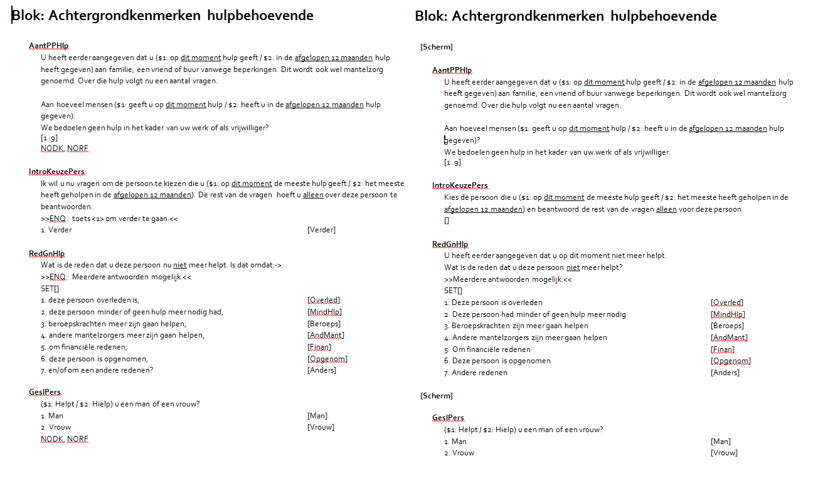
CATI
CAWI
Checks
Tables
Notes:
In CAWI we have to define what questions are represented together on one screen ({Scherm})
CAWI uses auxfield for introductions, no action is required. In CATI this is not possible, you would risk an interviewer skipping the introduction. Moreover, it is not possible to record the starting time of a question block. An interviewer is instructed to press 1 to continue.
On the right side (from the top to bottom):
In CATI and CAPI, interviewers have been instructed to read a sentence aloud until they reach the question mark. This means, question marks are sometimes used in sentences where you would expect a dot or other reading sign.
In CATI and CAPI, non-response categories such as Don’t Know (DK) and Refusal (RF) are always implicitly allowed, unless specified otherwise (NoDK, NoRf). In CAWI this is mostly the other way around; non-response is not allowed unless otherwise specified.
In CATI interviewer instructions are indicated by the phrase “ENQ”
When in CATI answer categories should be read out aloud, the answer categories are rephrased so they can be read out as a whole sentence. After the question, an arrow is shown to indicate that an interviewer should read on, each category ends with a comma, and the question mark is set after the last answer category that should be read aloud.

Slide 14
1. Omnimode
CATI (1978) and CAPI (1987)
CAWI (2008)
Disadvantages
Double work
Many iterations
Error prone
CATI/
CAPI
CATI/
CAPI
CATI/
CAPI
CAWI
Notes:
As a result, we had to make two on paper designs (both Word and Visio) and also two programmed questionnaires.
Double work
Many iterations: starting with CAWI -> adjusting teh design -> discovering problems with CATI / CAPI -> adjusting the CAWI design as well
Error prone: often last-minute alterations, when you forget to make a change in one version you get mode differences

Slide 15
OMNIMODE
Solution: one design for all modes
Advantages + | Disadvantages -
Saves time making an on paper design Possibly: less time to program or test a questionnaire Less iterations Less work for data processing department Less errors | Compromises might be necessary Interviewers have to be re-instructed
Notes:
What if we can make some adjustment to our designing method so we are able to make one design for all modes.

Slide 16
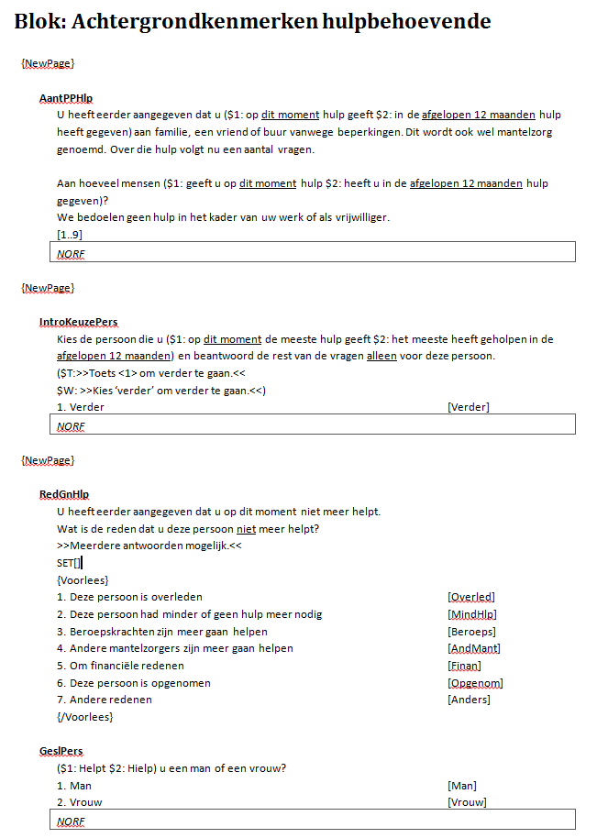
O
M
N
I
M
O
D
E
Notes:
Answer categories are the exact same in CATI and CAWI: in CATI, the punctuation marks now have their normal meaning again. An interviewer knows how many answer categories should be read aloud because they have a different colour: blue. This is indicated for our questionnaire builder in the design by the statements {Voorlees} (meaning ‘Read aloud’) and {/Voorlees} (end statement). As a result; the answer categories might sound a bit more ‘stacato’ in the CATI and CAPI mode.
Non-response attributes are the same in all modes: if RF is allowed in CATI, this should also be allowed in CAWI. In general, we always allow RF and don’t allow DK, unless specified otherwise.
The introduction now requires an action in the CAWI mode as well (click ‘verder’ to continue), this will force respondents to read the introduction.
The “ENQ” phrase has been omitted. The text of the instruction is the same for all modes (addressed to the respondent and not the interviewer).
In CATI we do no longer use pop-up fields for checks/controls, questions are used.
Mode-specific imputations $W, $T, $P: of course it will not be possible to make the exact same design for all modes. Differences can be indicated with mode-specific imputations or by routing on mode.

Slide 17
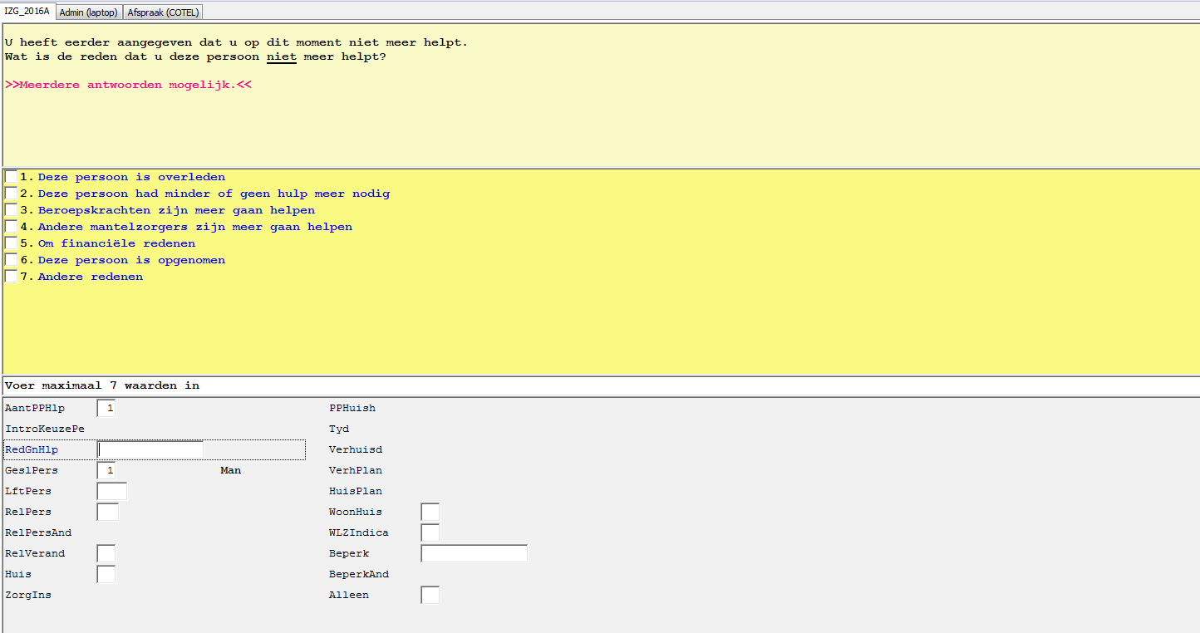
Old
New

Slide 18
First experiences
☺
Saves time designing on paper
Practical: all the information in one document
Interviewers are positive
☹
Takes some time getting used to
All modes have to be ready at the same time
Now -> towards ONE programmed LFS
Notes:
First tried the omnimode method in our Belevingen study, new subject each year, all three modes involved.
97,5% indicated they did not have any problems working with the new interviewer rules.

Slide 19
B1-principles
Common words that have a literary meaning (avoid jargon!)
Short sentences (max. 10 to 15 words)
Colloquial language instead of formal written language
Use active verbs over passive verbs
Present the most important message in a question first
Phrase an instruction as a question

Slide 20
Active verbs
Old:
What kind of profession or position do you have?
New:
What is your profession or position?

Slide 21
Instructions as questions
Old:
If you do not know the exact answer, please try to give an estimate.
New:
Don’t know the exact answer? Try to give an estimate.

Slide 22


Jargon
“Job” didn’t comprise all work situations:
Solution? “workcircle”
Another problem?
Employee
Notes:
Self-employed persons do not think the word ‘job’ applies -> more general term: workcircle
- For example: how many workcircles do you have? What’s the name of your workcircle? Etc.

Slide 23
Old questionnaire
At the moment, do you do paid work? -> Yes
Do your paid working activities concern one or more workcircles? -> More
How many workcircles?
What is the name of the workcircle in which you work the most hours?
Since when do you work here?
Do you work here as an employee? -> No
Do you then work:
in your own company,
the company of your partner,
the company of a family member
or none of the above?
Notes:
Self-employed persons do not think the word ‘job’ applies -> more general term: workcircle
- For example: how many workcircles do you have? What’s the name of your workcircle? Etc.

Slide 24
Employment Status
How are you employed?
>>Multiple answers might apply<<
{Read aloud}
I have a job as an employee
I have my own company or work as ZZP’er/freelancer
I work for my partner’s or family member’s company
Other
{/Read aloud}
Notes:
Putting the terms into context, respondents understand the terms better.
Second: if they choose 2, we inform futher whether they have their own company or work as a freelancer, zzp’ er etc. With a check if it really concerns different activities.

Slide 25
Other situations
Which other situation applies to you?
>>Choose the answer that fits your situation best.<<
{Read aloud}
I have a side job
I work as an intern or a trainee
I’m retired and only work now and then
Other
{/Read aloud}

Slide 26
Number of jobs
Employee -> how many jobs do you have?
)
Self-employed -> how many companies do you have?
ZZP’er ( = self-employed without employees) ( = 1)
Freelancer ( = 1)
freelancer
Intern ( = 1)
“company x”
Side-job -> (if no other employment statuses apply:) how many side jobs do you have?
side job”

Slide 27
New Solution?
Employee: your job at “company x” (or employment agency)
Self-employed: your work for “company x”
ZZP’er: your work as ZZP’er
Freelancer: your work as freelancer
Intern: your internship at “company x”
Side-job: your work for “company x” or “Your work for your side job”

Slide 28


