Slide 1


14th Workshop on Labour Force Survey Methodology
Budapest, 16–17 May 2019
Integrating LFS and HBS from the interviewers’ network
Manuela Morricone
Alessandro Ortenzi
Rita Ranaldi
Emanuela Vergura

Slide 2
Summary
Italian LFS and HBS background
  LFS and HBS sampling design and positive coordination of the PSUs
  Interviewers training program
The integration of the interviewers’ network and a comparison with the past
Conclusions

Slide 3
Context
Istat does not own an interviewers’ network, neither for CAPI mode nor for CATI mode
It usually entrusts data collection phase of each households survey to different external companies through calls for tenders
Sometimes the coverage of the whole territory is rather onerous even for external companies specially recruited for the fieldwork management

Slide 4

LFS
Mixed mode CAPI-CATI survey
Every year about 280,000 households spread in about 1,100 municipalities
Almost half of the sampling households are interviewed using CAPI mode
The reference period is the week, so the fieldwork data collection takes place all the days of the year

Slide 5

HBS
Multimode CAPI-CADI survey
Every year about 20,000 households residing in about 500 municipalities
The reference period is the month and fieldwork data collection occurs all the days of the year

Slide 6
HBS: criticality
The smallness of HBS sample size distributed through the year at territory level ➔ has determined over time a problem of coverage
Sometimes for private companies data collection is not convenient in municipalities not easily accessible and with a low number of assigned interviews, with consequent low response rates

Slide 7

Is there a solution?
Istat has thought to take advantage of the pre-existing and consolidated LFS network and at the end of 2016 it entrusted to a private company the management of the interviewers’ network and CAPI data collection fieldwork for both LFS and HBS
In order to achieve this goal, Istat preventively revised:
the HBS sampling design in order to maximise the overlap of the sample units at the first stage (municipalities) with those of LFS
the interviewers training program

Slide 8
LFS and HBS sampling design
Two-stages sampling design
At the first stage ➔ Municipalities are stratified at NUTS 3 level for LFS and at NUTS 2 level for HBS according to resident population (and in HBS to municipal type too)
At the second stage ➔ Households are randomly selected from the population registers in all the municipalities drawn at the first stage. In addition for LFS, FSUs are rotated according to a 2-(2)-2 rotation scheme

Slide 9
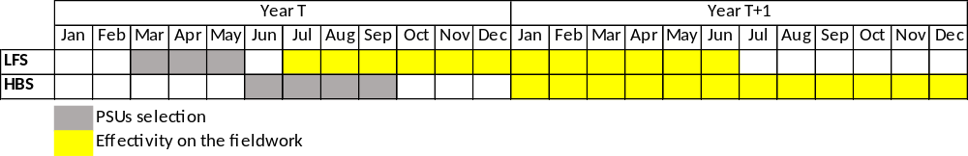
LFS and HBS PSUs selection
At the first stage …
During the definition of the HBS list, a specific algorithm, defined by Istat methodological directorate, guarantees a good positive coordination of the PSUs with those of LFS (about 80%)
Considering the different timing, the overlap of the sample municipalities can be appreciated in particular with reference to the first 6 months of each year

Slide 10
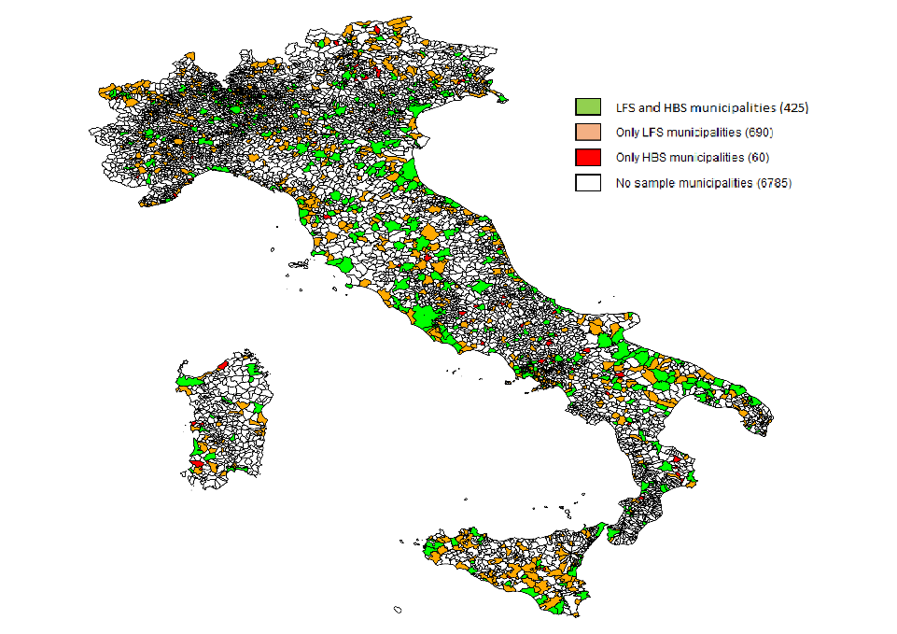
Positive coordination of the PSUs
At the beginning of 2018
425 municipalities (in green colour) were common both for HBS (87% of its total PSUs) and for LFS (38% of its total PSUs)
only 60 municipalities (in red colour) were exclusively involved in HBS

Slide 11

Interviewers training program
The interviewers training program which, although different for the two surveys, has included transversal training cycles
The initial interviewers training was scheduled at different times, before for LFS and later for HBS
➔ 3.5 days for interviewers involved in LFS
➔ 3 days for interviewers who did not attend the previous LFS training cycle and 2.5 days for interviewers already trained and working for LFS fieldwork
With the use of an interviewers’ integrated network, the company would have obtained considerable savings both in terms of recruitment costs and expenses for training briefings

Slide 12

Integration of the interviewers’ network /1
In the background previously outlined, for the private company that won the call for tender, it has been convenient to use for both surveys a single national interviewers’ network, that one already existing for the LFS, making only a few additions
about 350 interviewers spread across the whole territory
almost all of them (91.3%) involved in LFS and HBS
only a residual part exclusively involved in a single survey (5.9% only in LFS and 2.8% only in HBS)
the strategy adopted by the private company has been to assign to each HBS interview about four LFS interviews

Slide 13
Integration of the interviewers’ network /2
In the last two years, the fieldwork has been the object of a specific quality control. The concern was in particular for LFS because the previous period was characterized by elevated performance and the new interviewers’ integrated network could have destabilized the situation
We have observed across time specific performance indicators at different levels of detail (NUTS2 and NUTS3 level, municipality level, interviewer level, etc.), in order to monitor the quality of fieldwork and the impact of introduced changes for HBS and in particular for LFS

Slide 14
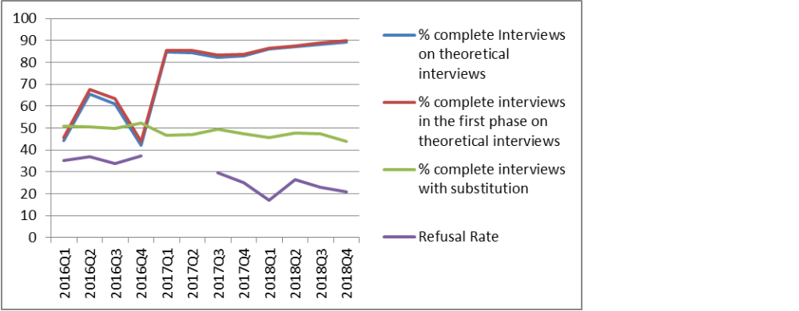
HBS: a comparison with the past
HBS main quality indicators by quarter – 2016-2018

Slide 15
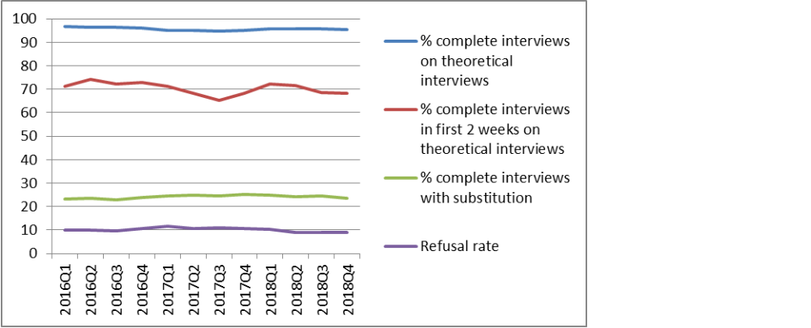
LFS: a comparison with the past
LFS main quality CAPI indicators by quarter – 2016-2018

Slide 16

Conclusions
LFS and HBS integration from the interviewers’ network point of view turned out a good strategy that has allowed to maintain high LFS response rate and, at the same time, to increase significantly HBS response rate
LFS peculiarities are suitable so that its network can be used to embed much smaller surveys but with continuity features, without losses in terms of expected responses
This innovation can be considered one of the first steps of the integration project of social surveys to which Istat is currently moving in the context of the new IESS Framework regulation

Slide 17

Thank you for your attention and I hope you are not in this condition …

