Slide 1

Utilising Interviewer Observations
on Housing Unit Characteristics
in the Hungarian LFS Nonresponse Analysis:
A Research Plan
Mohay, Linda & Mújdricza, Ferenc
Methodology Department
16. May 2019.

Slide 2
Outline
Work-in-progress research on nonresponse adjustment
Design phase
Significant changes
original plan was a simple split-sample experiment on the effect of well-tailored interviewer training
Today:
early results of the literature review
at-a-glance analysis of existing variables
overview of alternative options
next steps and expected results of the study

Slide 3

Background and progress made
The nonresponse issue and adjustment for nonresponse bias

Slide 4
Increasing HLFS nonresponse rates

Slide 5
Nonresponse and administrative data
Increasing nonresponse potentially increases nonresponse bias
Adjustment for nonresponse bias by weighting procedures
Strong correlation is needed between weighting classes and survey measures as well as response propensity (Lynn 2003)
Usually based on administrative data (Lynn 2003)
Problems with this approach:
The HCSO does not access adequate administrative data sources
Correlations are often not strong enough (Lynn 2003)

Slide 6
Nonresponse and interviewer observations
Interviewer observations on HU/neighbourhood characteristics
Data on the nonrespondents
Indirect, but
Free from nonresponse issues
Fully controlled (in theory)
Better alternative for nonresponse adjustment

Slide 7
HU/neighbourhood characteristics observations
Strong correlation is required with key survey variables and survey participation (Lynn 2003)
Correlations are low, weak predictive power (Casas-Cordero 2010, West 2011, etc.)
Not suitable for nonresponse adjustment (Casas-Cordero 2010, West 2011, etc.)
But:
Successful quantitative reliability/validity tests
(Andresen et al. 2006, Andresen et al. 2008, etc.)

Slide 8
Why are the correlations low?
(Andresen et al. 2006, Andresen et al. 2008, Kreuter et al. 2010, West 2011, Casas-Cordero et al. 2013, West & Kreuter 2015)
Survey: auxiliary observations →← quantitative tests
Measurement error/interviewer effect: erroneous interviewer judgments
Solution (?): enhanced training protocols
standardising the use of the instrument
minimising the differences in individual perception and judgment (Casas-Cordero 2010, Casas-Cordero et al. 2013, West 2011, Sinibaldi et al. 2013, West & Kreuter 2015, 2018)
But:
Andresen et al. (2013) – no improvement in measurement quality!

Slide 9
Another direction: enhancing the instrument
Researchers blame the interviewers for measurement error!
Example: Respondent rents or owns the dwelling? - Accuracy: 46% (Pickering et al. 2003)
West (2011): social psychological aspects of judgments based on brief observations
Admit instead if the instrument is inadequate for its purpose.
Adequate instrument is a prerequisite:
Go back to design (operationalisation) phase!

Slide 10
Lack of appropriate testing
‘As with questionnaire items, observation questions should accurately capture the construct of interest and be understood consistently by interviewers.’ (Sinibaldi et al. 2013, 190.)
Intended use and interpretation cannot be tested and corrected by quantitative psychometric tests
How then?
Qualitative test protocols – Cognitive interviewing
The literature does not report cognitive testing of the variables

Slide 11
Dealing with measurement error summarised
Two possible directions:
Enhancing training protocols: multiple studies
Enhancing the instrument by cognitive testing: no studies
First change in the research plan:
cognitive testing of the HU/neighbourhood observation variables is necessary.

Slide 12
Core requirements on HU/neighbourhood observation variables
1. Flawless design
Logically sound, precise formulations, represent the typical HU/neighbourhood characteristics of the population
2. Clarity and ease of use
clear, straightforward, easy to use items, proper interviewer interpretation
3. Suitability for adjustment
Suitability for nonresponse bias assessment, i.e. strong correlations

Slide 13
Existing variables
First glance expert analysis of the Hungarian LFS HU/neighbourhood observation variables
Serious design issues
Not ready for cognitive testing
Not ready for interviewer training
Not ready for field survey use
Second change in the research plan:
Existing instrument needs to be corrected and complemented with further items

Slide 14

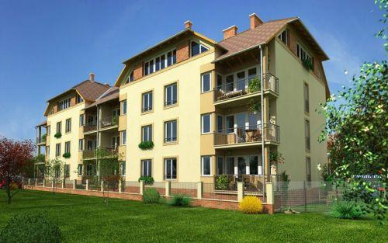
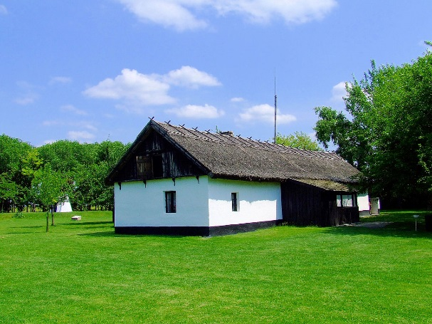
Interviewer observation variables in the HLFS
A. Neighbourhood characteristics of the close residential area of the building
traditional urban built environment
microdistrict
3) block of flats and villa district
4) detached houses
5) rural characteristics
6) industrial area
peripheral
socio-economically deprived neighbourhood
9) other, namely .....................
?
vacation homes?

Slide 15
Interviewer observation variables in the HLFS
B. What is the condition of the building in which the dwelling resided by the household is situated? | Interviewer observations in LFS 2018
excellent (newly built, renovated) | 11.28 %
good | 59.84 %
satisfactory | 22.78 %
4) degraded condition | 6.1 %
Interpretation of categories?

Slide 16

Interviewer observation variables in the HLFS
C. In what type of building is the dwelling?
detached house
semi-detached or terraced house
block of flats with less than 10 flats
block of flats with 10 or more than 10 flats
other dwelling unit, namely …

Slide 17
Instruments from the literature
4 instruments stand out, but further research is needed
6-item Krause scale (1998)
  does not work in case of noncontact
AAH 5-item Neighbourhood Assessment Scale (Andresen et al. 2006)
  Subjective assessment items (amount of noise, air quality)
  No item on type and condition of the building

Slide 18
Instruments from the literature (continued)
AAH 7-item NAS (Andresen et al. 2008)
  Less subjective, more sensitive
  Still no item on type and condition of the building
Longer scales, e.g. 18-item NAS (Andresen et al. 2013), LA FANS 30+ items (Casas-Cordero 2010)
Too burdensome for interviewers
LA FANS instrument covers the type and condition of the building, but has serious design flaws.
Andresen et al. (2013): shorter scales have better utility for survey use

Slide 19
Next steps and expectations of the study

Slide 20
Next steps
Designing a new, succinct, less than 10-item instrument
Adaptation of the instruments in the literature – adjusting them to Hungarian conditions
Complementing them with items on the buildings/residential area/close built environment.
Cognitive testing of the instrument among survey interviewers, and implementation of the necessary corrections

Slide 21
Next steps (continued)
Devising a brief but efficient training protocol
Extensive trainings (e.g. Andresen et al. 2013) are unrealistic
Novel education solutions: Google Street View situations instead of pictures
Two versions of training: traditional classroom and e-learning
Control and treatment training groups for testing the effectiveness of the two versions.
Tests after the training to assess if e-learning is feasible or not.
(Street View situations to assess using the instrument)

Slide 22
Final step
Correlation analysis of the new instrument with
key survey variables and
nonresponse data
using the data to be collected in the next wave of the HLFS.

Slide 23
Expectations
In case the after-training test-results are promising, we expect strong correlations and low levels of measurement error that enables the future devising of nonresponse adjustment procedures.
Walsh et al. (2013): if the instruments perform well on the field, they can predict level of effort (number of contact attempts and interim refusals)
Future upgrading of the Hungarian LFS data collection procedures to apply adaptive design.

Slide 24
Questions
Does any of the countries collect interviewer observations in LFS?
Which observations are found to be working for nonresponse analysis of the LFS?
Does any of the countries use interviewer observations to estimate the level of sufficient fieldwork effort?
Do interviewers get special training on collecting these observations?

Slide 25
Thank you for your kind attention!
References
Andresen, E. M., Malmstrom, T. K., Miller, D. K. & Wolinsky, F. D. (2006): Reliability and Validity of Observer Ratings of Neighborhoods. Journal of Aging and Health 18(1): 28-36.
Andresen, E. M., Malmstrom, T. K., Schootman, M., Wolinsky, F. D., Miller, J. P. and Miller, D. K. (2013): Observer Ratings of Neighborhoods: Comparison of Two Methods. BMC Public Health 13(1024).
Andresen, E. M., Malmstrom, T. K., Wolinsky, F. D., Schootman, M., Miller, J. P. and Miller, D. K. (2008): Rating Neighborhoods for Older Adult Health: Results from the African American Health Study. BMC Public Health 8(35)
Casas-Cordero, V. (2010): Neighborhood Characteristics and Participation in Household Surveys. PhD. dissertation, Faculty of the Graduate School of the University of Maryland, College Park.
Casas-Cordero, V., Kreuter, F., Wang, Y. & Babey, S. (2013): Assessing the Measurement Error Properties of Interviewer Observations of Neighbourhood Characteristics. Journal of the Royal Statistical Society A 176: 227-249.
Kreuter, F., Olson, K., Wagner, J., Yan, T., Ezzati-Rice, T. M., Casas-Cordero, C., Lemay, M., Peytchev, A., Groves, R. M. & Raghunathan, T. E. (2010): Using Proxy Measures and Other Correlates of Survey Outcomes to Adjust for Non-response: Examples from Multiple Surveys. Journal of the Royal Statistical Society A 173: 389-407.
Lynn, P. (2003): PEDAKSI: Methodology for Collecting Data About Survey Non-Respondents. Quality and Quantity 37: 239-261.
Pickering, K., Thomas, R. & Lynn, P. (2003): Testing the Shadow Sample Approach for the English House Condition Survey. Report. London: National Centre for Social Research.
Sinibaldi, J., Durrant, G. B. & Kreuter, F. (2013): Evaluating the Measurement Error of Interviewer Observed Paradata. Public Opinion Quarterly 77(Special Issue): 173-193.
Walsh, R., Dahlhamer, J. & Bates, N. (2013): Assessing Interviewer Observations in the NHIS. Conference paper presented at the JSM 2013 Survey Research Methods Section.
West, B. T. (2011): The Error Properties of Interviewer Observations and their Implications for Nonresponse Adjustment of Survey Estimates. PhD. dissertation, University of Michigan.
West, B. T. & Kreuter, F. (2015): A Practical Technique for Improving the Accuracy of Interviewer Observations of Respondent Characteristics. Field Methods 27(2): 144-162.

