Slide 1
A Responsive Design to Increase Calling Efficiency in a Telephone Survey
Lina Lloyd
ONS Social Survey Operations
lina.lloyd@ons.gov.uk

Slide 2
Background
Social Survey Operations (SSO) are responsible for delivering many of the largest social surveys run across Great Britain.
Seven core surveys provide the data that underpins core National Statistics and the wider UK statistical system.
Our 700 face-to-face interviewers visit households across the UK and conduct over 250,000 interviews a year
We have 200 telephone interviewers who make approximately 1,000,000 phone calls each year re-contacting households for follow-up waves of our Labour Force Survey

Slide 3
What is a responsive design?
Notes:
Changes here

Slide 4
Responsive design
“an adaptive data-collection approach that uses information available, both before and during data collection, to adjust the collection strategy for the remaining cases”.
Notes:
That is, all the cases interviewed are not treated the same during the period that the responsive design is in place as the cases are treated differently.

Slide 5
What is the UK Labour Force Survey?

Slide 6
What is the Labour Force Survey?
Labour Force Survey (LFS)
  Largest voluntary longitudinal household survey in the UK.
  Survey collects data quarterly
  Wave 1: Face-to-face interview
    Collecting socio-demographic data in respondents households
  Wave 2-5: Telephone interview
    Collecting data over the phone in ONS offices
Notes:
Focus resources more effectively which could in turn lead to cost-savings for the office or free-up interviewer resource.

Slide 7
Why a responsive design in Telephone Operations was implemented?

Slide 8
Why responsive design?
2013 National Statistics Quality review on LFS
  - Explore adaptive fieldwork to focus resource more efficiently
Most feasible to implement an adaptive design for waves 2-5, where respondent characteristics would have been collected
  - Before the trial, no adaptive design was ever implemented in the Telephone Operations
Notes:
Focus resources more effectively which could in turn lead to cost-savings for the office or free-up interviewer resource.
As a responsive design uses information available from BEFORE and DURING data collection. It was seen as optimal to trial it in the TO as information from wave 1 could be used, where the data is collected face-to-face. And during the telephone data collection in the following waves.

Slide 9
What would a Responsive design for TO look like?

Slide 10
LFS Telephone Operations schedule
Week 1: Cases that hasn’t been tried since last wave
Week 2: Cases that have already been tried for one week
Week 3: Cases that have already been tried for two weeks
Notes:
The data collection period of LFS is just over two weeks (2weeks & 2days). For each week there will be 3 weeks of data collection proceeding at the same time for different cases.

Slide 11
How the process would work
Week 1: Cases that hasn’t been tried since last wave
Week 2: Cases that have already been tried for one week
Week 3: Cases that have already been tried for two weeks
Notes:
The responsive design is implemented in week 2, where cases not yet contacted in week one is included in the responsive design. Implementing the responsive design for the second week would also let the responsive design account for information gathered from the first week of the cases in the telephone operations.

Slide 12
Responsive design in TO
Aim:
To achieve the same response rate more efficiently
whilst ensuring representativeness is not negatively affected

Slide 13
Method

Slide 14
Methodology
Aim:
To achieve the same response rate more efficiently
Tenure
Age group of HRP
Parental status of HRP
Gender of HRP
Work status of HRP
Ethnicity of HRP
Number of days tried
Total calls this wave
Number of times slots tried
In developing a model which predicts how likely a household is to respond, we had to consider:
Statistical modelling methods
Operational concerns (e.g. which variables can be rotated into next wave)
Notes:
We used a generalised estimating equations model on the data which predicted probabilities of response
(A GEE approach with a logistic link function was fit to the data from the previous wave(s).
Eligible cases (LFS W2+, that have no contact from an interviewer in the first week of the field period) were then selected, then the inverse logit function using the estimate values was applied to calculate the probabilities.)

Slide 15

Methodology
Aim:
whilst ensuring representativeness is not negatively affected
Allocating sample units to pre-defined domains
Based on response rates of different groups
Fixed groups based on household characteristics
Smallest variance within groups and different means across groups
Representativeness at wave 1 and after attrition
Notes:
If the responsive design would only look at response propensities then characteristics associated with non-response would be lost, which is why we ensure that the responsive design controlled for that.
This was done looking at a Non-Response Link Study that linked Census data to wave 1 LFS data to find out information about the non-responders, which allowed us to identify and control for under-representation in our responsive design.
The responsive design that we developed ensured that groups associated with low-response was equally represented so that it wouldn’t increase non-response bias during the data collection.

Slide 16
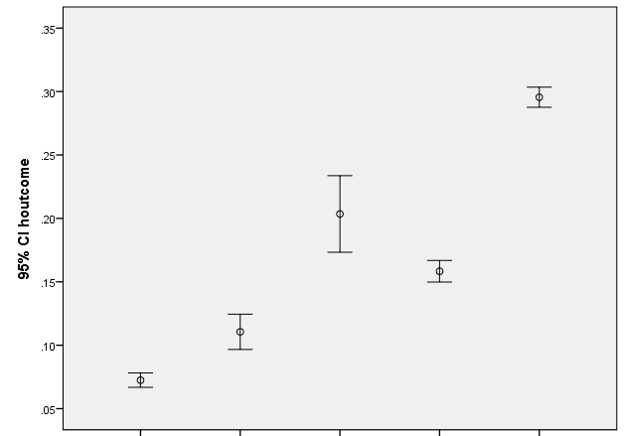
Methodology
Aim:
    whilst ensuring representativeness is not negatively affected
Allocating sample units to pre-defined domains
 | HRP’s ethnicity | Household type | Tenure
Domain 1 | Ethnic minority + missing | All | All
Domain 2 | White | Lone parent | Renting
Domain 3 | White | Lone parent | Not renting
Domain 4 | White | Not lone parent | Renting
Domain 5 | White | Not lone parent | Not renting
Domain 1
Domain 2
Domain 3
Domain 4
Domain 5
Notes:
Here you can see the domains developed based on information that we have about their response patterns.
Lowest 25% of cases associated with low-response, then we would miss out domain 1-4 completely. This is why we wanted to control for that.

Slide 17
Methodology
Putting these together
Domain 1
Most likely to respond
..........
Domain 2
Most likely to respond
Domain 3
Domain 4
Most likely to respond
...........
..........
Least likely to respond
..........
..........
Least likely to respond
...........
..........
...........
Least likely to respond
Most likely to respond
Least likely to respond
Domain 5
Most likely to respond
...........
...........
Least likely to respond
Notes:
Putting these together
Using propensities to rank within domains
Domains weighted equally
A case most likely to respond within domain 1 is given the same priority as a case most likely to respond within domain 2, even if they actually have very different absolute likelihoods of responding
Resources will be focused on those most likely to respond within each domain

Slide 18
Methodology
Domain 1
Quartile 1
Quartile 2
Domain 2
Quartile 1
Domain 3
Domain 4
Quartile 1
Quartile 3
Quartile 4
Quartile 1
Domain 5
Quartile 1
Quartile 2
Quartile 3
Quartile 4
Quartile 2
Quartile 3
Quartile 4
Quartile 2
Quartile 3
Quartile 4
Quartile 2
Quartile 3
Quartile 4
Putting these together
Quartile 1: Most likely to respond –case ranked top 75%
Quartile 2: Likely to respond - case ranked between 50-75%
Quartile 3: Less likely to respond - case ranked between 25-50%
Quartile 4: Least likely to respond – case ranked between 0-25%

Slide 19
Methodology
The first-third quartile within each domain will be treated using normal prioritisation rules given the case status during the field period
Domain 1
Quartile 1
Domain 2
Quartile 1
Domain 3
Domain 4
Quartile 1
Quartile 1
Domain 5
Quartile 1
Quartile 2
Quartile 3
Quartile 2
Quartile 3
Quartile 2
Quartile 3
Quartile 2
Quartile 3
Quartile 2
Quartile 3
Domain 1
Quartile 4
Domain 2
Quartile 4
Domain 3
Domain 4
Quartile 4
Quartile 4
Domain 5
Quartile 4
The last quartile will be taken off the calling scheduler, coded as non-contact and put forward to the next wave
Notes:
In the second week of data collection in the TO, the cases assigned to the forth quartile in each domain will not be called. These cases will be rotated out of the call scheduler and will be tried again in the next LFS wave (that is, in 3months time).
By removing the forth quartile from each domain in the second week of data collection ensure that resources are spent on the units most likely to end in success, whilst still ensuring that there is no more non-response bias when introducing a responsive design in TO.
Having to re-calculate the thresholds each week was necessary in order to achieve the 25% of cases in the rank 4 group (bottom 25th percentile) as weekly the data probability distribution was seen to be too volatile in order to use pre-set probability boundaries from the modelled data.

Slide 20
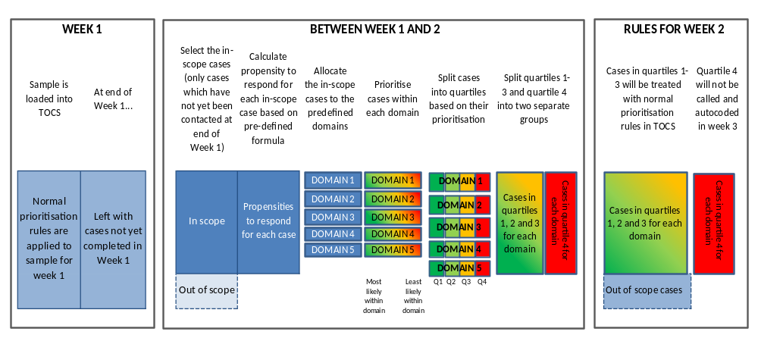
How process would look like
Notes:
TOCS- Telephone Operations Call Scheduler
Normal prioritization rules – based on case’s call history in that wave so far, which are used to prioritize calls to cases within that week
Out of scope cases – would include data collection carried out for other surveys that LFS in the TO for example

Slide 21
Evaluation
Notes:
We evaluated the trial by looking at 5months worth of data collected from August 2018 to January 2019 when the RD was in place, and comparing it to the same time period a year earlier.

Slide 22
Impact on Response Rates
Notes:
Response remained stable and this is a success – the primary aim of the project was to improve how efficient we are at collecting data, not to achieve higher response (response improvement was more of a secondary ambitious aim).

Slide 23
Achieved Interviews
Notes:
Higher proportion of all cases between Wednesday and Saturday (during their first week of the field period) are coded out as achieved interviews during the trial period, when compared to the previous year.
This could be attributed to the responsive design where the week 1 work is prioritised Monday and Tuesday and the old work (cases that are in their second week of the interviewing period) is pushed out by TOCS between Wednesday and Saturday and as a consequence of better prioritisation of the old work more resource was attributed to achieve outcomes for the new work quicker.
Results showed that in the second week the proportion of achieved interviews was almost equal in both trial period and the previous year, hence higher overall response rate on the LFS was not achieved.

Slide 24
Descriptive analysis
KEY FINDING: Responsive design decrease the number of calls needed to reach first contact
KEY FINDING: Responsive design decrease the number of calls per case called

Slide 25
Regression analysis results
Regression model was built to take account of other ad-hoc surveys and staff hours worked.
Significant decrease in the number of calls to first contact on LFS W2+ cases in TO.
Significant decrease in the total number of calls made on LFS W2+ cases in TO.
Significant increase in the total number of contact calls on LFS W2+ cases in TO.
Notes:
Bank holiday- the responsive design effectively uses the resource available in shorter working weeks where the same amount of weekly cases would need to be covered.

Slide 26
Benefits of the responsive design
Creates resource availability to work on other surveys, without compromising LFS
Mitigates the effect of staff shortages
Fewer phone calls with a “no answer” for Week 2 work (which should boost interviewer morale).

Slide 27



Example of efficiency saving
Pre-trial
1minute/call
Cases
Average number of calls/case: 13.6
Responsive Design
1minute/call
Cases
Average number of calls/case: 11.7
Efficiency Saving =
63hours/week!
Notes:
Average number of calls/case having taken account of other factors in the analysis.

Slide 28
Thank you!
Any questions, please don’t hesitate to email: lina.lloyd@ons.gov.uk

