Slide 1

Quality checks
Éva Németh-Kovács
Eva.Nemeth-Kovacs@ksh.hu
Budapest, 2019.05.16.

Slide 2
Training of the interviewer
Education package
Classroom training
15 question test
Upload practice questionnaries
Fieldwork

Slide 3
Monitoring
Expected implementation rate:
  Rural cities, towns, villages and other rural communities: 80% implementation
  In Budapest: 75% implementation
  Within each settlement at least 50% implementation
Weekly monitoring: realization indexes, progress of data collection
Make monthly assessment of the results

Slide 4
Telephone and on-site check-ups
Telephone cheks:
  every interviewer, in every three months
  checking at 3-5 addresses
On-site check-ups:
  Monthly visit households
Call-center: to manage issues of the data providers considering
Professional hotline after working hours

Slide 5

Quality checks of the collected data
Control mechanism:
  Built-in checking mechanism of the Blumen system
  new check-up methods of data tables
Fieldwork Faulty or doubtful questionnaries correcting in Blumen system Create data tables Overall chek-up

Slide 6
Data tables
Structure based on: typical mistakes, connection between collected data
Lists:
  Household table
  Welfare provisions, job search, education table
  Main employment, working hours, field of employment
  Complementray collection table (optional)
Correspondence of the data: some question appear in several tables

Slide 7
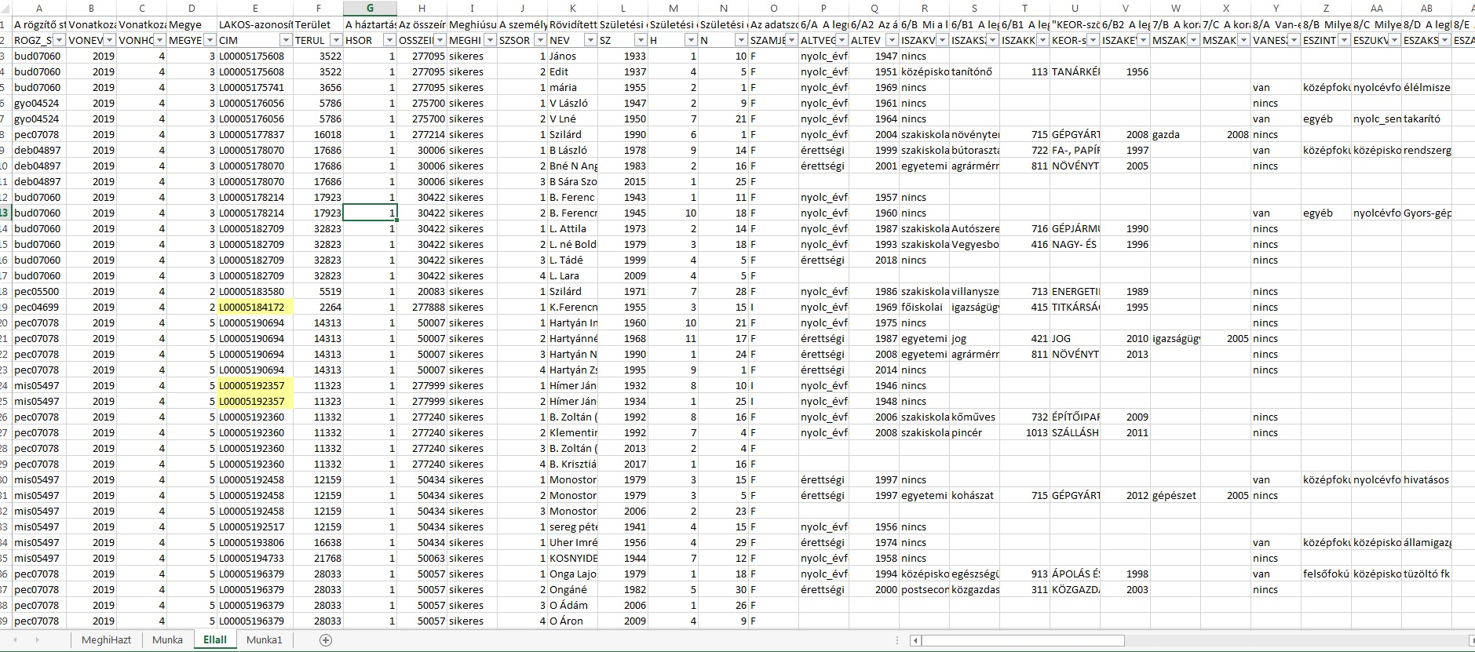
Structure of the data tables (I.)

Slide 8
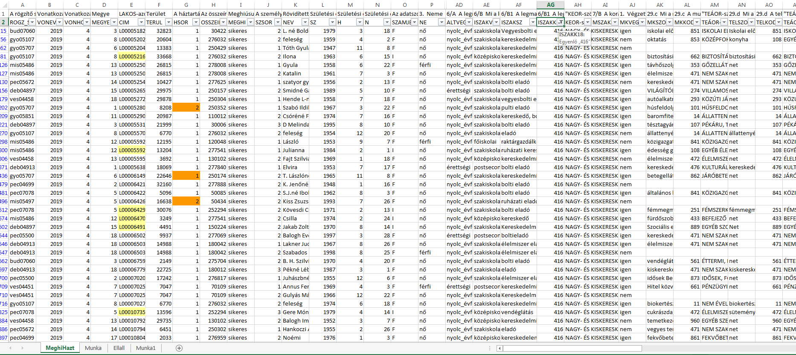
Structure of the data tables (II.)

Slide 9
The process of using data tables
Control aspects: in the Implementation Order
Faulty or suspicious result consulting the interviewer correct the questionnaire in Blumen system
Indicate with different colors:
  Yellow - start up code
  Orange – based on previous experiences often contain mistake
  Red – sure to need correction

Slide 10
Summary
Advantages:
  Easier to discover and correct typical mistakes, and inform interviewer
  Filters: easier to find data affected by specific mistakes
  Increase efficiency of quality checks
Challanges:
  Quarterly complementary data collection: always have to prepeare a new data table
  Find the balance: encouragement, positive feedbak feedback on mistakes for upholding the quality of work

Slide 11

Thank you for your attention!
11

