Slide 1
Proxy interviews in the Polish LFS – reasons and determinants, effects, possible solutions to deal with
Hanna Strzelecka, Tomasz Piasecki

Slide 2
Introduction
The work carried out included the following issues:
assessment the frequency and main areas of occurrence of the phenomenon (subpopulations affected)
finding the determinants of proxy interviews
assessment of the impact on the values indicators based on the key LFS variables
assessment and analysis of factors, circumstances, activities that could potentially increase respondents' propensity to provide direct interviews
building, taking into account the results of this assessment, some solutions and proposals for changes in the survey, which could increase the frequency of direct interviews and testing these solutions in a pilot study

Slide 3
The frequency of proxy interviews
Over the last years (2012-2017) the share of proxy interviews in Poland has been decreasing, beginning from 40.9% in 2012 to 37.0% in 2017.
During the same period the share of proxy interviews in the European Union showed a quite stable tendency, at the level of about 30%.
In 2016, what is the reference year for more detailed analyses, the rate in Poland was equal to 37.2%.

Slide 4
The analysis of the determinants of proxy interviews - what and how do we analyse
respondent’s characteristics -> proxy occurrence
The ways to measure how the respondents’ characteristics explain the occurrence of proxy interview
  comparison of proxy rates in the subpopulations defined by particular characteristics (male vs female, different age groups, etc)
  explaining the occurrence of proxy interview with the use of logistic regression (by modelling)
    value of interest: proxy occurrence
    explanatory variables: characteristics of the respondent and the interview
    proxy = f(characteristic₁, charcteristic₂, ...)

Slide 5
The analysis of the determinants of proxy interviews – what do we find out
Comparison of proxy rates
  shows what subpopulations are most (or less) affected
  does not show if the characteristic is a true determinant of proxy occurrence – high proxy rate may be really (directly) caused by the characteristic, but may be also a result of differences in the structure of subpopulations by another characteristics being the true determinant
Model effects
  the estimate of the parameter associated with the particular characteristic allow to asses the effect on proxy probability, which is purified from the influence of the all other characteristics included in the model (‚pure’ effect)

Slide 6
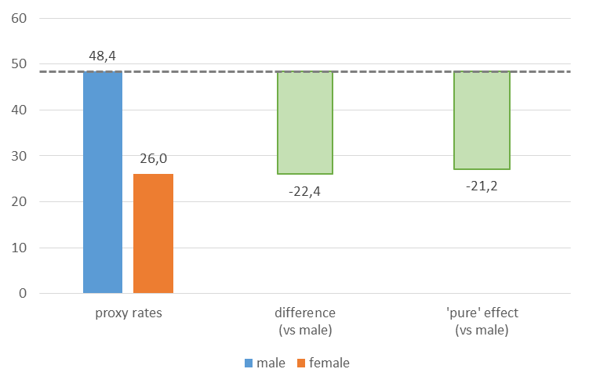
The analysis of the determinants
Sample results: respondent’s sex

Slide 7
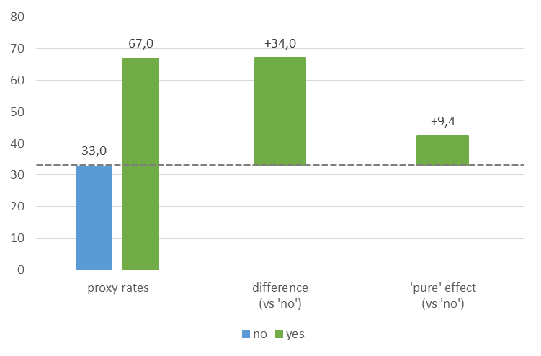
The analysis of the determinants
Sample results: respondent in formal education

Slide 8
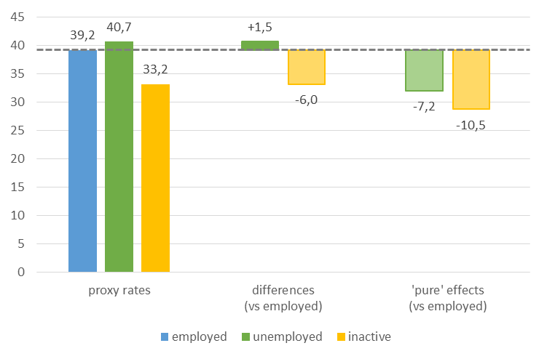
The analysis of the determinants
Sample results: labour market status

Slide 9
The analysis of the determinants of proxy interviews – conclusions
Proxy interviews are observed with much higher probability in case of men than women
Probability of proxy interview strongly declines with the respondent’s age, with the exception of the oldest age group where it is higher than in case of slightly younger respondents
Participation in formal education also strongly influences (differentiates) the observed proxy rates, but it is much less important determinant of the proxy interviews occurrence than age; the high frequency of proxy interviews for the people participating in formal education is mainly caused by coincidence with young age

Slide 10
The analysis of the determinants of proxy interviews – conclusions (cont.)
Probability of proxy interview is higher in case of the unemployed than economically inactive persons, and for both these categories higher than in case of the employed with very short working time and lower than in case of the employed working typical hours
Probability of the proxy interview occurrence is negatively related to level of education and positively related to the number of hours worked a week, and the last relation is stronger in case of persons working shorter than 40 hours than in case of persons working more than 40 hours (for working more than 40 hours the effect is statistically insignificant)
In case of labour market status, the number of working hours, and probably also the level of education and participation in education, these conclusions may be to some extent biased because of the measurement error related to the proxy interview

Slide 11
Assessment of the effect of proxy interviews on the key LFS indicators
proxy occurrence -> LFS indicators estimates
Comparison of the values of indicators calculated on the subsets of direct and proxy interviews does not distinguish between the effects of :
  proxy measurement error (bias) – proxy respondent may not know the truth or to give another answer than the reference person would
  differences in the chance to get direct answer from respondents belonging to different subpopulations
Modelling can provide some way to asses the proxy effect (proxy bias) using some assumptions

Slide 12
Assessment of the effect of proxy interviews on the key LFS indicators – modelling
The observed value of the variable at individual level may be expressed as the function of the characteristics of an individual and the proxy indicator (dummy variable)
y = f(proxy, charactreristic₁, characteristic₂, ...)
The parameter associated with the proxy variables should be an estimate of the proxy measurement error if the other explanatory variables:
  effectively explain the true value of variable y
  are not significantly affected by proxy measurement error
The choice of explanatory variables expresses the assumptions (we assume them relatively unaffected by proxy bias, known to proxy respondents)

Slide 13
Assessment of the effect of proxy interview by modelling – explanatory variables
Characteristics of the interview
  survey wave
  survey period (week)
Characteristics of the respondents considered (and assumed) as not (or less) affected by the proxy measurement error
  sex
  age
  place of residence (voivodship and type of place)
  education
  participation in formal education
  the fact of working during the reference period (but not the full labour status)
  “typical” number of working hours in the main job strongly approximated (with the use of rough bands)

Slide 14
Assessment of the effect of proxy interviews on the key LFS indicators – which ones?
activity rate
employment rate
share of unemployed
unemployment rate
share of persons in non-formal education
life-long learning
early leavers from education and training
NEET indicator
percentage of employed persons with hours worked < 10, <19 and ≥ 50

Slide 15
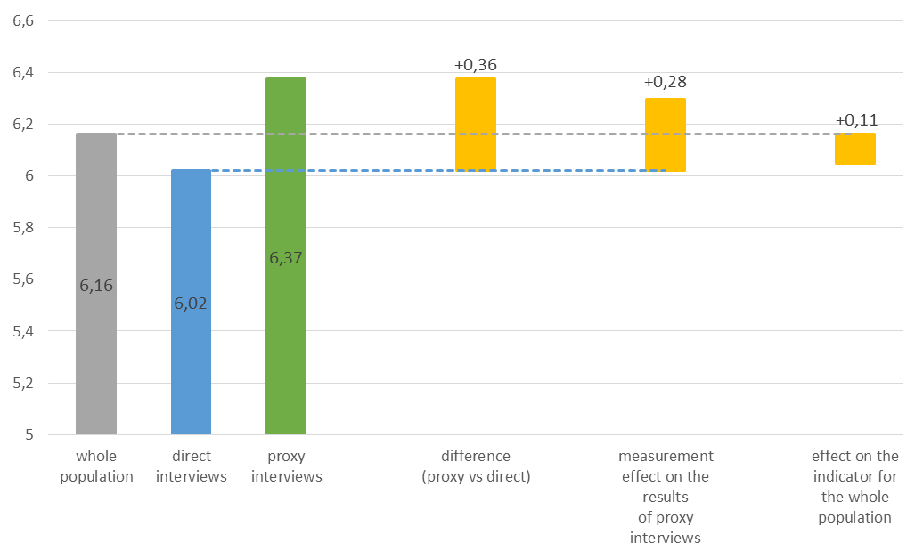
Assessment of the effect of proxy interviews
Sample results: unemployment rate

Slide 16
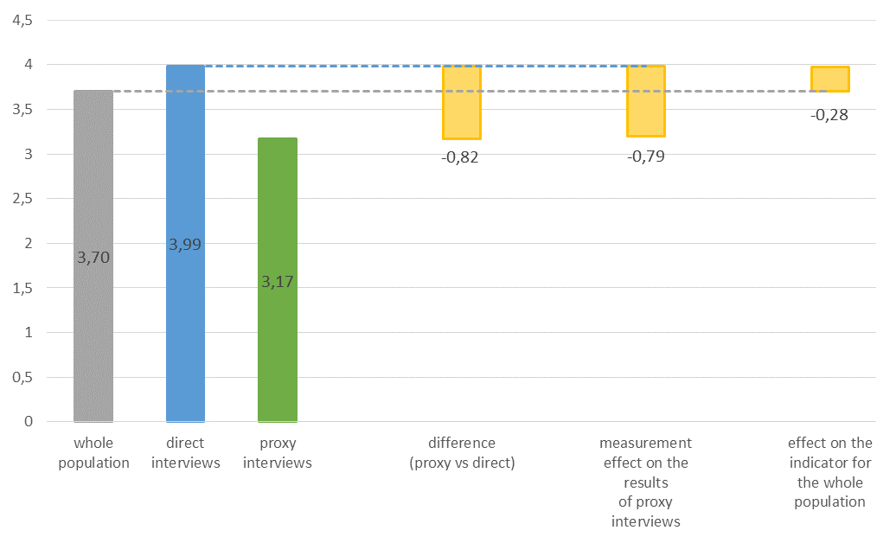
Assessment of the effect of proxy interviews
Sample results: life-long learning

Slide 17
Assessment of the effect of proxy interviews on the key LFS indicators – conclusions
There were not observed the effects of proxy interview, which would significantly bias the analysed indicators, although for the majority of them the measurement effects were assessed as statistically significant; the strongest estimated effect (regarding the estimate for the whole population) is almost 0.3 pp (13% in relative terms)
The concluded estimations indicate that measurement bias related to the proxy interview may:
slightly (in absolute figure; in relative figure between a few and a dozen or so percent) underrate the percentages of persons with unusually low and unusually high number of hours worked, the percentage of persons participating in non-formal education and life-long learning indicator;
slightly (for the unemployment rate by about 0.1 pp, i.e. about 2%) overrate the number (share) of unemployed persons and unemployment rate;

Slide 18
Assessment of the effect of proxy interviews on the key LFS indicators – conclusions (cont.)
The strongest effects were observed in case of indicators related to non-formal education
Among indicators concerning the main labour market categories, the most affected seems the unemployment rate, however – as was mentioned earlier – it is not meaningful
Obtained estimates should be treated as conditional in respect to assumptions made in the analysis; in particular, biased may be estimates of the effects regarding the number of hours worked (due to direct impact on the proxy probability) and the effects concerning the employed (underestimated due to the model assumptions)

Slide 19
Assessment of the effect of proxy interviews on the key LFS indicators – conclusions (cont.)
It can be concluded that the answers given by other household members (as proxy) do not worsen significantly the obtained results of the LFS, compared to potential direct answers, which is positive information
Such state of affairs is probably influenced by fact that in most cases of proxy – the answers are given by the closest persons from the respondent’s family, hence the ones most familiar with his/her employment and educational situation

Slide 20
Developing approaches facilitating the reduction in the rate of proxy interviews
The basic tool serving the purpose of development of such solutions and assessment of their effectiveness was preparation of the opinion questionnaire for the respondents regarding the method of the LFS interviews implementation
Its objective was finding the respondents’ preferences regarding
(1) the survey implementation method with and without the interviewers and
(2) the inclination to give a personal telephone interview by the respondents who were absent during the interviewer’s visit (thus reducing the rate of proxy answers)

Slide 21
Developing approaches facilitating the reduction in the rate of proxy interviews
Majority of the respondents (over 70%) was willing to give a telephone interview, but these declarations were unfortunately not confirmed in the first test survey
Conducting direct interviews succeeded in case of relatively low percentage of persons (about 17%) from whom telephone numbers were obtained with their consent for a repeated contact
Making telephone calls to persons absent from the household during the personal visit of the interviewer – increased the share of direct interviews, albeit to a smaller extent that it could be expected, however
It increases the survey cost and burdening the interviewers’ network; so it seems not very real for permanent adoption into the survey organisation

Slide 22
Developing approaches facilitating the reduction in the rate of proxy interviews
The other action concerned recognition whether the change in the way of respondents’ selection (from the currently used sampling of dwellings’ addresses into the sampling of particular persons); could cause:
  facilitating more efficient (valid) sample selection by reduction of selecting ’empty’ addresses
  reducing the percentage of the proxy interviews
The incentive here were the results of the analysis on proxy rates in the LFS survey in the EU countries, which indicated that the countries using for the survey implementation the sample of persons obtain decidedly lower rate of proxy interviews

Slide 23
Developing approaches facilitating the reduction in the rate of proxy interviews
The tested approach consisting in a change in the Polish LFS organisation resulted in a significant growth in the direct interviews rate
During the first observation of the second test survey, the indictor comprised 89%, while in the 2016 LFS survey it stayed at the level of slightly around 63%
The increase in the share of direct interviews obtained with the use of the sample of people and telephone interviews was at the expense of the decline in the response rate

Slide 24
Developing approaches facilitating the reduction in the rate of proxy interviews
The appliance of the sample of persons in the Polish LFS would require working out the Sampling Frame for Social Surveys by the Statistics Poland to be up-to-date allowing selecting the sample of persons directly from the sample frame
The sample frame should include also the information about the person’s telephone number which would allow much larger use of the CATI method in the Polish LFS
Other aspects - including the cost of the changed survey organisation - should be also considered
Another important aspect that should not be forgotten is the problem with collecting the demanded variables concerning the entire household

Slide 25
Final conclusions and recommendations
It is currently not recommended to change the way Polish LFS is organized. Respondents prefer to contact the interviewer they know, and relatively few respondents also volunteered to participate in the survey conducted via the Internet
The change in the selection of respondents by introducing the selection of people instead of addresses of flats could contribute to an increase in the share of direct interviews in the data collected
However this would result in a decrease in the survey response rate, which is a key factor against such changes, the more so that the analysis showed that the influence of the proxy on the results of the LFS indicators is not so significant

Slide 26
If you have any questions please send them to:
H.Strzelecka@stat.gov.pl or T.Piasecki@stat.gov.pl

