Slide 1

CAWI from the Danish experience
LFS Workshop, Budapest 16-17 May 2019
Kathrine Lindeskov Johansen, Statistics Denmark

Slide 2
Background facts
The Danish LFS consists of a core individual survey of approximately 20,000 interviews and a household part of approximately 5,000 interviews each quarter.
Since 2010 it has been possible to answer the household survey by web.
From January 2016 Statistics Denmark introduced multi mode data collection in the core survey of the Danish LFS as well: We went from collecting data only by telephone to also collect it by web.

Slide 3
Our experience

Slide 4
Our experience

Slide 5
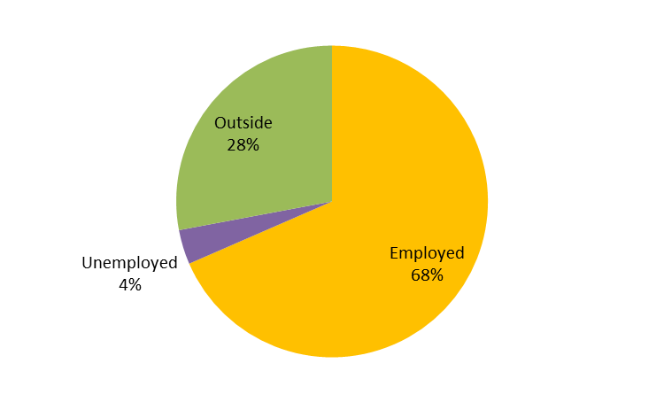
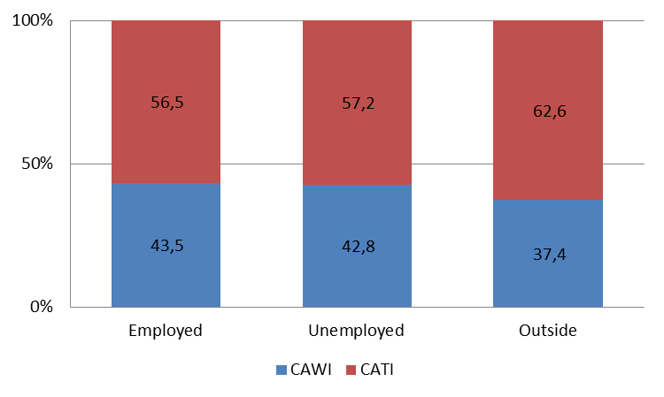
Who use CAWI in Denmark? (2018)
Is labour market participation a factor?

Slide 6
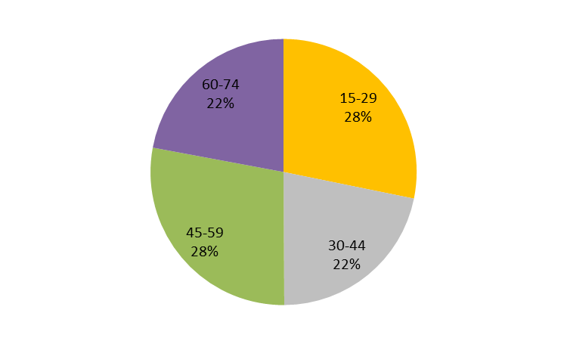
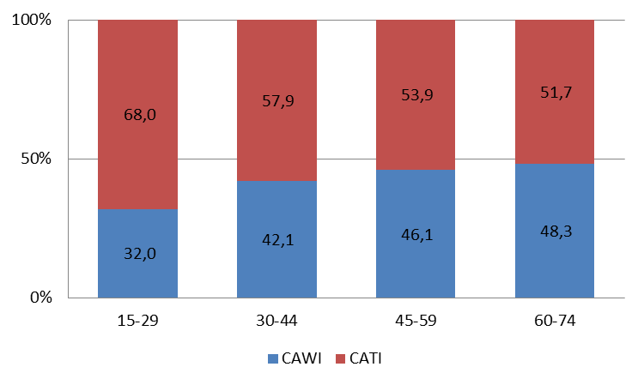
Who use CAWI in Denmark? (2018)
Is age a factor?

Slide 7
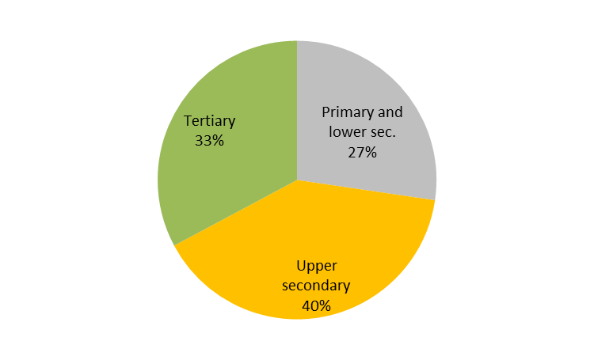
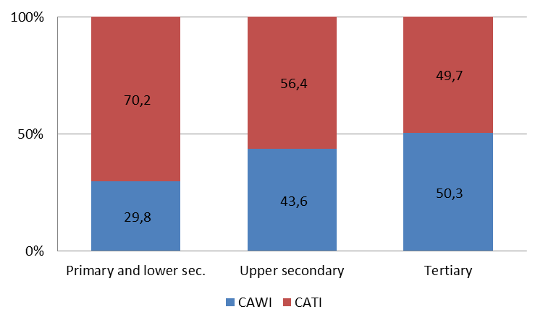
Who use CAWI in Denmark? (2018)
Is education a factor?

Slide 8
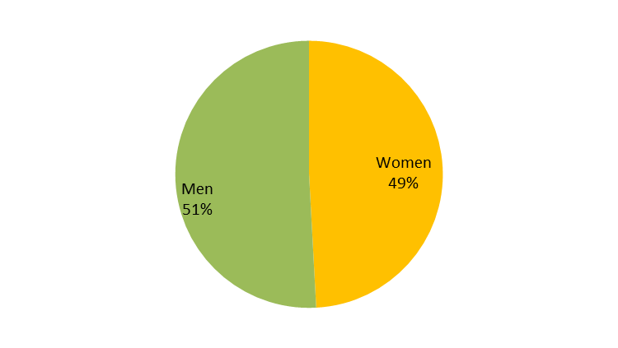
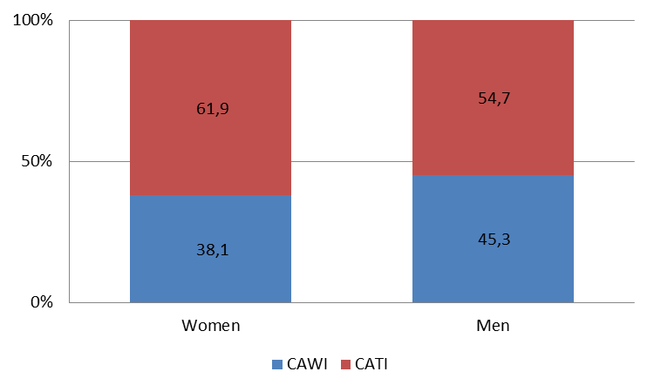
Who use CAWI in Denmark? (2018)
Is gender a factor?

Slide 9
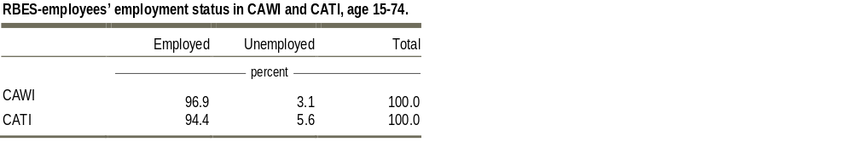
Consistency with Denmark’s register based employment statistics (2017)
Cordes, Tine. 2018.The impact of using web in the Danish LFS, Statistics Denmark.

Slide 10
A brief experiment in 2019

Slide 11
A brief experiment in 2019
How many CATI could potentially be achieved by CAWI?
  Add extra CAWI text message reminder on Wednesday, 1st week after the reference week.
  Postpone CATI to Sunday, 1st week after the reference week.
Can you guess what happened?

Slide 12
A brief experiment in 2019 − very brief!

Slide 13
Sharing information is important
Thank you for your attention!
For further information, feedback etc., feel free to get in touch:
  Kathrine L. Johansen, Senior Advisor, Labour Market Division
  T: +45 3917 3067
  E: klj@dst.dk

