Slide 1
LFS Workshop Budapest, May 2019
Results from the 1st pilot
Swiss LFS multimode CAWI (optimized for smartphone) / CATI
Sylvie Regli Greub (sylvie.regli@bfs.admin.ch)
Notes:
I will present you some results of our 1st pilot on LFS multimode. Multimode in the sense that people can choose between CAWI and CATI mode. CAWI being pushing first.

Slide 2
Content of the presentation
Context
Sample and contact strategy
Overall response rate, respondent’s characteristics
CAWI and CATI specificities
Assessing specific questions: occupations and establishments
Conclusion and response rate of pilot 2
Notes:
First of all, I will talk about the backgroud of the pilot, then I will say a few words on the sample and I will explain the contact strategy that we chose. Then I will give general results about response rate according to different respondent’s characeristics. I will talk about some specificities of CAWI and CATI. We sill psend some time assessing 2 specific questions using external database and finally I will make a conclusion and give a few response rate for the pilot 2, that has just been finished.

Slide 3
Context
Stage 1
Lay-out
CAWI questionnaire (from scratch)
Smartphone optimisation
Usabiliy tests
Internal tests (smartphones)
Stage 2
CATI questionnaire
Interviewers’ training
Set up of hotlines
CATI tests
Stage 3
Pilot 1
Pilot 2
Decision: Multimode LFS in 2021
Notes:
The results of the pilot I that I will present you now forms part of the project to revise de Swiss LFS. Today, our survey is a CATI base survey only and as we face difficulties to get in touch with people by phone, we decided to go for a multimode survey, pushing CAWI first.
We can divide the project in 3 stages.
The first stage was to develop a good online version of the questionnaire. The wording of questions was adapted to smart phones and the layout of the online questionnaire was also discussed. This phase was completed by usability tests in French and German. We then proceeded to conduct internal tests on smart phones only. During the second stage, we used the new CAWI questionnaire as a basis for formulating the CATI questions. This stage was more time-consuming for the German questionnaire, as all the CATI questions had to be rephrased in Swiss-German. We also established principles to determine which parts of the CATI questionnaire were to be read (or not) by the interviewers. Following this, tests were carried out on the CATI questionnaire in French and German. These tests enabled us to check various aspects related to technical issues, as well as to the presentation and content3. After these initial tests we were at last able to launch the pilot with the aim of measuring the following elements:
-
1. Contact procedures
2. Response rate, partial non-response rate and impact of reminder letters
3. Proportion of CAWI and CATI by various characteristics
4. Sending introductory and reminder letters
5. General survey organisation (training and address management)
6. Running the hotline and reasons for calls
7. Reporting
8. Performance of LINK IT system
9. Efficiency of external databases (businesses and occupations)
10 modes effects (still on-going)

Slide 4
Sample and contact strategy
Activation of 1622 persons aged 15 to 89 ans, including 4 belonging to staff members
Addresses drown from our official sampling frame, usual sampling method (stratified by NUTS3 level)
French and German
414 addresses without phone number
Activation from Monday 29.10.19 to Sunday 16.12. → 7 weeks
Notes:
Very important to include staff members in the sample in order to test the survey properly.

Slide 5
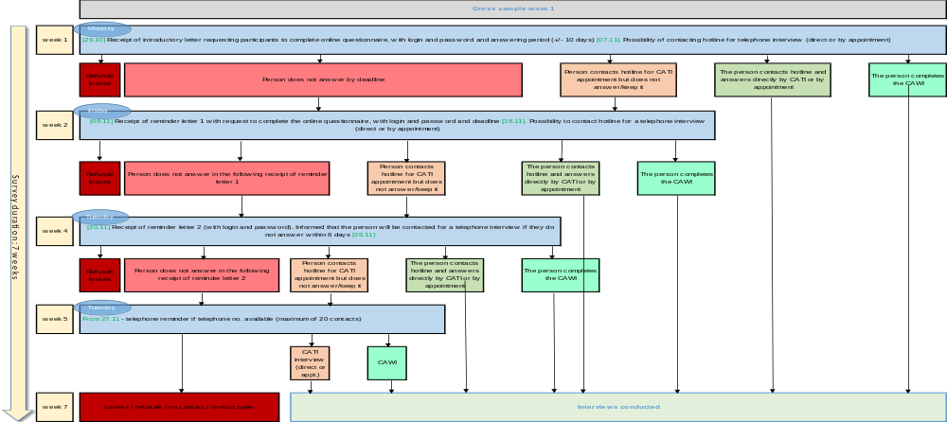
Notes:
The first day of the survey, the selected persons received an introductory letter, inviting them to take part in the online survey. However, the letter indicated that it was possible to call the hotline if they preferred to do the survey by phone. People were given a period of nine days to complete the questionnaire.
- If people had not answered by this time, a first reminder letter was sent, with the same instructions as the introductory letter as well as a 9 day period to complete the questionnaire.
- After this second period, a second reminder letter was sent, with a 6-day period to complete the questionnaire. With a mention that if a response was still lacking after this, our institute would call the persons concerned to conduct the interview.
- After this third period, reminders by telephone were started for people with a telephone number

Slide 6
Overall response rate (voluntary survey)
Gross response rate: 66.3 % (4Q18, wave 1: 57.9%)
Proportion: 80.7% CAWI and 19.3% CATI
63% persons with no phone number participated
36% of the interviews conducted prior to 1st reminder letter
77% of the interviews conducted after the 1st reminder letter
87% after the 2nd reminder letter and the remainder after the reminder by phone
Notes:
Gross response rate= no of interviews conducted divided by addresses activated).

Slide 7
Gross rate by response mode
Notes:
The graph highlights the positive effect of the reminder letters. The reminder by telephone also seems to have been effective. Being active for seven weeks, the sample may seem well saturated.

Slide 8
Respondents ‘ characteristics: CAWI / CATI distribution by age group
Notes:
Respondents’ characteristics: no difference between F/ G.
With regard to the different age groups, we observed that people aged 65 and over preferred the CAWI survey mode.

Slide 9
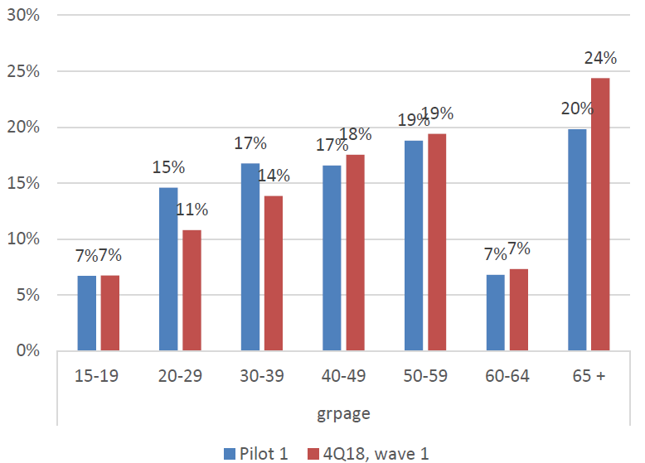
Respondents ‘ characteristics: Comparaison by age group, 4Q18 and pilot 1
Notes:
In comparison with the current SLFL survey, we can see that the proportion of persons aged 15-19, 50-59 and 60-64 is the same in both surveys, whereas the proportion of persons aged 20-29 and 30-39 is higher respectively for the pilot and that the reverse holds true for persons aged 65 and over.

Slide 10
Respondents ‘characteristics: activity status
Notes:
This graph compares the activity statuses from the pilot with the weighted results of the survey from the 4th quarter 2018. Considered as a whole, the pilot data show an almost identical distribution of activity statuses. (compare yellow and gray bars). It is highly likely that the differences observed would be even fewer had the pilot been weighted. This is not, however, conceivable, as it is impossible to reproduce the current methods on a very small scale.

Slide 11
CAWI interviews : Type of device
Notes:
For the CAWI interviews, we noticed that more than a third of participants used their smart phone. This significant percentage demonstrates that the questionnaire was well adapted to this mode.
It comes as no surprise that the majority of the 15-19 age group used their smart phone.

Slide 12
CAWI interviews : behaviour and problems
83% of CAWI interviews were carried out in one go, 12% of participants took two goes to complete the survey and 5% 3 or more goes.
69 persons started the CAWI but never finished it. However, 16 of them did reply in a CATI.
14 of the 53 people who never finished the survey stopped before the first question. The remaining people stopped at different stages of the questionnaire → not one particular question posing a problem.
→ How to convince them to continue the interview?
Notes:
83% of CAWI interviews were carried out in one go, 12% of participants took two goes to complete the survey and 5% 3 or more goes.
Sixty-nine persons started the CAWI but never finished it. However, 16 of them did reply in a CATI.
Fourteen of the 53 people who never finished the survey stopped before the first question. The remaining people stopped at different stages of the questionnaire, which leads us to think that there is not one particular question posing a problem.
After the CAWI pre-tests, we simplified the internet address: www.eLabour.ch. We were, however, able to ascertain that it was not necessarily the name of the website that was causing people difficulty but how they were looking for it. People who used a search engine (Google for example) were unable to come up with a result. We had asked LINK to index the site very early on but despite their efforts, this was unsuccessful. According to research conducted by LINK, the lack of indexing is because the page has insufficient content. We therefore prepared a version with more content for the second pilot to overcome this problem.

Slide 13
Interviews CATI
 | Before reminder 1 | After reminder 1 | After reminder 2 | After telephone reminder | Total
Outbound CATI | 0 | 0 | 0 | 80 | 80
Inbound CATI (= the participants call) | 36 | 62 | 29 | 0 | 127

Slide 14
Questions on occupation and business establishment
Use of external databank to find occupation and establishment
Goal: make the search easy and intuitive for the respondents, who are not as experienced as the interviewers
→ use of a «google search bar»

Slide 15
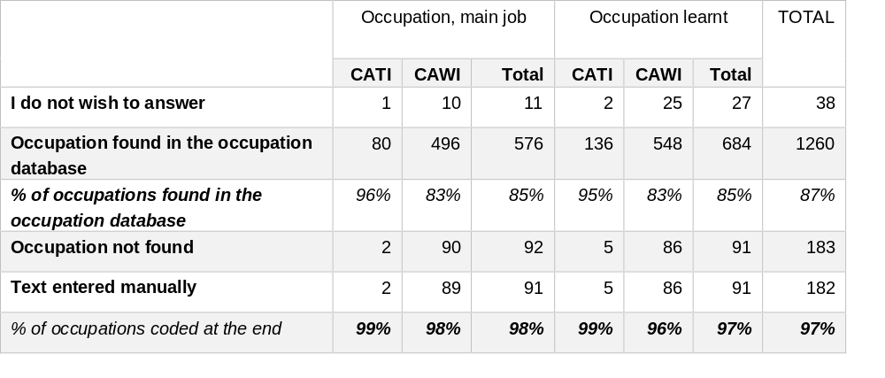
Questions on occupations
Notes:
Persons answering a CAWI were able to write their occupation in a field and then start an automatic search in the occupation database. In total, 83% of people responding by CAWI found their current occupation in the database. When they were unable to find their occupation, all but one of the CAWI participants entered text manually. At the end of the survey, after complementary coding conducted at the FSO based on manually entered texts, 90% of current occupations were coded, which is an excellent result. The remaining 2% were people who did not wish to answer the question. It appears to be difficult to get them to change their mind.

Slide 16
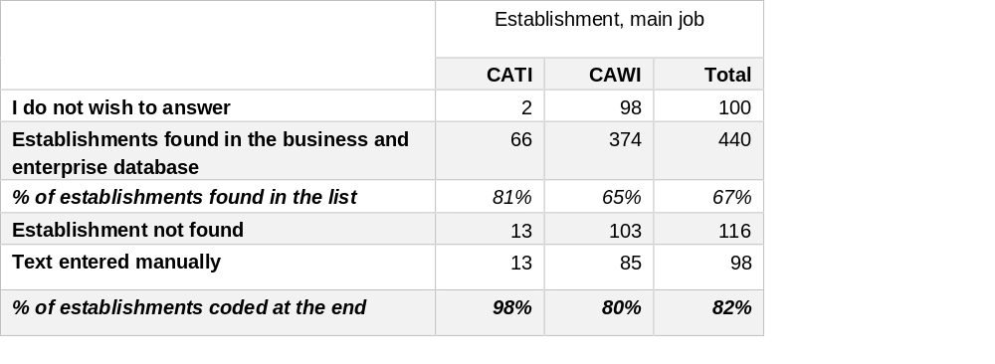
Questions on the establishment
Notes:
With regard to the establishment, the search system is comparable to the occupation system, only more complicated: participants enter the name of the establishment, followed (or not) by the town and even the address of the establishment in which they work. For their main job, 65% of persons interviewed by CAWI found their establishment in the database. Among the 103 persons who did not find their establishment, 85 entered a text manually and we were able to find the establishment for every case. At the end, 80% of establishments were coded. The main problem here is people not wishing to answer. To reduce the risk of non-response, we have decided in future to add a comment explaining that this information “will be used to ascertain the economic activity and the size of the establishment. Your anonymity is guaranteed”.

Slide 17
Conclusions
The entire process of the survey worked perfectly
Online surveys are widely accepted, LFS questionnaire works well
The contact strategy is optimal and allow to saturate the sample
Results (+80% CAWI) better than anticipated
Smartphone participation is big → useful to adapt questions for small screens
CAWI + CATI inbounds → population’s willingness to participate in FSO surveys.

Slide 18
Main results on pilot 2 (interrogation wave 2)
Gross sample: 844 CAWI 160 CATI.
2 different contact strategies according to survey mode
Overall response rate: 87.9%
CAWI response rate: 88.4% (732 in CAWI, 14 in CATI)
CATI response rate: 85.1%.
Etat: LIVE Report

Slide 19


